Slide 1
Why is Finance Important?
Most business decisions cannot be made without considering the impact on the financial well-being of the firm.
Financial decisions relate primarily to the funds the firm generates and how those funds are used.
  A firm must plan to ensure funds required to implement decisions are available when needed.
  A firm must plan to invest (“put to work”) funds that are not needed at the present time.

Slide 2
What is Finance?
Decisions about money:
  From what sources does a firm get its funds?
  How does the firm use its funds?
Everything else being equal:
  More value is preferred to less.
  The sooner cash is received the more value it has.
  Less risky assets are more valuable than riskier assets.

Slide 3
Forms of Business organization
Most firms form as proprietorships or partnerships when they first start doing business and then change to the corporate form of business when they grow larger, because:
Small businesses do not require large sums of money, at least initially.
As firms grow, they need greater amounts of funds, and they also face greater liabilities.

Slide 4
Alternative Forms of Business Organization
Proprietorship
  One owner
  70% – 75% of organizations
Partnership
  Two or more owners
  10% – 15% of organizations
Corporation
    Legal entity
    15% – 20% of organizations
    80% – 85% of all sales
Hybrid Forms of Business
Primary forms of business

Slide 5
Proprietorships and Partnerships
Advantages of proprietorships and partnerships:
  Easy and relatively inexpensive to form
  Affected by few regulations
  Business is taxed as an individual
Disadvantages
  Unlimited personal liability
  Life is limited
  Ownership transfer can be difficult
  Limited ability to raise funds

Slide 6
Corporations
Advantages of a corporation:
  limited liability
  unlimited life
  easy transfer of ownership
  ease of raising capital
Disadvantages:
  cost of set-up and filing financial reports
  double taxation

Slide 7
Wealth Maximization
Wealth maximization should be the primary goal of the firm.
Same as maximizing the firm’s stock price.
Must be socially responsible.
Actions that maximize the value of the firm also are beneficial to society; wealth maximization improves the standard of living.
  Efficient operations
  Fair prices for products
  Good salaries for employees

Slide 8
Agency Relationships
An agency relationship
  Exists when owners do not manage the firm’s day-to-day operations of a firm.
  Decision makers are “agents” for the owners.
  “Agents” should operate the firm to achieve goals of the owners.
An agency “problem” exists if managers attempt to satisfy interests that differ from the best interests of the firm’s owners.

Slide 9
Business Ethics & Corporate Governance
Business Ethics: A company’s attitude and conduct toward its stakeholders, which include its employees, its customers, its community, and its investors (debt holders and stockholders)—based on how it conducts business.
Governance: The “set of rules” a firm follows when conducting business.
Firms that have good corporate governance and follow good ethics policies generate higher returns to stockholders.

Slide 10
U.S. Firms versus Foreign Firms
Most businesses that are based outside the United States are “closed” organizations in the sense that they have more concentrated ownership—that is, fewer owners.

Slide 11
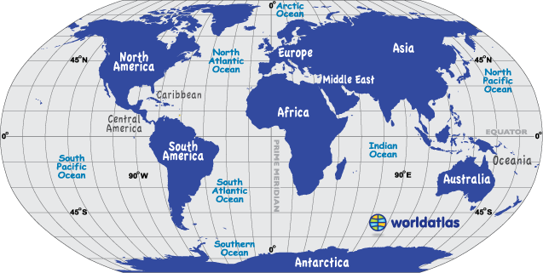
Multinational Corporations
Firms go “international” to
  seek new markets
  seek raw materials
  seek new technology
  seek production efficiency
  avoid political and regulatory hurdles
raw materials
technology
production
efficiencies
new markets

Slide 12
Factors that Distinguish Domestic
Firms from Multinational Firms
different currency denominations
language differences
cultural differences
economic and legal ramifications
government involvement
political risk

Slide 13
Chapter 1 Questions
1. Why should everyone have a basic understanding of finance, regardless of the careers they pursue?
2. Why do most firms form as proprietorships or partnerships when they first start doing business and then change to the corporate form of business when they grow larger? What are the advantages and disadvantages of each of the three forms of business mentioned in this question?
3. Would the management of a firm in an oligopolistic industry or in a competitive one be more likely to engage in what might be called “socially conscious” practices? Why?
4. Describe the goal of wealth maximization. Can a firm sustain its operations by maximizing stockholders’ wealth at the expense of other stakeholders? Is wealth maximization the same as maximizing net income each year?
5. What are the basic differences between the ownership structures of U.S. firms and non-U.S. (foreign) firms?

