Slide 1
Financial Statements
  Following are the financial statements contained in corporation’s annual report:
  Balance sheet
  Income statement
  Statement of cash flows
  Statement of retained earnings

Slide 2
Balance Sheet
  Takes “inventory” of items at a particular point in time.
  Assets
  Liabilities (debt)
  Equity (stock) = Net worth
  Investments
  Financing
  Assets = Liabilities + Equity
  Investments = Financing
  Net worth
  (Owners’ equity) = Assets - Liabilities

Slide 3
Income Statement
  Measures activity over a particular period.
    Reports revenues and expenses
    Accrual method of accounting
    Matching principle
    Income versus cash flows
More important than income; normally Income ≠ Cash flows

Slide 4
Statement of Cash Flows
  Measures activity over a particular period.
    Shows sources of cash inflows and cash outflows.
    Sources of cash
      Income
      Decrease in asset—sell
      Increase in liabilities or equities—raise funds
    Uses of cash—opposite of sources
      Dividend payment
      Increase in asset—buy
      Decrease in liabilities or equities—pay off

Slide 5
Sources and Uses of Funds
  Asset
  Liability OR Equity
  Source:
  Decrease = sale
  Increase = raise funds
  Use:
  Increase = purchase
  Decrease = repayment

Slide 6
Statement of Retained Earnings
  Measures activity over a particular period.
  Reports changes in the equity section of the balance sheet.

Slide 7
Ratio Analysis
  Ratio analysis is used to evaluate a firm’s current financial position and, based on the results, to forecast the firm’s FUTURE financial position.
  Investors use the information to determine the potential for investing in the firm.
  Managers use the information to plan FUTURE funding needs and FUTURE investment opportunities.

Slide 8
Ratio Analysis
  DO NOT MEMORIZE any ratios, or other equations in this chapter. All the equations you need either will be on the formula sheet provided to you with the exam or will be included on the exam.

Slide 9
Ratio Analysis—Information Provided
  Liquidity ratios—provide an indication as to how well the firm is able to meet its current obligations; that is, pay its bills in the current period.
  Asset management ratios—provide an indication of how efficiently the firm is operated; measure how effectively assets are used to generate sales

Slide 10
Ratio Analysis—Information Provided
  Debt management ratios
    Provide an indication as to how much debt (primarily long-term) the firm has and whether the firm is able to take on more debt.
    Indicate how much of the firm is financed with debt and equity.
  Profitability ratios—show the effects of the firm’s liquidity, management of assets, and financing on its overall operations.
  Market value ratios—provide an indication of what investors think about the firm’s future prospects.

Slide 11
Ratio Analysis
  Comparative ratios versus trend analysis
    Comparative analysis—benchmarking with similar firms at a particular point in time.
    Trend analysis—evaluation of ratios for a particular firm over some time period.
  The primary purpose of ratio analysis is to form general impressions about a firm’s FUTURE financial position
  Judgment must be used when interpreting financial ratios

Slide 12
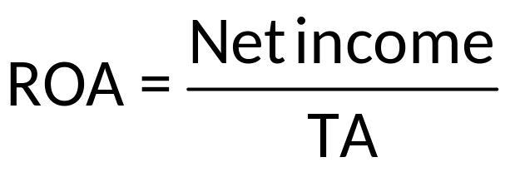
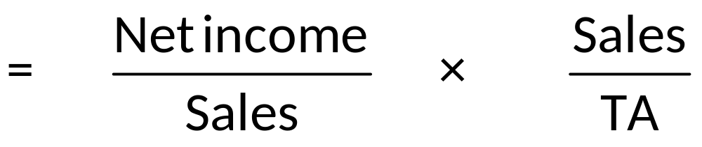
Ratio Analysis—DuPont Analysis
  Used to deconstruct ratios to provide more detail.
  Return on assets (ROA) can be deconstructed as follows:

Slide 13
Ratio Analysis—Caveats
  Some factors that make evaluation of financial statements difficult:
    Large, multidivisional firms
    Seasonality/inflation
    Alternative accounting methods
    Historical costs
    Generalization
    Window dressing

Slide 14
Chapter 2 Questions
What financial statements do corporations publish, and what information does each provide?
What changes in balance sheet accounts that would constitute sources (uses) of funds.
How do investors and potential investors utilize financial statements? How do mangers utilize financial statements?
What is ratio analysis and why are the results important to both managers and investors?
What information is provided with each category of ratios given in the book?
What are some steps that must be taken when using ratio analysis? What is the most important aspect of ratio analysis?
What are some potential problems/issues associated with financial statement analysis?

Slide 15
Ratio Analysis
  DO NOT MEMORIZE any ratios, or other equations in this or any other chapter. All the equations you need either will be on the formula sheet provided to you with the exam or will be included on the exam.

