Slide 1
Time Value of Money (TVM)
  NEVER compare dollar amounts from different time periods!
    Dollars from different time periods have different amounts of interest.
  Application of TVM concepts allows us to evaluate/compare various investments (dollar amounts) regardless of their time dimension.

Slide 2
Time Value of Money (TVM)
  Which of the following is preferrable?
    Receiving $5,000 today.
    Receiving $6,500 in five years; future payment is guaranteed.
  The opportunity cost rate is 6 percent, compounded monthly.

Slide 3
  Future Value (FV) versus Present Value (PV)
  Application of TVM concepts involves one of only two actions, either:
  FV (future value)—add interest to a current amount to determine what it is worth (its value) at some future date with the added interest
  PV (present value)—take out interest from a future amount to determine what it is worth (its value) today

Slide 4
  Future Value (FV)
  Example: Invest $2,000 today at 10 percent, compounded (paid) annually. How much will you have in three years?
Year:
CF:
0 1 2 3
r = 10%
2,000
x 1.10
2,200
x 1.10
2,420
x 1.10
2,662
= FV₃
Interest: 200 220 242
FV₃ = 2,000 x 1.10 x 1.10 x 1.10 = 2,000(1.10)³
FV_{n} = PV(1 + r)^{n}
= 2,000(1.10)³ = 2,000(1.3310) = 2,662

Slide 5
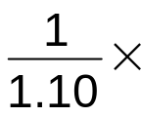

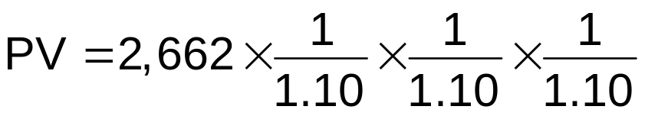
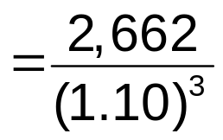
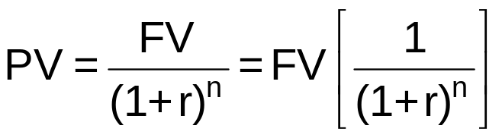
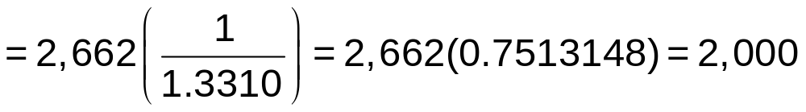
  Present Value (PV)
  Example: How much should you pay today for an investment that will pay you $2,662 in three years? The opportunity cost rate is 10 percent.
Year:
CF:
0 1 2 3
r = 10%
2,000
2,200
2,420
2,662
= FV₃
FV_{n} = PV(1 + r)^{n}

Slide 6
  Solving TVM Problems
Approaches to solve TVM problems include the following:
Cash flow timeline
Equation (formula)
Financial Calculator
Spreadsheet
Interest tables
Set up your calculator
Set up your calculator
See Appendix A in book
Obsolete

Slide 7
  Using Your Calculator
FV_{n} = 2,000(1.10)³ = 2,000(1.3310) = 2,662
Start by solving for (1.10)³, and then multiply the result by 2,000:
Turn on your calculator.
Enter 1.10
Find and press the key on your calculator.
y^{x}
Enter 3 and press the equals sign; you should see 1.331 in the display area.
Press the multiplication sign (×), 2,000, and then the equals sign.
The result, 2,662, should be displayed.

Slide 8
Cash Flow Patterns
Lump-sum amount—single (one-time) payment either today or at some date in the future
Annuity—equal payments over equal time periods
  Ordinary annuity—end-of-period payments
  Annuity due—beginning-of-period payments
Uneven cash flows—multiple payments of unequal amounts, at unequal intervals, or both

Slide 9
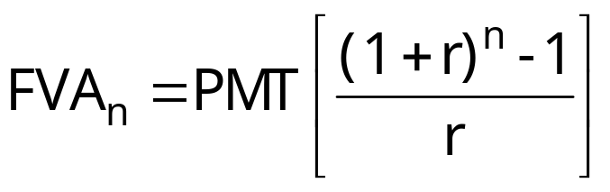
  Future Value of an Annuity (FVA)
  Example: Suppose you invest $400 at the end of each of the next three years. If your opportunity cost rate is 5 percent, what will your investment be worth at the end of three years?
FV @ End of Year 3
0 1 2 3
r = 5%
400
400
400
x (1.05)⁰
400
x (1.05)¹
420
x (1.05)²
441
FVA = 1,261

Slide 10
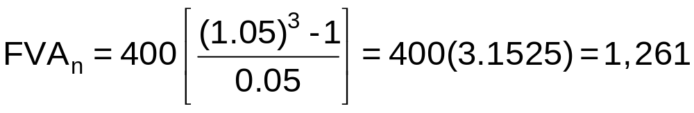
  Future Value of an Annuity (FVA)
CF timeline
Solution
0 1 2 3
r = 5%
FVA = 1,261
400
400
400
Equation
Solution
Financial
Calculator
Solution
3 5.0 0 -400 ?
N
I/Y
PV
PMT
FV
1,261
Annuity Due
3 5.0 0 -400 ?
BGN
N
I/Y
PV
PMT
FV
1,324.05

Slide 11
  Future Value of an Annuity
Ordinary Annuity
FV @ End of Year 3
0 1 2 3
r = 5%
400
400
400
1,261 = FVA
Annuity Due
FV @ End of Year 3
0 1 2 3
r = 5%
400
400
400
1,324.05 = FVA(DUE)
FVA(DUE) > FVA
Greater interest is earned on the annuity due payments.

Slide 12
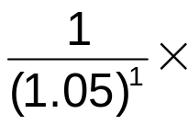
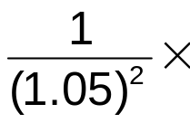

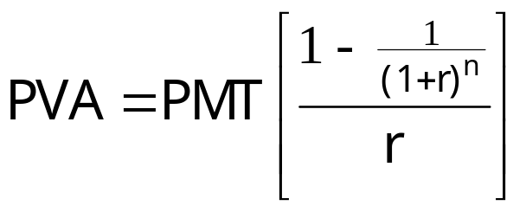
  Present Value of an Annuity (PVA)
  Example: What is the current (present) value of an invest-ment that pays $400 per year at the end of each of the next three years if the opportunity cost rate is 5 percent?
Present Value
0 1 2 3
r = 5%
400
400
400
380.95
362.81
345.54
PVA =1,089.30

Slide 13
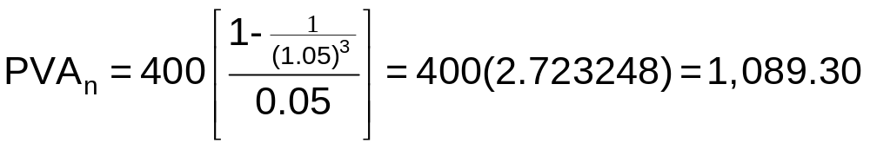
  Present Value of an Annuity
CF timeline
Solution
0 1 2 3
r = 5%
PVA = 1,089.30
400
400
400
Equation
Solution
Financial
Calculator
Solution
3 5.0 ? -400 0
N
I/Y
PV
PMT
FV
1,089.30
Annuity Due
3 5.0 ? -400 0
BGN
N
I/Y
PV
PMT
FV
1,143.76

Slide 14
  Present Value of an Annuity
Ordinary Annuity
0 1 2 3
r = 5%
PVA = 1,089.30
400
400
400
Annuity Due
0 1 2 3
r = 5%
PVA(DUE) = 1,143.76
400
400
400
FVA(DUE) > FVA
Less interest is earned on the annuity due payments.

Slide 15
  Time Value of Money—Interpretation
0 1 2 3
r = 5%
400
400
400
PVA = 1,089.30
A
1,261 = FVA
C
B
Which option is best/preferred?
A = B
A = C
which means
B = C
FV = 1,089.30(1.05)³ = 1,089.30(1.157625) = 1,261.00
PV = 1,261/(1.05)³ = 1,261(0.863838) = 1,089.30
Which option is best if you need money TODAY?

Slide 16

PVA, FVA, and Lump-Sum Amount
PMT = $400; r = 5%; n = 3; PVA = $1,089.30
Beginning Interest Ending Payment/
Year Balance @ 5% Balance Withdrawal
A
1 $1,089.30 $54.46 $1,143.76 $400.00
2 743.76 37.19 780.95 400.00
3 380.95 19.05 400.00 400.00
B
FV = 1,089.30(1.05)³ = 1,089.30(1.157625) = 1,261.00
C
PV = 1,261.00/(1.05)³ = 1,261(0.8638376) = 1,089.30
A = B = C

Slide 17
  Interest Compounding
Compounding occurs when interest earns interest.
When interest compounding occurs, the interest payment increases year over year, because interest earns additional interest each year.
Year:
CF:
0 1 2 3
r = 10%
2,000
x 1.10
2,200
x 1.10
2,420
x 1.10
2,662
= FV₃
Interest: 200 220 242
When saving (investing), more compounding during the year is better than less compounding.

Slide 18
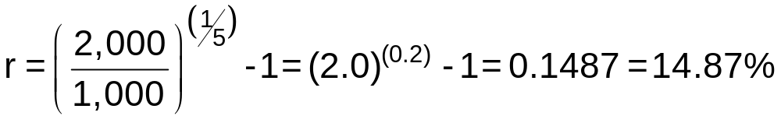
  Interest Compounding
If your investment grew from $1,000 to $2,000 over a 5-year period, what was the annual growth rate?
Equation set up:
FV = PV(1 + r)^{n}
2,000 = 1,000(1 + r)⁵
Financial calculator solution:
5 ? -1,000 0 2,000
N
I/Y
PV
PMT
FV
14.87

Slide 19
APR versus r_{EAR}
Annual percentage rate = APR = simple interest
  Used to compute the interest rate per period: r_{PER} = APR/m, where m is the number of compounding periods (times interest is paid) per year.
  APR does NOT consider the effect of compounding
Effective annual return = r_{EAR} = actual rate earned each year, considering the effects of compounding.

Slide 20
APR versus r_{EAR}
Example: An investment pays 9 percent interest, compounded monthly. If you invest $10,000, how much will you have at the end of one year?
When interest is compounded more than once per year, two adjustments must be made to compute FV or PV:
  Use the annual rate (APR) to compute the rate per interest period, r_{PER}. In our example, r_{PER} = 9%/12 = 0.75%, which is the interest rate paid each month.
  Compute the number of interest periods (payments), n_{PER}. In our example, n_{PER} = 1 x 12 =12, which is the number of times interest is paid during the one-year period.

Slide 21
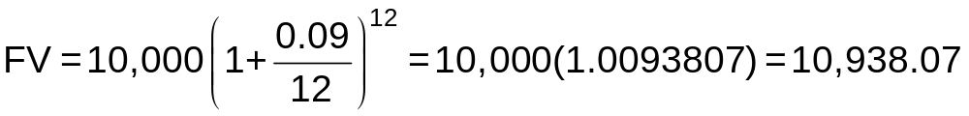
APR versus r_{EAR}
Example: An investment pays 9 percent interest, compounded monthly. If you invest $10,000 in this investment, how much will you have at the end of one year?
1 x 12 9/12 -10,000 0 ?
N
I/Y
PV
PMT
FV
10,938.07

Slide 22
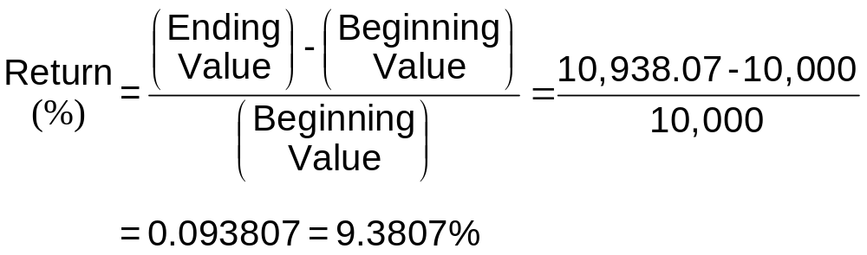
APR versus r_{EAR}
What effective rate of return would you earn on the investment?
PV = 10,000 FV = 10,938.07
1 ? -10,000 0 10,938.07
N
I/Y
PV
PMT
FV
9.3807

Slide 23
APR versus r_{EAR}
Example: Investment X pays 9 percent interest, compounded monthly and Investment Y pays 9.3807 percent, compounded annually. If you invest $6,000 in each investment, how much will each be worth at the end of 10 years?
Investment X
10x12 9/12 -6,000 0 ?
N
I/Y
PV
PMT
FV
14,708.14
Investment Y
10x1 9.3807/1 -6,000 0 ?
N
I/Y
PV
PMT
FV
14,708.16

Slide 24
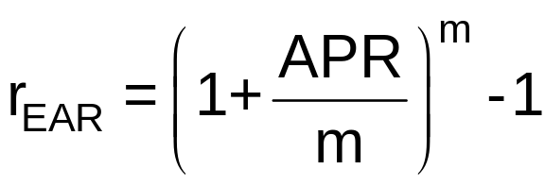
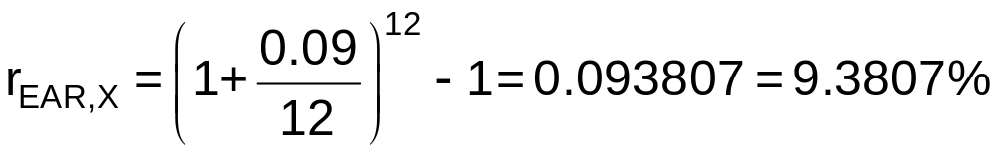
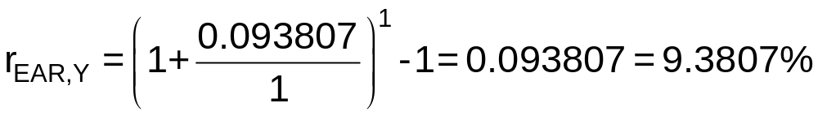
APR versus r_{EAR}
Example: Investment X pays 9 percent interest, compounded monthly and Investment Y pays 9.3807 percent, compounded annually. What is the effective annual rate of each investment?
Investment X
Investment Y

Slide 25
APR versus r_{EAR}
Always compare effective annual rates, r_{EAR}
r_{EAR} > APR, except when interest is compounded annually, in which case r_{EAR} = APR
Banks often report a loan’s APR rather than its r_{EAR}
Banks often report a CD’s r_{EAR} (APY) rather than its APR

Slide 26
APR versus r_{EAR}
Vehicle Loans
Effective 01/31/2023
Type | APR*
New Auto | as low as 4.99%
Used Auto | as low as 4.99%
Motorcycle | as low as 7.24%
Share Certificates & IRA Certificates
Effective 2/4/2020
01/31/2023
Term | APR | APY**
6 Month | 1.74% | 1.75%
12 Month | 2.72% | 2.85%
24 Month | 2.96% | 3.00%
36 Month | 2.96% | 3.00%
48 Month | 2.76% | 2.80%
60 Month | 2.86% | 2.90%

Slide 27
Time Value of Money (TVM)
  Which of the following is preferrable?
    Option 1—Receiving $5,000 today.
    Option 2—Receiving $6,500 in five years.
  The opportunity cost rate is 6 percent, compounded monthly.
Option 1 is preferrable
FV of Current Amount
12x5 6/12 -5,000 0 ?
N
I/Y
PV
PMT
FV
PV of Future Amount
6,744.25
60 0.5 ? 0 6,500
N
I/Y
PV
PMT
FV
Option 1 is preferrable
4,818.92

Slide 28
Amortized Loans
An amortized loan is paid off in equal amounts over its life.
Each payment includes:
  Interest on the outstanding balance (amount owed).
  Partial repayment of the loan.
The portion of each payment that represents interest is greatest at the beginning of the loan, and vice versa.
The portion of each payment that represents repayment of the loan is smallest at the beginning of the loan, and vice versa.

Slide 29
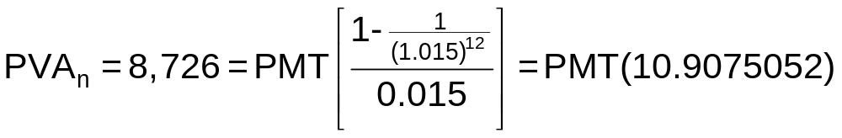
Amortized Loans
Mr. Ed wants to renovate his house. To do so, he must borrow $8,726. The USF Federal Credit Union will provide the money to Mr. Ed through a home equity line of credit (HELOC) with a 6 percent APR. The terms of the HELOC require Mr. Ed to repay the loan in quarterly installments over a three-year period. If he takes out the loan, what will be Mr. Ed’s quarterly payments?
12 1.5 8,726 ? 0
N
I/Y
PV
PMT
FV
-800

Slide 30
Amortization Schedule
Payment = $800
Begin. Payment = Interest (I) + Loan Repay.
Year Pmt # Balance (Pmt) [1.5% x Beg Bal] = Pmt – I
1 1 $8,726.00 $800 $130.89 $669.11
2 8,056.89 800 120.85 679.15
3 7,377.74 800 110.67 689.33
4 6,688.41 800 100.33 699.67
2 5 5,988.74 800 89.83 710.17
6 5,278.57 800 79.18 720.82
7 4,557.75 800 68.37 731.63
8 3,826.12 800 57.39 742.61
3 9 3,083.51 800 46.25 753.75
10 2,329.76 800 34.95 765.05
11 1,564.71 800 23.47 776.53
12 788.18 800 11.82 788.18
$9,600 = $874.00 + $8,726.00

Slide 31
Amortization Schedule
Suppose Mr. Ed has made payments on the HELOC for two years; that is, he has made eight quarterly payments of $800.
If he wants to payoff the loan today, for how much should he write the check?

Slide 32
Amortization Schedule
Payment = $800
Begin. Payment Interest (I) Loan Repay.
Year Pmt # Balance (Pmt) [1.5% x Beg Bal] = Pmt – I
1 1 $8,726.00 $800 $130.89 $669.11
2 8,056.89 800 120.85 679.15
3 7,377.74 800 110.67 689.33
4 6,688.41 800 100.33 699.67
2 5 5,988.74 800 89.83 710.17
6 5,278.57 800 79.18 720.82
7 4,557.75 800 68.37 731.63
8 3,826.12 800 57.39 742.61
3 9 3,083.51 800 46.25 753.75
10 2,329.76 800 34.95 765.05
11 1,564.71 800 23.47 776.53
12 788.18 800 11.82 788.18
$3,200 $116.49 $3,083.51

Slide 33
Amortization Schedule
Suppose Mr. Ed has made payments on the HELOC for two years; that is, he has made eight quarterly payments of $800.
If he wants to payoff the loan today, for how much must he write the check?
?
4 1.5 800 0
N
I/Y
PV
PMT
FV
-3,083.51

Slide 34
Chapter 4 Questions
What does application of time value of money (TVM) concepts entail? Why is it necessary to apply TVM concepts when making financial decisions?
What cash flow patterns are normally observed in business? Describe the characteristics of each.
What is interest compounding? Explain. Everything else the same, would you rather have a savings account that pays interest that is compounded semiannually or one that pays interest with daily compounding? Explain.
If a firm’s earnings per share grew from $1 to $2 over a 10-year period, the total growth would be 100 percent, but the annual growth rate would be less than 10 percent. True or false? Explain.

Slide 35
Chapter 4 Questions
What is the difference between the annual percentage rate (APR) and the effective annual rate (r_{EAR})? When/how is each used? What is the relationship between these two measures?
When financial institutions, such as banks or credit unions, advertise the rates on their loans, they often report the APR. If you wanted to compare the interest rates on loans from different financial institutions, should you compare the APRs? Explain your reasoning.
What is an amortized loan, and what are the characteristics of an amortized loan payment? What is an amortization schedule, and how is it used?

