Slide 1
The Cost of Money
Cost of money =
  interest rates
  rent/cost to use other people’s money
Determined by supply and demand factors:
  Supply is primarily controlled by the Federal Reserve (Fed)
  Demand is determined by market participants (borrowers)

Slide 2
The Cost of Money
Interest Rate
Supply—Fed controls
r₁
r₂
Demand—market participants
Money ($)
M₁
M₂

Slide 3
The Cost of Money
Demand for money is based on the following factors:
Production Opportunities—greater production opportunities, greater demand for funds
Time Preference for Consumption—individuals save less if they have a great need for current consumption
Risk—investors demand higher returns for riskier investments
Inflation—investors save to increase their ability to purchase in the future; purchasing power loss due to inflation must be recaptured
In each situation mentioned above, everything else equal, interest rates would increase.

Slide 4
The Cost of Money
Relationship between risk and returns (interest rates):
Return (r)
Varies
with risk
Risk Premium = RP
r = r_{RF} + RP
r_{RF}
Risk-Free Return = r_{RF}
Same for all
investments
0
Risk

Slide 5
Determinants of Interest Rates
r = r_{RF} + RP
= [r* + IP]
+ [DRP + LP + MRP]
[r* + IP]
[DRP + LP + MRP]
r* = real risk-free rate
IP = inflation premium
r* = real risk-free rate
IP = inflation premium
= r_{RF} = nominal risk-free rate
DRP = default risk premium
LP = liquidity (marketability) premium
MRP = maturity risk premium
DRP = default risk premium
LP = liquidity (marketability) premium
MRP = maturity risk premium
= RP

Slide 6
Yield Curves
  Graph of the term structure of interest rates
  Shows the relationship between the yields on long-term bonds and the yields on short-term bonds.
Rate (Yield)
Upward sloping
Flat
Downward sloping
Maturity
Short-Term Bonds Long-Term Bonds

Slide 7
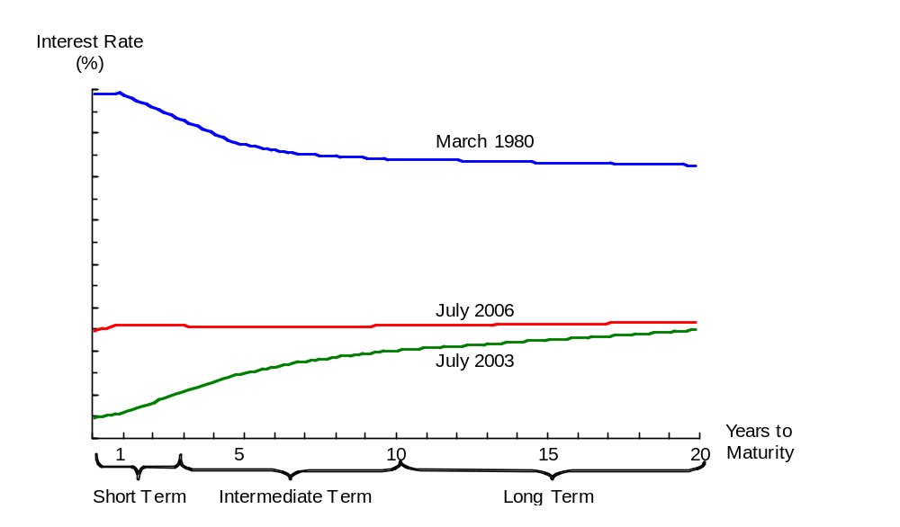
U.S. Treasury Bond Interest Rates on Different Dates (Yield Curves)
15
10
5
0
Notes:
11

Slide 8
Recent Yield Curves
Rate
(%)
Jan18
Sept 21
Feb 21
Oct 20
May 20
Maturity
1 5 10 20

Slide 9
Recent Yield Curves
Rate
(%)
Oct 22
Feb 23
Sept 21
1 5 10 20
Maturity

Slide 10
Yield Curves
Explanations for various shapes of yield curves.
Expectations Theory
The slope of yield curve is in the same direction as expected interest movements.
Liquidity Preference Theory
Investors prefer more liquidity to less, which means they are willing to pay higher prices (accept lower rates) for more liquid investments.
Market Segmentation Theory
Market is segmented by maturity (LT or ST)

Slide 11
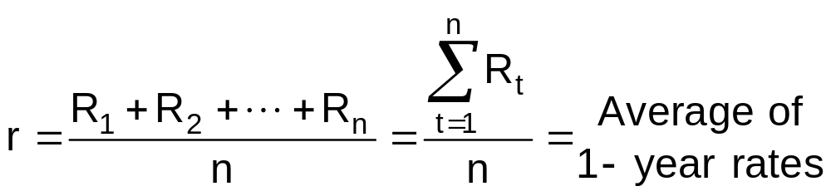
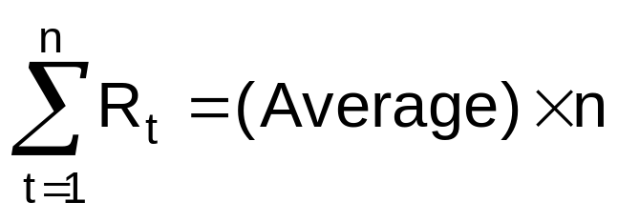
Interest Rates
Yield = average of one- year rates, R_{t}
R₁ = rate in Year 1
R₂ = rate in Year 2
One-year rates
• •
• •
• •
R_{n} = rate in Year n
= r x n
= Sum of all one-year rates for a particular bond

Slide 12
Forecasting Interest Rates
Exp Infl
Year Each Yr
Avg Inflation Per Yr = IP_{t}
20x1 1%
20x2 5%
20x3 6%
1-yr avg = 1%/1 = 1%
2-yr avg = (1%+5%)/2 = 3%
3-yr avg = (1%+5%+6%)/3 = 4%

Slide 13
Forecasting Interest Rates
Exp Infl
Year Each Yr Avg Inflation Per Yr = IP_{t}
20x1 1% 1-yr avg 1%
20x2 5 2-yr avg 3
20x3 6 3-yr avg 4
If the real risk-free rate, r*, is 3 percent annually, then the forecasted yields on bonds will be:
Bond Type r* + IP_{t} = Nominal Rate, r_{RF}
1-year bond 3% + 1% = 4%
2-year bond 3% + 3% = 6%
3-year bond 3% + 4% = 7%

Slide 14
Forecasting Interest Rates
Exp Infl r* Nominal Rate
Year Each Yr + Each Yr = each Yr, R_{t}
20x1 1% 3% 4%
20x2 5 3 8
20x3 6 3 9
If the real risk-free rate, r*, is 3 percent annually, then the forecasted yields on bonds will be:
Bond Type r* + IP_{t} = Nominal Rate, r_{RF}
1-year bond 3% + 1% = 4%
2-year bond 3% + 3% = 6%
3-year bond 3% + 4% = 7%

Slide 15
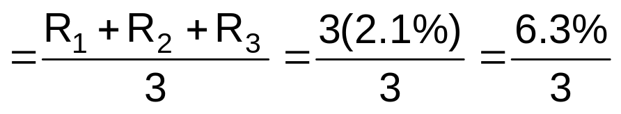
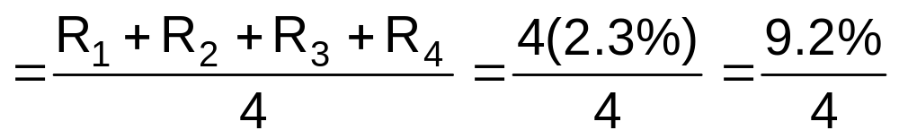

Forecasting Interest Rates
Suppose currently a 3-year bond has a yield of 2.1 percent and a 4-year bond has a yield of 2.3 percent.
Based on this information, we know the following:
Bond Type Yield = Average of Rates:
3-year 2.1%
4-year 2.3
One-year rate in Year 4 = R₄ = (R₁ + R₂ + R₃ + R₄) – (R₁ + R₂ + R₃)
= 9.2% – 6.3%
= 2.9%

Slide 16
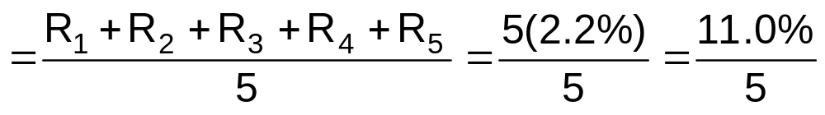
Forecasting Interest Rates
Bond Type Yield = Average of Rates:
3-year 2.1%
4-year 2.3
5-year 2.2
1-year rate in Year 4 = R₄ = (R₁ + R₂ + R₃ + R₄) – (R₁ + R₂ + R₃)
= 9.2% – 6.3% = 2.9%
1-year rate in Year 5 = R₅ = (R₁ + R₂ + R₃ + R₄ + R₅) – (R₁ + R₂ + R₃ + R₄)
= 11.0% – 9.2% = 1.8%

Slide 17
The Federal Reserve & Interest Rates
Open market operations
Fed buys and sells government securities to change the supply of money in the economy.
If the Fed wants to increase interest rates, should it buy or sell government securities?
  Sell
  When the Fed sells securities, investors purchase with money, which reduces the supply of money in the economy.

Slide 18
Business Activity & Interest Rates
Business activity primarily affects the demand for money.
More business investment leads to greater demand for money, which increases interest rates, everything else equal.
Other factors that affect interest rates include:
  Federal deficits
  Foreign trade balance

Slide 19
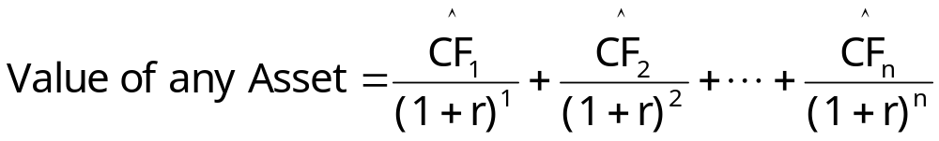
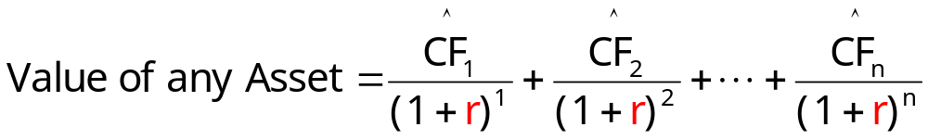

Valuing Any Asset
= expected cash flow in Period t
r = required rate of return
r = required rate of return

Slide 20
Chapter 5 Questions
What is the cost of money, and how is it determined? What factors affect the cost of money?
What is a yield curve? Why do yield curves differ?
Discuss the explanations for various shapes of yield curves. How can yield curves by used to forecast future interest rates?
How does the Federal Reserve change the money supply in the United States? What actions would the Fed take to increase interest (decrease) rates?
How does general business activity affect interest rates?
How are the values of financial assets affected by changes in interest rates?

