Slide 1
Bonds—Characteristics
A loan
A few characteristics (see book for others):
  Principal, face value, maturity value, and par value
  Interest payments—based on coupon rate of interest
  Priority to assets and earnings
What is debt (i.e., a bond)?
1st priority—before ANY stock
  Control of the firm
none—no voting rights
Indenture—bond contract
  Maturity, coupon rate, restrictions, etc.
  Call provision
  Convertible feature
  Sinking fund
Different types of debt—read the chapter; questions about the types of debt will be on the exam

Slide 2
Bonds—Ratings
Importance:
Indication of default risk.
Ratings changes—affect a firm’s ability to borrow and the cost of borrowing.
Institutional investors are restricted to securities rated investment-grade or higher.

Slide 3
Bonds—Ratings
Moody’s S&P
Aaa AAA
Aa AA
A A
Baa BBB
Ba BB
B B
Caa CCC
C D
High quality
Investment grade
Ba BB
B B
Caa CCC
C D
Substandard
Junk Bonds
Speculative

Slide 4
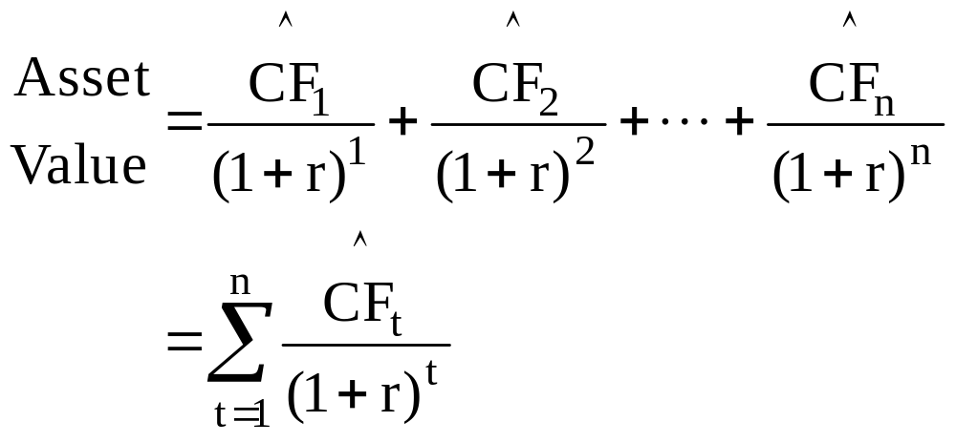
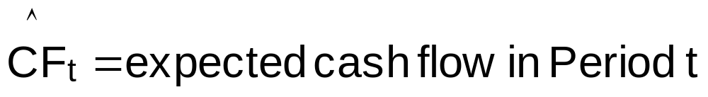
Bonds—Valuation
Basic Valuation Model—value of any asset
r = required rate of return

Slide 5
Bonds—Valuation
0
1
2
3
N
r_{d}
…
INT
INT
INT
INT
PV of INT
PV of M
M
Bond Value = V_{d}
Annuity
Lump-Sum

Slide 6
Valuation of Bonds—Example
Bond Characteristics:
Face (maturity) value, M $1,000
Coupon rate of interest, C 5%
Annual interest payment, INT $50 = $1,000 x 0.05
Years to maturity, N 8
Market rate, r_{d} 6%
Market rate when bond was issued—does not change
Current market rate
Should the bond be selling at a premium, at par, or at a discount?
The bond’s market value must change so the bond sells at a price that yields r_{d}. In this example, r_{d} = 6%.

Slide 7
Valuation of Bonds—Example
Bond Characteristics:
Face (maturity) value, M $1,000
Coupon rate of interest, C 5%
Annual interest payment, INT $50 = $1,000 x 0.05
Years to maturity, N 8
Market rate, r_{d} 6%
8 x 1
6/1
?
50/1
1,000
N
I/Y
PV
PMT
FV
-937.90

Slide 8
Valuation of Bonds—Example
Existing (Old) Bond Characteristics:
Annual interest payment, INT $50
Years to maturity, N 8
Market rate, r_{d} 6%
C_{New} = 6%
INT_{New} = $60
The coupon rate on a new bond issued today will equal the current market rate, which is 6 percent, such that the interest paid on a new bond will be $60 per year.
Would you pay $1,000 to buy the “old” bond that pays $50 annual interest when you can buy a new bond for $1,000 that pays $60 annual interest?
Absolutely NOT!
Any investor who buys the old bond is paid $10 per year less interest compared to a new bond.
How much is the $10 difference worth today if the opportunity cost (market) rate is 6 percent?

Slide 9
Valuation of Bonds—Example
INT_{New} – INT_{Old} = $60 – $50 $10
Years to maturity, N 8
Market rate, r_{d} 6%
Compute the PV of the $10 difference in annual interest payments.
The PV represents the appropriate price adjustment to the market value of the old bond.
8
6
?
10
0
N
I/Y
PV
PMT
FV
-62.10
The market value of the old bond should be:
V_{old} = $1,000 - $62.10 = $937.90
Investors who pay $937.90 for the “old” bond on average will earn 6 percent interest per year, which is the market yield.

Slide 10
Valuation of Bonds—Semiannual Interest Payments
Most bonds pay interest semiannually
Adjustments to computations:
  N = # years x m = number of remaining interest payments
  m = # of interest payments per year
  r = r_{d}/m = 6-month market rate of return (yield)= r_{PER}
  INT = interest payment per period = (Annual INT)/m
Example: M = $1,000, Years to maturity = 8, r_{d} = 6%; C = 5% (paid semiannually),
16=8x2
25=50/2
3=6/2
?
25=50/2
1,000
N
I/Y
PV
PMT
FV
-937.19

Slide 11
Bond Yields
A bond’s yield is the average return investors earn (demand) on their investment in the bond.
Yield to maturity—YTM = average annual return from the current period to maturity
Yield to call—YTC = average annual return from the current period to the first call date

Slide 12
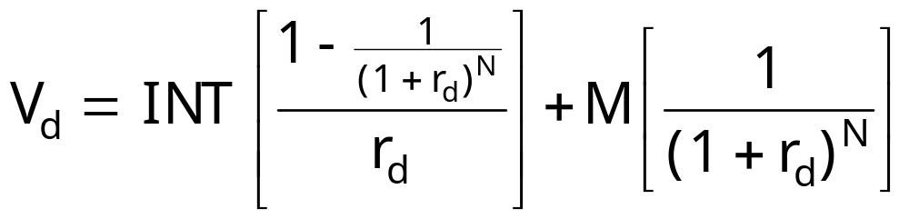
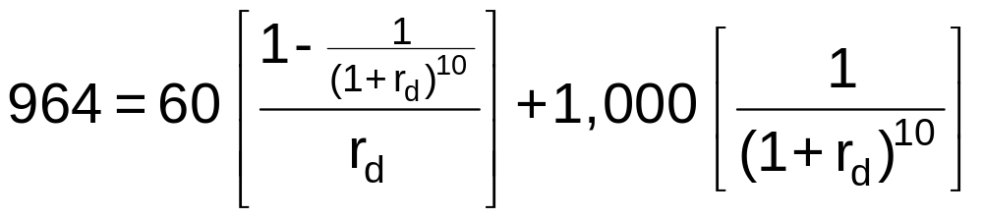
Bond Valuation—Yield to Maturity, r_{d}
r_{d} = YTM
Bond Characteristics:
Face (maturity) value, M $1,000
Annual interest payment, INT $60
Years to maturity, N 10
Market price, V_{d} $964
Solve for r_{d} using trial-and-error method

Slide 13
Bond Valuation—Yield to Maturity, r_{d}
Bond Characteristics:
Face (maturity) value, M $1,000
Annual interest payment, INT $60
Years to maturity, N 10
Market price, V_{d} $964
10 x 1
?
-964
60/1
1,000
N
I/Y
PV
PMT
FV
6.5

Slide 14
Bond Valuation—Yield to Call
Bond Characteristics:
Face (maturity) value, M $1,000
Call price $1,060
Annual interest payment, INT $60
Years to maturity, N 10
Years to first call date 5
Market price, V_{d} $964
5 x 1
?
-964
60/1
1,060
N
I/Y
PV
PMT
FV
7.9

Slide 15
Valuation—Relationship Between Prices and Yields
Whenever the going rate of interest, r_{d}, equals the coupon rate, a bond will sell at its par value
An increase (decrease) in interest rates will cause the price of an outstanding bond to fall (rise).
The market value of a bond will always approach its par value as its maturity date approaches, provided the firm does not go bankrupt.
Long-term bonds are affected more than short-term by a change in interest rates.

Slide 16
Valuation—Relationship Between Prices and Maturity
Both Bond S and Bond L have the following characteristics:
M = $1,000
INT = $50 (annual)
r_{d} = 5%
Bond S matures in 5 years
Bond L matures in 30 years
Currently, V_{S} = V_{L} = $1,000
Suppose r_{d} increases to 7 percent later today.
V_{S} = $918
V_{L} = $752
%Δ = -8.2%
%Δ = -24.8%

Slide 17
Valuation—Relationship of YTM, Coupon, and Price
 |  |  |  | Example: N = 10 yrs; C = 6%; M = 1,000
Relationship of rates |  |  | Market Price, V_{d} | If r_{d} = | V_{d} =
Market rate, r_{d} | = | Coupon rate, C
Market rate, r_{d} | > | Coupon rate, C
Market rate, r_{d} | < | Coupon rate, C
V_{d} = M
par
6%
1,000.00
V_{d} < M
discount
8%
865.80
V_{d} > M
premium
4%
1,162.22

Slide 18
Bond Valuation—Interest-Rate Risk
When market rates change, bondholders are affected in two ways:
  bond prices change in an opposite direction—price risk
  the returns investors earn change—reinvestment risk
Rate, r_{d} | Value, V_{d}
4% | $1,162.22
6 | 1,000.00
8 | 865.80
10 | 754.22
12 | 660.99
Bond Characteristics:
M = $1,000.00
INT = $60.00
N = 10 yrs
Annual Interest

Slide 19
Bond Valuation—Return on Investment
Return on
investment
Income
yield
Capital
gains yield
=
+
INT
V_{d1} – V_{d0}
V_{d0}
r_{d}
=
+
V_{d0}
Yield to
Maturity
Current
yield
Capital
gains yield
=
+

Slide 20
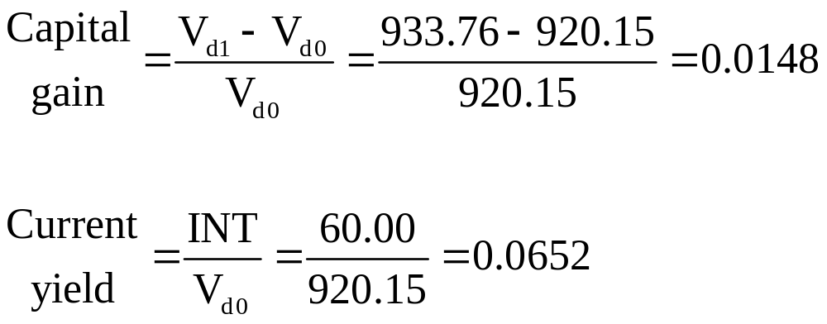
Bond Valuation—Return & Change in Value Over Time
constant
Bond Characteristics: M = $1,000.00, INT = $60.00, r_{d} = 8%
Years to Maturity | End of Year Value, V_{d} | Capital Gain = (V_{d1}-V_{d0})/V_{d0} | Current Yield = INT/V_{d0} | Total Return
5
4
3
2
1
0
920.15
933.76
1.48%
6.52%
8.00%
948.46
1.57
6.43
8.00%
964.33
1.67
6.33
8.00%
981.48
1.78
6.22
8.00%
1,000.00
1.89
6.11
8.00%

Slide 21
Bond Valuation—Return & Change in Value Over Time
INT = $60 (C = 6%)
N = 5 yrs
Market Value ($), V_{d}
1,100.00
1,089.04 if r_{d} = 4% < C = 6%
Premium bond, V_{d} > M
1,050.00
Par bond, V_{d} = M; r_{d} = C = 6%
1,000.00
M = 1,000
950.00
Discount bond, V_{d} < M
900.00
920.15 if r_{d} = 8% > C = 6%
850.00
Years to
Maturity
800.00
5
4
3
2
1
0
Assumes r_{d} does not change during the remainder of the bond’s life.

Slide 22
Bond Valuation—Return & Change in Value Over Time
Bond Characteristics: M = $1,000.00, INT = $60.00
Maturity | r_{d} | V_{d}
5 | 8% | $920.15
4 | 6 | 1,000.00
3 | 4 | 1,055.50
2 | 7 | 981.92
1 | 8 | 981.48
0 |  | 1,000.00
V_{d}
Maturity

Slide 23
Chapter 6 Questions
What is debt? What are some of the characteristics of debt?
What information do bond ratings provide? Why are these ratings important?
How are bond prices determined?
How are bond yields determined?
What is the relationship between bond prices and (a) market rates and (b) time to maturity?
  If market rates rise after a bond is issued, what will happen to the bond’s price and to its YTM?
  Does the length of time to maturity affect the extent to which a given change in interest rates affects a bond’s price?

