Slide 1
Stocks—Characteristics
Preferred stock versus common stock
  All corporations must have common stock.
  Preferred stock—preference over common
Preferred stock is equity that has characteristics similar to both bonds and common stock.
  Constant dividend
  Call provision
  Convertible feature
  Distribution of earnings/proceeds—AFTER debt, but BEFORE common stock.
  Control of firm (similar to bonds)—no voting power.

Slide 2
Stocks—Characteristics
Common stock—owners of the firm
  Distribution of earnings/proceeds—paid LAST
    Common stockholders are paid after (1) debtholders AND (2) preferred stockholders
  Dividends—can be, but are not normally fixed.
  Control of the firm—vote for members of the board; owners of the firm, thus they have control.

Slide 3
Stocks—Valuation
Stock value = Present value of the cash flows that the company is expected to distribute (pay) during its life.
  Cash flows associated with common stock are dividends, whether they are regular dividends, special dividends, or liquidating dividends
If the stock (or any other asset/investment) never pays a dividend (cash flow), its value is $0.

Slide 4
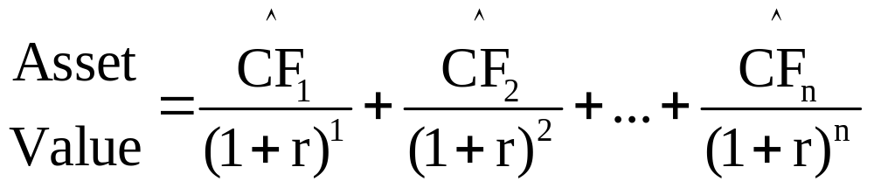
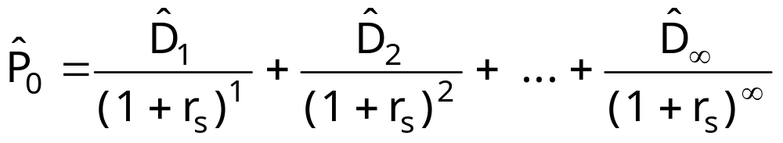
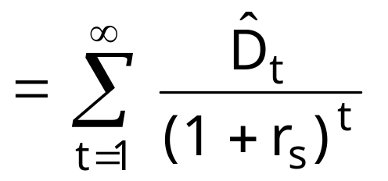

Stocks—Valuation
= dividend expected to be paid in Period t
r_{s} = required return on stock

Slide 5








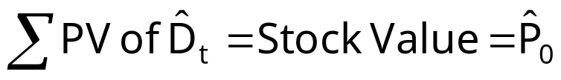
Stocks—Valuation
Stock ownership entitles the investor to the future cash flows, called dividends, paid by the firm
0
r_{s}
1
2
3
∞
…
.
.
.

Slide 6

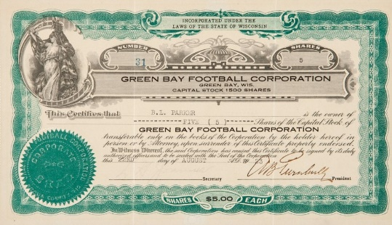
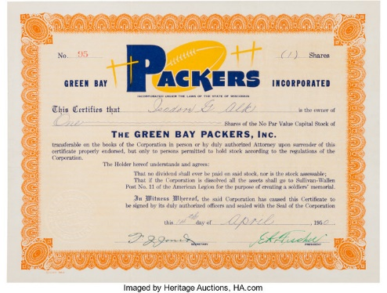
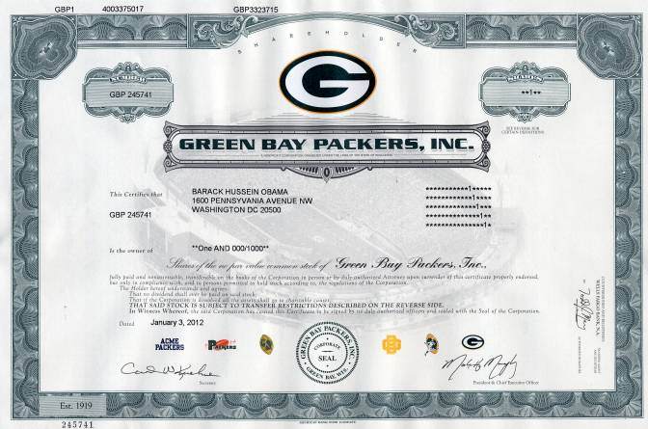
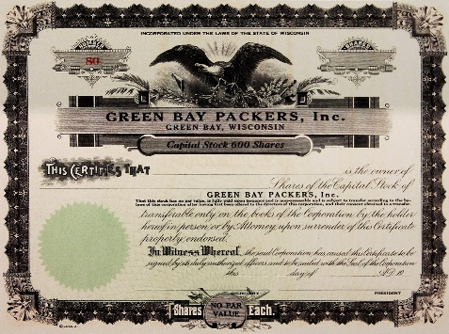
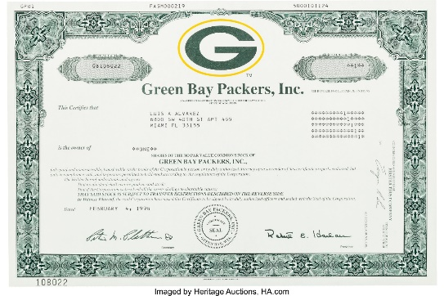
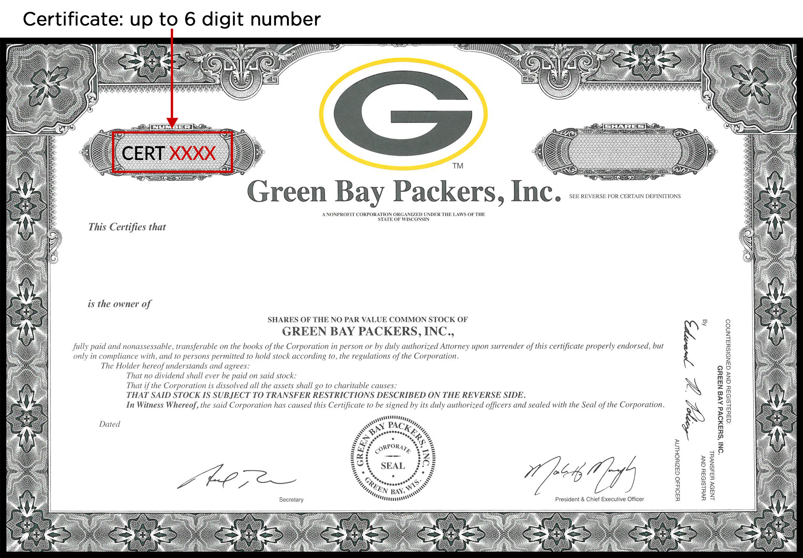
Stocks—Valuation
Green Bay Packers—stock sales
1923
1950
2011
1935
1997
2011

Slide 7
Stocks—Valuation
Green Bay Packers—stock sales
1923— $5 per share; $5,500
1935— $25 per share; $12,000
1950— $25 per share; $104,000
1997— $200 per share; $24,000,000
2011— $250 per share; $67,400,000
2021— $300 per share; $65,800,000
Total = 5,200,000 million shares; about 537,000 stockholders; greater than $157 million raised

Slide 8
Stocks—Valuation
Green Bay Packer stock does not have the same rights as traditional publicly-traded stock.
Provides no equity interest in the team
Dividends are not paid and will not be paid in the future.
Cannot be traded—can only be sold back to the team.
Shares can only be gifted to immediate family members.
Provides no privileges/priorities for purchasing season tickets.
Stockholders can vote at annual meetings.
What is the financial value of this stock?
$0

Slide 9
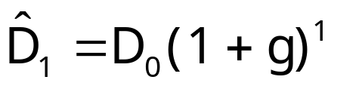
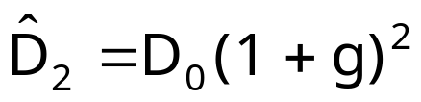
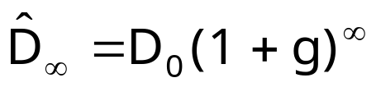
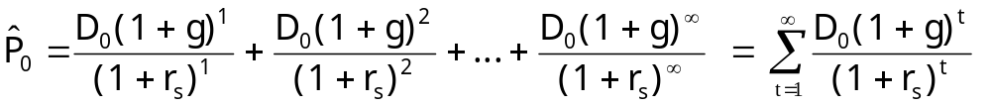
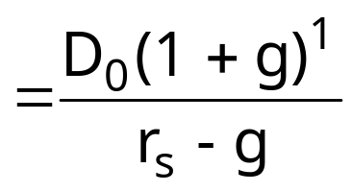
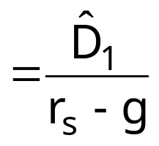
Valuation—Constant Growth, g
If growth is constant such that g = g₁ = g₂ = … = g∞
…
Value of a constant-growth stock
Required: g = constant
r_{s} > g

Slide 10
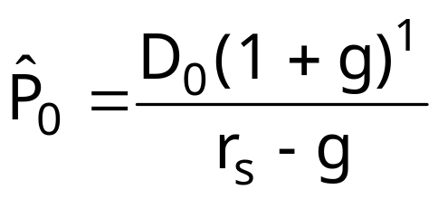
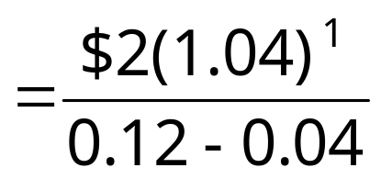
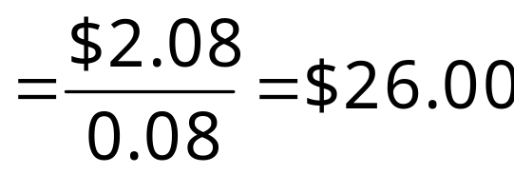
Valuation—Constant Growth, g
Example: The most recent dividend paid by a firm was $2; the firm is expected to grow at a constant rate equal to 4 percent; and the required rate of return on similar risk investments is 12 percent.
D₀ = $2
g = 4%
r_{s} = 12%

Slide 11

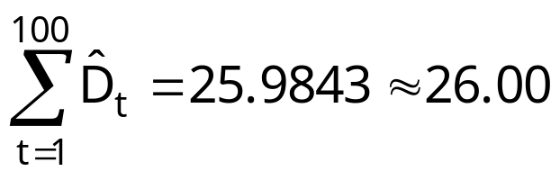
Valuation—Constant Growth, g
D₀ = $2; g = 4%; r_{s} = 12%
Year
Dividend,
= $2.00(1.04)^{t}
PV of @ 12%
1 | $2.0800 | = $2.00(1.04)¹ | $1.8571
2 | 2.1632 | = 2.00(1.04)² | 1.7245
3 | 2.2497 | = 2.00(1.04)³ | 1.6013
5 | 2.4333 | = 2.00(1.04)⁵ | 1.3807
10 | 2.9605 | = 2.00(1.04)¹⁰ | 0.9532
50 | 14.2134 | = 2.00(1.04)⁵⁰ | 0.0492
100 | 101.0099 | = 2.00(1.04)¹⁰⁰ | 0.0012

Slide 12
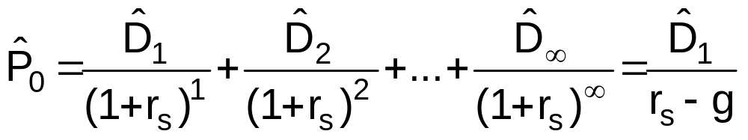
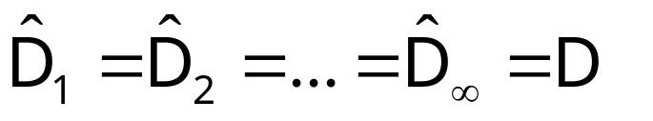
Valuation—Constant Growth, g = 0
When g = 0, the same dividend is paid each year, which is a characteristic of preferred stock
D
=
r
s
Perpetuity
g = 0
D
D
D
D
ˆ
=
+
+
…
+
P
=
0
(1
+
r
)
1
(1
+
r
)
2
(1
+
r
)
∞
r
s
s
s
s
=
PMT
r

Slide 13
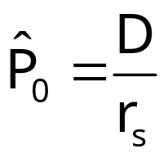
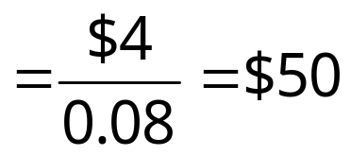
Valuation—Constant Growth, g
Example: The preferred stock of a company pays a constant dollar dividend equal to $4 per share. The required rate of return on similar risk investments is 8 percent.
Relationship between value and r_{s}
Required Return, r_{s} | Stock Value
5.0%
8.0
12.0
Relationship between value and r_{s}
Required Return, r_{s} | Stock Value
5.0% | $80.00
Relationship between value and r_{s}
Required Return, r_{s} | Stock Value
5.0% | $80.00
8.0 | 50.00
Relationship between value and r_{s}
Required Return, r_{s} | Stock Value
5.0% | $80.00
8.0 | 50.00
12.0 | 33.33
12.0 | 33.33

Slide 14
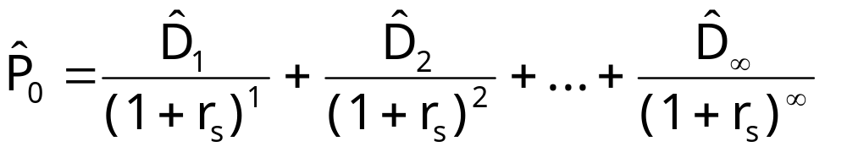
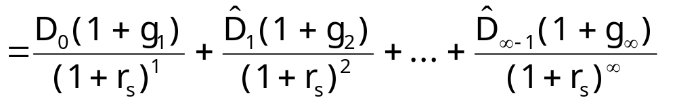
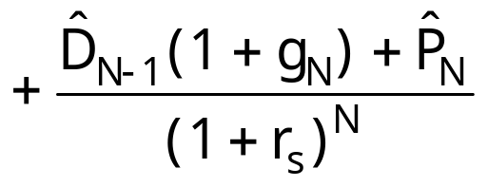

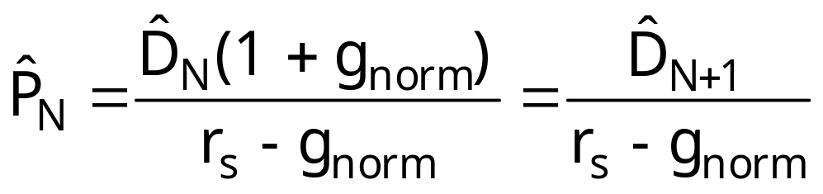
Valuation—Nonconstant Growth
g_{norm} = constant, or normal, growth
Assume constant growth, g_{norm}, begins at some point in the future, Year N.

Slide 15
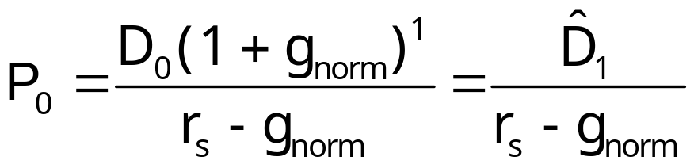

Valuation—Constant Growth Versus Nonconstant Growth
Value of a stock growing at a constant rate today:
Value of a stock growing at a constant rate in Year N:
When N = 0,

Slide 16
Valuation—Nonconstant Growth
Example:
D₀ = $1.25
g₁ = 20%
g₂ = 20%
g₃ = -10%
g₄ = 5% = g₆ = … = g∞
r_{s} = 11.5%
nonconstant growth
Constant growth, g_{norm}

Slide 17

Valuation—Nonconstant Growth
Steps to Follow
Step 1:
    Start computing dividends.
START
Continue computing dividends until you compute the first constant growth dividend.
Using ONLY the nonconstant growth dividends, compute the PVs of those dividends.
Sum the results.

Slide 18
Valuation—Nonconstant Growth
Steps to Follow
Step 2:
Using the first constant growth dividend, compute the value of the stock at the end of the nonconstant growth period
  The value you compute represents the PV at Year N (N years in the future) of all the future dividends that will grow at a constant rate, g_{norm}.
  This is the value of the stock at the end of Year N
Compute the PV of the future stock value (price).

Slide 19
Valuation—Nonconstant Growth
Steps to Follow
Step 3:
Sum the PV of the nonconstant growth dividends computed in Step 1 and the PV of the future stock price computed in Step 2.

Slide 20
Valuation—Nonconstant Growth
Step 1: Compute PV of nonconstant-growth dividends
D₀ = $1.25
START
    Start computing future dividends.
Year
Growth rate, g
Dividend,
Computation
1 20% $1.5000 = $1.2500(1.20)
2 20 1.8000 = 1.5000(1.20)
3 -10 1.6200 = 1.8000(0.90)
4 5 1.7010 = 1.6200(1.05)
First constant growth dividend; save for Step 2

Slide 21

Valuation—Nonconstant Growth
Step 1: Compute PV of nonconstant-growth dividends
r_{s} = 11.5%
Year
Dividend,
PV of
1 $1.5000 $1.5000/(1.115)¹ = $1.3453
2 1.8000 1.8000/(1.115)² = 1.4478
3 1.6200 1.6200/(1.115)³ = 1.1687
3.9618
= PV of nonconstant-growth dividends paid in Years 1 – 3

Slide 22
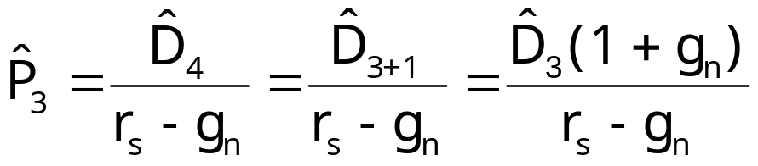
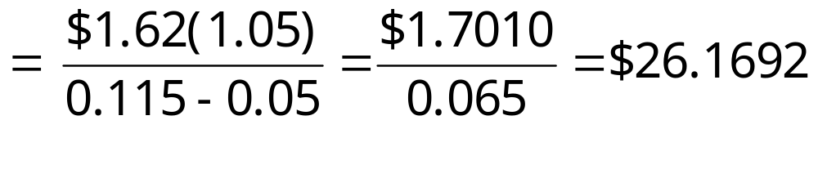
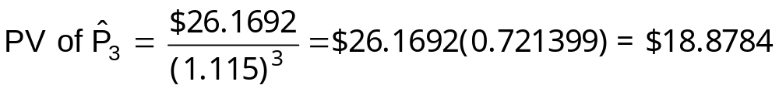
Valuation—Nonconstant Growth
Step 2: Compute PV of constant-growth dividends.
Because the dividends grow at a constant rate after Year 3, we can apply the constant growth model to compute the PV of the future constant-growth dividends at the end of
Year 3, which is the end of the nonconstant growth period:
= PV of constant-growth dividends paid in Years 4 – ∞

Slide 23

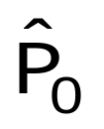

Valuation—Nonconstant Growth
Step 3: Sum the PV of the nonconstant growth dividends computed in Step 1 and the PV of the future stock price computed in Step 2.
PV of nonconstant dividends = $3.9618
PV of future price, = $18.8784
= $22.8402
= Current value of the stock

Slide 24
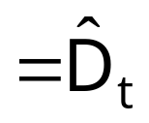



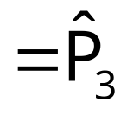
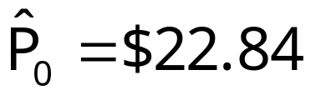

Valuation—Nonconstant Growth
Cash Flow Timeline
0
1
2
3
4 5 
14%
… … …
1.5000
1.8000
1.6200
…
…
3.9618
18.8784
26.1692
22.8402
= PV of constant growth dividends in Year 4 through Year ∞

Slide 25
Valuation—Nonconstant Growth
The key to computing the value of a stock that exhibits nonconstant growth is to assume constant growth occurs at some point in the future—it might start in five years, 50 years, or 100 years.

Slide 26
Valuation—Stock Returns
Return on
investment
Income
yield
Capital
gains yield
=
+
ˆ
D
ˆ
=
1
+
r
g
s
P
0
Expected
dividend
yield
Expected growth
rate (capital
gains yield)
Expected rate
of return
=
+

Slide 27
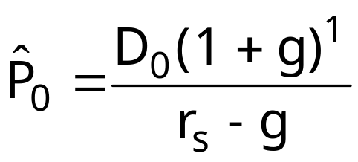
Valuation—Factors that Affect Prices
Market conditions
Investors’ risk preferences, which determine r_{s}
  Higher r_{s}, lower price
Company factors
  Growth rate
    Higher g, higher price
  Dividend payments
    Higher D₀, higher price

Slide 28
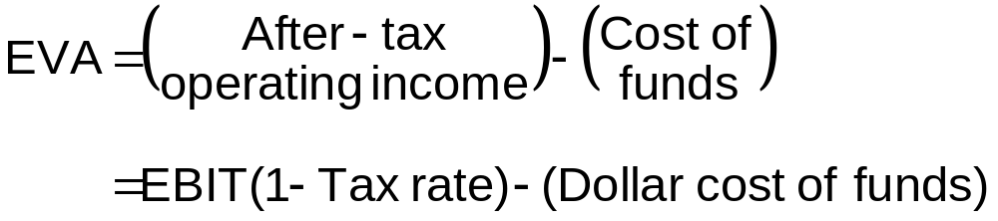
Valuation—Alternative Techniques
P/E ratios
  P/E ratio = Price ÷ EPS = price multiple
  “Normal” P/E
Economic value added (EVA)
  Earnings must be sufficient to pay those who provide funds to the firm; otherwise the value of the firm should decrease.

Slide 29
Chapter 7 Questions
What is equity? What are some characteristics of equity?
  Explain the following statement: “Whereas a bond contains a promise to pay interest, common stock provides an expectation but no promise of dividends.”
  What is the significance of the par value of a preferred stock? Of a common stock?
How are stock prices determined?
How are stock returns determined? What two components are included in a stock’s return?
What factors affect stock prices? Explain.
What alternative techniques do investors use to value stocks? Why?

