Slide 1
Risk—Definitions
Dictionary: common definition—chance of loss
In finance, risk is defined as the chance that something other than what is expected occurs—that is, there is variability in the returns.
Two sides to risk:
  “Bad” risk—when the results are worse than expected (lower-than-expected returns)
  “Good”—when the results are better than expected (higher-than-expected returns).
An investment (situation) is risky if more than one future outcome is possible—that is, there are two or more possible payoffs associated with the investment.

Slide 2
Risk—Definitions
Stand-alone risk—risk of an investment if it was held by itself, or alone
Portfolio risk—risk of an investment when it is combined/held in a portfolio with other investments

Slide 3

Measuring Risk
Risk-Free
Asset
5.0%
5.0
5.0
Economy Probability Payoff
Booming 0.2 5.0%
Normal 0.5 5.1
Recession 0.3 5.0
1.0
Risky?
Yes, because there are multiple (two) possible outcomes.

Slide 4
Measuring Risk
Probability Distributions—Example
Economy Probability Payoff
Booming 0.2 15.0%
Normal 0.5 11.0
Recession 0.3 -5.0
1.0

Slide 5
Risk and Return
Expected return
  Weighted average of the various possible outcomes based on the probability that each outcome will occur.
  Average of the outcomes if the action—for example, an investment—was continued over and over again and the probability (weight) for each outcome remained the same.

Slide 6
Expected Return
Expected
rate
ˆ
L
=
r
=
Pr
r
+
Pr
r
+
+
Pr
r
of
return
1
1
2
2
n
n
n
=
∑
Pr
r
i
i
i
=
1
r_{i} = the result of outcome i
Pr_{i} = the probability that outcome i will occur

Slide 7

Expected Return
Economy Probability, Pr_{i} Payoff, r_{i} Pr_{i} x r
Boom 0.2 15.0% 3.0%
Normal 0.5 11.0 5.5
Recession 0.3 -5.0 -1.5
7.0%
Interpretation?

Slide 8
Measuring Stand-Alone Risk
Standard Deviation, σ
σ measures the tightness, or variability, of a set of outcomes, or a probability distribution
The tighter the distribution, the less the variability of the outcomes and the less risk associated with the event
σ measures risk for a single investment—that is an investment held by itself (standing alone)

Slide 9
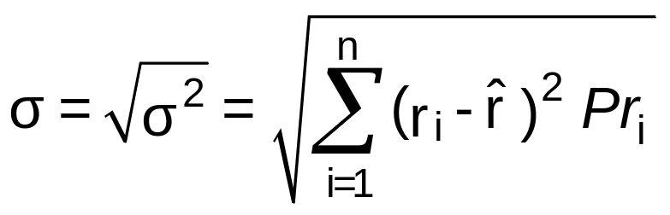
Measuring Stand-Alone Risk
Standard Deviation, σ
Variance, σ²—measures the variability of outcomes
2
=
(
r
−
ˆ
2
+
−
ˆ
2
+
+
−
ˆ
2
σ
r
)
Pr
(
r
r
)
Pr
L
(
r
r
)
Pr
1
1
2
2
n
n
n
=
∑
−
ˆ
2
(
r
r
)
Pr
i
i
i
=
1
Standard deviation, σ

Slide 10



Measuring Stand-Alone Risk
Standard Deviation, σ
r_{i} – = r_{i}– (r_{i}– )² x Pr_{i} (r_{i}– )²Pr_{i}
11.0 – 7.0 = 4.0 16.0 x 0.5 = 8.0
-5.0 – 7.0 = -12.0 144.0 x 0.3 = 43.2
15.0% – 7.0% = 8.0% 64.0
15.0% – 7.0% = 8.0% 64.0 x 0.2
15.0% – 7.0%
15.0% – 7.0% = 8.0%
15.0%
15.0% – 7.0% = 8.0% 64.0 x 0.2 = 12.8
σ² = 64.0
8%(0.2) + 4%(0.5) +(-12%)(0.3) = 0.0

Slide 11
Risk Attitudes
Attitudes
  Averse
  Neutral
  Seeker
Risk Aversion—all else equal, risk averse investors prefer:
  higher returns to lower returns.
  less risk to more risk.
Risk averse investors demand higher returns for investments with higher risk

Slide 12
Risk Attitudes
Return
Want to
define.
Risk Premium = RP
r = r_{RF} + RP
r_{RF}
Risk-Free Return = r_{RF}
0
Risk

Slide 13
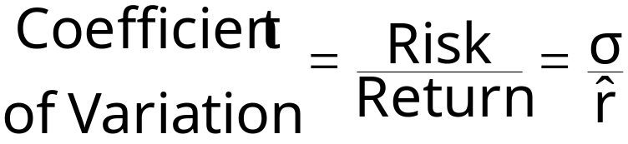
Risk Aversion—Coefficient of Variation
Measures the relationship between risk and return.
Allows for comparisons among various investments that have different risks and different returns.
A low CV is preferred to a high CV.

Slide 14
Risk Aversion—Coefficient of Variation
Economy Probability A
Boom 0.2 15.0%
Normal 0.5 11.0
Recession 0.3 -5.0
Payoffs
Economy Probability A Y
Boom 0.2 15.0% 59.0%
Normal 0.5 1.0 20.0
Recession 0.3 -5.0 -16.0
Expected return, 7.0% 17.0%
Standard deviation, σ 8.0% 26.2%
Coeff of variation, CV 1.14 1.54

Slide 15
Diversification
Diversification = risk reduction
By combining investments to form a portfolio, or collection of investments, diversification can be achieved.

Slide 16
Diversification—Portfolio Risk
When evaluated in a portfolio, the performance of a single investment is not very important, because some Investments will perform better than expected while others will perform worse than expected.
The performance of the portfolio as a whole is important, not the performance of any one investment.
Correlation among investments is important—determines the degree of diversification achieved.

Slide 17
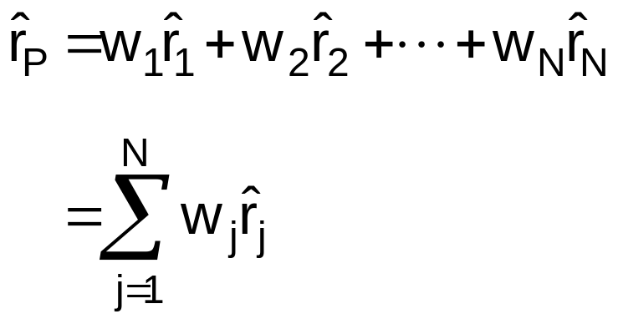
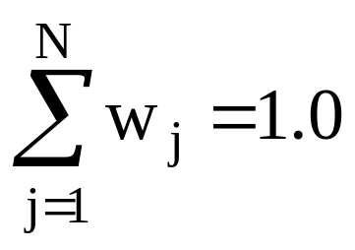
Portfolio Return
Expected return of a portfolio = weighted average of the expected returns of the individual investments in the portfolio:
w_{j} = proportion of funds invested in Asset j

Slide 18

Portfolio Return
Payoffs
Probability A B
Boom 0.2 15.0% -1.0%
Norm 0.5 11.0 3.0
Recess 0.3 -5.0 19.0
7.0% 7.0%
σ 8.0% 8.0%
CV 1.14 1.14
Portfolio w_{A}=0.6; w_{B}=0.4
15(0.6) + (-1)(0.4) = 8.6
11(0.6) + 3(0.4) = 7.8
(-5)(0.6) + 19(0.4) = 4.6
7%(0.6) + 7%(0.4) = 7.0%
1.6%
0.23

Slide 19
Portfolio Return
Probability M
Boom 0.2 8.6%
Norm 0.5 7.8
Recess 0.3 4.6
σ
CV
1.6%
0.23
7.0%

Slide 20
Portfolio Return
Payoffs
Probability A B
Boom 0.2 15.0% -1.0%
Norm 0.5 11.0 3.0
Recess 0.3 -5.0 19.0
7.0% 7.0%
σ 8.0% 8.0%
CV 1.14 1.14
Portfolio w_{A}=0.6; w_{B}=0.4
15(0.6) + (-1)(0.4) = 8.6
11(0.6) + 3(0.4) = 7.8
(-5)(0.6) + 19(0.4) = 4.6
7%(0.6) + 7%(0.4) = 7.0%
1.6%
0.23

Slide 21
Diversification—Portfolio Risk
The amount of the risk reduction depends on how the investments in a portfolio are related.
The smaller (greater) the positive (negative) relationship among the various investments included in a portfolio, the greater the diversification.
Diversification—investing in a combination of investments (stocks) generally reduces risk overall.

Slide 22
Total Risk—Deconstruction
Stand-alone risk
= σ = total risk
σ = firm-specific risk
+ market risk
= diversifiable risk
+ nondiversifiable risk
NOT relevant
Relevant risk

Slide 23
Risk—Relevant and Irrelevant
Relevant risk = risk that cannot be reduced
Relevant risk = systematic risk = market risk
“Irrelevant” risk = firm-specific, or unsystematic risk, because this portion of total risk can be reduced or eliminated through diversification
Investors should NOT be rewarded for taking “irrelevant” risk—that is, for not diversifying
Risk premiums are based on the amount of systematic (relevant) risk associated with an investment

Slide 24
Relevant Risk
Return
Risk Premium based on
systematic risk
r = r_{RF} + RP
r_{RF}
Risk-Free Return
0
Systematic risk

Slide 25
Relevant Risk
Market, or systematic, risk is measured by comparing the return on an investment with the return on the market in general, or an average stock.
The market is very well diversified, which means any movements should be the result of systematic risk only; i.e., firm-specific risk should not affect the entire market.
Beta coefficient, β—measures systematic risk, which is the relationship between an individual investment’s returns and the market’s returns (i.e., a benchmark).
β = 1.0 for the market.

Slide 26
Systematic Risk—Concept of Beta, β
Return on the
..
y = α + βx + e
Stock, r
j
.
.
.
.
.
.
.
.
β =
slope
.
.
.
.
.
.
.
.
.
.
.
.
.
.
.
.
.
.
.
.
.
Return on the
..
Market, r
.
M

Slide 27
Systematic Risk—Concept of Beta, β
Ford Motor Company
β = 1.2
NYSE Composite
09/2016 – 09/2021

Slide 28
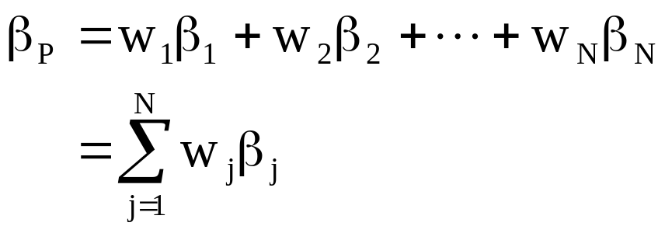
Portfolio Beta, β_{P}
A portfolio’s beta, β_{p} is a function of the betas of the individual investments in the portfolio
A portfolio beta is the weighted average of the betas associated with the individual investments contained in the portfolio
w_{j} = % of total funds invested in asset j
β_{j} = Asset j’s beta coefficient

Slide 29
Portfolio Beta, β_{P}—Example
Amount
Investment Invested Beta, β_{j}
Amount
Investment Invested Beta, β_{j} Weight, w_{j} β_{j} x w_{j}
Amount
Investment Invested
Amount
Investment Invested Beta, β_{j} Weight, w_{j}
Stock A $ 30,000
Stock B 20,000
Stock C 10,000
Stock D 40,000
100,000
Stock A $ 30,000 2.0
Stock B 20,000
Stock C 10,000
Stock D 40,000
100,000
Stock A $ 30,000 2.0
Stock B 20,000 1.5
Stock C 10,000
Stock D 40,000
100,000
Stock A $ 30,000 2.0
Stock B 20,000 1.5
Stock C 10,000 1.0
Stock D 40,000
100,000
Stock A $ 30,000 2.0
Stock B 20,000 1.5
Stock C 10,000 1.0
Stock D 40,000 0.5
100,000
Stock A $ 30,000 2.0 0.3
Stock B 20,000 1.5
Stock C 10,000 1.0
Stock D 40,000 0.5
100,000
Stock A $ 30,000 2.0 0.3
Stock B 20,000 1.5 0.2
Stock C 10,000 1.0 0.1
Stock D 40,000 0.5 0.4
100,000
Stock A $ 30,000 2.0 0.3
Stock B 20,000 1.5 0.2
Stock C 10,000 1.0 0.1
Stock D 40,000 0.5 0.4
100,000 1.0
Stock A $ 30,000 2.0 0.3 0.6
Stock B 20,000 1.5 0.2
Stock C 10,000 1.0 0.1
Stock D 40,000 0.5 0.4
100,000 1.0
Stock A $ 30,000 2.0 0.3 0.6
Stock B 20,000 1.5 0.2 0.3
Stock C 10,000 1.0 0.1 0.1
Stock D 40,000 0.5 0.4 0.2
100,000 1.0
Stock A $ 30,000 2.0 0.3 0.6
Stock B 20,000 1.5 0.2 0.3
Stock C 10,000 1.0 0.1 0.1
Stock D 40,000 0.5 0.4 0.2
100,000 1.0 β_{p}= 1.2

Slide 30
Relationship between Risk and Rates of Return
r = r_{RF} + Risk premium (Chapter 5)
Risk premium = RP = r – r_{RF}
Market risk premium = RP_{M} = r_{M} - r_{RF}
RP_{M} = return associated with the riskiness of a well-diversified portfolio, which is the market (used as a benchmark); it is the risk premium for an investment with “average” risk.
RP_{M} is based on how risk averse investors are on average.

Slide 31
Relationship between Risk and Rates of Return
Because an investment’s beta coefficient measures its systematic risk, we can use β to determine the risk premium for an investment.
β > 1.0 means the investment’s relevant risk is greater than average, which means it should earn a risk premium greater than average, and vice versa.
Investment risk premium = RP_{Invest} = RP_{M} x β_{Invest}
A more volatile investment—that is, an investment with a higher β—will earn a higher risk premium, thus a higher return, than a less volatile investment.

Slide 32
Relationship between Risk and Rates of Return
Return = Risk-free rate + Risk Premium
r_{Invest} = r_{RF} + RP_{Invest}
= r_{RF} + ( RP_{M} ) β_{Invest}
= r_{RF} + ( r_{M} – r_{RF} ) β_{Invest}
Capital Asset Pricing Model (CAPM)

Slide 33
Relationship between Risk and Rates of Return
Suppose the following information is known:
r_{RF} = 5.0%
r_{M} = 9%
β_{j} = 1.5
3.0
Return = Risk-free rate + Risk Premium
r_{Invest} = r_{RF} + ( r_{M} – r_{RF} ) β_{Invest}
= 5% + (9% - 5%)1.5
= r_{RF} + ( RP_{M} ) β_{Invest}
= 5% + (4%)1.5
= r_{RF} + RP_{Invest}
= 5% + 6%
3.0
3.0
17%
12.0
= 11%
Same for all investments
Differs based on relevant risk

Slide 34

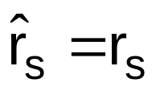
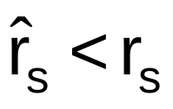
Rates of Return—Market Equilibrium
Stock prices are not constant due to changes in r_{RF}, RP_{M}, β_{s}, and so forth.
If the required rate of return, r_{s}, and the expected rate of return, , are not equal, then the price of the investment will change until .
If , investors who own the stock will sell it; other investors will not want to purchase it.

Slide 35
Chapter 8 Questions
What does it mean to take risk when investing?
How are risk and return of an investment measured?
How can investors reduce risk?
For what type of risk is an average investor rewarded?
  What is the difference between firm-specific risk and market risk?
  Which risk is relevant when determining a stock’s required rate of return? Why?
  Which risk is measured by a stock’s beta coefficient, β?
What actions do investors take when the return they require to purchase an investment is different from the return the investment is expected to produce?

