Slide 1
Capital Budgeting
Capital budgeting—decisions about investment in long-term (capital) assets.
  Long-term effect—capital, or long-term funds, raised by the firms are used to invest in assets that enable the firm to generate revenues several years into the future.
  Timing of a decision is important—decisions impact the firm for several years.

Slide 2
Capital Budgeting Basics—Project Classifications
Replacement decisions versus expansion decisions (Chapter 10)
  Replacement decision—intended to maintain existing levels of operations
  Expansion decision—a decision concerning whether the firm should expand operations
Independent projects versus mutually exclusive projects
  Independent project—accepting one independent project does not affect the acceptance of any other project
  Mutually exclusive projects—only one project can be purchased

Slide 3
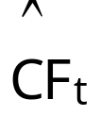
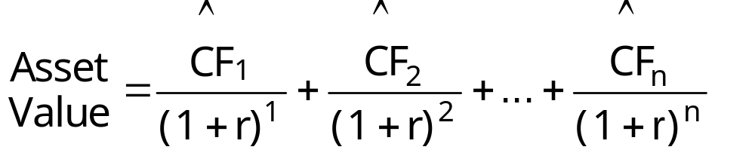

Capital Budgeting versus Basic Asset Valuation
Value of any asset = PV of the cash flows, , the asset is expected to generate during its life:
REMEMBER: PV is the amount you must invest at r to generate the same future cash flows for yourself.
Therefore, an asset is an acceptable investment if its computed value is greater than its cost (purchase price):
Acceptable if: PV of > Cost

Slide 4
Capital Budgeting Techniques
Net present value
Internal rate of return
Payback period

Slide 5

Capital Budgeting Techniques
Illustration
Year Cash Flow,
0 (7,000)
1 2,000
2 1,000
3 5,000
4 3,000
r = 15%

Slide 6
Capital Budgeting Illustration
Cash Flow Timeline
0
1
2
3
4
15%
(7,000.00)
2,000
1,000
5,000
3,000
1,739.13
1/(1.15)¹ x
Σ PV =
7,498.11
756.14
1/(1.15)² x
1/(1.15)³ x
3,287.58
1/(1.15)⁴ x
1,715.26
498.11
NPV = Investment cost + Σ PV of Future CFs

Slide 7

Capital Budgeting Illustration
Net Present Value (NPV)
NPV = present value of future cash flows net of the initial investment (a cash outflow)
∧
∧
∧
CF
1
CF
2
…
CF
n
NPV
=
CF
+
+
+
+
0
(1
+
r)
1
(1
+
r)
2
(1
+
r)
n
∧
n
CF
=
∑
t
(1
+
r)
t
t
=
0
NPV indicates by how much the firm’s value will change if the project/investment is purchased.
An investment is acceptable if NPV > 0

Slide 8
Capital Budgeting Illustration
Net Present Value (NPV)
$2,000
$1,000
$5,000
$3,000
NPV
=
−
$7,000
+
+
+
+
(1.15)
1
(1.15)
2
(1.15)
3
(1.15)
4
=
−
$7,000
+
$1,739.13
+
$756.14
+
$3,287.58
+
$1,715.26
=
$498.11
NPV = $498.11 > 0, so the project is acceptable
NPV = $498.11 means the current value of the firm should increase by nearly $500 if the firm purchases the investment.

Slide 9
Capital Budgeting Techniques—NPV
Advantages:
Cash flows rather than profits are analyzed
Recognizes the time value of money
Acceptance criterion is consistent with the goal of maximizing value
Disadvantage:
Detailed, accurate long-term forecasts are required to evaluate a project’s acceptance

Slide 10
Solving for NPV Using a Financial Calculator
Input the following into the cash flow register:
CF₀ = -7,000
CF₁ = 2,000
CF₂ = 1,000
CF₃ = 5,000
CF₄ = 3,000
Input I = 15
Compute NPV = 498.12
See examples/instructions on the course webpage–calculator help.

Slide 11
Capital Budgeting Techniques
Internal Rate of Return (IRR)
If NPV > 0, project’s return > r (required rate)
  Example:
  Initial investment = $7,000.00
  PV of future cash flows = $7,498.12
NPV = $498.12
r = 15%
IRR > 15%
IRR = project’s rate of return
IRR = the rate of return that causes the NPV of the project to equal zero, which occurs when the present value of the future cash flows equals the initial investment.
IRR = rate ALL companies that purchase the asset will earn on average; the same concept as YTM for bonds

Slide 12
Capital Budgeting Techniques—IRR
∧
∧
∧
CF
CF
…
CF
NPV
=
CF
+
1
+
2
+
+
n
=
0
0
(1
+
IRR)
1
(1
+
IRR)
2
(1
+
IRR)
n
∧
∧
∧
CF
CF
…
CF
CF
=
1
+
2
+
+
n
0
(1
+
IRR)
1
(1
+
IRR)
2
(1
+
IRR)
n
IRR represents the return the project is expected to generate during its life; IRR is equivalent to a bond’s YTM; i.e., IRR of a project = YTM for the project.
A project is acceptable if its IRR > r

Slide 13
Capital Budgeting Techniques—IRR
2,000
1,000
5,000
3,000
NPV
=
−
7,000
+
+
+
+
=
0
(1
+
IRR)
1
(1
+
IRR)
2
(1
+
IRR)
3
(1
+
IRR)
4
$2,000
$1,000
$5,000
$3,000
$7,000
=
+
+
+
(1
+
IRR)
1
(1
+
IRR)
2
(1
+
IRR)
3
(1
+
IRR)
4

Slide 14
Capital Budgeting Techniques—IRR
Cash Flow Timeline
0
1
2
3
4
IRR = ?
(7,000)
2,000
1,000
5,000
3,000
Σ of PVs = 7,000
0 = NPV

Slide 15
Solving for IRR
Using the Trial-and-Error Method
Plug in values for IRR until the left side and the right side of the following equation are equal.
$2,000
$1,000
$5,000
$3,000
$7,000
=
+
+
+
(1
+
IRR)
1
(1
+
2
+
3
+
4
IRR)
(1
IRR)
(1
IRR)
Rate of Return NPV
15% 498.12
16 327.46
17 162.72
18 3.62
19 (150.08)
} 18% < IRR < 19%

Slide 16
Solving for IRR
Using a Financial Calculator
Input the following into the cash flow register:
CF₀ = -7,000
CF₁ = 2,000
CF₂ = 1,000
CF₃ = 5,000
CF₄ = 3,000
Compute IRR = 18.02%

Slide 17
Capital Budgeting Techniques—IRR
Advantages:
Cash flows rather than profits are analyzed
Recognizes the time value of money
Acceptance criterion is consistent with the goal of maximizing value
Disadvantages:
Detailed, accurate long-term forecasts are required to evaluate a project’s acceptance
Difficult to solve for IRR without a financial calculator or spreadsheet

Slide 18
Capital Budgeting Techniques
Traditional Payback Period
Number of years it takes to recapture the initial investment.
Year Cash Flow Cumulative CF = ΣCF
0 $(7,000) $(7,000)
1 2,000 (5,000)
2 1,000 (4,000)
3 5,000 1,000
4 3,000 4,000
} 2 yrs < PB < 3 yrs

Slide 19
Capital Budgeting Techniques
Traditional Payback Period—PB
Year Cash Flow Cumulative CF
0 $(7,000) $(7,000)
1 2,000 (5,000)
2 1,000 (4,000)
3 5,000 1,000
4 3,000 4,000
} 2<Payback<3
Traditional
#
of
years
before
$
investment
remaining
Payback
=
full
recovery
of
+
to
be
recaptured
period
original
investment
$
cash
flow
in
year
of
payback
=
2
+
$4,000
$5,000
=
2.80
years

Slide 20
Capital Budgeting Techniques
Traditional Payback Period—PB
Accept the project if PB < some number of years established by the firm
PB = 2.8 years is acceptable if the firm has established a maximum payback of 4.0 years
PB = 2.8 years is not acceptable if the firm has established a maximum payback of 2.0 years

Slide 21
Capital Budgeting Techniques
Traditional Payback Period—PB
Advantages:
Simple
Cash flows are used
Provides an indication of the liquidity of a project
Disadvantages:
Does not consider time value of money concepts, thus PB is not consistent with goal of maximizing value
Cash flows beyond the payback period are ignored

Slide 22
Capital Budgeting Techniques
Discounted Payback Period—DPB
Payback period computed using the present values of the future cash flows.
Cumulative (Σ)
Year Cash Flow PV of CF @15% PV of CF
0 $(7,000) $(7,000.00) $(7,000.00)
1 2,000 1,739.13 (5,260.87)
2 1,000 756.14 (4,504.73)
3 5,000 3,287.58 (1,217.14)
4 3,000 1,715.26 498.12
} DPB= 3.71
NPV = 498.12
NPV
A project is acceptable if DPB < project’s life

Slide 23
Capital Budgeting Techniques
PB versus DPB
Payback period computed using the present values of the future cash flows.
Unadjusted
Year Cash Flow PV of CF @15%
=
0 $(7,000) $(7,000.00)
1 2,000 1,739.13
2 1,000 756.14
3 5,000 3,287.58 4 3,000 1,715.26
>
(PB = 2.80 years) < (DPB = 3.71 years)

Slide 24
Relationship of Capital Budgeting Techniques
All capital budgeting techniques that use time value of money concepts provide the same accept-reject decisions.
The traditional payback period, PB, is not based on time value of money concepts.

Slide 25
NPV versus IRR
When NPV > 0, a project is acceptable because the firm will increase its value, which means the firm earns a return greater than its required rate of return (r) if it invests in the project.
When IRR > r, a project is acceptable because the firm will earn a return greater than its required rate of return (r) if it invests in the project, which will increase the value of the firm.
When NPV > 0, IRR > r for a project—that is, if a project is acceptable using NPV, it is also acceptable using IRR. The firm’s value increases.

Slide 26
Accept/Reject Decisions Using
NPV, Discounted Payback, and IRR
Technique Evaluation Result Acceptable?
NPV NPV > 0
IRR IRR > r
Discounted PB DPB < project’s life
YES
YES
YES
NPV > 0
IRR > r
DPB < project’s life
All techniques that consider the time value of money MUST give the same accept-reject (good-bad) decision—that is, if a project is determined to be acceptable using NPV, then it must also be acceptable when IRR and DPB are used.

Slide 27
NPV Profile
A graph that shows the NPVs of a project at various required rates of return.
Rate of Return NPV
15% 498.12
16 327.46
17 162.72
18 3.62
19 (150.08)
20 (298.61)
21 (442.20)

Slide 28
NPV Profile
NPV
$5,000
$4,000
$3,000
$2,000
IRR = 18.02%
$1,000
NPV > 0
$0
r
NPV < 0
5%
10%
15%
20%
25%
($1,000)
($2,000)

Slide 29

Capital Budgeting Techniques
Illustrative Projects A & B
Cash Flow,
Year Project A
Project B
0 (7,000.00)
1 2,000.00
2 1,000.00
3 5,000.00
4 3,000.00
Trad PB = 2.80
NPV = 498.12
IRR = 18.02%
(8,000.00)
6,000.00
3,000.00
1,000.00
500.00
1.67
429.22
19.03%
r = 15%

Slide 30
NPV Profiles for Projects A & B
NPV
5000
Project A
4000
3000
Crossover = 16.15
2000
1000
Project B
IRR_{B} = 19.03
●
r
0
5%
10%
15%
20%
25%
-1000
IRR_{A} = 18.02
-2000

Slide 31
NPV Profiles for Projects A & B
NPV_{B}
429.22
318.71
210.94
105.82
3.26
(96.84)
(194.55)
Rate of Return NPV_{A}
15% 498.12
16 327.46
17 162.72
18 3.62
19 (150.08)
20 (298.61)
21 (442.20)
NPV_{B}
429.22
318.71
210.94
105.82
3.26
(96.84)
(194.55)
Rate of Return NPV_{A}
15% 498.12
16 327.46
17 162.72
18 3.62
19 (150.08)
20 (298.61)
21 (442.20)
Rate of Return
15%
16
17
18
19
20
21

Slide 32
NPV/IRR Ranking Conflicts
Asset A Asset B
Traditional PB 2.80 yrs 1.67 yrs
Discounted PB 3.71 yrs 2.78 yrs
NPV $498.12 $429.22
IRR 18.02% 19.03%
Asset A
Traditional PB 2.80 yrs
Discounted PB 3.71 yrs
NPV $498.12
IRR 18.02%
Which asset(s) should be purchased?
Independent:
Both assets, because both NPVs > 0
Mutually exclusive:
Asset A, because it has the higher NPV
Asset A adds more value ($498.12) to the firm than Asset B ($429.22).

Slide 33
NPV/IRR Ranking Conflicts
Ranking conflicts result from:
  Cash flow timing differences
  Size differences
  Unequal lives
Reinvestment rate assumptions:
  NPV—reinvest at the firm’s required rate of return
  IRR—reinvest at the project’s internal rate of return, IRR

Slide 34
Multiple IRRs
Conventional cash flow pattern—cash outflow(s) occurs at the beginning of the project’s life, followed by a series of cash inflows.
― + + + + + +
― ― ― + + + +
Unconventional cash flow pattern—cash outflow(s) occurs during the life of the project, after cash inflows have been generated.
― + + ― + + +
An IRR solution occurs when a cash flow pattern is interrupted; if a cash flow pattern is interrupted more than once, then more than one IRR solution exists.

Slide 35
Multiple IRRs—Example
Year Cash Flow
0 (15,000)
1 40,150
2 (13,210)
3 (16,495)
IRR₁ = 22.5%
IRR₂ = 92.0%

Slide 36
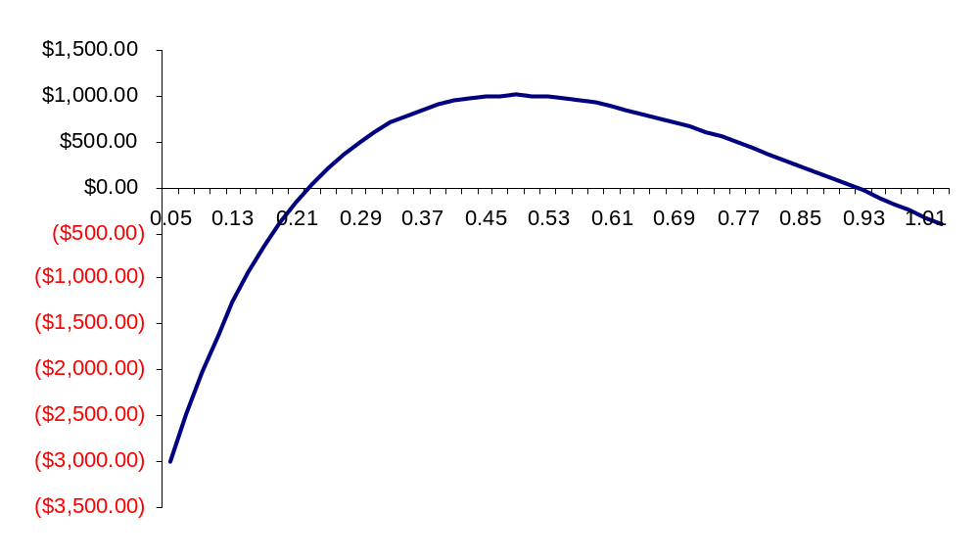
Multiple IRRs—Example
IRR₁ = 22.5%
IRR₂ = 92.0%
Notes:
36

Slide 37
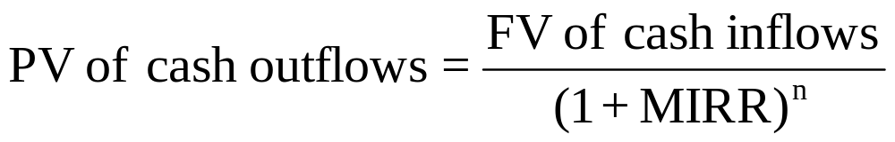
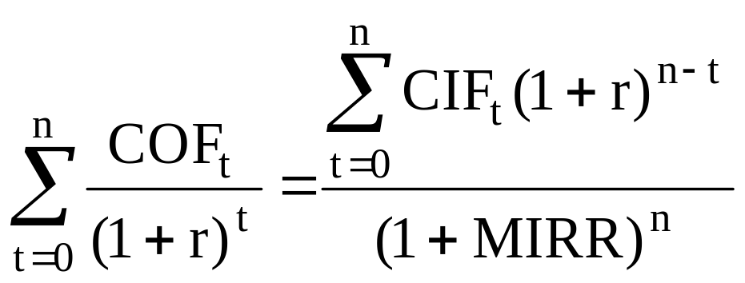
Modified Internal Rate of Return (MIRR)
Generally solves the ranking conflict and the multiple IRR problem

Slide 38
MIRR Example
Year Project A Project B
0 (7,000) (8,000)
1 2,000 6,000
2 1,000 3,000
3 5,000 1,000
4 3,000 500
DPB_{A} > DPB_{B}
NPV_{A} > NPV_{B}
IRR_{A} < IRR_{B}
MIRR_{A} > IRR_{B}
Project A—calculator solution: N = 4, PV = -7,000, PMT = 0, FV = 13,114.25; I/Y = 16.99 = MIRR_{A}
Project A—calculator solution: N = 4, PV = -7,000, PMT = 0, FV = 13,114.25; I/Y = 16.99 = MIRR_{A}
Project B—calculator solution: N = 4, PV = -8,000, PMT = 0, FV = 14,742.75; I/Y = 16.51 = MIRR_{B}
Notes:
38

Slide 39
Capital Budgeting in Practice
Large firms use all the capital budgeting techniques discussed earlier.
Shift to more technical techniques as electronics/technologies have improved.
About 85 percent use NPV; 77 percent also use IRR

Slide 40
Chapter 9 Questions
How do firms make decisions about whether to invest in costly, long-lived assets? What techniques are used?
How are different capital budgeting techniques related?
How does a firm make a choice between two acceptable investments when only one can be purchased?
Which capital budgeting methods do firms actually use?

Slide 41
Chapter 9 Supplemental Questions
Would changes in a firm’s required rate of return ever cause a change in the IRR ranking of two projects? Explain.
A firm’s required rate of return is not included in the computation of IRR.
The required rate of return is used to make a decision; i.e., a project is acceptable if IRR > r.

Slide 42
Chapter 9 Supplemental Questions
After evaluating a capital budgeting project, Susan discovered that the project’s NPV = 0. What does this information tell us about the project’s IRR and discounted payback (DPB)? Can anything be concluded about the project’s traditional payback period (PB)?
The project is neither acceptable nor unacceptable.
IRR = r
DPB = project’s life
Traditional PB = ?

Slide 43
Chapter 9 Supplemental Questions
“If a firm has no mutually exclusive projects, only independent ones, and it also has both a constant required rate of return and projects with conventional cash flow patterns, then the NPV and IRR methods will always lead to identical capital budgeting decisions.” Discuss this statement. What does it imply about using the IRR method in lieu of the NPV method? If the projects are mutually exclusive, would your answer be the same?
The statement is correct.
All techniques that include time value of money provide the same accept-reject conclusions.
If the projects are mutually exclusive, statement is not correct; NPV should be used to determine which project to purchase.

Slide 44
Chapter 9 Supplemental Questions
“Two companies examined the same capital budgeting project, which has an internal rate of return equal to 19 percent. One firm accepted the project, but the other firm rejected it. One of the firms must have made an incorrect decision.” Discuss the validity of this statement.
The statement is incorrect.
The firm that accepted the project must have a required rate of return that is less than 19 percent.
The firm that rejected the project must have a required rate of return that is greater than 19 percent.

