Slide 1
Working Capital Management
Management of ST assets and ST liabilities.
Net Working Capital (NWC)
  NWC = Current assets – Current liabilities
  NWC = Amount of current assets financed by long-term liabilities
Working Capital Policy
  Target levels for each current asset account
  How current assets will be financed
Working capital only includes current liabilities that are specifically used to finance current assets.

Slide 2
The Cash Conversion Cycle (CCC)
CCC = length of time from when the payment is made for purchases of materials used to manufacture a product until when the collection for the sale of the finished product is made.
CCC = (ICP + DSO) – DPO
  ICP = Inventory conversion period
  DSO = Receivables collection period
  = Days Sales Outstanding
  DPO = Payables deferral period

Slide 3
The Cash Conversion Cycle (CCC)
Inventory Conversion Period (ICP)
  Length of time it takes to convert materials into finished goods and then to sell those goods.
  The amount of time the product remains in inventory in various stages of completion.
Receivables Collection Period (DSO)
  Average length of time required to convert the firm’s receivables into cash; also called days sales outstanding (DSO)
Payables Deferral Period (DPO)
  Average length of time between the purchase of raw materials and labor and the payment of cash for them.

Slide 4
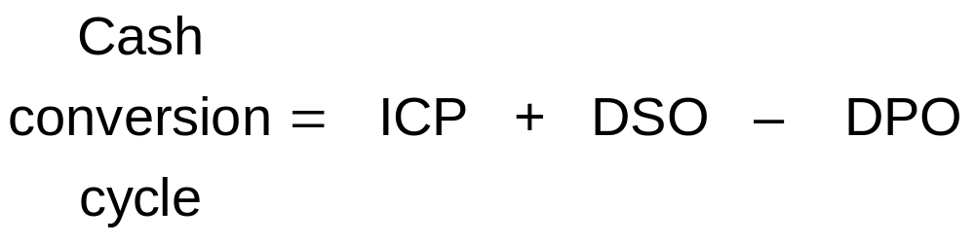
The Cash Conversion Cycle (CCC)
CCC = Average length of time a dollar is tied up (invested) in current assets.

Slide 5
The CCC for Unilate Textiles
Inventory Conversion
Period (79.0 days)
Receivables Collection
Period (43.2 days)
Payables
Deferral
Period
(8.8 days)
Cash Conversion Cycle
(79.0 days + 43.2 days – 8.8 days = 113.4 days)
Purchase Raw
Materials—Increase
Accounts Payable
Pay for Raw Materials
Sell Finished Goods—Increase Accounts Receivable
Collect Accounts Receivable
(CASH OUT)
(CASH IN)

Slide 6
Current Asset Financing Policies
How should current assets be financed?
Permanent current assets versus temporary current assets:
  Permanent CA—level that remains stable no matter seasonal or economic conditions (some minimum level of CA).
  Temporary CA—level that fluctuates with seasonal and economic conditions.

Slide 7
Alternative Current Asset Financing Policies
Maturity Matching Approach
  Match maturities of assets and liabilities.
  Moderate approach; some CA maturities are uncertain.
Conservative Approach
  Use permanent (long-term) capital to finance all permanent assets and some seasonal, temporary needs; use spontaneous, ST debt to finance the rest.
  Least risky approach; “store liquidity” during off season.
Aggressive Approach
  Finance all temporary CA with short-term, spontaneous debt, and finance all fixed assets and some permanent current assets with long-term, non-spontaneous funds.
  Riskiest approach; most profitable.

Slide 8
Alternative CA Financing Policies
Maturity Matching Approach
Dollars
Short-Term Nonspontaneous Debt Financing
Temporary Current Assets
Permanent Level of Current Assets
Long-Term Debt and Equity plus Spontaneous Current Liabilities
Total
Permanent Assets
Fixed Assets
1 2 3 4 5 6 7 8
Time

Slide 9
Alternative CA Financing Policies
Conservative Approach
Dollars
Short-Term Nonspontaneous Debt Financing
Marketable Securities
Temporary Current Assets
Permanent Level of Current Assets
Long-Term Debt and Equity plus Spontaneous Current Liabilities
Total
Permanent Assets
Fixed Assets
1 2 3 4 5 6 7 8
Time

Slide 10
Alternative CA Financing Policies
Aggressive (Somewhat) Approach
Dollars
Temporary
Current Assets
Short-Term Nonspontaneous Debt Financing
Temporary Current Assets
Permanent Level of Current Assets
Long-Term Debt and Equity plus Spontaneous Current Liabilities
Total
Permanent Assets
Fixed Assets
1 2 3 4 5 6 7 8
Time

Slide 11
Using Short-Term Financing
Maturity—short-term debt generally is defined as a liability originally scheduled for repayment within one year.
Speed—a short-term loan can be obtained much faster than long-term credit.
Cost—short-term debt generally is less expensive (interest rate is lower) than long-term debt.
Risk—short-term debt is considered riskier than long-term debt.

Slide 12
Sources of Short-Term Financing
Accruals—recurring short-term liabilities, such as wages and taxes, that increase spontaneously with operations.
Accounts Payable (Trade Credit)—credit created when one firm buys on credit from another firm.

Slide 13
Sources of Short-Term Financing
Short-Term Bank Loans
  Maturity typically 90 days or less
  Promissory note—specifies terms and conditions
  Compensating Balance (CB) of 10 to 20 percent of loan
  Line of credit (LOC)
    Specified maximum amount of funds available
    Revolving LOC—funds are committed
    Commitment fee—fee charged on the unused balance of a revolving credit agreement

Slide 14
Sources of Short-Term Financing
Commercial Paper
  Unsecured short-term promissory notes (IOUs) issued by large, financially sound firms
  Discounted financial instrument
  Maturity is 270 days or less

Slide 15
Sources of Short-Term Financing
Secured Loans—short-term assets used as collateral
  Accounts receivable financing
    Pledging receivables—used as collateral for loans.
    Factoring receivables—sold to a factor
  Inventory financing:
    Blanket lien—lien against all inventory
    Trust receipt—inventory held in trust for lender; items can be easily identified
    Warehouse receipt—inventory used as collateral is physically separated from borrower’s other inventory

Slide 16
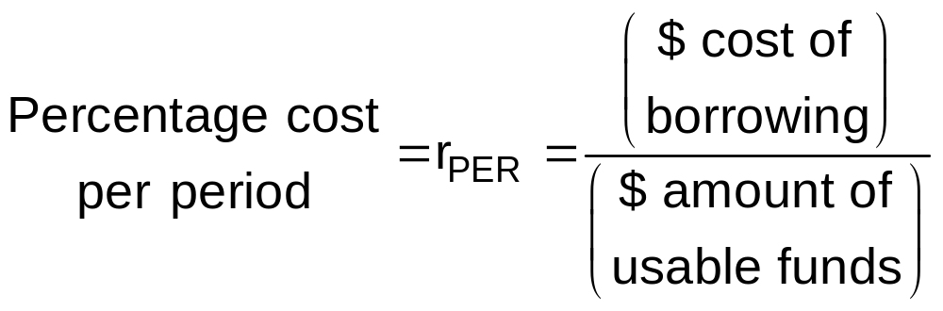
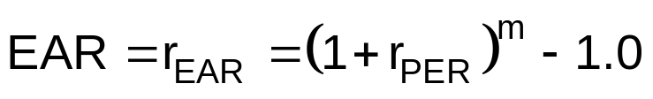

Computing the Cost of Short-term Credit
Compute the cost/interest rate per period, r_{PER}
2. Use r_{PER} to compute the APR and EAR
* m = the number of borrowing periods in one year

Slide 17
Computing the Cost of Short-Term Credit
Trade Credit
Suppose a firm buys on credit from its supplier with terms of 3/15 net 45.
If the firm purchases products with an invoice price of $100, its effective price is $97 because it receives a $3 discount for paying on Day 15 of the billing cycle.
If the firm pays on Day 45, effectively, it would pay $3 interest on a 30-day loan in the amount of $97.
  In this situation, the one-month interest rate is r_{PER} = $3/$97 = 3.09%

Slide 18
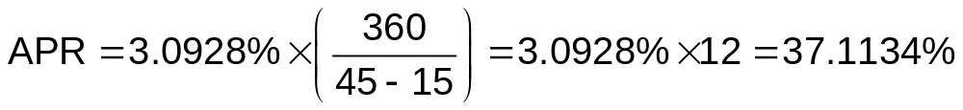
Computing the Cost of Short-Term Credit
Trade Credit
Credit terms: 3/15 net 45.

Slide 19
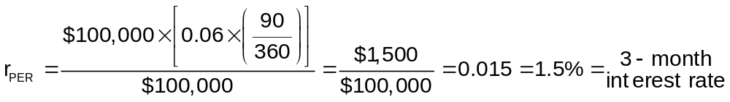
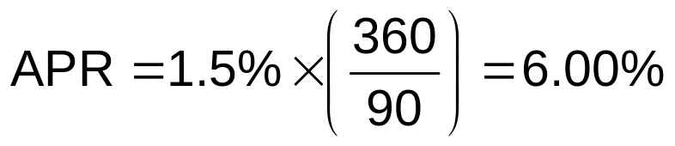
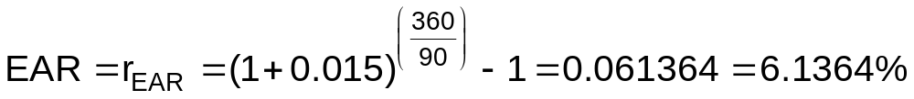
Computing the Cost of Short-term Credit
Bank Loan—Simple Interest
Suppose a firm borrows $100,000 at 6 percent for three (3) months (90 days).
Simple interest loan—both principal and interest are paid at maturity

Slide 20
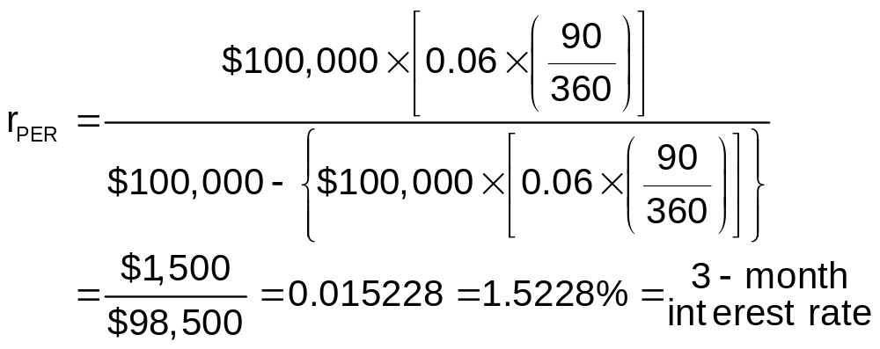
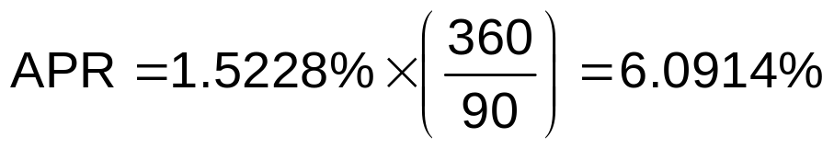
Computing the Cost of Short-term Credit
Bank Loan—Discount Interest
Suppose a firm borrows $100,000 at 6 percent for three (3) months (90 days).
Discount interest loan—interest is paid “up front”

Slide 21

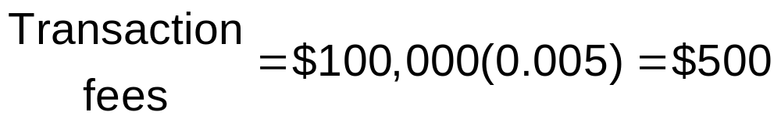
Computing the Cost of Short-term Credit
Commercial Paper
Suppose a firm issues 3-month commercial paper with a $100,000 face value and a 6 percent interest. Transactions fees are 0.5 percent of the issue amount.
Discount instrument

Slide 22
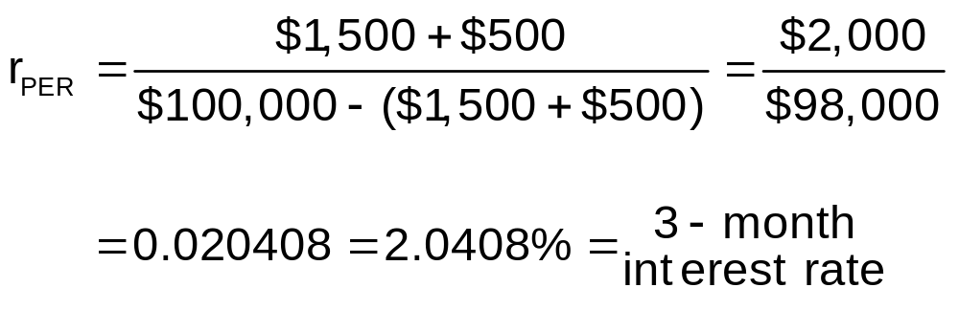
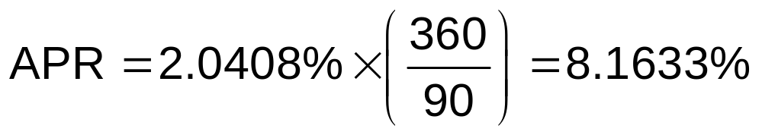
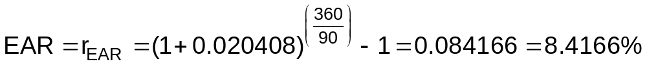
Computing the Cost of Short-term Credit
Commercial Paper
Discount = $1,500
Transaction fees = $500

Slide 23
Principal Amount versus Required Amount
Suppose a firm needs $100,000 to support operations. The firm plans to raise the funds by borrowing from the bank. The loan would be for three months, its interest rate would be 6 percent, and a 20 percent compensating balance would be required. The firm has no money in the bank.
To use $100,000, the firm must borrow more than $100,000, because some of the loan must be taken out of the principal amount of the loan to satisfy the compensating balance.

Slide 24
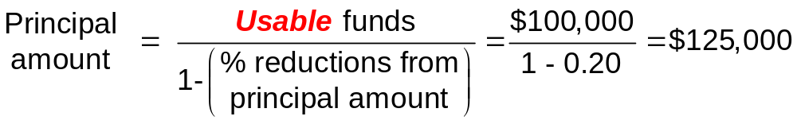
Principal Amount versus Required Amount
Firm needs $100,000; interest is 6 percent; compensating balance requirement is 20 percent of the amount borrowed.
If the firm borrows $125,000, the compensating balance requirement is $25,000 = $125,000(0.2)
The amount of funds the firms will be able to use is $100,000 = $125,000 – $25,000

Slide 25
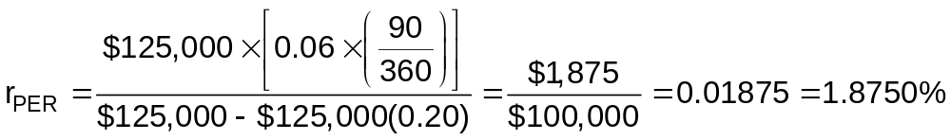
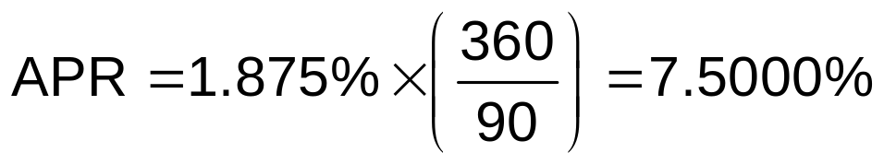
Principal Amount versus Required Amount
Firm issues $125,000; interest is 6 percent; compensating balance requirement is 20 percent of the amount borrowed.

Slide 26
Multinational Working Capital Management
Same techniques are used to manage working capital in multinational firms as in purely domestic firms
  More complex due to language differences, political situations, and so forth
Working capital policies—U.S. firms compared to European Firms
  Average cash conversion cycle of European firms is more than twice that of U.S. firms.
  U.S. firms follow more conservative working capital policies than European firms do.

Slide 27
Learning Outcomes
Chapter 14 Questions
1. What is working capital management?
2. What is the cash conversion cycle and how it can be used to better manage working capital activities?
What policies might a firm might follow when financing it current assets?
What are the primary characteristics of short-term credit? What are some of the different sources of ST credit?
Discuss and compute the cost (both APR and EAR) of short-term credit.
6. How does working capital management differ in multinational firms compared to domestic firms.

