Slide 1
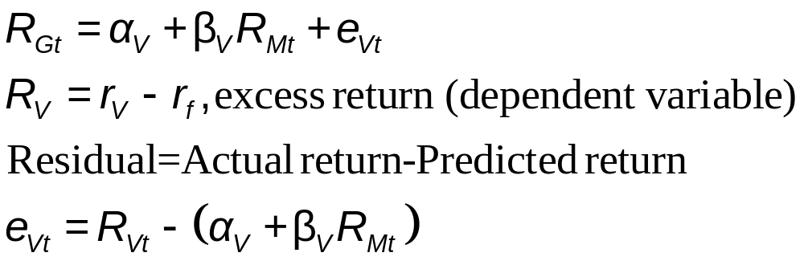
7.2 CAPM and Index Models
Estimating Index Model
Security Characteristic Line (SCL)
Plot of security’s expected excess return over risk-free rate as function of excess return on market

Slide 2
Computing Beta
Collecting Data
Date | 90-Day T-bill |  |  | S&P 500 Index |  |  |  | Valvoline (VVV)
 | Annual rate | Monthly rate |  | Closing price | Monthly Return | Excess Return |  | Closing price | Monthly Return | Excess Return
12/1/2018 | 2.37% | 0.20% |  | 2506.85 |  |  |  | 19.35
1/1/2019 | 2.37% | 0.20% |  | 2704.10 | 7.87% | 7.67% |  | 22.11 | 14.26% | 14.07%
2/1/2019 | 2.39% | 0.20% |  | 2784.49 | 2.97% | 2.77% |  | 18.79 | -15.02% | -15.21%
3/1/2019 | 2.40% | 0.20% |  | 2834.40 | 1.79% | 1.59% |  | 18.56 | -1.22% | -1.42%
4/1/2019 | 2.38% | 0.20% |  | 2945.83 | 3.93% | 3.73% |  | 18.50 | -0.32% | -0.52%
5/1/2019 | 2.35% | 0.20% |  | 2752.06 | -6.58% | -6.77% |  | 17.45 | -5.68% | -5.87%
6/1/2019 | 2.175 | 0.18% |  | 2941.76 | 6.89% | 6.71% |  | 19.53 | 11.92% | 11.74%
7/1/2019 | 2.10% | 0.18% |  | 2980.38 | 1.31% | 1.14% |  | 20.19 | 3.38% | 3.20%
8/1/2019 | 1.95% | 0.16% |  | 2926.46 | -1.81% | -1.97% |  | 22.60 | 11.94% | 11.77%
9/1/2019 | 1.88% | 0.16% |  | 2966.60 | 1.37% | 1.21% |  | 21.82 | -3.45% | -3.61%

Slide 3
Monthly Return Statistics Oct 2016 – Sept 2019
Statistic | 90-Day T-Bills (%) | S&P 500 (%) | Valvoline (%)
Average rate of return | 0.13 | 0.936 | 0.044
Average excess return | - | 0.807 | -0.085
Standard deviation* | 0.06 | 3.532 | 7.139
Geometric average | 0.13 | 0.875 | -0.205
* The rate on T-bills is known in advance, so SD does not reflect risk.

Slide 4
Monthly Returns
Valvoline
S&P 500
T-bills

Slide 5
Scatter Diagram of Valvoline Excess Returns and
S&P 500 Excess Returns 2016 - 2019
r_{Valvoline}
8/2019
Characteristic Line
(Market Risk Relationship)
r_{S&P 500}
Firm-specific risk
2/2019

Slide 6
Scatter Graph of
Valvoline Returns and S&P 500 Returns 2016 - 2019
Most points are not on the line.
  Unsystematic risk
There is a good amount of scatter.
  Suggests the market does not explain all the variation in the stock’s return.
  In a regression analysis, r² ≠ 1.0
When running a regression which is the dependent variable and which is the independent variable?
  Dependent variable is the one you wish to predict based on knowledge of the independent variable.

Slide 7
Regression Analysis:
Valvoline Returns and S&P 500 Returns 2016 - 2019
SUMMARY OUTPUT
Regression Statistics
Multiple R | 0.442146
R Square | 0.195493
Adjusted R Square | 0.171831
Standard Error | 0.064979
Observations | 36
Using CORREL in Excel:
Correlation = 0.442146
ANOVA
 | df | SS | MS | F | Significance F
Regression | 1 | 0.034884 | 0.034884 | 8.261928 | 0.006934
Residual | 34 | 0.143557 | 0.004222
Total | 35 | 0.178441
 | Coefficients | Standard Error | t Stat | P-value | Lower 95% | Upper 95% | Lower 95.0% | Upper 95.0%
Intercept | -0.00806 | 0.011117 | -0.72512 | 0.473338 | -0.03065 | 0.014531 | -0.03065 | 0.014531
X Variable | 0.893848 | 0.310972 | 2.874357 | 0.006934 | 0.261875 | 1.525822 | 0.261875 | 1.525822

