Slide 1

Essentials of Investments
Eleventh Edition
Bodie, Kane, and Marcus
Chapter 1
Investments: Background and Issues
© 2019 McGraw-Hill Education. All rights reserved. Authorized only for instructor use in the classroom. No reproduction or further distribution permitted without the prior written consent of McGraw-Hill Education.

Slide 2
1.1 Real versus Financial Assets
Nature of Investment: Reduce current consumption for greater future consumption
Financial Assets:
Claims on Real Assets or Real Asset Income
Property, plants and equipment, human capital, etc.
Productive Capacity
Real Assets

Slide 3
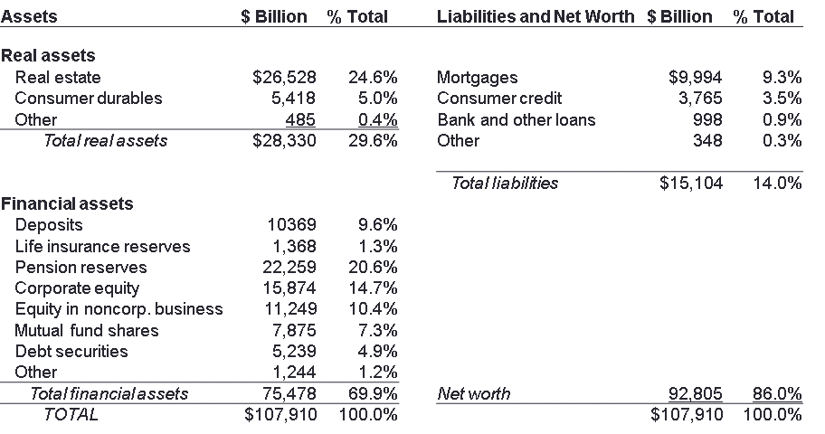
Table 1.1 Balance Sheet, U.S. Households, 2017
Note: Column sums may differ from total because of rounding error.
SOURCE: Flow of Funds Accounts of the United States, Board of Governors of the Federal Reserve System, March 2017.

Slide 4
1.1 Financial Assets = Financial Liabilities
Financial Assets and Liabilities must balance.
Financial Assets (Owner of the claim)
Financial Liability (Issues of the Claim)
Aggregated balance sheets → only real assets remain
Domestic Net Worth = Sum of real assets

Slide 5
Table 1.2 Domestic Net Worth, 2017
Assets | $ Billion
Commercial real estate | $18,335
Residential real estate | 33,061
Equipment and IP | 8,449
Inventories | 2,523
Consumer durables | 5,418
TOTAL | $67,786
Note: Column sums may differ from total because of rounding error.
SOURCE: Flow of Funds Accounts of the United States, Board of Governors of the Federal Reserve System, March 2017.

Slide 6
1.2 Financial Assets
Asset Classes
Common Stock
  Ownership stake in entity, residual cash flow
Fixed Income Securities
  Money market instruments, Bonds, Preferred stock
Derivative Securities
  Contract, value derived from underlying market condition

Slide 7
1.3 Financial Markets and the Economy (1 of 7)
Informational Role of Financial Markets
Capital flow to companies with best prospects
Market Price = Fair Value?
Do markets allocate capital to best uses?
Other mechanisms to allocate capital?
Advantages/disadvantages of other systems?

Slide 8
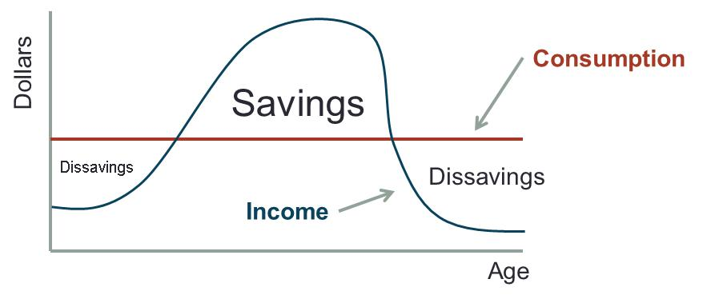
1.3 Financial Markets and the Economy (2 of 7)
Consumption Timing
Use securities to store wealth
Transfer consumption to the future
Jump to long description

Slide 9
1.3 Financial Markets and the Economy (3 of 7)
Risk Allocation
Investors select desired risk level
  Bond vs. stock
  Bank CD vs. company bond
Is there always a Risk/Expected Return trade-off?

Slide 10
1.3 Financial Markets and the Economy (4 of 7)
Separation of Ownership and Management
Separation → Agency Problems
Mitigating Factors
Performance-based compensation
Boards of directors may fire managers
Threat of takeovers
Notes:
Think: Notice that mitigating factors align interests of managers with interest of owners.

Slide 11
1.3 Financial Markets and the Economy (5 of 7)
Corporate Governance and Corporate Ethics
Businesses and markets require trust
  No trust → additional costly laws and regulations
Governance and ethics failures cost the economy
  Erodes public support and confidence

Slide 12
1.3 Financial Markets and the Economy (6 of 7)
Corporate Governance and Corporate Ethics
Accounting scandals
  Enron, WorldCom, Rite-Aid, HealthSouth, Global Crossing, Qwest
Misleading research reports
  Citicorp, Merrill Lynch, others
Auditors: Watchdogs or consultants?
  Arthur Andersen and Enron

Slide 13
1.3 Financial Markets and the Economy (7 of 7)
Corporate Governance and Corporate Ethics
Sarbanes-Oxley Act:
  Requires more independent directors on
  CFO to personally verifies the financial statements
  Oversight board for the accounting/audit industry
  Charged board with maintaining a culture of high ethical standards

Slide 14
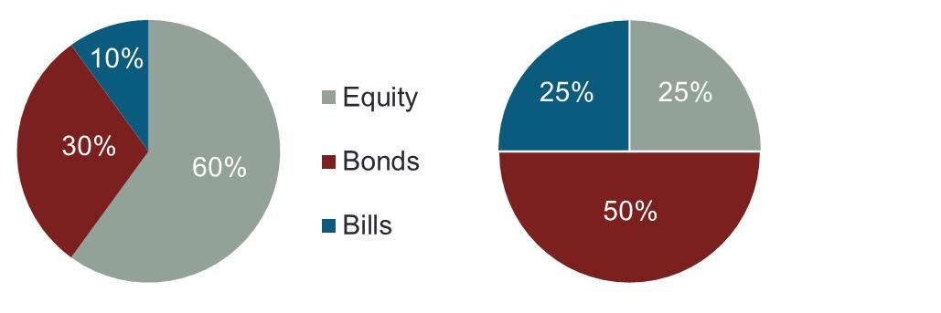
1.4 The Investment Process: Asset Allocation
Asset Allocation
Primary determinant of a portfolio's return
Percentage of fund in asset classes, for example:
Top Down Investment Strategies starts with Asset Allocation
Notes:
Think: What type of investors would likely hold the portfolio on the left? On the right?

Slide 15
1.4 The Investment Process: Security Selection
Security Selection
Choice of particular securities within asset class
Security Analysis
  Analysis of the value of securities.
Bottom Up Investment Strategies starts with Security Selection

Slide 16
1.5 Markets Are Competitive (1 of 4)
Risk-Return Trade-Off
Assets with higher expected returns have higher risk
 | Average Annual Return | Minimum (1931) | Maximum (1933)
Stocks | About 12% | −46% | 55%
Stock portfolios lose money an average of 25%
Bonds
  Lower average rates of return (under 6%)
  Not lost more than 13% of value in any one year

Slide 17
1.5 Markets Are Competitive (2 of 4)
Risk-Return Trade-Off
How do we measure risk?
How does diversification affect risk?

Slide 18
1.5 Markets Are Competitive (3 of 4)
In Efficient Markets Securities should
be neither underpriced nor overpriced on average
reflect all information available to investors
  Your Belief in Market Efficiency
  Choice of Investment-Management Style

Slide 19
1.5 Markets Are Competitive (4 of 4)
 | Active Management | Passive Management
Markets are… | Inefficient | Efficient
Security Selection: | Actively Seek Undervalued Stocks | No Attempt to Find Undervalued Securities
Asset Allocation | Market Timing | No Attempt to Time Market

Slide 20
1.6 The Players (1 of 6)
Business Firms (net borrowers)
Households (net savers)
Governments (can be both borrowers and savers)
Financial Intermediaries (connectors of borrowers and lenders)
Commercial banks
Investment companies
Insurance companies
Pension funds
Hedge funds

Slide 21
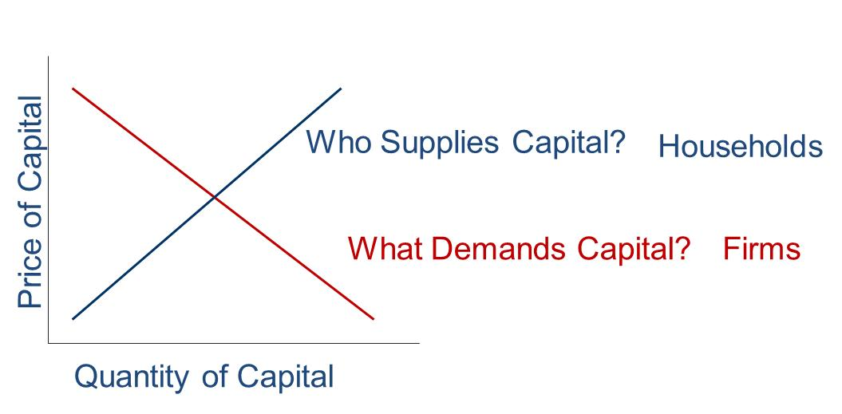
1.6 The Players (2 of 6)
Roll of Government?
Roll of Intermediaries?
Jump to long description
Notes:
Think: Is the relationship between price and quantity of capital any different than any other supply/demand curve?

Slide 22
1.6 The Players (3 of 6)
Investment Bankers
Specialize in primary market transactions
Primary market
  Newly issued securities offered to public
  Investment banker “underwrites” issue
Secondary market
  Preexisting securities traded among investors

Slide 23
1.6 The Players (4 of 6)
Investment Bankers
Separate from commercial banks' functions by law (1933-1999)
Post-1999: Large commercial banks increased investment-banking activities, pressuring investment banks’ profit margins
September 2008: Mortgage-market collapse
  Major investment banks bankrupt; purchased/reorganized

Slide 24
1.6 The Players (5 of 6)
Investment Bankers
Investment banks may become commercial banks
  Obtain deposit funding
  Have access to government assistance
Major banks now under stricter regulations

Slide 25
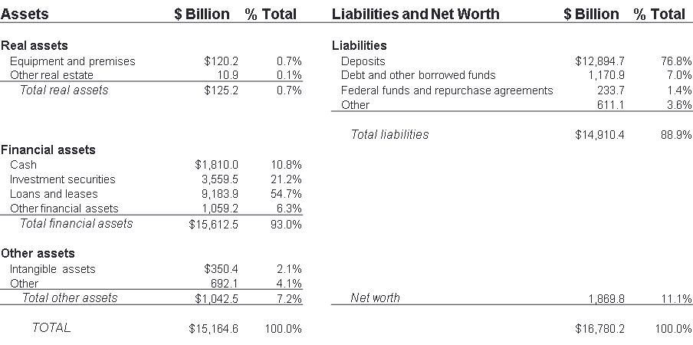
Table 1.3 Balance Sheet of Commercial Banks, 2017
Note: Column sums may differ from total because of rounding error.
SOURCE: Federal Deposit Insurance Corporation, www.fdic.gov, March 2017.

Slide 26
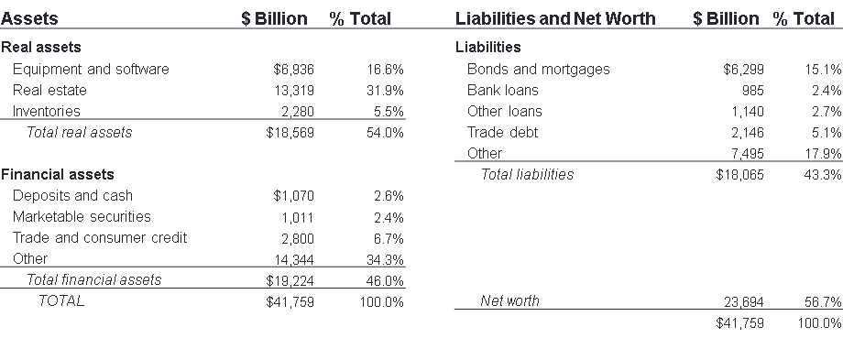
Table 1.4 Balance Sheet of Nonfinancial U.S. Business, 2017
Note: Column sums may differ from total because of rounding error.
SOURCE: Flow of Funds Accounts of the United States, Board of Governors of the Federal Reserve System, March, 2017.

Slide 27
1.6 The Players (6 of 6)
Venture Capital and Private Equity
Venture capital
  Equity Investment to finance new firm
Private equity
  Investments in privately-held companies

Slide 28
1.7 The Financial Crisis of 2008 (1 of 6)
Changes in Housing Finance
Old Way
Local thrift institution made mortgage loans to homeowners
Thrift’s possessed a portfolio of long-term mortgage loans
Thrift’s main liability: Deposits
“Originate to hold”
New Way
Securitization: Fannie Mae and Freddie Mac bought mortgage loans and bundled them into large pools
Mortgage-backed securities are tradable claims against the underlying mortgage pool
“Originate to distribute”

Slide 29
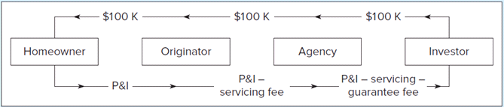
1.7 Changes in Housing Finance (1 of 2)
Securitization:
FIGURE 1.4
Cash flows in a mortgage pass-through security
Jump to long description
Notes:
1. Securitization: Buying mortgage loans from originators and bundling them into mortgage-backed securities
2. Replacement of low-risk conforming mortgages with nonconforming “subprime” loans
3. Trend toward low-documentation and then no-documentation loans and rising allowed leverage on home loans (loan-to-value ratio)
4. Low adjustable-rate mortgages (ARMs) that “maxed out” borrowers' paying capacity at low rates

Slide 30
1.7 Changes in Housing Finance (2 of 2)
Inclusion of nonconforming “subprime” loans
Low/No-documentation loans
Rising loan-to-value ratio
Adjustable-Rate Mortgages
Notes:
1. Securitization: Buying mortgage loans from originators and bundling them into mortgage-backed securities
2. Replacement of low-risk conforming mortgages with nonconforming “subprime” loans
3. Trend toward low-documentation and then no-documentation loans and rising allowed leverage on home loans (loan-to-value ratio)
4. Low adjustable-rate mortgages (ARMs) that “maxed out” borrowers' paying capacity at low rates

Slide 31
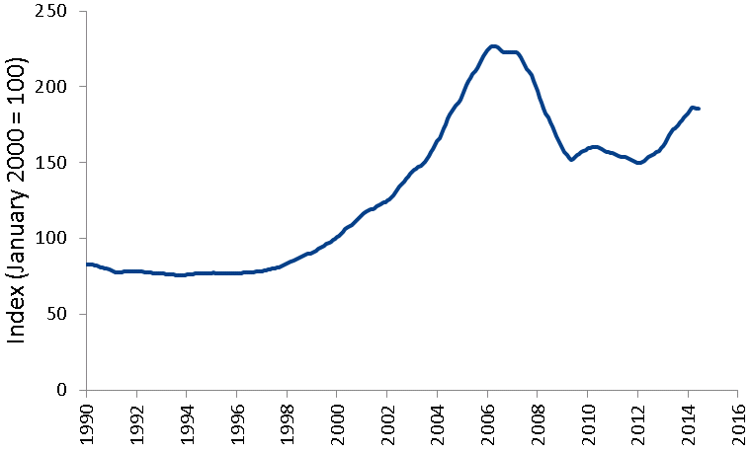
Figure 1.3 Case-Shiller Index of U.S. Housing Prices

Slide 32
1.7 The Financial Crisis of 2008 (2 of 6)
Mortgage Derivatives
CDOs: Consolidated default risk of loans onto one class of investor, divided payment into tranches
Ratings agencies paid by issuers; pressured to give high ratings

Slide 33
1.7 The Financial Crisis of 2008 (3 of 6)
Credit Default Swaps
Insurance contract against the default of borrowers
Issuers ramped up risk to unsupportable levels
AIG sold $400 billion in CDS contracts

Slide 34
1.7 The Financial Crisis of 2008 (4 of 6)
Systemic Risk
Risk of breakdown in financial system — spillover effects from one market into others
Banks highly leveraged; assets less liquid
Formal exchange trading replaced by over-the-counter markets — no margin for insolvency protection

Slide 35
1.7 The Financial Crisis of 2008 (5 of 6)
The Shoe Drops
September 7: Fannie Mae and Freddie Mac put into conservatorship
Lehman Brothers and Merrill Lynch verged on bankruptcy
September 17: Government lends $85 billion to AIG
Money market panic freezes short-term financing market

Slide 36
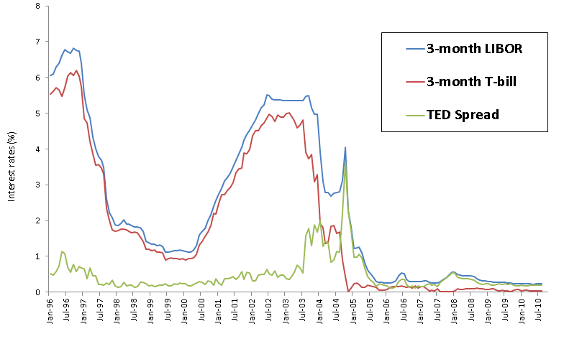
Figure 1.1 LIBOR, T-Bill Rates and the TED Spread
Jump to long description

Slide 37
1.7 The Financial Crisis of 2008 (6 of 6)
Dodd-Frank Reform Act
Stricter rules for bank capital, liquidity, risk management
Mandated increased transparency
Clarified regulatory system
Volcker Rule

Slide 38
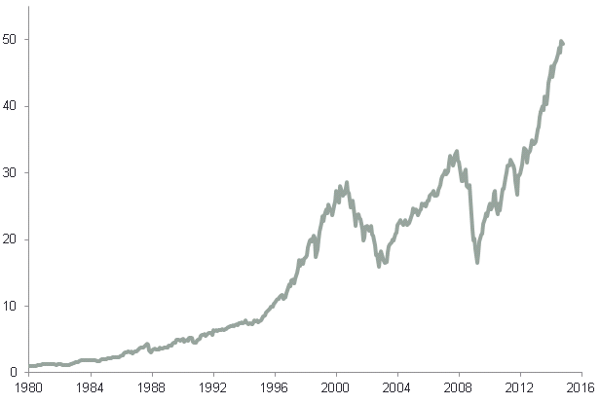
Figure 1.2 Cumulative Returns
Cumulative returns on a $1 investment in the S&P 500 index
Jump to long description

Slide 39
1.8 Text Outline
Part One: Introduction to Financial Markets, Securities, and Trading Methods
Part Two: Modern Portfolio Theory
Part Three: Debt Securities
Part Four: Equity Security Analysis
Part Five: Derivative Markets
Part Six: Active Investment Management Strategies

Slide 40
Appendix of Image Long Descriptions

Slide 41
1.3 Financial Markets and the Economy (2 of 7) Long Description
A straight horizontal line representing consumption extends midway point on the graph. A bell-shaped curve for income is shown and where it starts and ends, below the consumption line, is labeled Dissavings. Savings is above the consumption line.
Jump to image

Slide 42
1.6 The Players (2 of 6) Long Description
Upward sloping diagonal line represents who supplies capital, or households. Downward sloping diagonal line represents what demands capital, or firms.
Jump to image

Slide 43
Figure 1.1 LIBOR, T-Bill Rates and the TED Spread Long Description
Percent is on the vertical axis, and the years 2000 to 2018, marked for January of each year, are on the horizontal axis. TED spread begins at 0.05 percent and trends between 0.05 percent and 1 percent until going into January 2008. Between roughly July 2007 and January 2008, it trends between 1 percent and 2 percent. At January 2009, it spikes to 3.5 percent, dropping to almost zero by January 2010. It trends under 0.05 percent for the remainder of the period. The 3-month T-Bill start at 5.5 percent, spikes to 6 percent at January 2001, and then drops to 1 percent around July 2003. It then climbs to 5 percent in January 2006 and trends there until roughly July 2007, where it drops to 1.25 percent in January 2008 and zero in January 2009. It trends between 0 percent and 0.25 percent for the remainder of the period. The 3-month LIBOR trends with the 3-month T-Bill, but half a percent higher over the period. All values are approximations.
Jump to image

Slide 44
Figure 1.2 Cumulative Returns Long Description
Cumulative Value of a $1 Investment is on the vertical axis and the years 1980 to 2018 are on the horizontal axis. The S and P index climbs from 1 in 1980 to 30 by 2000, drops to 20 in 2003, up to 30 again in late 2007, dropping to 15 in 2009, and then climbing steadily to end at 50 in 2016. All values are approximations.
Jump to image

Slide 45
FIGURE 1.4 Case flows in a mortgage pass-through security Long Description
Four rectangles are arrayed horizontally and labeled, left to right: homeowner, originator, agency, and investor. Under the boxes, arrows indicate a left to right flow: principle and interest (P and I) to P and I minus servicing fee to P and I minus servicing minus guarantee fee. Above the boxes, arrows indicate a right to left flow of $100,000 between each box.
Jump to image

