Slide 1

Essentials of Investments
Eleventh Edition
Bodie, Kane, and Marcus
Chapter 3
Security Markets
© 2019 McGraw-Hill Education. All rights reserved. Authorized only for instructor use in the classroom. No reproduction or further distribution permitted without the prior written consent of McGraw-Hill Education.

Slide 2
3.1 How Firms Issue Securities: Primary versus Secondary
Primary | Secondary
New Issue Created/Sold | Current owner sells to another party
Issuer Receives Proceeds from Sale | Issuer Does Not Receive Proceeds from Sale

Slide 3
3.1 How Firms Issue Securities: Primary versus Public
 | Privately Held | Publicly Traded
Definition | Ownership help by a small group of investors | Securities sold to the general public; investors to trade shares
Shareholders | Up to 2000 shareholders | Unlimited number
Financial Statements | Fewer obligations to release financial statements to public | Obligated to release financial statements to the public
Primary Offering | Sold Directly to a Small group of Investors | Sold to the Public (often with an Underwriter)

Slide 4
3.1 How Firms Issue Securities: IPO
Publicly Traded Companies
Initial public offering: First sale of stock by a formerly private company
Underwriters: Purchase securities from issuing company and resell them
Prospectus: Description of firm and security being issued

Slide 5
3.1 How Firms Issue Securities
Initial Public Offerings
Issuer and underwriter put on “road show”
Purpose: Bookbuilding and pricing
Underpricing
  Post-initial sale returns average 10% or more—“winner’s curse”
  Easier to market issue → costly to issuing firm

Slide 6
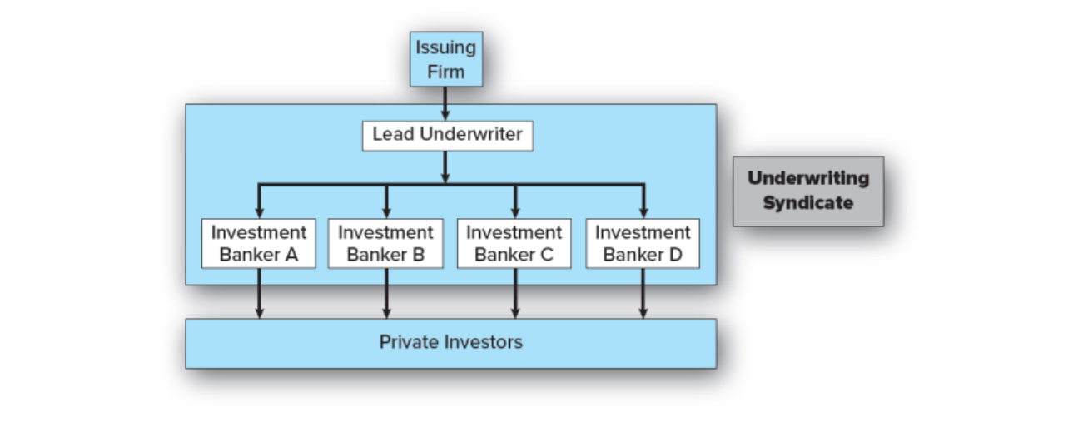
Figure 3.1 Relationship among a Firm Issuing Securities, the Underwriters, and the Public
Jump to long description

Slide 7
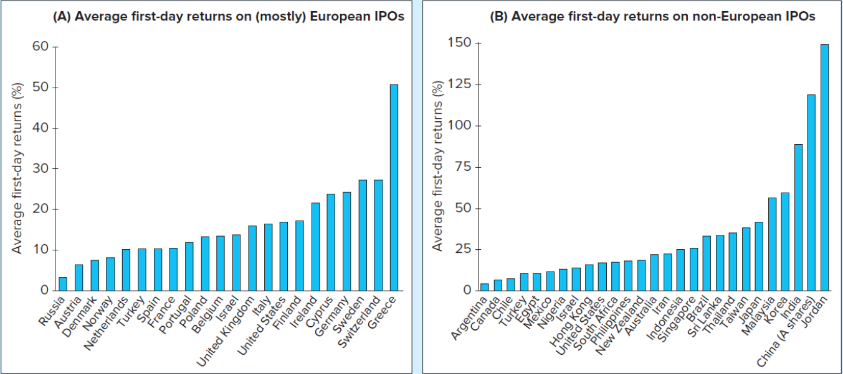
Figure 3.2 Average First-Day Returns
FIGURE 3.2 Average initial returns for (A) U.S. and European and (B) non-European IPOs
Source: Provided by Professor J. Ritter of the University of Florida, 2015. This is an updated version of the information contained in T. Loughran, J. Ritter, and K. Rydqvist, “Initial Public Offerings: International Insights,” Pacific-Basin Finance Journal 2 (1994), pp. 165−199.
Jump to long description

Slide 8
3.1 How Firms Issue Securities: Shelf Registration
SEC Rule 415
Security is preregistered
Offered at any time within the next two years
24-hour notice: Any or all of preregistered amount may be offered
Introduced in 1982
Why would a firm use Rule 415?

Slide 9
3.2 How Securities Are Traded: Financial Markets
Overall purpose: Facilitate low-cost investment
Bring together buyers and sellers at low cost
Provide adequate liquidity
  Minimize time to trade
  Promotes price continuity
Set and update prices of financial assets
Reduce information costs associated with investing

Slide 10
3.2 How Securities Are Traded: Market Types
Direct Search Markets
Buyers and sellers locate one another on their own
Brokered Markets
Third-party assistance in locating buyer or seller
Dealer Markets
Third party acts as intermediate buyer/seller
Auction Markets
Brokers and dealers trade in one location
Trading is more or less continuous

Slide 11
3.2 How Securities Are Traded: Order Types
Market order:
Execute immediately at best price
Bid price: price at which dealer will buy security
Ask price: price at which dealer will sell security
Price-contingent order:
Limit buy/sell order: specifies price at which investor will buy/sell
Stop order: not to be executed until price point hit

Slide 12
3.2 How Securities are Traded: Price-Contingent Orders
 | Condition: Price falls below the limit | Condition: Price rises above the limit
Action: Buy | Limit buy order | Stop-buy order
Action: Sell | Stop-loss order | Limit sell order

Slide 13
Figure 3.4 Limit Order
FIGURE 3.4
A portion of the limit order book for Facebook on the BATS market, May 16, 2017
Source: www.bats.com
Facebook, Inc. (FB)
149.73 ↓0.56 (0.38%) 3:05 EDT
Bid: Price | Bid: Size | Ask: Price | Ask: Size
147.75 | 50 | 149.76 | 500
149.74 | 701 | 149.77 | 308
149.73 | 150 | 149.78 | 300
149.72 | 400 | 149.79 | 500
149.71 | 400 | 149.80 | 884

Slide 14
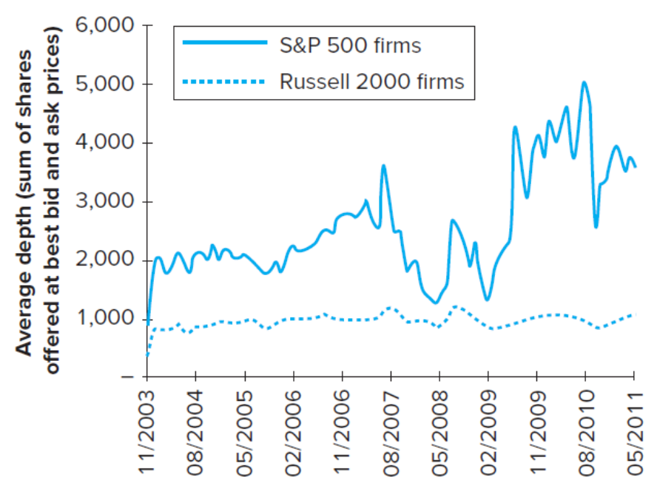
Figure 3.3 Market Orders: Average Market Depth
FIGURE 3.3
Average market depth for large (S&P 500) and small (Russell 2000) firms
Source: Adapted from James J. Angel, Lawrence E. Harris, and Chester Spatt, “Equity Trading in the 21st Century,” Quarterly Jour­nal of Finance 1 (2011), pp. 1-53; Knight Capital Group.
Jump to long description

Slide 15
3.2 How Securities Are Traded
Trading Mechanisms
Dealer markets
  Over-the-counter (OTC) market: Informal network of brokers/dealers who negotiate securities sales
  NASDAQ stock market: Computer-linked price quotation system for OTC market
Electronic communication networks (ECNs)
  Computer networks that allow direct trading
Specialist markets
  Specialist: Makes market in shares of one or more firms; maintains “fair and orderly market” by dealing personally

Slide 16
3.3 Rise of Electronic Trading: Timeline of Market Changes (1 of 2)
1969: Instinet (first ECN) established
1975: Fixed commissions on NYSE eliminated
Congress amends Securities and Exchange Act to create National Market System (NMS)
1994: NASDAQ scandal
SEC institutes new order-handling rules
NASDAQ integrates ECN quotes into display
SEC adopts Regulation Alternative Trading Systems, giving ECNs ability to register as stock exchanges

Slide 17
3.3 Rise of Electronic Trading: Timeline of Market Changes (2 of 2)
1997: SEC drops minimum tick size from 1/8 to 1/16 of $1
2000: National Association of Securities Dealers splits from NASDAQ
2001: Minimum tick size $.01
2006: NYSE acquires Archipelago Exchanges and renames it NYSE Arca
SEC adopts Regulation NMS, requiring exchanges to honor quotes of other exchanges

Slide 18
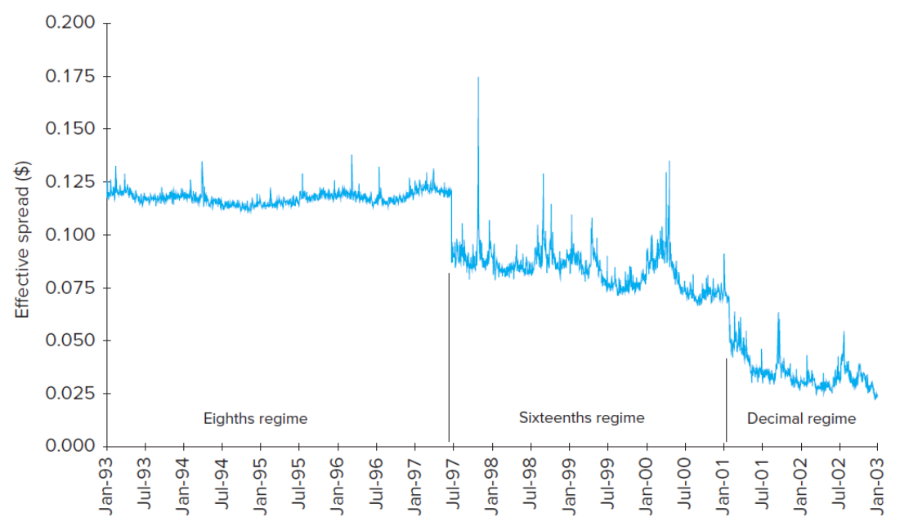
Figure 3.5 Effective Spread vs. Minimum Tick Size
FIGURE 3.5
The effective spread (measured in dollars per share) fell dramatically as the minimum tick size fell. (Value-weighted average of NYSE-listed shares)
Source: Tarun Chordia, Richard Roll, and Avanidhar Subrahmanyam, “Liquidity and Market Efficiency,” Journal of Financial Economics 87 (2008), pp. 249-268.
Jump to long description

Slide 19
3.4 U.S. Markets
NASDAQ
Approximately 3,000 firms
New York Stock Exchange (NYSE)
Stock exchanges: Secondary markets where already-issued securities are bought and sold
NYSE is largest U.S. Stock exchange
ECNs
Latency: Time it takes to accept, process, and deliver a trading order

Slide 20
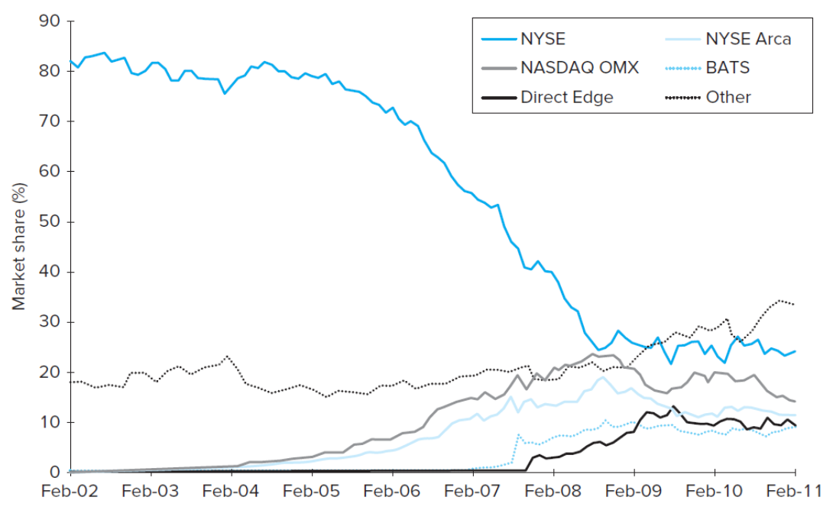
FIGURE 3.6 Market Share of Trading in NYSE-Listed Shares
Source: James J. Angel, Lawrence E. Harris, and Chester Spatt, “Equity Trading in the 21st Century,” Quarterly Journal of Finance 1 (2011), pp. 1-53.
Jump to long description

Slide 21
3.5 New Trading Strategies (1 of 2)
Algorithmic Trading
Use of computer programs to make rapid trading decisions
High-frequency trading: Computer programs make very rapid trading decisions for very small profits

Slide 22
3.5 New Trading Strategies (2 of 2)
Dark Pools
ECNs where participants can buy/sell large blocks of securities anonymously
Blocks: Transactions of at least 10,000 shares

Slide 23
3.6 Globalization of Stock Markets
Moving to automated electronic trading
Current trends will eventually result in 24-hour global markets
Moving toward market consolidation

Slide 24
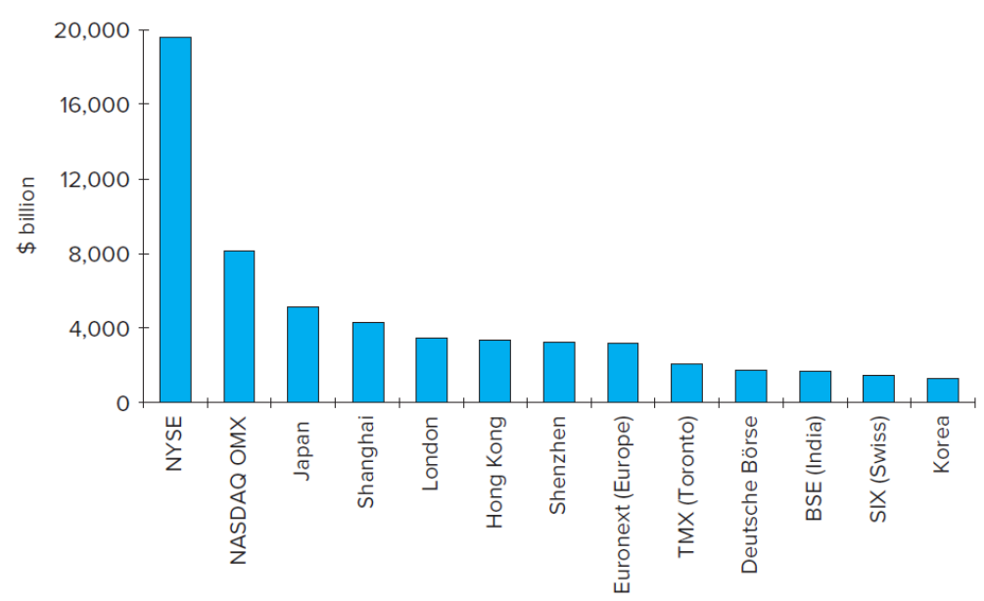
Market Capitalization of World Stock Exchanges, 2016
FIGURE 3.7
Market capitalization of major world stock exchanges, 2016
Source: World Federation of Exchanges.
Jump to long description

Slide 25
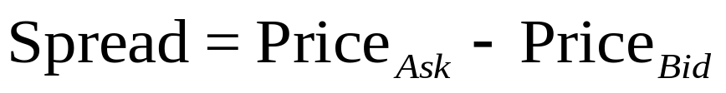
3.7 Trading Costs
Commission: Fee paid to broker for making transaction
Spread: Cost of trading with dealer
Bid: Price at which dealer will buy from you
Ask: Price at which dealer will sell to you
Combination: On some trades both are paid

Slide 26
3.8 Buying on Margin (1 of 6)
Margin: Describes securities purchased with money borrowed in part from broker
Net worth of investor's account
Initial Margin Requirement (IMR)
Minimum set by Federal Reserve under Regulation T, currently 50% for stocks
Minimum % initial investor equity
1 − IMR = Maximum % amount investor can borrow

Slide 27
3.8 Buying on Margin (2 of 6)
Equity
Position value – Borrowing + Additional cash
Maintenance Margin Requirement (MMR)
Minimum amount equity can be before additional funds must be put into account
Exchanges mandate minimum 25%
Margin Call
Notification from broker that you must put up additional funds or have position liquidated

Slide 28
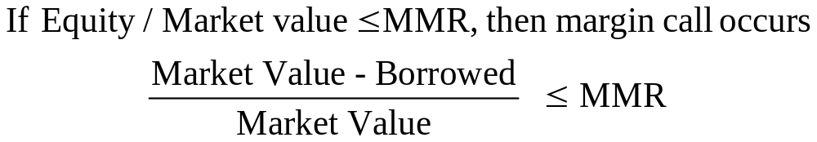
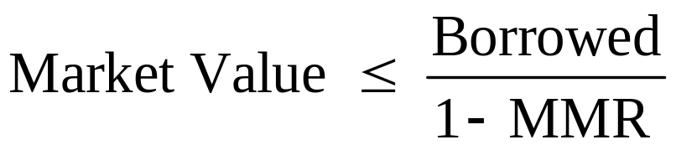
3.8 Buying on Margin (3 of 6)
Solve for market value
A margin call will occur when:

Slide 29
3.8 Buying on Margin (4 of 6)
Margin Trading: Initial Conditions
X Corp: Stock price = $70
50%: Initial margin
40%: Maintenance margin
1000 shares purchased
Initial Position
Stock | $70,000 | Borrowed | $35,000
 |  | Equity | $35,000

Slide 30
3.8 Buying on Margin (5 of 6)
Stock price falls to $60 per share
Position value – Borrowing + Additional cash
New Position
Stock | $60,000 | Borrowed | $35,000
 |  | Equity | $25,000
How far can price fall before margin call?

Slide 31
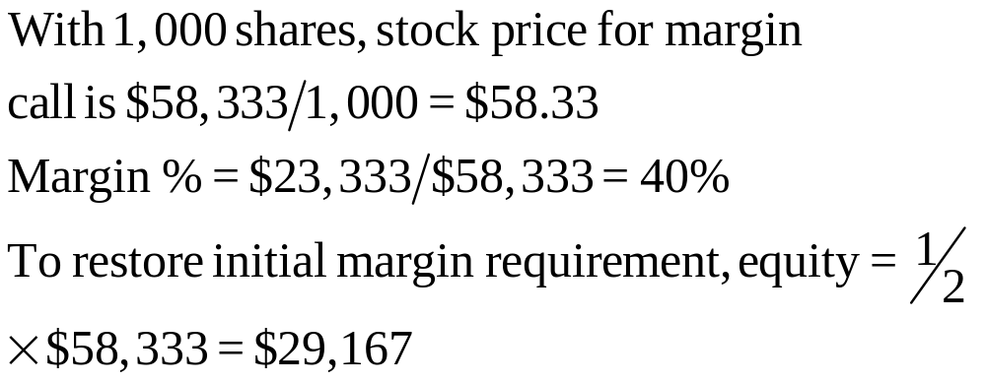
3.8 Buying on Margin (6 of 6)
New Position
Stock | $60,000 | Borrowed | $35,000
 |  | Equity | $23,333

Slide 32
Table 3.1 Illustration of Buying Stock on Margin
Change in Stock Price | End-of-Year Value of Shares | Repayment of Principal and Interest* | Investor's Rate of Return
30% increase | $26,000 | $10,900 | 51%
No change | 20,000 | 10,900 | −9
30% decrease | 14,000 | 10,900 | −69

Slide 33
3.9 Short Sales (1 of 3)
Sale of shares not owned by investor but borrowed through broker
Mechanics
Borrow stock from broker; must post margin
Broker sells stock, and deposits proceeds/margin in margin account
Covering or closing out position: Buy stock; broker returns title to original party

Slide 34
3.9 Short Sales (2 of 3)
Required initial margin: Usually 50%
More for low-priced stocks
Liable for any cash flows
Dividend on stock
Zero tick, uptick rule
Eliminated by SEC in July 2007

Slide 35
3.9 Short Sales: Example (1 of 2)
Sell 100 short shares of stock at $60 per share
$6,000 must be pledged to broker
Pledge 50% margin, or $3,000
Now there is $9,000 in margin account
Short sale equity = Total margin account – Market value

Slide 36
3.9 Short Sales (3 of 3)
Example
Maintenance margin for short sale of stock with price > $16.75 is 30% market value
  30% x $6,000 = $1,800
You have $1,200 excess margin
What price for margin call?

Slide 37
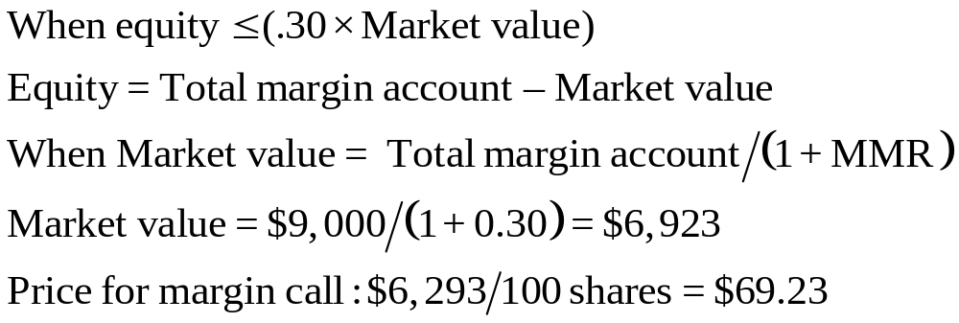
3.9 Short Sales: Example, Margin Call

Slide 38

3.9 Short Sales: Example (2 of 2)
If this occurs:
Equity = $9,000 − $6,923 = $2,077
To restore 50% initial margin:

Slide 39
Table 3.2 Cash Flows from Purchasing vs. Short-Selling
TABLE 3.2 Cash flows from purchasing versus short-selling shares of stock
Purchase of Stock
Time | Action | Cash Flow*
0 | Buy share | −Initial price
1 | Receive dividend, sell share | Ending price + Dividend
Profit = (Ending price + Dividend) − Initial price
Short Sale of Stock
Time | Action | Cash Flow*
0 | Borrow share; sell it | +Initial price
1 | Repay dividend and buy share to replace the share originally borrowed | −(Ending price + Dividend)
Profit = Initial price − (Ending price + Dividend)
*Note: A negative cash flow implies a cash outflow.

Slide 40
3.10 Regulation of Securities Markets
Self-Regulation
The Sarbanes-Oxley Act
Insider Trading
Inside information: Nonpublic knowledge about a corporation possessed by officers, major owners, etc., with privileged access to information

Slide 41
Appendix of Image Long Descriptions

Slide 42
Figure 3.1 Relationship among a Firm Issuing Securities, the Underwriters, and the Public Long Description
Flowchart goes from issuing firm to lead underwriter. Lead underwriter breaks out to four boxes labeled as investment bankers A through D. All investment bankers go to the same box labeled private investors. Lead underwriter and investment bankers are grouped in a box labeled underwriting syndicate.
Jump to image

Slide 43
Average First-Day Returns Long Description
Both bar charts have Average First-Day Returns (percent) on the vertical axis. In the first graph, from left to right are Russia, Austria, Denmark, Norway, Netherlands, Turkey, Spain, France, Portugal, Poland, Belgium, Israel, United Kingdom, Italy, United States, Finland, Ireland, Cyprus, Germany, Sweden, Switzerland, and Greece. Russia is 2 percent. Bars increase left to right with Austria at 6 percent and Switzerland 26 percent. Greece is 50 percent. Second graph, left to right, is Argentina, Canada, Chile, Turkey, Egypt, Mexico, Nigeria, Israel, Hong Kong, United States, South Africa, Philippines, New Zealand, Australia, Iran, Indonesia, Singapore, Brazil, Sri Lanka, Thailand, Taiwan, Japan, Malaysia, Korea, India, China (A shares), and Jordan. Increasing left to right, Argentina is 5 percent and Japan is 30 percent. Malaysia and Korea are 50 percent. India is 85 percent. China is 120 percent, and Jordan is 150 percent.
Jump to image

Slide 44
Market Orders: Average Market Depth Long Description
Average Depth (Sum of Shares Offered at Best Bid and Ask Prices) is on the vertical axis, and dates from 2003 to 2011 are on the horizontal. The line for Russell 2000 Firms trends between 900 and 1,000 over the period. The line for S and P 500 firms trends around 2000 until 2006, climbs to 3,300 in 2007. It drops to 1,200 in early 2008 but climbs to 2,200 in late 2008 before dropping again to 1,200 in 2009. After 2009, it trends between 3,000 and 5,000, ending at 3,800 in 2011. All values are estimates.
Jump to image

Slide 45
Effective Spread vs. Minimum Tick Size Long Description
Effective Spread (dollars) is on the vertical axis and dates from January 1993 to January 2003 are on the horizontal. January 2003 to July 1997 is labeled Eighths regime and trends tightly just below 0.125. From July 1997 to January 2001, the trend moves downward from 0.100 to 0.075, but less tightly and with large spikes. January 2001 to January 2003 is labeled Decimal regime and trend down from 0.65 to 0.025; the trend is not as tight as the first regime, but tighter than the second, and the spikes are less extreme than the second regime. All values are estimates.
Jump to image

Slide 46
FIGURE 3.6 Market Share of Trading in NYSE-Listed Shares Long Description
Percentage is on the vertical axis and dates from February 2002 to February 2011 are on the horizontal. The New York Stock exchange drops from 81 percent in 2002 to 25 percent in 2011. The category, other, starts at 19 percent and trends up to end 30 percent in 2011. The NASDAQ OMX starts at 0 in 2002, peaks at 25 percent in late 2008, and ends at 15 percent in 2011. Direct Edge is 0 percent until late 2007, trends up to 10 percent in mid 2009 and ends at 9 percent in 2011. New York Stock Exchange Arca is zero until 2004, peaks at 15 percent in late 2008 and ends at 10 percent in 2011. BATS is zero at the start of 2007, climbs to 8 percent in late 2007 and remains between 8 percent and 10 percent for the remainder of the period.
Jump to image

Slide 47
Market Capitalization of World Stock Exchanges, 2016 Long Description
Bar graph has dollars in billions on the vertical axis. The New York stock exchange is $19,500; NASDAQ OMX is $8,000; Japan $5,000; Shanghai $4,000; London $3,900; Hong Kong $3,900; Shenzhen $3,800; Euronext (Europe) $3,800; T M X (Toronto) $2,000; Deutsche Borse $1,900, B S E (India) $1,900, and SIX (Swiss) and Korea are each $1,700. All values are approximations.
Jump to image

