Slide 1

Essentials of Investments
Eleventh Edition
Bodie, Kane, and Marcus
Chapter 5
Risk, Return and the Historical Record
© 2019 McGraw-Hill Education. All rights reserved. Authorized only for instructor use in the classroom. No reproduction or further distribution permitted without the prior written consent of McGraw-Hill Education.

Slide 2
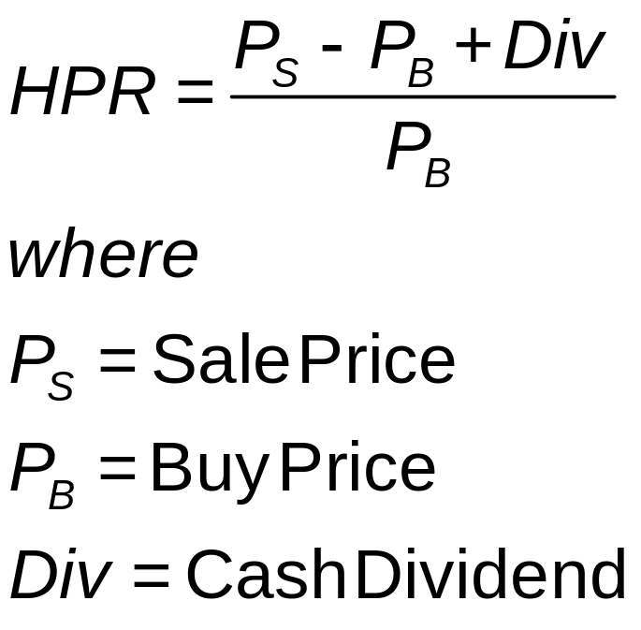
5.1 Rates of Return (1 of 2)
Holding-Period Return (HPR)
Rate of return over given investment period

Slide 3
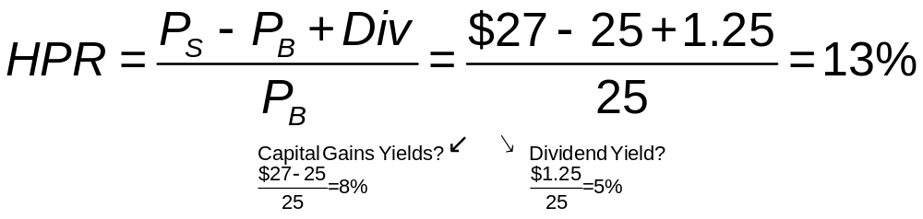
5.1 Rates of Return: Example
What is the HPR for a share of stock that was purchase for $25, sold for $27 and distributed $1.25 in dividends?

Slide 4
5.1 Rates of Return: Measuring over Multiple Periods
Arithmetic average
Sum of returns in each period divided by number of periods
Geometric average
Single per-period return
Gives same cumulative performance as sequence of actual returns
Compound period-by-period returns
Dollar-weighted average return
Internal rate of return on investment

Slide 5
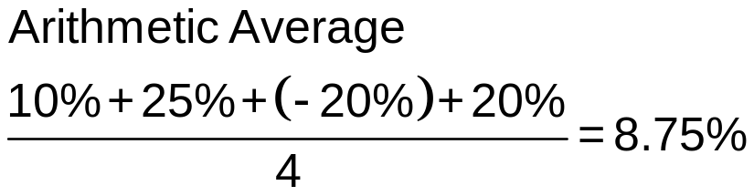
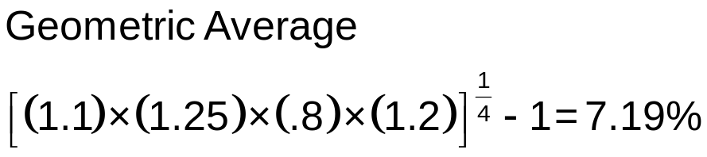
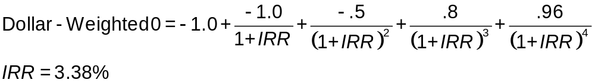
Table 5.1 Rates of Return of a Mutual Fund: Example
 | 1st Quarter | 2nd Quarter | 3rd Quarter | 4th Quarter
Assets under management at start of quarter | 1 | 1.2 | 2 | 0.8
Holding-period return (%) | 10 | 25 | −20 | 20
Total assets before net inflows | 1.1 | 1.5 | 1.6 | 0.96
Net inflow ($ million) | 0.1 | 0.5 | −0.8 | 0.6
Assets under management at end of quarter | 1.2 | 2 | 0.8 | 1.56

Slide 6
5.1 Rates of Return (2 of 2)
Annualizing Rates of Return
APR = Annual Percentage Rate
  Per-period rate × Periods per year
  Ignores Compounding
EAR = Effective Annual Rate
  Actual rate an investment grows
  Does not ignore compounding

Slide 7
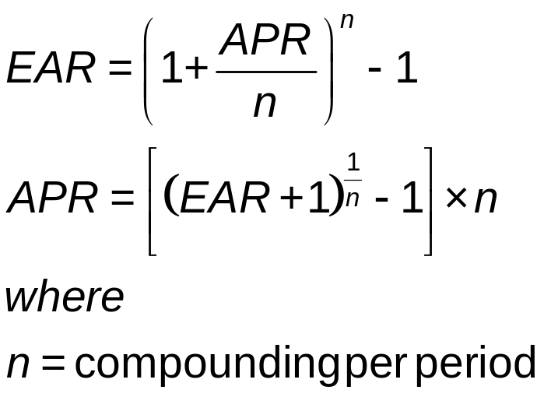
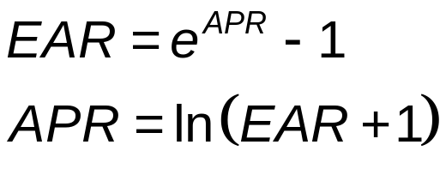
5.1 Rates of Return: EAR vs. APR
For n periods of compounding:
For Continuous Compounding:

Slide 8
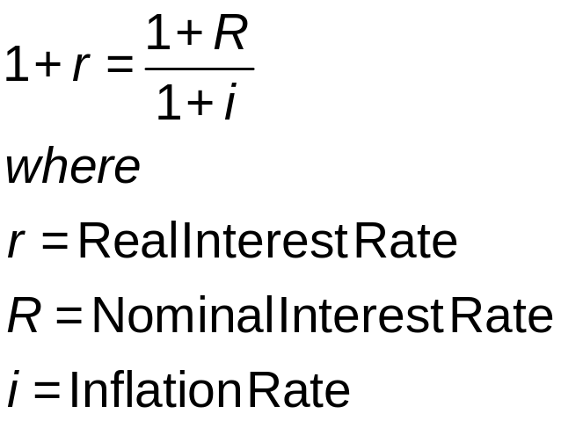
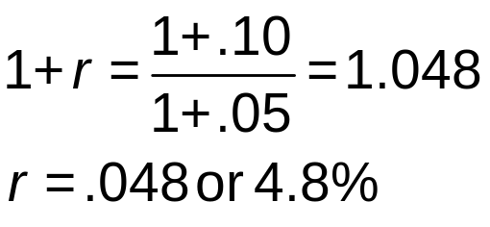
5.2 Inflation and The Real Rates of Interest (1 of 3)
Nominal Interest and Real Interest
Example: What is the real return on an investment that earns a nominal 10% return during a period of 5% inflation?

Slide 9
5.2 Inflation and The Real Rates of Interest (2 of 3)
Equilibrium Nominal Rate of Interest
Fisher Equation
  R = r + E(i)
  E(i): Current expected inflation
  R: Nominal interest rate
  r: Real interest rate

Slide 10
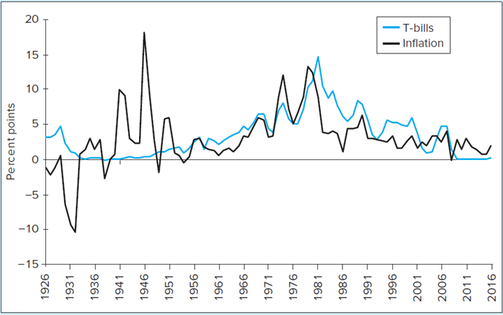
Interest Rates, Inflation, and Real Interest Rates
FIGURE 5.1
Inflation and interest rates, 1926-2016
Jump to long description

Slide 11
5.2 Inflation and The Real Rates of Interest (3 of 3)
U.S. History of Interest Rates, Inflation, and Real Interest Rates
Since the 1950s, nominal rates have increased roughly in tandem with inflation
1930s/1940s: Volatile inflation affects real rates of return

Slide 12
5.3 Risk and Risk Premiums (1 of 5)
Scenario Analysis and Probability Distributions
Scenario analysis: Possible economic scenarios; specify likelihood and HPR
Probability distribution: Possible outcomes with probabilities
Expected return: Mean value
Variance: Expected value of squared deviation from mean
Standard deviation: Square root of variance

Slide 13
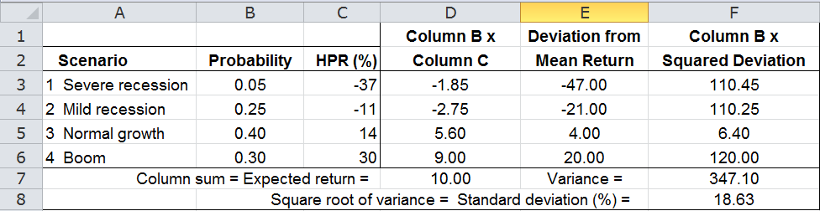
Spreadsheet 5.1 Scenario Analysis for the Stock Market
Jump to long description

Slide 14
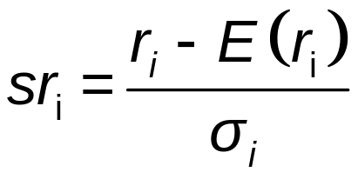
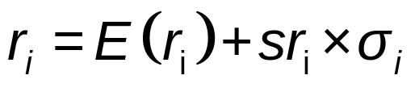
5.3 Risk and Risk Premiums (2 of 5)
The Normal Distribution
Transform normally distributed return into standard deviation score:
Original return, given standard normal return:

Slide 15
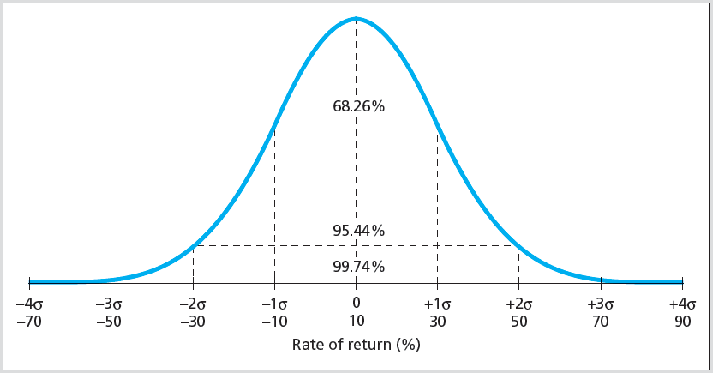
Figure 5.2 Normal Distribution r = 10% and σ = 20%
Jump to long description

Slide 16
5.3 Risk and Risk Premiums (3 of 5)
Normality over Time
When returns over very short time periods are normally distributed, HPRs up to 1 month can be treated as normal
Use continuously compounded rates where normality plays crucial role

Slide 17
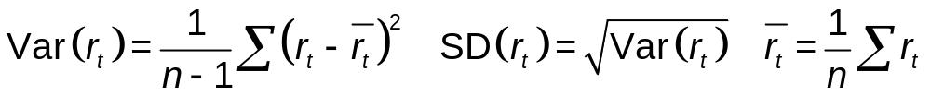
5.3 Risk and Risk Premiums (4 of 5)
Deviation from Normality and Value at Risk
Kurtosis: Measure of fatness of tails of probability distribution; indicates likelihood of extreme outcomes
Skew: Measure of asymmetry of probability distribution
Using Time Series of Return
Scenario analysis derived from sample history of returns
Variance and standard deviation estimates from time series of returns:

Slide 18
5.3 Risk and Risk Premiums: Value at Risk
Value at risk (VaR):
Measure of downside risk
Worst loss with given probability, usually 5%

Slide 19
5.3 Risk and Risk Premiums (5 of 5)
Risk Premiums and Risk Aversion
Risk-free rate: Rate of return that can be earned with certainty
Risk premium: Expected return in excess of that on risk-free securities
Excess return: Rate of return in excess of risk-free rate
Risk aversion: Reluctance to accept risk
Price of risk: Ratio of risk premium to variance

Slide 20
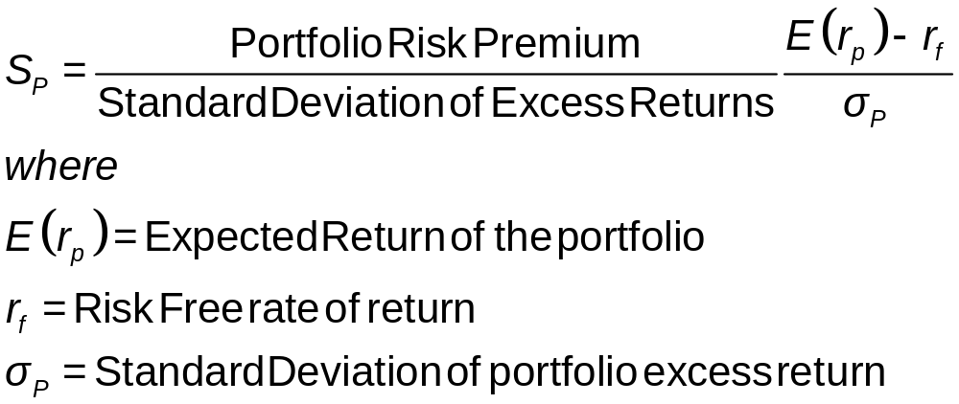
5.3 Risk and Risk Premiums: Sharpe Ratios
The Sharpe (Reward-to-Volatility) Ratio
Ratio of portfolio risk premium to standard deviation
Mean-Variance Analysis
Ranking portfolios by Sharpe ratios

Slide 21
Excess Returns
TABLE 5.5 Excess Returns statistics for the Market index
 | Average | Std Dev | Sharpe Ratio
1926−1927 | 8.48 | 20.29 | 0.42
1927−1956 | 11.22 | 24.75 | 0.45
1957−1987 | 5.46 | 17.91 | 0.31
1988−2016 | 8.88 | 17.69 | 0.50

Slide 22
5.4 The Historical Record: World Portfolios
World Large stocks: 24 developed countries, ~6000 stocks
U.S. large stocks: Standard & Poor's 500 largest cap
U.S. small stocks: Smallest 20% on NYSE, NASDAQ, and Amex
World bonds: Same countries as World Large stocks
U.S. Treasury bonds: Barclay's Long-Term Treasury Bond Index

Slide 23
Historical Return and Risk
TABLE 5.3 Risk and return of investments in major asset classes, 1927-2016
 | T-bills | T-bonds | Stocks
Arithmetic average | 3.42 | 5.51 | 11.91
Risk premium | N/A | 2.08 | 8.48
Standard deviation | 3.14 | 8.14 | 19.99
max | 14.71 | 38.07 | 56.38
min | −0.02 | −8.47 | −43.73

Slide 24
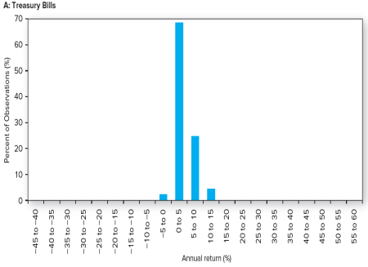
Historic Returns: Treasury Bills
Jump to long description
Notes:
Think: Do these look normally distributed?
Note: You might wonder about the negative T-bill rates that show up in the frequency distribution above. T-bills did not make their debut until the 1940s. For earlier dates, commercial paper is used as the closest approximation to short-term risk-free rates. In a few instances they were issued slightly above par and thus yielded slightly negative rates.

Slide 25
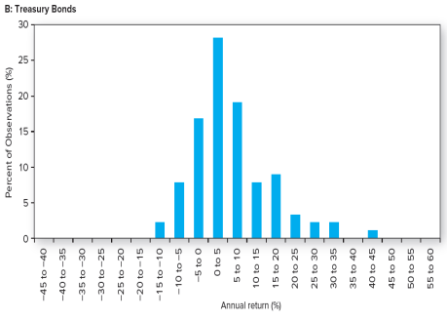
Historic Returns: Treasury Bonds
Jump to long description
Notes:
Think: Do these look normally distributed?
Note: You might wonder about the negative T-bill rates that show up in the frequency distribution above. T-bills did not make their debut until the 1940s. For earlier dates, commercial paper is used as the closest approximation to short-term risk-free rates. In a few instances they were issued slightly above par and thus yielded slightly negative rates.

Slide 26
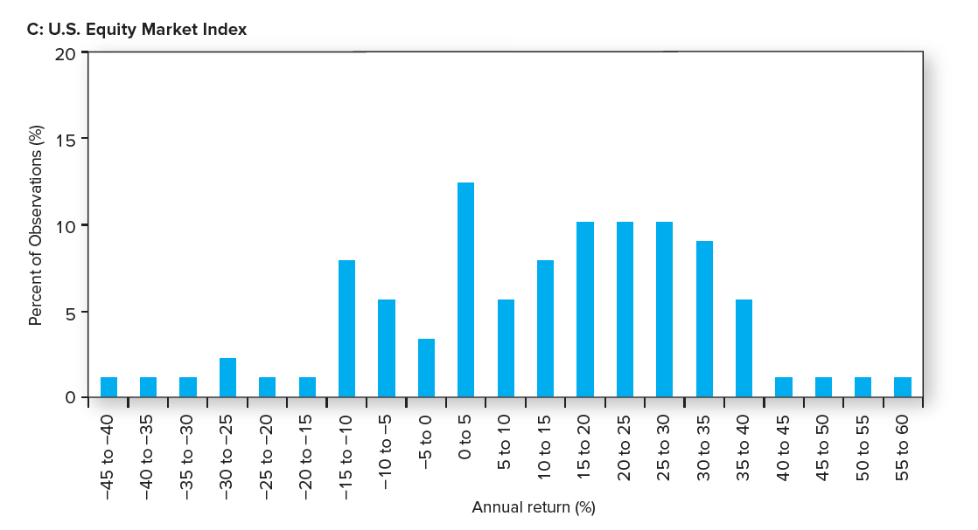
Historic Returns: Equity Markets
Jump to long description
Notes:
Think: Does this look normally distributed?

Slide 27
5.5 Asset Allocation across Portfolios (1 of 3)
Asset Allocation
Portfolio choice among broad investment classes
Complete Portfolio
Entire portfolio, including risky and risk-free assets
Capital Allocation
Choice between risky and risk-free assets

Slide 28
5.5 Asset Allocation across Portfolios (2 of 3)
The Risk-Free Asset
Treasury bonds (still affected by inflation)
Price-indexed government bonds
Money market instruments effectively risk-free
Risk of CDs and commercial paper is miniscule compared to most assets

Slide 29
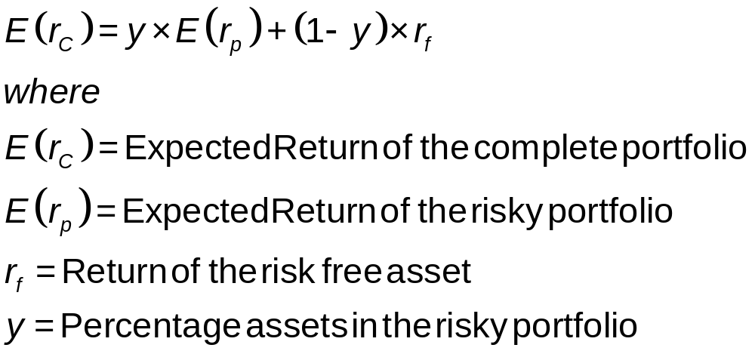
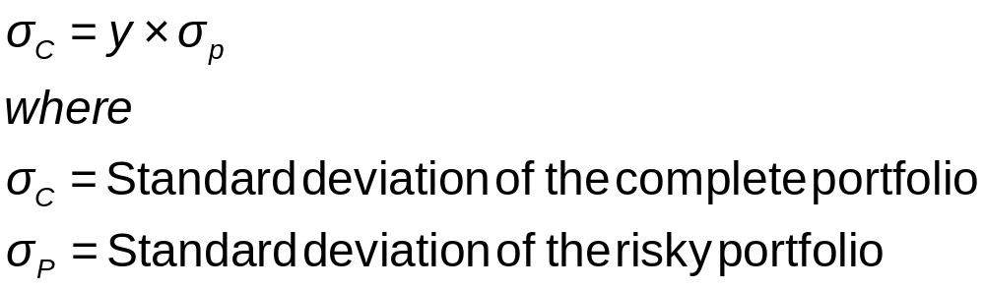
5.5 Portfolio Asset Allocation: Expected Return and Risk
Expected Return of the Complete Portfolio
Standard Deviation of the Complete Portfolio

Slide 30
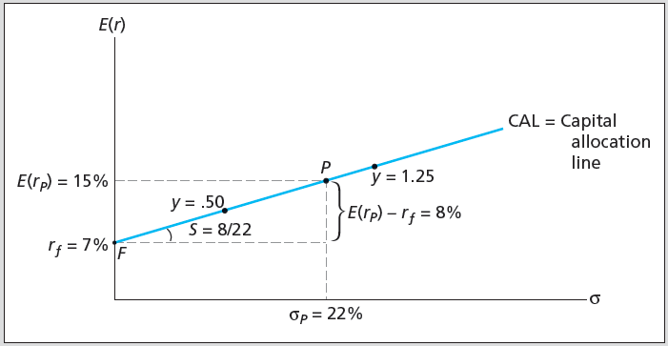
Figure 5.6 Investment Opportunity Set
Jump to long description

Slide 31
5.5 Asset Allocation across Portfolios (3 of 3)
Capital Allocation Line (CAL)
Plot of risk-return combinations available by varying allocation between risky and risk-free
Risk Aversion and Capital Allocation
y: Preferred capital allocation

Slide 32
5.6 Passive Strategies and the Capital Market Line (1 of 2)
Passive Strategy
Investment policy that avoids security analysis
Capital Market Line (CML)
Capital allocation line using market-index portfolio as risky asset

Slide 33
5.6 Passive Strategies and the Capital Market Line (2 of 2)
Cost and Benefits of Passive Investing
Passive investing is inexpensive and simple
Expense ratio of active mutual fund averages 1%
Expense ratio of hedge fund averages 1%-2%, plus 10% of returns above risk-free rate
Active management offers potential for higher returns

Slide 34
Appendix of Image Long Descriptions

Slide 35
Spreadsheet 5.1 Scenario Analysis for the Stock Market Long Description
Excel spreadsheet showing 4 scenarios listed in column A: Severe recession, mild recession, normal growth, and boom. The columns provide the probability of each of those scenarios, the H P R percentage, the product of those two columns (which sums to the total mean return), the deviation from the mean return, the squared deviation from the mean return, and the product of those two columns, summing to the variance. Finally, the square root is shown below the variance.
Jump to image

Slide 36
Figure 5.1 Interest Rates, Inflation, and Real Interest Rates Long Description
Percentage points is on the vertical axis, and the years 1926 to 2016 are on the horizontal. Graph shows T-Bills dropping to 0 percent and slightly higher during the Great Depression, recovering during World War II and reaching 15 percent in the late 1970s. Since then, T-Bills have steadily declined, dropping to 0 percent in 2007 and staying there. Inflation is negative ten percent during the Great Depression and reaching 18 percent toward the end of World War II. After World War II, it climbed unsteadily, reaching 13 percent in the late 1970s. After that, it varies between 2 percent and 5 percent, appearing to level off at 2 percent in 2016. All values are approximations.
Jump to image

Slide 37
Figure 5.2 Normal Distribution r = 10% and σ = 20% Long Description
From negative 3 sigma to 3 sigma is 99.74 percent.
From negative 2 sigma to 2 sigma is 95.44 percent.
From negative 1 sigma to 1 sigma is 68.26 percent.
Jump to image

Slide 38
Historic Returns: Treasury Bills Long Description Long Description
The bar graph has percent of observations on the vertical axis and annual return (percent) on the horizontal. Annual returns is incremented in 5 percent units from negative 45 to positive 60. For treasury bills only four bars occur. Three percent of the observations occur at negative 5 to 0 percent; 68% of the observations occur at 0 to 5 percent; 22% of the observations occur at 5 to 10 percent; and 6% of the observations occur at 10 to 15 percent. All values are approximations.
Jump to image

Slide 39
Historic Returns: Treasury Bonds Long Description
For graph (B), 10-year treasury bonds, 0 to 5 percent has about 37% of the observations. Negative 5 to 0 percent and 5 to 10 percent are both between 15 and 20% of the observations. Negative 10 to negative 5 percent, 10 to 15 percent, and 15 to 20 percent are all between 6 and 9% of the observations. The remaining returns have fewer than five percent of the observations. All values are approximations.
Jump to image

Slide 40
Historic Returns: Equity Markets Long Description
For graph (C), common stocks, returns from negative 15 percent to positive 40% were all relatively similar in terms of frequency, occurring about 8 to 10% of the time. Losses of negative 10 percent to negative 45% and gains of 40% to 60% were much less likely to occur, happening about 1 to 2% of the time.
Jump to image

Slide 41
Figure 5.6 Investment Opportunity Set Long Description
The following values are provided: E of r sub p equals 15 percent and r sub f equals 7 percent. Sigma sub p equals 22 percent. The rise from point F to point P is noted as E of r sub p minus r sub f equals 8 percent. The angle at point is noted as S equals 8 over 22.
Jump to image

