Slide 1

Essentials of Investments
Eleventh Edition
Bodie, Kane, and Marcus
Chapter 6
Efficient Diversification
© 2019 McGraw-Hill Education. All rights reserved. Authorized only for instructor use in the classroom. No reproduction or further distribution permitted without the prior written consent of McGraw-Hill Education.

Slide 2
6.1 Diversification and Portfolio Risk
Market/Systematic/Nondiversifiable Risk
Risk factors common to whole economy
Unique/Firm-Specific/Nonsystematic/ Diversifiable Risk
Risk that can be eliminated by diversification

Slide 3
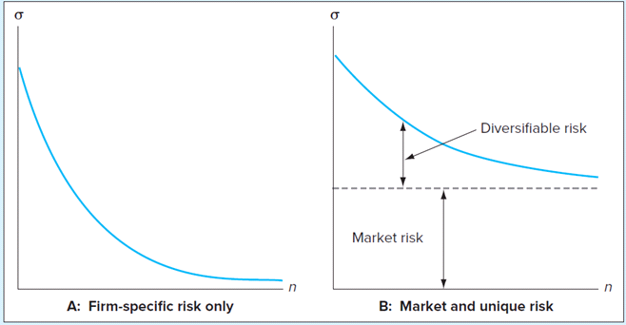
Risk as Function of Number of Stocks in Portfolio
FIGURE 6.1
Portfolio risk as a function of the number of stocks in the portfolio

Slide 4
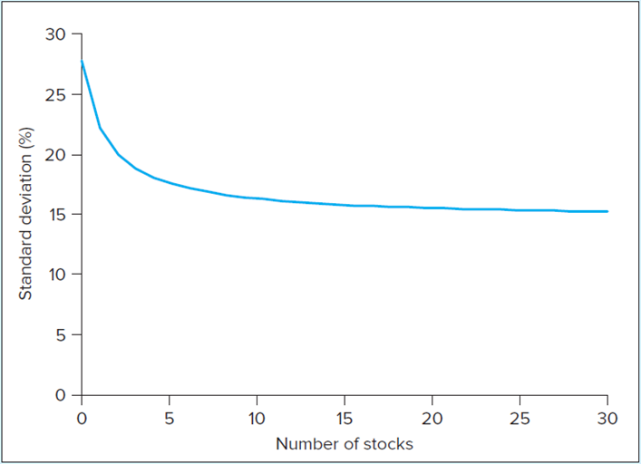
Risk versus Diversification
FIGURE 6.2
Portfolio risk decreases as diversification increases
Source: Author’s calculations. This an update of a plot that first appeared in Meir Statman, “How Many Stocks Make a Diversified Portfolio?” Journal of Financial and Quantitative Analysis 22, September 1987. This plot uses data over the 5-year period 2010-2014.
Systematic Risk

Slide 5
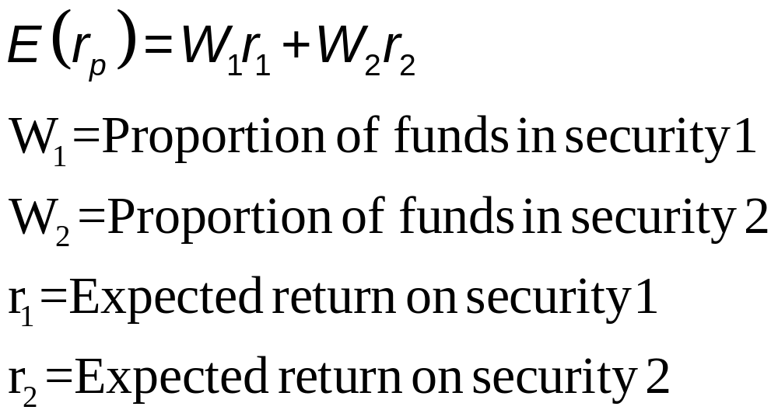
6.2 Asset Allocation with Two Risky Assets
Covariance and Correlation
Portfolio risk depends on covariance between returns of assets
Expected return on two-security portfolio

Slide 6
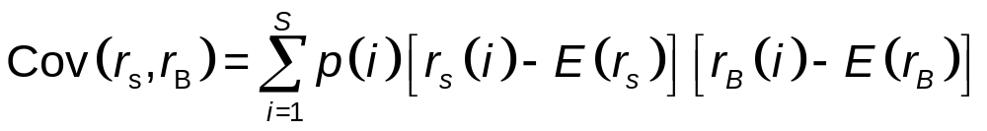
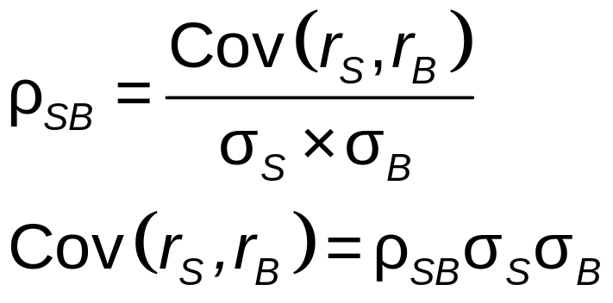
6.2 Asset Allocation with Two Risky Assets
Covariance Calculations
Correlation Coefficient

Slide 7
6.2 Asset Allocation with Two Risky Assets
Using Historical Data
Variability/covariability change slowly over time
Use realized returns to estimate
  Cannot estimate averages precisely
Focus for risk on deviations of returns from average value

Slide 8
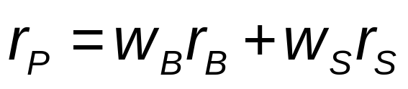
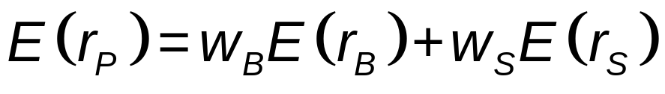
6.2 Asset Allocation with Two Risky Assets
RoR: Weighted average of returns on components, with investment proportions as weights
E(RoR): Weighted average of expected returns on components, with portfolio proportions as weights
Interaction term
Variance of RoR:

Slide 9
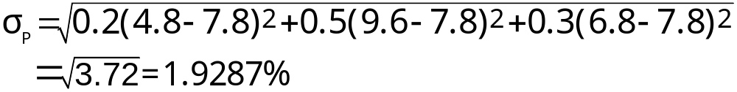

Portfolio Return & Risk
Payoffs
Pr A B
Boom 0.2 18.0% -15.0%
Norm 0.5 8.0 12.0
Recess 0.3 -2.0 20.0
E(r) 7.0% 9.0%
σ 7.00% 12.49%
4.8 = 0.6(18) + 0.4(-15)
9.6 = 0.6( 8) + 0.4( 12)
6.8 = 0.6( -2) + 0.4( 20)
7.8 = 0.6( 7) + 0.4( 9)
Portfolio
w_{A}=0.6; w_{B}=0.4
1.93%
E(r_{P}) = 0.2(4.8%) + 0.5(9.6%) + 0.3(6.8%) = 7.8%

Slide 10
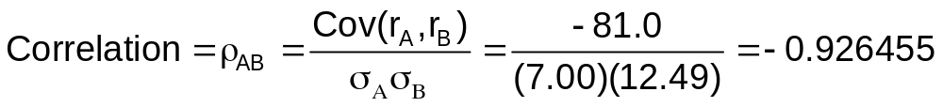
Portfolio Return & Risk
Payoffs
Pr A B
Boom 0.2 18.0% -15.0%
Norm 0.5 8.0 12.0
Recess 0.3 -2.0 20.0
E(r_{A}) = 7.0%
E(r_{B}) = 9.0%
σ_{A} = 7.00%
σ_{B} = 12.49%
Cov(r_{A},r_{B}) = 0.2(18% – 7%)(-15% – 9%)
+ 0.5( 8% – 7%)( 12% – 9%)
+ 0.3( -2% – 7%)( 20% – 9%) = -81.0

Slide 11
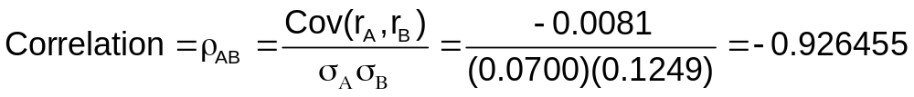
Portfolio Return & Risk
Payoffs
Pr A B
Boom 0.2 18.0% -15.0%
Norm 0.5 8.0 12.0
Recess 0.3 -2.0 20.0
E(r_{A}) = 7.0%
E(r_{B}) = 9.0%
σ_{A} = 7.00%
σ_{B} = 12.49%
Cov(r_{A},r_{B}) = 0.2( 0.18 – 0.07)(-0.15 – 0.09)
+ 0.5( 0.08 – 0.07)( 0.12 – 0.09)
+ 0.3(-0.02 – 0.07)( 0.20 – 0.09) = -0.0081

Slide 12
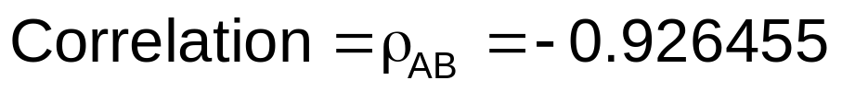
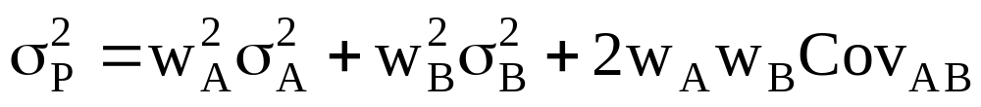
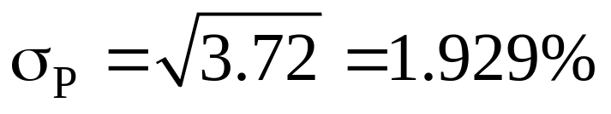
Portfolio Return & Risk
σ_{A} = 7.00%
σ_{B} = 12.49%
Cov(r_{A},r_{B}) = -81.0
= (0.6)²(7.00)² + (0.4)²(12.49)²
+ 2[(0.6)(7.00)][(0.4)(12.49)](-0.926455) = 3.72
= (0.6)²(7.00)² + (0.4)²(12.49)²
+ 2[(0.6)(0.4)(-81.0)] = 3.72

Slide 13
6.2 Asset Allocation with Two Risky Assets
Risk-Return Trade-Off
Investment opportunity set
  Available portfolio risk-return combinations
Mean-Variance Criterion
If E(r_{A}) ≥ E(r_{B}) and σ_{A} ≤ σ_{B}
  Portfolio A dominates portfolio B

Slide 14
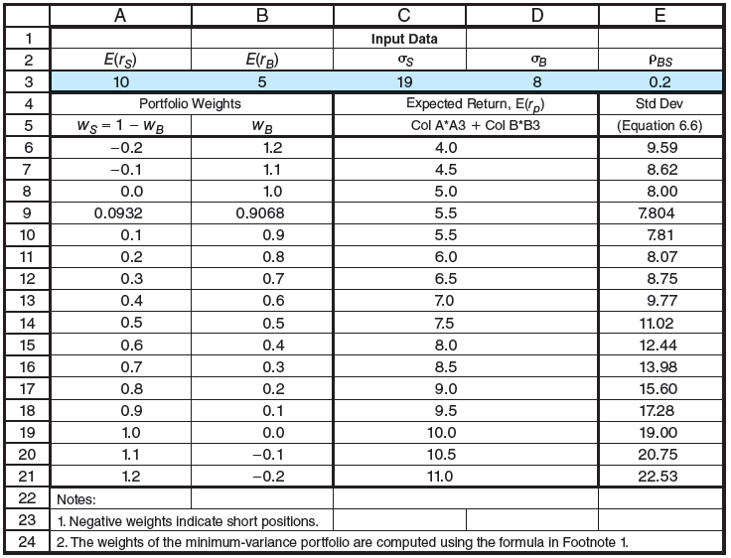
Spreadsheet 6.5 Investment Opportunity Set
Jump to long description

Slide 15
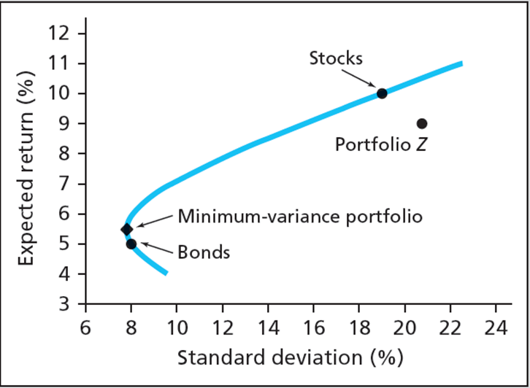
Figure 6.3 Investment Opportunity Set

Slide 16
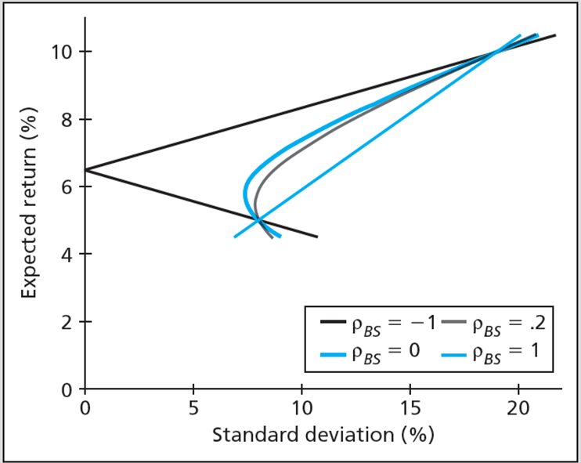
Figure 6.4 Opportunity Sets: Various Correlation Coefficients
Jump to long description

Slide 17
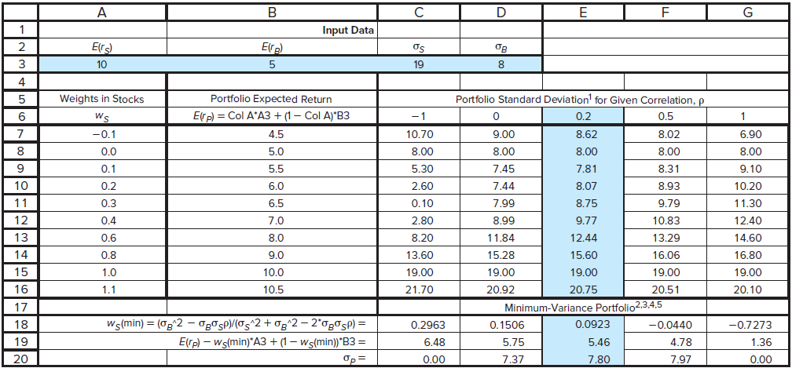
Spreadsheet 6.6 Opportunity Set –Various Correlation Coefficients
Jump to long description

Slide 18
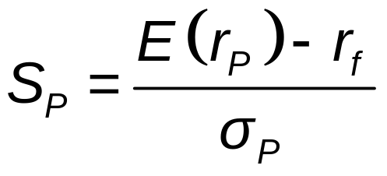
6.3 The Optimal Risky Portfolio with a Risk-Free Asset
Slope of Capital Allocation Line (CAL) is Sharpe Ratio of Risky Portfolio
Optimal Risky Portfolio
  Best combination of risky and safe assets to form portfolio

Slide 19
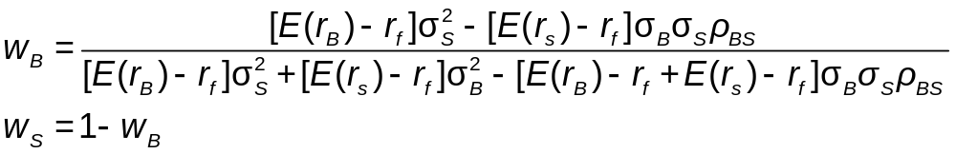
6.3 The Optimal Risky Portfolio with a Risk-Free Asset
Calculating Optimal Risky Portfolio
Two risky assets

Slide 20
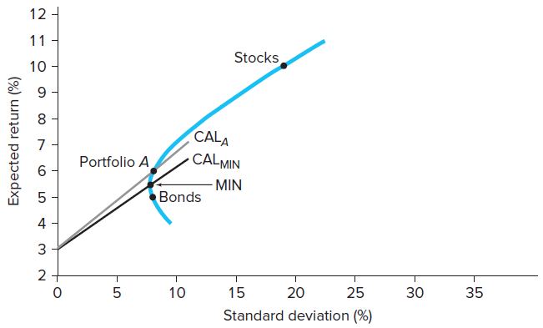
Figure 6.5 Two Capital Allocation Lines
Jump to long description

Slide 21
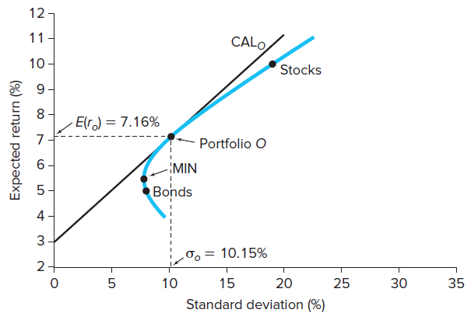
Figure 6.6 Bond, Stock and T-Bill Optimal Allocation
Jump to long description

Slide 22
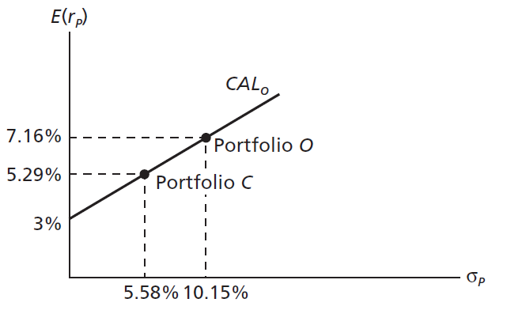
Figure 6.7 The Complete Portfolio
W_{f} = 45%
Jump to long description

Slide 23
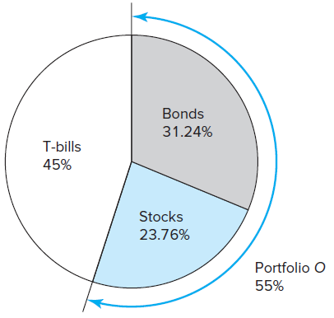
Figure 6.8 Portfolio Composition: Asset Allocation Solution
Jump to long description

Slide 24
6.4 Efficient Diversification with Many Risky Assets
Efficient Frontier of Risky Assets
Graph representing set of portfolios that maximizes expected return at each level of portfolio risk
  Three methods
    Maximize risk premium for any level standard deviation
    Minimize standard deviation for any level risk premium
    Maximize Sharpe ratio for any standard deviation or risk premium

Slide 25
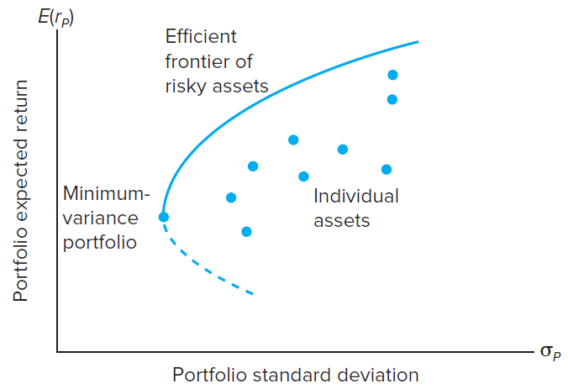
Figure 6.10 Efficient Frontier: Risky and Individual Assets

Slide 26
6.4 Efficient Diversification with
Many Risky Assets
Choosing Optimal Risky Portfolio
Optimal portfolio CAL tangent to efficient frontier
Separation Property implies portfolio choice, separated into two tasks
Determination of optimal risky portfolio
Personal choice of best mix of risky portfolio and risk-free asset

Slide 27
6.4 Efficient Diversification with
Many Risky Asset
Optimal Risky Portfolio: Illustration
Efficiently diversified global portfolio using stock market indices of six countries
Standard deviation and correlation estimated from historical data
Risk premium forecast generated from fundamental analysis

Slide 28
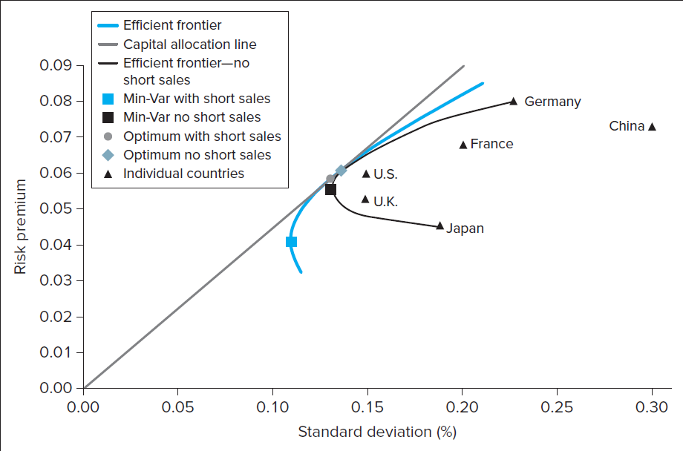
Figure 6.11 Efficient Frontiers/CAL: Table 6.1
Jump to long description

Slide 29
6.5 A Single-Index Stock Market
Index model
Relates stock returns to returns on broad market index & firm-specific factors
Excess return
RoR in excess of risk-free rate
Beta
Sensitivity of security’s returns to market factor
Firm-specific or residual risk
Component of return variance independent of market factor
Alpha
Stock’s expected return beyond that induced by market index

Slide 30
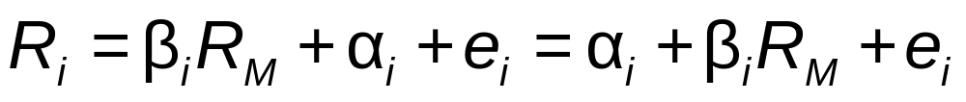
6.5 A Single-Index Stock Market
Excess Return
Where:
β_{i}R_{M}: component of return due to movements in overall market
  β_{i}: security’s responsiveness to market—systematic risk
α_{i}: stock’s expected excess return if market factor is neutral; i.e., market-index excess return is zero
e_{i}: Component attributable to unexpected events relevant only to this security (firm-specific)

Slide 31
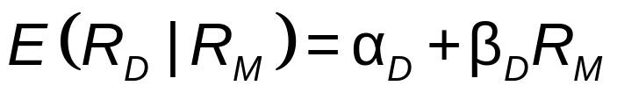
6.5 A Single-Index Stock Market
Statistical and Graphical Representation of Single-Index Model
Security Characteristic Line (SCL)
  Plot of security’s predicted excess return from excess return of market
Algebraic representation of regression line

Slide 32
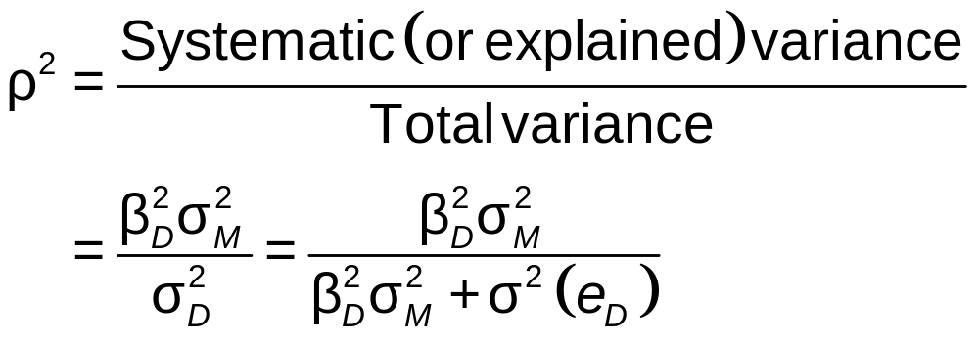
6.5 A Single-Index Stock Market
Statistical and Graphical Representation of Single-Index Model
Ratio of systematic variance to total variance

Slide 33
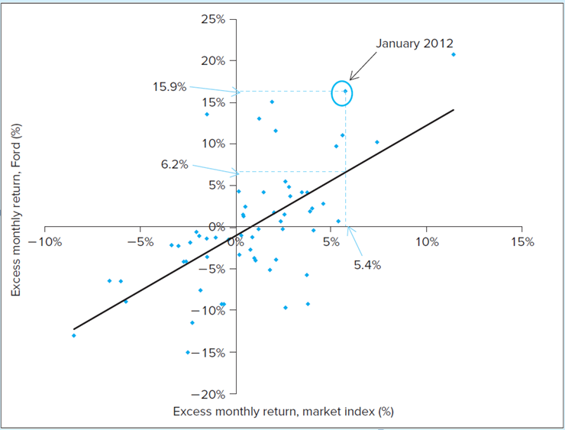
Scatter Diagram for Ford
FIGURE 6.12 Scatter diagram for Ford against the market index.

Slide 34
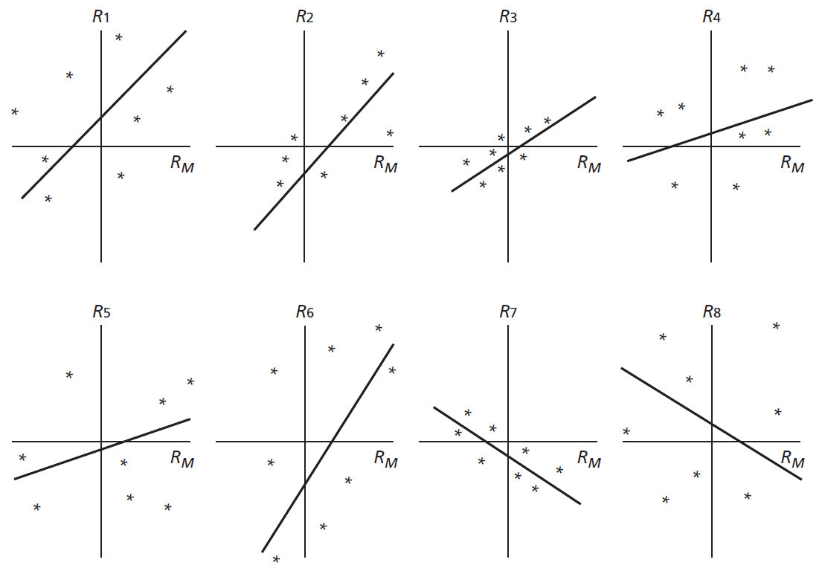
Figure 6.13 Various Scatter Diagrams
Jump to long description

Slide 35
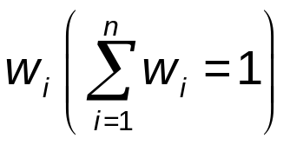
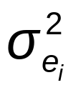
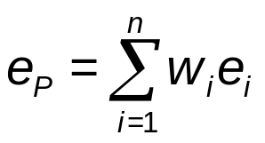
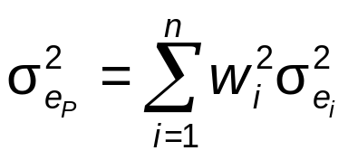
6.5 A Single-Index Stock Market
Diversification in Single-Index Security Market
In portfolio of n securities with weights
    In securities with nonsystematic risk
    Nonsystematic portion of portfolio return
  Portfolio nonsystematic variance

Slide 36
6.5 A Single-Index Stock Market
Using Security Analysis with Index Model
Information ratio
  Ratio of alpha to standard deviation of residual
Active portfolio
  Portfolio formed by optimally combining analyzed stocks

Slide 37

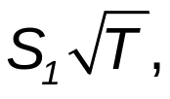
6.6 Risk of Long-Term Investments
Why the Unending Confusion?
Vast majority of financial advisers believe stocks are less risky if held for long run
  Risk premium grows at rate of horizon, T
  Standard deviation grows at
Sharpe ratio,
  grows with investment horizon

Slide 38
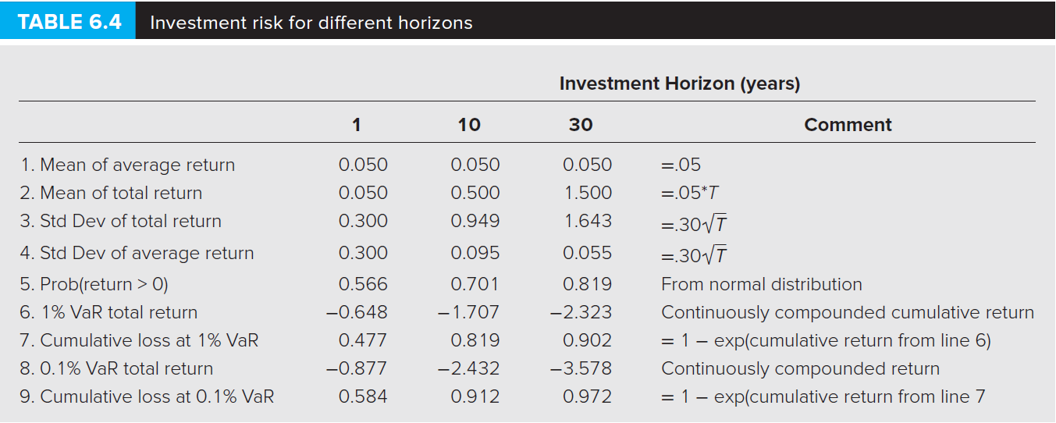
Table 6.4 Investment Risk for Different Horizons

