Slide 1

Essentials of Investments
Eleventh Edition
Bodie, Kane, and Marcus
Chapter 7
CAPM and APT
© 2019 McGraw-Hill Education. All rights reserved. Authorized only for instructor use in the classroom. No reproduction or further distribution permitted without the prior written consent of McGraw-Hill Education.

Slide 2
7.1 The Capital Asset Pricing Model
Capital Asset Pricing Model (CAPM)
Security’s required rate of return relates to systematic risk measured by beta
E(R_{i}|R_{M}) = α_{i} + β_{i}R_{M}
R_{i} = investment excess return = r_{i} - r_{f}
R_{M} = Market excess return = r_{M} - r_{f}
α_{i} = alpha, which represents the excess return
β_{i} = measure of investment’s systematic risk
Market Portfolio (M)
Each security held in proportion to market value

Slide 3
7.1 The Capital Asset Pricing Model: Assumptions
Market Assumptions | Investor Assumptions
All investors are price takers | Investors plan for the same (single-period) horizon
All information relevant to security analysis is free and publicly available. | Investors are efficient users of analytical methods → investors have homogeneous expectations.
All securities are publicly owned and traded. | Investors are rational, mean-variance optimizers.
No taxes on investment returns.
No transaction costs.
Lending and borrowing at the same risk-free rate are unlimited.

Slide 4
7.1 The Capital Asset Pricing Model
Hypothetical Equilibrium
All investors choose to hold market portfolio
  Each security held in proportion to market value
  Perfectly diversified
Market portfolio is on efficient frontier, optimal risky portfolio
Return
Market
Portfolio
Efficient Frontier
•
Risk

Slide 5
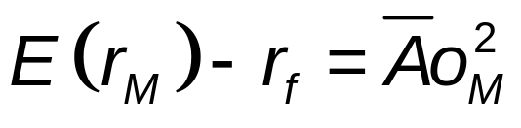
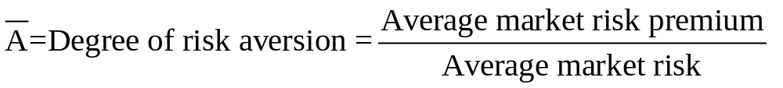
7.1 The Capital Asset Pricing Model
Hypothetical Equilibrium
Risk premium on market portfolio is proportional to variance of market portfolio and investor’s risk aversion.
Risk premium on individual assets
  Proportional to risk premium on market portfolio
  Proportional to beta coefficient of security on market portfolio

Slide 6
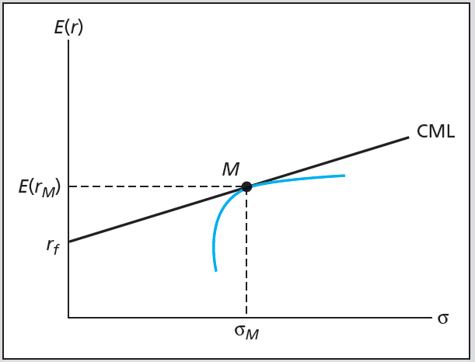
Figure 7.1 Efficient Frontier and Capital Market Line
Market portfolio—some portion is held by all investors
CAL tangent to efficient frontier

Slide 7
7.1 The Capital Asset Pricing Model
Passive Strategy is Efficient
Mutual fund theorem:
  All investors desire same portfolio of risky assets, can be satisfied by single mutual fund composed of that portfolio
  No need to spend resources searching for portfolios that will provide excess returns.
If passive strategy is costless and efficient, why follow active strategy?
  If no one does security analysis, what brings about efficiency of market portfolio?

Slide 8
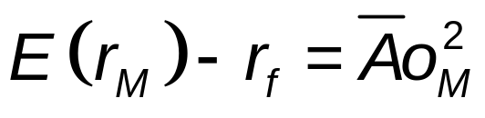
7.1 The Capital Asset Pricing Model
Risk Premium of Market Portfolio = E(r_{M}) - r_{f}
Demand drives prices, lowers expected rate of return/risk premiums
When premiums fall, investors tend to move funds into risk-free asset
Equilibrium risk premium of market portfolio proportional to
  Riskiness of market
  Risk aversion of average investor

Slide 9
7.1 The Capital Asset Pricing Model
Expected Returns on Individual Securities
Expected return-beta relationship
  Implication of CAPM that security risk premiums (expected returns in excess of r_{f}) are proportional to beta, which is a measure of systematic/relevant risk.

Slide 10
7.1 The Capital Asset Pricing Model
Expected Returns on Individual Securities
Reward for taking risk should be benchmarked to the market or average risk premium (systematic risk only).
  The market is perfectly diversified, which means it exhibits no unsystematic risk; i.e., only systematic risk exists in the market portfolio.
E(r_{D}) = r_{f} + [E(r_{M}) – r_{f}]β_{D}
E(r_{D}) – r_{f} = [E(r_{M}) – r_{f}]β_{D}

Slide 11
7.1 The Capital Asset Pricing Model
Investment Portfolios
The beta relationship holds for combinations of investments.
A portfolio’s beta is simply the weighted average of the betas of the individual investments.
β_{Portfolio} = W₁β₁ + W₂β₂ + W₃β₃ + … W_{n}β_{n} = ΣW_{i}β_{i}

Slide 12
7.1 The Capital Asset Pricing Model
The Security Market Line (SML)
Represents graph of expected return-beta relationship of CAPM
Graphs individual asset risk premiums as function of asset risk
Alpha
Abnormal rate of return on security in excess of (different from) that predicted by equilibrium model (CAPM)
Alpha = Actual return – E(r_{D})

Slide 13
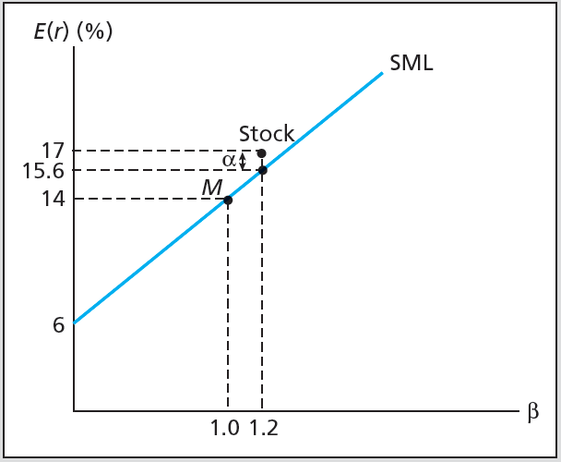
Figure 7.2 The SML and a Positive-Alpha Stock
A
α_{A} = 1.4%

Slide 14
7.1 The Capital Asset Pricing Model
Applications of CAPM
Use SML as benchmark for fair return on risky asset
SML provides “hurdle rate” for internal projects
Principal Limitations of CAPM
Relies on a theoretical market portfolio that includes all investments. Can be proxied by an index model, such as the S&P 500.
Based on expected, not actual, returns.

Slide 15
7.2 CAPM and Index Models
Index Model, Realized Returns, Mean-Beta Equation
r_{it} - r_{ft} = α_{i} + (r_{Mt} – r_{ft}]β_{i} + e_{it}
r_{i} = HPR
r_{M} = market index, such as S&P 500
α_{i} = intercept of security characteristic line
β_{i} = slope of security characteristic line
e_{i} = firm-specific effects
E(r_{D}) = r_{f} + [E(r_{M}) – r_{f}]β_{D}
E(r_{D}) - r_{f} = [E(r_{M}) – r_{f}]β_{D}

Slide 16
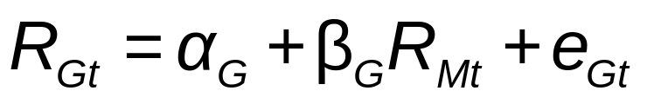
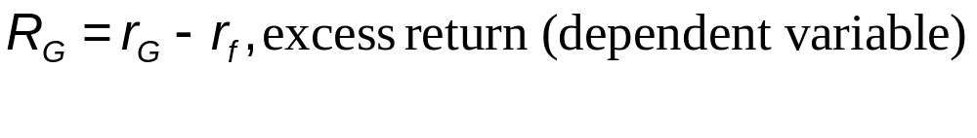
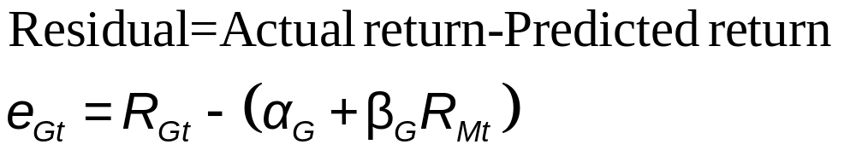
7.2 CAPM and Index Models
Estimating Index Model

Slide 17
7.2 CAPM and Index Models: SCL
Security Characteristic Line (SCL)
Plot of security’s expected excess return over risk-free rate as function of excess return on market
Required rate =
Risk-free rate + β x E(Excess return of market index)

Slide 18
Monthly Return Statistics Oct 2016 – Sept 2019
Statistic | T-Bills (%) | S&P 500 (%) | Valvoline (%)
Average rate of return | 1.548 | 0.936 | 0.044
Average excess return | - | -0.912 | -1.504
Standard deviation* | 0.682 | 3.525 | 7.139
Geometric average | 1.546 | 0.875 | -0.205
* The rate on T-bills is known in advance, SD does not reflect risk.

Slide 19
Monthly Returns
Valvoline
S&P 500
T-bills

Slide 20
Scatter Diagram of Valvoline Excess Returns and
S&P 500 Excess Returns 2016 - 2019
r_{Valvoline}
8/2019
Characteristic
Line
r_{S&P 500}
= β
10/2016

Slide 21
Scatter Graph of
Valvoline Returns and S&P 500 Returns 2016 - 2019
Most points are not on the line.
  Unsystematic risk
The scatter is pretty significant.
  Suggests the market (systematic risk) does not explain the variation in the stock’s return very well.
  In a regression analysis, r² will not be large.
When running a regression which is the dependent variable and which is the independent variable?
  Dependent variable is the one you wish to predict based on knowledge of the independent variable; that is, explain its variability.

Slide 22
Scatter Graph of
Valvoline Returns and S&P 500 Returns 2016 - 2019
SUMMARY OUTPUT
Regression Statistics
Multiple R | 0.453248
R Square | 0.205434
Adjusted R Square | 0.182064
Standard Error | 0.064958
Observations | 36
ANOVA
 | df | SS | MS | F | Significance F
Regression | 1 | 0.037092 | 0.037092 | 8.790639 | 0.005502
Residual | 34 | 0.143463 | 0.004219
Total | 35 | 0.180555
 | Coefficients | Standard Error | t Stat | P-value | Lower 95% | Upper 95% | Lower 95.0% | Upper 95.0%
Intercept | -0.0096 | 0.010981 | -0.874 | 0.388249 | -0.03191 | 0.012718 | -0.03191 | 0.012718
X Variable | 0.888118 | 0.299544 | 2.964901 | 0.005502 | 0.279372 | 1.496864 | 0.279372 | 1.496864
β

Slide 23
7.2 CAPM and Index Models
Predicting Betas
Mean reversion
  Betas move towards mean over time
  To predict future betas, adjust estimates from historical data to account for regression towards 1.0

Slide 24
7.3 CAPM and the Real World
CAPM is false based on validity of its assumptions
Useful predictor of expected returns
Untestable as a theory
Principles still valid
  Investors should diversify
  Systematic risk is the risk that matters
  Well-diversified risky portfolio can be suitable for wide range of investors

Slide 25
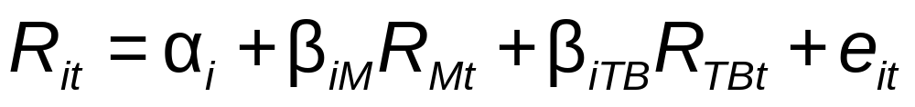
7.4 Multifactor Models and CAPM
Multifactor models
Models of security returns that respond to several systematic factors
Two-index portfolio in realized returns
  Two-factor SML

Slide 26
7.4 Multifactor Models and CAPM
Fama-French Three-Factor Model
      r_{HML} = returns of high book-to-market firms minus returns of low book-to-market firms = B/M premium
      r_{SMB} = returns of small firms minus returns of large (big) firms = size premium
Estimation results
  Three aspects of successful specification
    Higher adjusted R-square
    Lower residual SD
    Smaller value of alpha

Slide 27
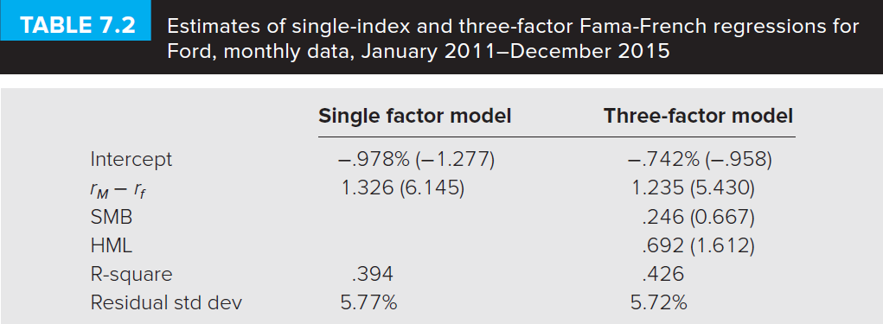
Table 7.2 Multifactor Models and CAPM

Slide 28
7.5 Arbitrage Pricing Theory
Arbitrage
Relative mispricing creates riskless profit
Arbitrage Pricing Theory (APT)
Risk-return relationships from no-arbitrage considerations in large capital markets
Well-diversified portfolio
Nonsystematic risk is negligible
Arbitrage portfolio
Positive return, zero-net-investment, risk-free portfolio

Slide 29
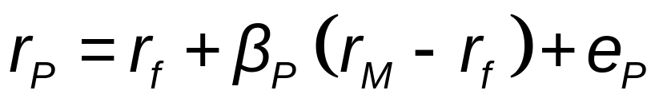
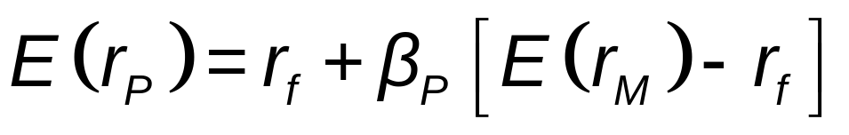
7.5 Arbitrage Pricing Theory
Calculating APT
Returns on well-diversified portfolio

Slide 30
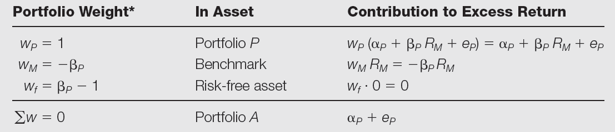
Table 7.5 Portfolio Conversion
Steps to convert a well-diversified portfolio into an arbitrage portfolio:
*When alpha is negative, you would reverse the signs of each portfolio weight to achieve a portfolio A with positive alpha and no net investment.

Slide 31
Table 7.5 Portfolio Conversion
Well-diversified portfolio, A, with beta = 0.4
Return = r_{f} + 0.4(r_{M} – r_{f})
Mimicking portfolio with 0.6 invested in T-bills and 0.4 invested in market portfolio
Return = 0.6r_{f} +0.4r_{M} = r_{f} +0.4(r_{M} – r_{f})
Buy $5 of Portfolio A and sell short $5 of the mimicking portfolio

Slide 32
Table 7.5 Portfolio Conversion
Investment Position
Buy in Portfolio A $5[r_{f} + 0.4(r_{M} – r_{f}) + α_{P}]
Short mimicking port. -$5[r_{f} +0.4(r_{M} – r_{f})]
Net Profit $5α_{P}

Slide 33
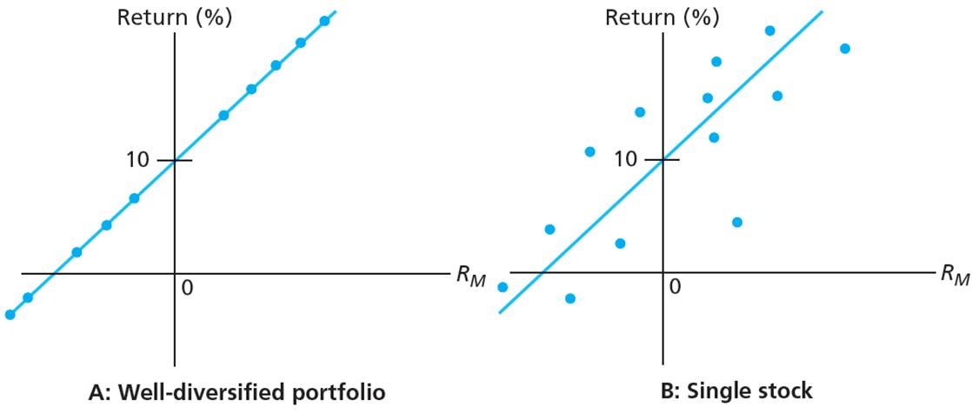
Figure 7.5 Security Characteristic Lines

Slide 34
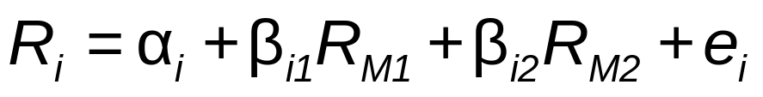
7.5 Arbitrage Pricing Theory
Multifactor Generalization of APT and CAPM
Factor portfolio
  Well-diversified portfolio constructed to have beta of 1.0 on one factor and beta of zero on any other factor
Two-Factor Model for APT
    R_{M1} might represent ∆ in manufacturing
    R_{M2} might represent ∆ in interest rates or inflation

Slide 35
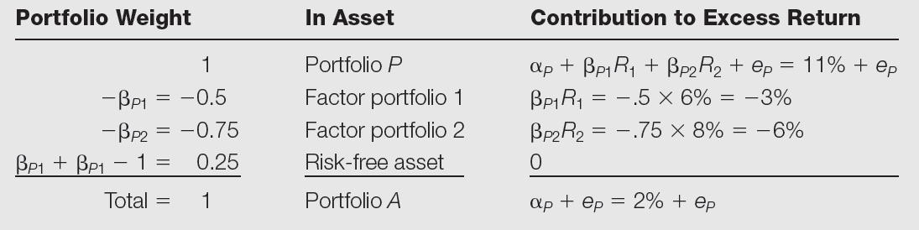
Table 7.9 Constructing an Arbitrage Portfolio
Constructing an arbitrage portfolio with two systemic factors

