Slide 1

Essentials of Investments
Eleventh Edition
Bodie, Kane, and Marcus
Chapter 8
The Efficient Market Hypothesis
© 2019 McGraw-Hill Education. All rights reserved. Authorized only for instructor use in the classroom. No reproduction or further distribution permitted without the prior written consent of McGraw-Hill Education.

Slide 2
8.1 Random Walks and
Efficient Market Hypothesis
Random Walk
Notion that stock price changes are random
Efficient Market Hypothesis (EMH)
Prices of securities fully reflect available information

Slide 3
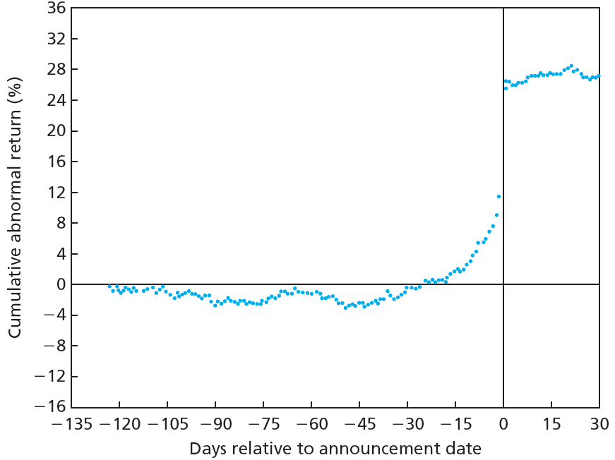
Figure 8.1 Cumulative Abnormal Returns before Takeover Attempts: Target Companies

Slide 4
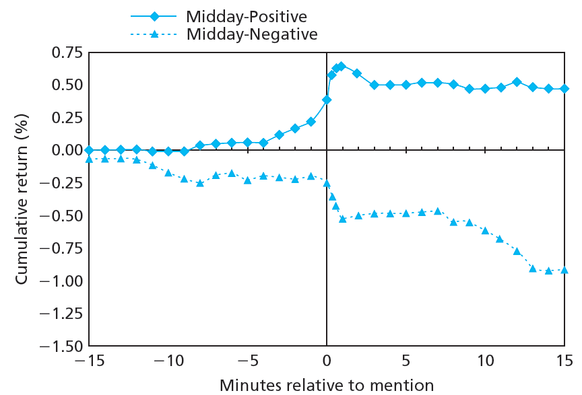
Figure 8.2 Stock Price Reaction to CNBC Reports

Slide 5
8.1 Random Walks and
Efficient Market Hypothesis
Competition as Source of Efficiency
Investor competition should imply stock prices reflect available information
Investors exploit available profit opportunities
Competitive advantage can verge on insider trading—corporate espionage

Slide 6
8.1 Efficient Market Hypothesis: Versions
Weak-form EMH: Stock prices already reflect all information contained in history of trading
Semistrong-form EMH: Stock prices already reflect all public information
Strong-form EMH: Stock prices already reflect all relevant information, including inside information
Strong-
form
set
Semistrong-
form
set
Weak-
form
set

Slide 7
8.2 Implications of the EMH
Technical Analysis
Research on recurrent/predictable price patterns and on proxies for buy/sell pressure in market
Believe history repeats itself
Do not search for mispriced securities
Resistance Level
Unlikely for stock/index to rise above
Support Level
Unlikely for stock/index to fall below

Slide 8
Implications of the EMH
Fundamental Analysis
Research on determinants of stock value; i.e., earnings, dividend prospects, future interest rate expectations and firm risk
Assumes stock price equal to discounted value of expected future cash flow
Search for mispriced securities might be useless

Slide 9
Implications of the EMH
Active versus Passive Portfolio Management
Active investment strategy
  Evaluate securities to determine their intrinsic values
  Search for mispriced securities
Passive investment strategy
  Buy well-diversified portfolio without attempting to find mispriced securities
  Follow a simple buy-and-hold strategy
  Believe active management is a waste of time and effort
Index fund
  Common strategy—buy a mutual fund that represents (mimics) the market
  ETF

Slide 10
8.2 Implications of the EMH
Role of Portfolio Management in Efficient Market
Active management assumes market inefficiency
Passive management consistent with semistrong efficiency
Portfolio management is still necessary
  To achieve risk preferences
  Tax considerations
Inefficient market pricing leads to inefficient resource allocation

Slide 11
8.3 Are Markets Efficient? Issues
Magnitude issue: Efficiency is relative, not binary
Selection bias issue
Investors who find successful investment schemes are less inclined to share findings
Observable favorable outcomes preselected in favor of failed attempts
Lucky event issue: Lucky investments receive disproportionate attention

Slide 12
8.3 Are Markets Efficient? Weak Form Tests
Weak-Form Tests: Patterns in Stock Returns
Returns over short horizons
  Momentum effect: Tendency of poorly- or well-performing stocks to continue abnormal performance in following periods
Returns over long horizons
  Reversal effect: Tendency of poorly- or well-performing stocks to experience reversals in following periods

Slide 13
8.3 Are Markets Efficient?
Predictors of Broad Market Performance
1988—Fama and French: Return on aggregate stock market tends to be higher when dividend yield is low
1988—Campbell and Shiller: Earnings yield can predict market returns
1986—Keim and Stambaugh: Bond market data (spread between yields) can predict market returns

Slide 14
8.3 Are Markets Efficient?
Semistrong Tests: Market Anomalies
Anomalies
  Patterns of returns contradicting EMH
P/E effect
  Portfolios of low P/E stocks exhibit higher average risk-adjusted returns than high P/E stocks
Small-firm effect
  Stocks of small firms can earn abnormal returns, primarily in January

Slide 15
8.3 Are Markets Efficient? Semistrong Tests
Semistrong Tests: Market Anomalies
Neglected-firm effect
  Stock of little-known firms can generate abnormal returns
Book-to-market effect
  Shares of high book-to-market firms can generate abnormal returns

Slide 16
8.3 Are Markets Efficient? Semistrong Tests
Semistrong Tests: Market Anomalies
Post-earnings announcement price drift
  Sluggish response of stock price to firm’s earnings announcement
  Abnormal return on announcement day, momentum continues past market price
Bubbles and market efficiency
  Speculative bubbles can raise prices above intrinsic value—irrational exuberance?
  Even if prices are inaccurate, it can be difficult to take advantage of them
  Bubbles are known only after they burst

Slide 17
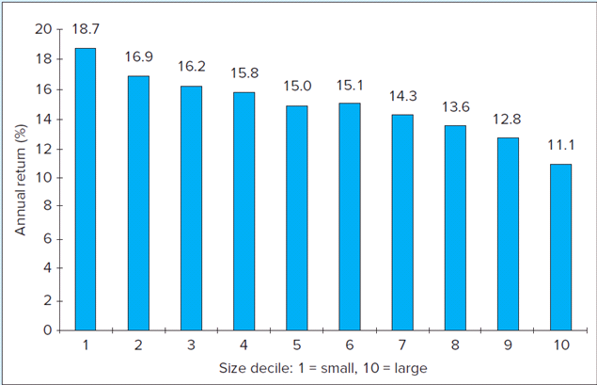
Average Annual Return: Ten Size-Based Portfolios
FIGURE 8.3
Average annual return for 10 size-based portfolios, 1926-2016

Slide 18
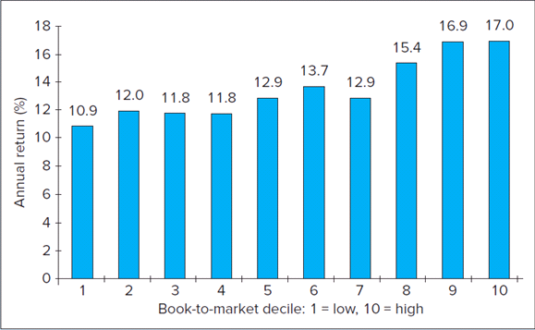
Annual Return as Function of
Book-to-Market Ratio
FIGURE 8.4
Average annual return as a function of the book-to-market ratio, 1926-2016

Slide 19
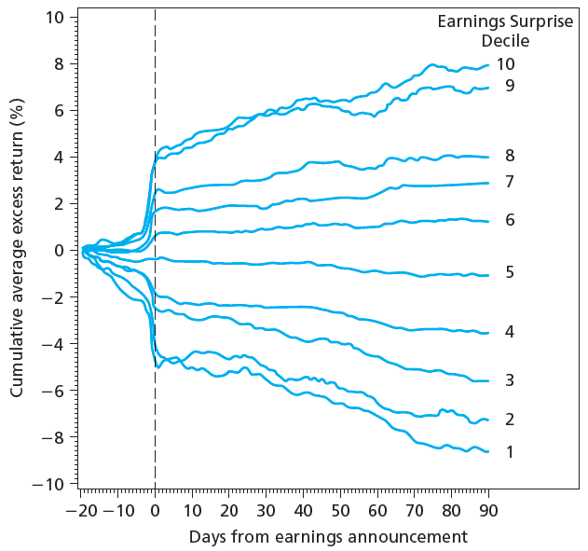
Figure 8.5 Cumulative Abnormal Returns after Earnings Announcements

Slide 20
8.3 Are Markets Efficient?
Interpreting Anomalies
Risk premiums or inefficiencies?
  Fama and French: Market phenomena can be explained as manifestations of risk premiums
  Lakonishok, Shleifer, and Vishny: Market phenomena are evidence of inefficient markets

Slide 21
8.3 Are Markets Efficient?
Interpreting Anomalies
Anomalies or data mining?
  Some anomalies have not shown staying power after being reported
    Small-firm effect
    Book-to-market effect

Slide 22
8.4 Mutual Fund and Analyst Performance
Stock Market Analysis
Analysts are overly positive about firm prospects
  Womack: Positive changes associated with 5% increase, negative with 11% decrease
  Jegadeesh, Kim, Kristie, and Lee: Level of consensus is inconsistent predictor of future performance
  Barber, Lehavy, McNichols, and Trueman: Firms with most-favorable recommendations outperform firms with least-favorable recommendations

Slide 23
8.4 Mutual Fund and Analyst Performance
Mutual Fund Managers
Today’s conventional model: Fama-French factors plus momentum factor
Wermers: Funds show positive gross alphas; negative net alphas after controlling for fees, risk
Carhart: Minor persistence in relative performance across managers, largely due to expense/transaction costs

Slide 24
8.4 Mutual Fund and Analyst Performance
Mutual Fund Managers
Berk and Green: Skilled managers with abnormal performance will attract new funds until additional cost, complexity drives alphas to zero
Chen, Ferson, and Peters: On average, bond mutual funds outperform passive bond indexes in gross returns, underperform once fees subtracted

Slide 25
8.4 Mutual Fund and Analyst Performance
Mutual Fund Managers
Kosowski, Timmerman, Wermers, and White: Stock-pricing ability of minority of managers sufficient to cover costs; performance persists over time
Samuelson: Records of most managers show no easy strategies for success

Slide 26
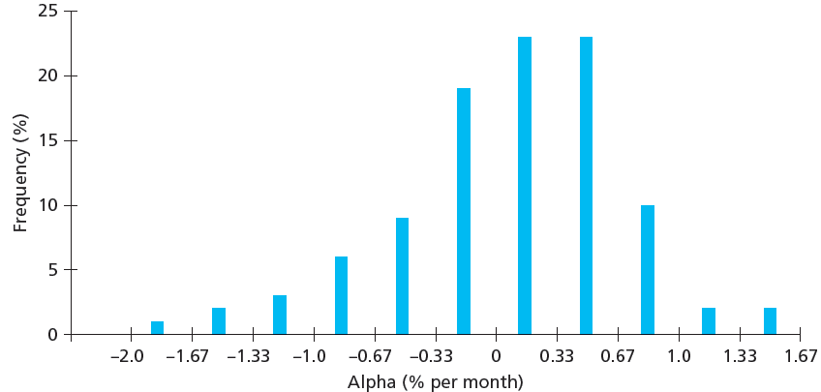
Figure 8.7 Mutual Fund Alphas Computed Using Four-Factor Model, 1993-2007

Slide 27
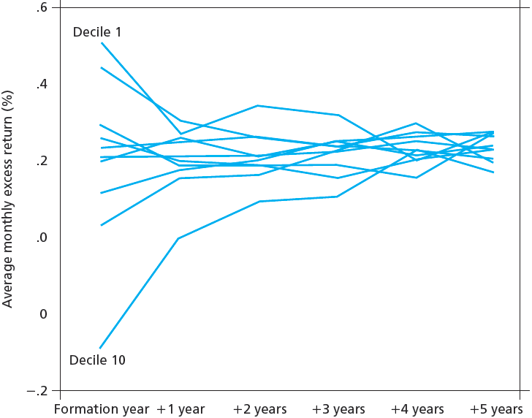
Figure 8.8 Persistence of Mutual Fund Performance

Slide 28
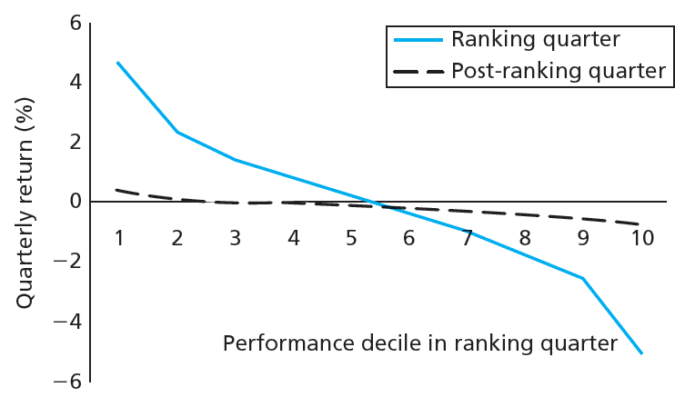
Figure 8.9 Risk-Adjusted Performance in Ranking Quarter, Following Quarter

Slide 29
8.4 Mutual Fund and Analyst Performance
So, Are Markets Efficient?
Enough that only differentially superior information will earn money
Professional manger’s margin of superiority likely too slight for statistical significance

