Slide 1

Essentials of Investments
Eleventh Edition
Bodie, Kane, and Marcus
Chapter 9
Behavioral Finance and Technical Analysis
© 2019 McGraw-Hill Education. All rights reserved. Authorized only for instructor use in the classroom. No reproduction or further distribution permitted without the prior written consent of McGraw-Hill Education.

Slide 2
9.1 Behavioral Critique
Behavioral Finance
Financial Market model emphasizing potential implications of psychological factors affecting investor behavior
Investors might not process information correctly.
Even if investors process information correctly, they might make irrational or suboptimal decisions
Existence of irrational investors is not sufficient to render capital Markets inefficient
Arbitrageurs exist
Ability to take advantage of arbitrage opportunities might be restricted

Slide 3
9.1 Behavioral Finance: Information Processing
Information Processing—errors in information processing can lead to mis-estimation of true events/populations.
Forecasting errors
  People overvalue recent experience compared to prior belief when forecasting (memory bias)
  People overestimate based on recent memories
Overconfidence
  People overestimate precision of beliefs or forecasts and overestimate their abilities (e.g., mutual fund mgrs.).
  Overconfidence—people believe they are very adept at active portfolio management.

Slide 4
9.1 Behavioral Finance: Information Processing
Information Processing
Conservatism bias
  Investors too slow in updating beliefs in response to recent evidence
  Investors “sit on the sidelines” for a while
  Sample size neglect and representativeness bias
  People are prone to believe a small sample is representative of population, which leads them to infer patterns too quickly

Slide 5
9.1 Behavioral Finance: Behavioral Biases
Behavioral Biases—even if information is processed correctly, investors might act irrationally when making decisions
Framing
  Decisions affected by how choices are posed; i.e., gains relative to low baseline level or losses relative to higher baseline

Slide 6
9.1 Behavioral Finance: Behavioral Biases
Behavioral Biases
  Mental accounting
    Form of framing; people segregate certain decisions
  Example: An investor might manage a retirement fund conservatively, but he or she speculates with funds that are considered “house money.”
  More likely to sell stocks that have large gains than stocks with large losses (disposition effect)

Slide 7
9.1 Behavioral Finance: Behavioral Biases
Behavioral Biases
Regret avoidance
  People blame themselves for unconventional choices that turn out badly
  Avoid regret by making conventional decisions
Affect
  Feeling of “good” or “bad”
  Investors might purchase stocks of companies that make them feel good; e.g., “green” firms.

Slide 8
9.1 Behavioral Critique: Prospect Theory
Prospect Theory
Challenges conventional view of the relationship between wealth and utility
Utility is a function of change in wealth
Investor utility depends on gains/losses from starting position, rather than levels of wealth
Investors might be willing to take more risks after losing

Slide 9
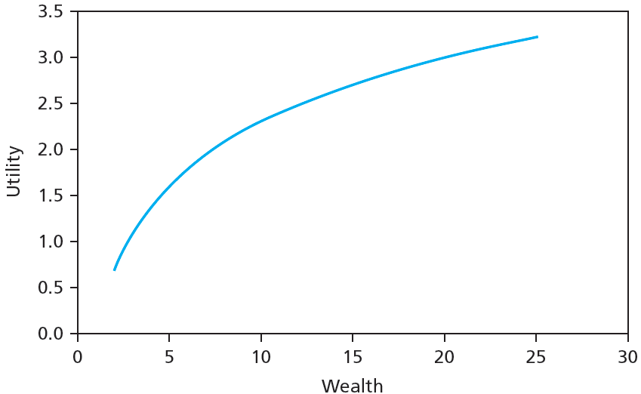
Figure 9.1A Conventional Utility Function

Slide 10
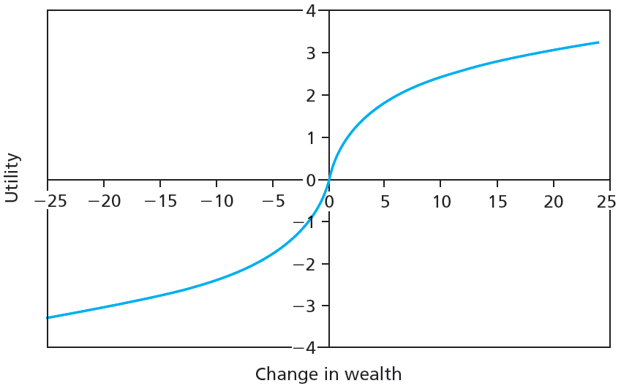
Figure 9.1B Utility Function under Prospect Theory

Slide 11
9.1 Behavioral Critique
Limits to Arbitrage—perhaps profits from arbitrage opportunities are limited
Fundamental risk
  Market changes or irrationality can eliminate profits; quick to make conclusions about current situation rather than consider long-term
  Price movements might not occur as expected

Slide 12
9.1 Behavioral Critique
Limits to Arbitrage
Implementation costs
  Exploiting overpricing is difficult; costs and time limits can eliminate profits
Model risk
  Inaccurate models generate inaccurate stock values
  Maybe the stock is not actually mispriced

Slide 13
9.1 Behavioral Critique
Limits to Arbitrage and Law of One Price
Law of One Price—identical investments (assets) should have the same price at the same time
“Siamese twin” companies
  Dual-listed/merged companies can appear to violate Law of One Price
Equity carve-outs
  Can violate Law of One Price due to inability to short sell
  Synergistic values; 2 + 2 =5

Slide 14
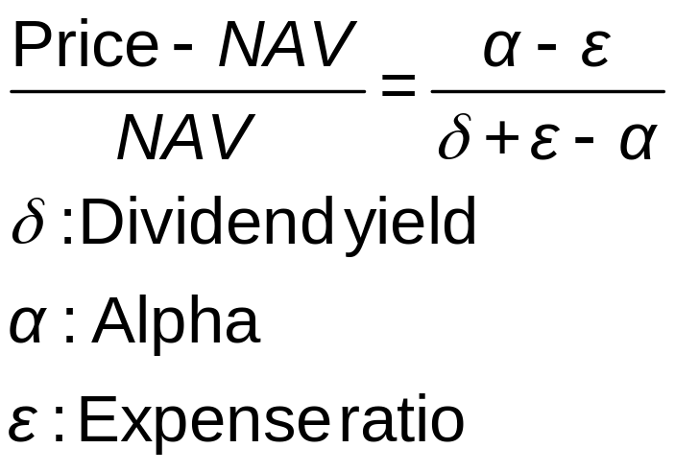
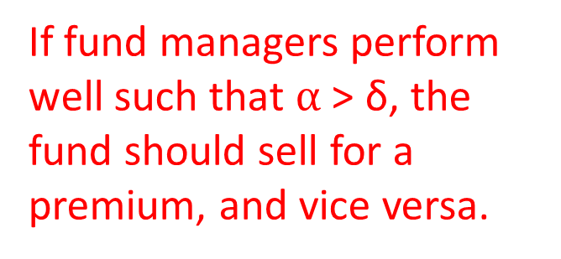
9.1 Behavioral Critique
Limits to Arbitrage and Law of One Price
Closed-end funds
  Premium of fund over net asset value
If fund managers perform well such that $α$ > δ, the fund should sell for a premium, and vice versa.

Slide 15
9.1 Behavioral Critique
Bubbles and Behavioral Economics
A bubble is characterized by a surge in investment prices that does not conform to fundamental valuation models.
Evidence of irrational investor behavior
Easier to identify once over

Slide 16
9.1 Behavioral Critique
Evaluating Behavioral Critique
No coherent theory—does not provide guidance as to how to exploit investors’ irrationality
How investors irrationality affect prices is unknown—numerous explanations are given
Most empirical support from one time period: late ‘90s

Slide 17
9.2 Technical Analysis and Behavioral Finance
Technicians do not deny that fundamentalists can find the intrinsic value of a stock; they simply are too slow in determining that value
Trends and Corrections
Moving average
  Average price over given interval; e.g. 50-day moving average
  Interval (window) is updated over time
  Attempts to identify underlying price trends

Slide 18
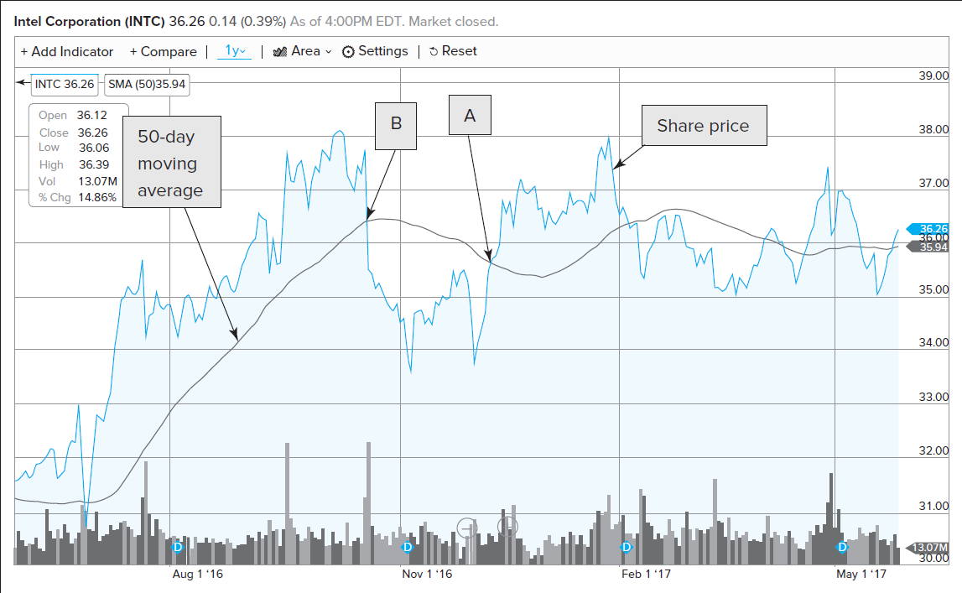
Figure 9.3 Share Price, 50-Day Moving Average for Intel
Break through—suggests reversal of trend

Slide 19
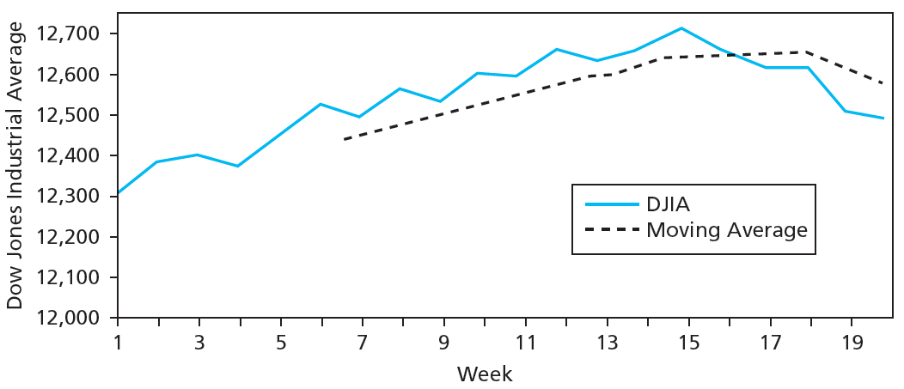
Figure 9.4 Moving Averages
EXAMPLE 9.4 Moving Averages (concluded)
Break through

Slide 20
9.2 Technical Analysis and Behavioral Finance
Trends and Corrections
Point and figure charts
  Traces significant upward/downward movements in prices without regard to timing
  X denotes price increase, O denotes decrease
  Sell/Buy signals generated when stock penetrates previous lows/highs
  Congestion area: Horizontal band of Xs/Os created by price reversals

Slide 21
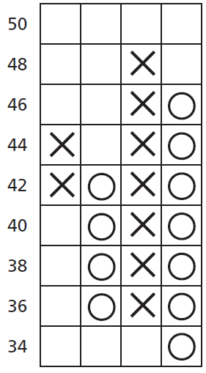
Figure 9.5 Point and Figure Chart for Table 9.1

Slide 22
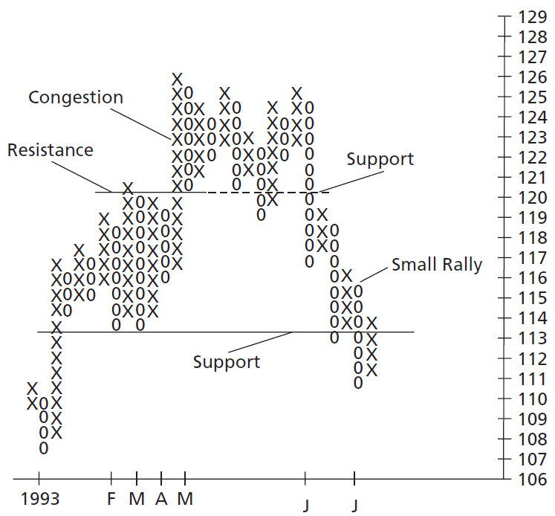
Figure 9.6 Point and Figure Chart for Atlantic Richfield

Slide 23
9.2 Technical Analysis and Behavioral Finance
Trends and Corrections
Breadth
  Extent to which broad Market index movements affect individual stock prices
  Advance-decline data
Relative Strength
  Recent performance of given stock/industry compared to that of broad Market index
  Ratio of individual stock price to either an industry index or a market index

Slide 24
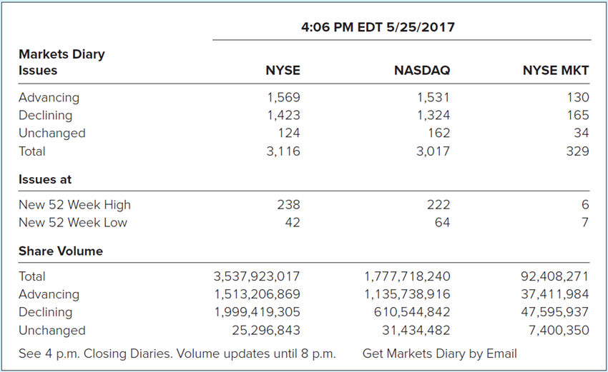
Figure 9.7 Market Diary
Source: The Wall Street Journal Online, May 25, 2017.

Slide 25
Table 9.2 Breadth
Day | Advances | Declines | Net Advances | Cumulative Breadth
1 | 1,802 | 1,748 | 54 | 54
2 | 1,917 | 1,640 | 277 | 331
3 | 1,703 | 1,772 | −69 | 262
4 | 1,512 | 2,122 | −610 | −348
5 | 1,633 | 2,004 | −371 | −719

Slide 26
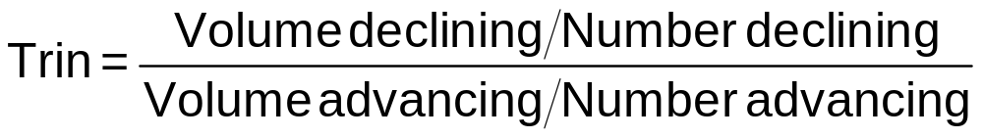
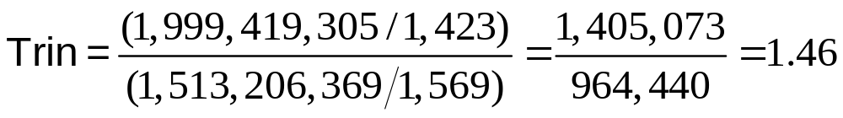
9.2 Technical Analysis and Behavioral Finance
Sentiment Indicators
Trin statistic
  Ratio of average volume in declining issues to average volume in advancing issues
  Market advances are considered favorable when accompanied by increased trading volume
  Trin > 1.0 suggests bearish trading

Slide 27
9.2 Technical Analysis and Behavioral Finance
Sentiment Indicators—level of investor optimism
Confidence index
  Ratio of top-rated corporate bond yield to intermediate-grade bond yield
  A narrow spread suggests traders are optimistic about the economy

Slide 28
9.2 Technical Analysis and Behavioral Finance
Sentiment Indicators
Short interest
  Total number of shares currently short-sold in Market
  Bullish or bearish?
  Short sellers generally are sophisticated investors.
Put/call ratio
  Ratio of put options to call options outstanding on stock
  A higher value suggests investor pessimism

Slide 29
9.2 Technical Analysis and Behavioral Finance
A Warning
People perceive patterns where none exist
Data mining generates apparent patterns within limited data sets
When evaluating rules, ask whether rule would be reasonable before looking at data

Slide 30
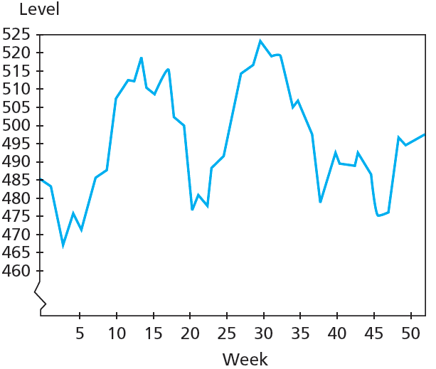
Figure 9.8A Actual Stock Price Levels, 52 Weeks

Slide 31
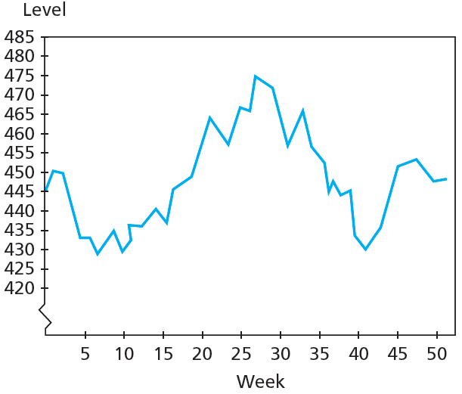
Figure 9.8B Simulated Stock Price Levels, 52 Weeks

Slide 32
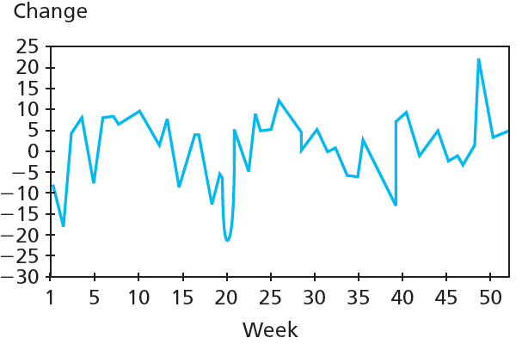
Figure 9.9A Actual Weekly Stock Price Changes, 52 Weeks

Slide 33
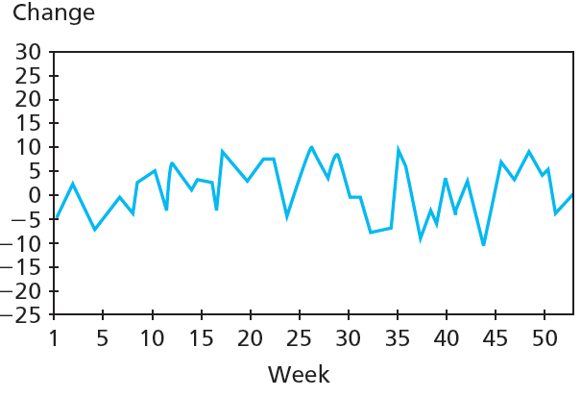
Figure 9.9B Simulated Weekly Stock Price Changes, 52 Weeks

