Slide 1

Essentials of Investments
Eleventh Edition
Bodie, Kane, and Marcus
Chapter 10
Bond Prices and Yield
© 2019 McGraw-Hill Education. All rights reserved. Authorized only for instructor use in the classroom. No reproduction or further distribution permitted without the prior written consent of McGraw-Hill Education.

Slide 2
10.1 Bond Characteristics (1 of 10)
Bond
Security that obligates issuer to make payments to holder over time
Face Value, Par Value
Payment to bondholder at maturity of bond
Coupon Rate
Bond’s annual interest payment per dollar of par value
Zero-Coupon Bond
Pays no coupons, sells at discount, provides only payment of par value at maturity

Slide 3
Prices/Yields of U.S. Treasury Bonds
FIGURE 10.1
Prices and yields of U.S. Treasury bonds, February 15, 2017
Source: The Wall Street Journal Online, April 22, 2017.
Maturity | Coupon | Bid | Ask | Chg | Ask yield to maturity
15-Feb-2018 | 3.500 | 102.5000 | 102.5156 | −0.0547 | 0.959
31-Dec-2020 | 1.750 | 99.7188 | 99.7344 | −0.1406 | 1.821
15-Nov-2022 | 1.625 | 97.0938 | 97.1094 | −0.2188 | 2.163
15-Feb-2026 | 1.625 | 92.9141 | 92.9297 | −0.2734 | 2.508
15-Feb-2026 | 6.000 | 128.4922 | 128.5078 | −0.3438 | 2.450
15-May-2030 | 6.250 | 140.5547 | 140.6172 | −0.4453 | 2.604
15-Nov-2043 | 3.750 | 112.3984 | 112.4297 | −0.7734 | 3.065
15-Feb-2047 | 3.000 | 98.2500 | 98.2813 | −0.5703 | 3.088
Source: Wall Street Journal Online, August 15, 2014.

Slide 4
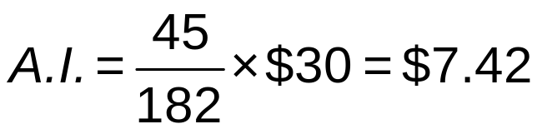
10.1 Bond Characteristics (2 of 10)
Treasury Bonds and Notes
Accrued interest and quoted bond prices
  Quoted prices do not include interest accruing between payment dates
Example: Consider a bond with the following characteristics: Semi-annual payments, coupon rate of 6%, $1,000 par value. If 45 days have passed since the last coupon payment, what is the accrued interest?

Slide 5
Figure 10.2 Listing of Corporate Bonds
Source: FINRA (Financial Industry Regulatory Authority), May 30, 2017.
Issuer Name | Symbol | Coupon | Maturity | Moody’s®/S&P | High | Low | Last | Change | Yield%
NORTHWESTERN UNIV | NWUA4062616 | 4.643% | 12/01/2044 | /AAA | 118.50400 | 118.30400 | 118.50400 | 2.245000 | 3.579884
SANOFIS A | SNY3990861 | 1.250% | 04/10/2018 | A1/ | 99.94500 | 99.82800 | 99.91960 | 0.143600 | 1.344026
MORGAN STANLEY | MS4190343 | 1.875% | 01/05/2018 | A3/BBB+ | 100.38300 | 100.12700 | 100.30600 | −0.060733 | 1.355591
WESTPAC BKG CORP | WBK4461873 | 2.150% | 03/06/2020 | Aa2/ | 100.38400 | 100.27000 | 100.38400 | 0.075000 | 2.005983
ROYAL BK CDA | RY4207609 | 1.875% | 02/05/2020 | Aaa/ | 99.89200 | 99.81200 | 99.81200 | 0.079000 | 1.946994
CREDIT SUISSE AG NEW YORK BRH MEDIUM TER | CS4237858 | 1.700% | 04/27/2018 | A1/A | 100.09500 | 100.03600 | 100.07600 | 0.053000 | 1.614536
PACCAR FINL CORP MEDIUM TERM SR NTS BOOK | PCAR4361418 | 1.300% | 05/10/2019 | A1/A+ | 99.18213 | 99.05900 | 99.11600 | 0.050000 | 1.764976
HSBC USA INC | HBC4217868 | 2.350% | 03/05/2020 | A2/A | 100.76200 | 100.56400 | 100.56400 | −0.214000 | 2.137972

Slide 6
10.1 Bond Characteristics (3 of 10)
Corporate Bonds
Call provisions on corporate bonds
  Callable bonds: May be repurchased by issuer at specified call price during call period
Convertible bonds
  Allow bondholder to exchange bond for specified number of common stock shares

Slide 7
10.1 Bond Characteristics (4 of 10)
Corporate Bonds
Puttable bonds
  Holder may choose to exchange for par value or to extend for given number of years
Floating-rate bonds
  Coupon rates periodically reset according to specified market date

Slide 8
10.1 Bond Characteristics (5 of 10)
Preferred Stock
Commonly pays fixed dividend
  Floating-rate preferred stock becoming more popular
Dividends not normally tax-deductible
  Corporations that purchase other corporations’ preferred stock are taxed on only 30% of dividends received

Slide 9
10.1 Bond Characteristics (6 of 10)
Other Domestic Issuers
State, local governments (municipal bonds)
Federal Home Loan Bank Board
Farm Credit agencies
Ginnie Mae, Fannie Mae, Freddie Mac

Slide 10
10.1 Bond Characteristics (7 of 10)
International Bonds
Foreign bonds
  Issued by borrower in different country than where bond sold
  Denominated in currency of market country
Eurobonds
  Denominated in currency (usually that of issuing country) different than that of market

Slide 11
10.1 Bond Characteristics (8 of 10)
Innovation in the Bond Market
Inverse floaters
  Coupon rate falls when interest rates rise
Asset-backed bonds
  Income from specified assets used to service debt

Slide 12
10.1 Bond Characteristics (9 of 10)
Innovation in the Bond Market
Pay-in-kind bonds
  Issuers can pay interest in cash or additional bonds
Catastrophe bonds
  Higher coupon rates to investors for taking on risk

Slide 13
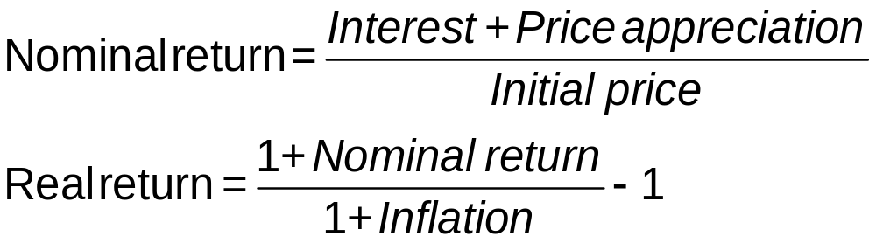
10.1 Bond Characteristics (10 of 10)
Innovation in the Bond Market
Indexed bonds
  Payments tied to general price index/price of particular commodity
  Treasury Inflation Protected Securities (TIPS): Par value of bond increases with consumer price index

Slide 14
Table 10.1 TIPS, Principal and Interest Payments
Principal and interest payments for a Treasury Inflation Protected Security
Time | Inflation in Year Just Ended | Par Value | Coupon Payment | + | Principal Repayment | = | Total Payment
0 |  | $1,000.00
1 | 2% | 1,020.00 | $40.80 |  | 0 |  | $ 40.80
2 | 3 | 1,050.60 | 42.02 |  | 0 |  | 42.02
3 | 1 | 1,061.11 | 42.44 |  | $1,061.11 |  | 1,103.55

Slide 15
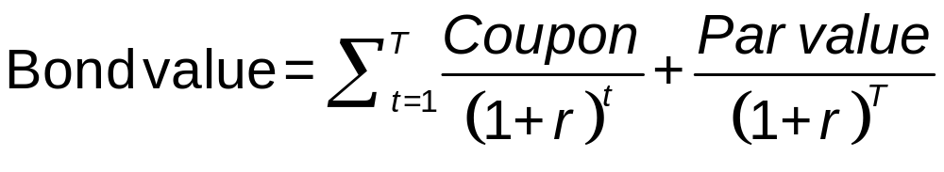
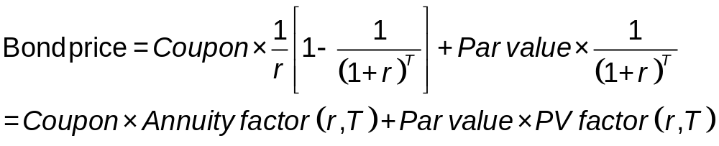
10.2 Bond Pricing (1 of 3)
Bond value = Present value of coupons + Present par value
T = Maturity date
r = discount rate

Slide 16
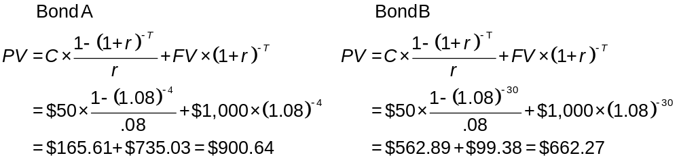
10.2 Bond Pricing: Example
What is the price of the following two bonds:
 | Bond A | Bond B
Maturity (T) | 4 Years | 30 Years
Coupon Rate (C) | 5% | 5%
Discount Rate (r) | 8% | 8%
Par Value (FV) | $1,000 | $1,000
Present Value of Coupons: $165.61, $562.89
Present Par Value: $735.03, $99.38

Slide 17
10.2 Bond Pricing (2 of 3)
Prices fall as market interest rate rises
Interest rate fluctuations are primary source of bond market risk
Bonds with longer maturities more sensitive to fluctuations in interest rate

Slide 18
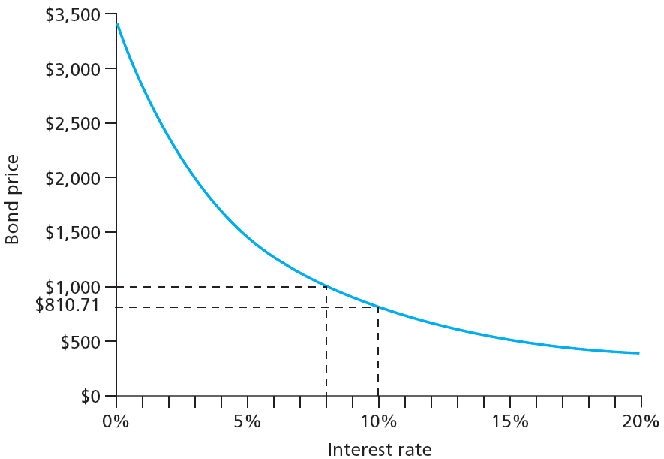
Figure 10.3 Inverse Relationship between Bond Prices and Yields
Jump to long description

Slide 19
Table 10.2 Bond Prices at Different Interest Rates
Time to Maturity | Bond Price at Given Market Interest Rate: 2% | Bond Price at Given Market Interest Rate: 4% | Bond Price at Given Market Interest Rate: 6% | Bond Price at Given Market Interest Rate: 8% | Bond Price at Given Market Interest Rate: 10%
1 year | $1,059.11 | $1,038.83 | $1,019.1 3 | $1,000.00 | $981.41
10 years | 1,541.37 | 1,327.03 | 1,148.77 | 1,000.00 | 875.38
20 years | 1,985.04 | 1,547.11 | 1,231.15 | 1,000.00 | 828.41
30 years | 2,348.65 | 1,695.22 | 1,276.76 | 1,000.00 | 810.71

Slide 20
10.2 Bond Pricing (3 of 3)
Bond Pricing between Coupon Dates
Invoice price = Flat price + Accrued interest
Bond Pricing in Excel
=PRICE (settlement date, maturity date, annual coupon rate, yield to maturity, redemption value as percent of par value, number of coupon payments per year)

Slide 21
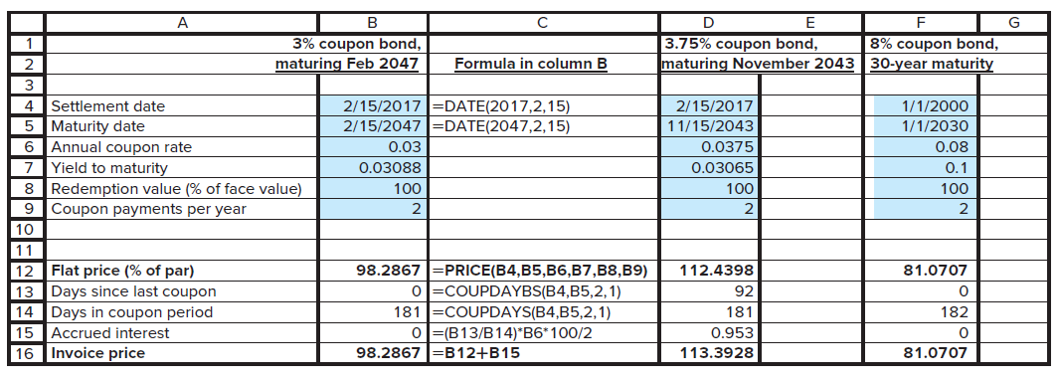
Spreadsheet 10.1 Valuing Bonds
Jump to long description
Notes:
Note: Spreadsheets available in Connect

Slide 22
10.3 Bond Yields (1 of 3)
Yield to Maturity
Discount rate that makes present value of bond’s payments equal to price.
Current Yield
Annual coupon divided by bond price
Premium Bonds
Bonds selling above par value
Discount Bonds
Bonds selling below par value

Slide 23
Spreadsheet 10.2 Finding Yield to Maturity
 | Semiannual coupons | Annual coupons
Settlement date | 1/1/2000 | 1/2/2000
Maturity date | 1/1/2030 | 1/2/2030
Annual coupon rate | 0.08 | 0.08
Bond price (flat) | 127.676 | 127.676
Redemption value (% of face value) | 100 | 100
Coupon payments per year | 2 | 1
Yield to maturity (decimal) | 0.0600 (YIELD) | 0.0599
The formula entered here is =YIELD(B3,B4,B5,B6,B7,B8)

Slide 24
10.3 Bond Yields (2 of 3)
Yield to Call
Calculated like yield to maturity
Time until call replaces time until maturity; call price replaces par value
Premium bonds more likely to be called than discount bonds

Slide 25
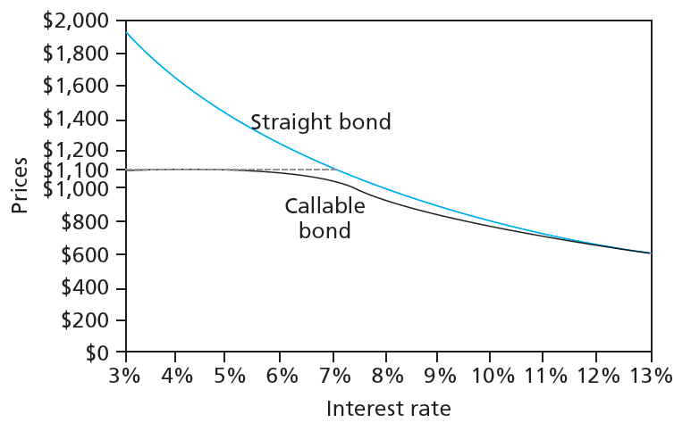
Figure 10.4 Bond Prices: Callable and Straight Debt
Jump to long description

Slide 26
10.3 Bond Yields (3 of 3)
Realized Compound Returns versus Yield to Maturity
Realized compound return
  Compound rate of return on bond with all coupons reinvested until maturity
Horizon analysis
  Analysis of bond returns over multiyear horizon
  Based on forecasts of bond’s YTM and investment options
Reinvestment rate risk
  Uncertainty surrounding cumulative future value of reinvested coupon payments

Slide 27
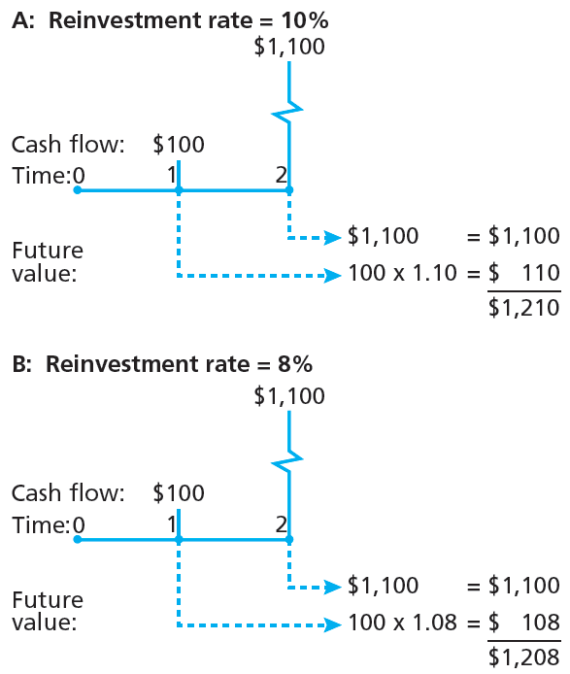
Figure 10.5 Growth of Invested Funds
Jump to long description

Slide 28
10.4 Bond Prices Over Time (1 of 3)
Yield to Maturity versus Holding Period Return (HPR)
Yield to maturity measures average RoR if investment held until bond matures
HPR is RoR over particular investment period; depends on market price at end of period

Slide 29
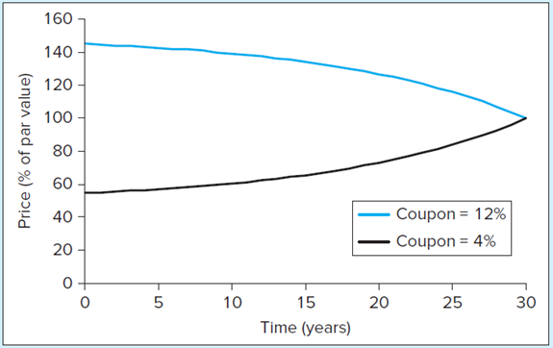
Figure 10.6 Price Paths of Coupon Bonds in Case of Constant Market Interest Rates
Price path of two 30-year maturity bonds each selling at a yield to maturity of 8%. Bond price approaches par value as maturity date approaches.
Jump to long description

Slide 30
10.4 Bond Prices Over Time (2 of 3)
Zero-Coupon Bonds and Treasury STRIPS
Zero-coupon bond: Carries no coupons, provides all return in form of price appreciation
Separate Trading of Registered Interest and Principal of Securities (STRIPS): Oversees creation of zero-coupon bonds from coupon-bearing notes and bonds

Slide 31
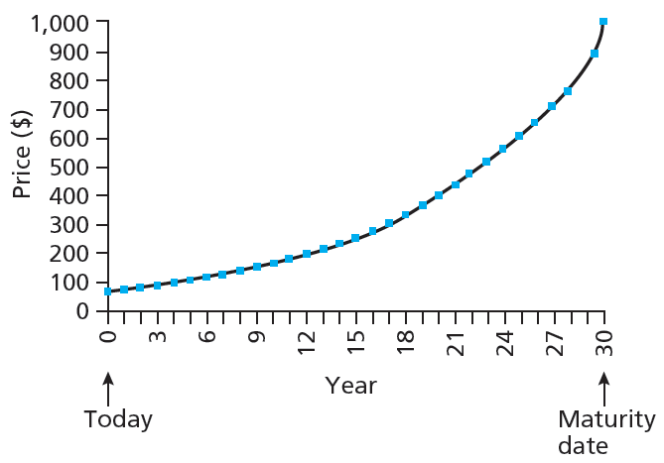
Figure 10.7 Price of 30-Year Zero-Coupon Bond over Time at Yield to Maturity of 10%
Jump to long description

Slide 32
10.4 Bond Prices Over Time (3 of 3)
After-Tax Returns
Built-in price appreciation on original-issue discount bonds constitutes implicit interest payment to holder
IRS calculates price appreciation schedule to determine taxable interest income for built-in appreciation

Slide 33
10.5 Default Risk and Bond Pricing (1 of 7)
Investment grade bond
Rated BBB and above by S&P or Baa and above by Moody’s
Speculative grade or junk bond
Rated BB or lower by S&P, Ba or lower by Moody’s, or unrated

Slide 34
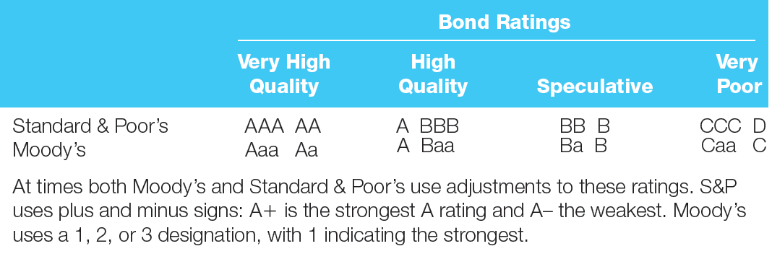
Figure 10.8 Bond Rating Classes
Jump to long description

Slide 35
10.5 Default Risk and Bond Pricing (2 of 7)
Determinants of Bond Safety
Coverage ratios: Company earnings to fixed costs
Leverage ratio: Debt to equity
Liquidity ratios
  Current: Current assets to current liabilities
  Quick: Assets excluding inventories to liabilities

Slide 36
10.5 Default Risk and Bond Pricing (3 of 7)
Determinants of Bond Safety
Profitability ratios: Measures of RoR on assets or equity
Cash flow-to-debt ratio: Total cash flow to outstanding debt

Slide 37
Financial Ratios and Default Risk
TABLE 10.3 Financial ratios by rating class
 | Aaa | Aa | A | Baa | Ba | B | C
EBITA/Assets (%) | 20.9% | 15.6% | 13.8% | 10.9% | 9.1% | 7.1% | 4.0%
Operating profit margin (%) | 22.0% | 17.1% | 17.6% | 14.1% | 11.2% | 8.9% | 4.1%
EBITA to interest coverage (multiple) | 28.9 | 15.1 | 9.7 | 5.9 | 3.5 | 1.7 | 0.6
Debt/EBITDA (multiple) | 0.58 | 2.03 | 1.83 | 2.58 | 3.41 | 5.26 | 8.35
Debt/(Debt + Equity) | 19.3% | 50.2% | 38.6% | 46.2% | 51.7% | 72.0% | 98.0%
Funds from operations/Total debt (multiple) | 1.335 | 0.385 | 0.425 | 0.296 | 0.206 | 0. 120 | 0.031
Retained cash flow/Net debt (multiple) | 1.3 | 0.3 | 0.4 | 0.3 | 0.2 | 0. 1 | 0.0

Slide 38
10.5 Default Risk and Bond Pricing (4 of 7)
Bond Indentures
Indenture
  Defines contract between issuer and holder
Sinking fund
  Indenture calling for issuer to periodically repurchase some proportion of outstanding bonds before maturity

Slide 39
10.5 Default Risk and Bond Pricing (5 of 7)
Bond Indentures
Subordination clause
  Restrictions on additional borrowing stipulating senior bondholders paid first in event of bankruptcy
Collateral
  Specific asset pledged against possible default
Debenture
  Bond not backed by specific collateral

Slide 40
10.5 Default Risk and Bond Pricing (6 of 7)
Yield to Maturity and Default Risk
Stated yield is maximum possible yield to maturity of bond
Default premium
  Increment to promised yield that compensates investor for default risk

Slide 41
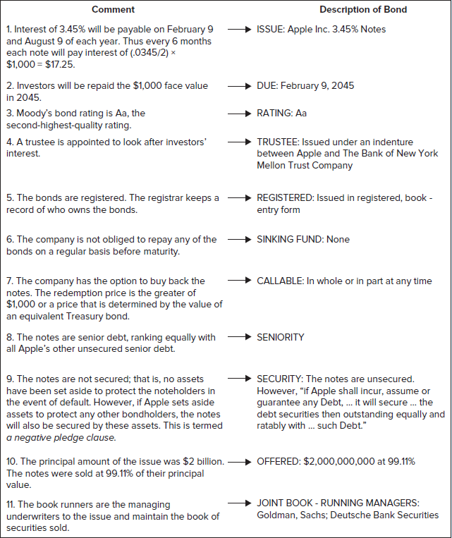
Figure 10.9 Callable Bond: Apple
Jump to long description

Slide 42
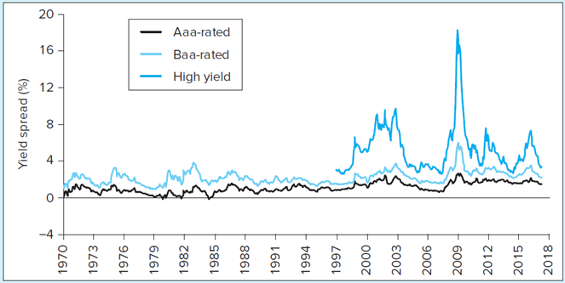
Yield Spreads among Corporate Bonds
Figure 10.10
Yield spreads between corporate and 10-year Treasury bonds
Source: Federal Reserve Bank of St. Louis.
Jump to long description

Slide 43
10.5 Default Risk and Bond Pricing (7 of 7)
Credit Default Swaps (CDS)
Insurance policy on default risk of corporate bond or loan
Designed to allow lenders to buy protection against losses on large loans
  Later used to speculate on financial health of companies

Slide 44
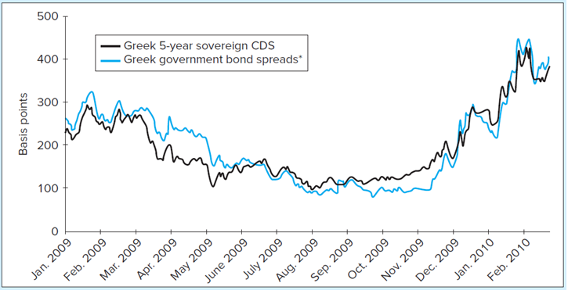
Prices of CDS, Greece
Figure 10.11
Prices of five-year credit default swaps
Source: Bloomberg, August 1, 2012, www.bloomberg.com/quote/ CDBR1U5:IND/chart
Jump to long description

Slide 45
10.6 The Yield Curve (1 of 3)
Yield Curve
Graph of yield to maturity as function of term to maturity
Term Structure of Interest Rates
Relationship between yields to maturity and terms to maturity across bonds
Expectations Hypothesis
Yields to maturity determined solely by expectations of future short-term interest rates

Slide 46
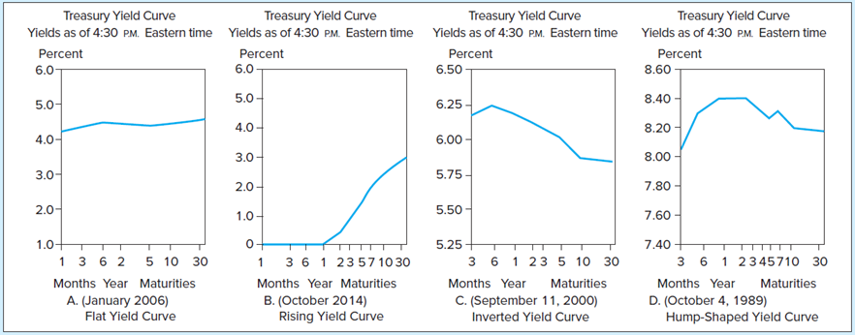
Figure 10.12 Treasury Yield Curve
Source: Various editions of The Wall Street Journal.
Jump to long description

Slide 47
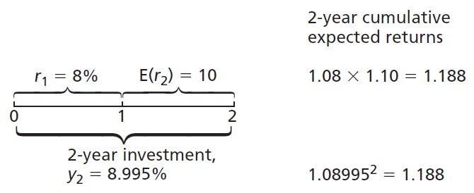
Figure 10.13 Returns to Two 2-Year Investment Strategies
Jump to long description

Slide 48
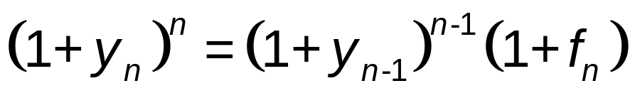
10.6 The Yield Curve (2 of 3)
Forward Rate
Inferred short-term ROI for future period, makes expected total return of long-term bond equal to that of rolling over short-term bonds

Slide 49
10.6 The Yield Curve (3 of 3)
Liquidity Preference Theory
Investors demand risk premium on long-term bonds
Liquidity premium
  Extra expected return demanded by investors as compensation for greater risk of long-term bonds
Spread between forward ROI and expected short sale
  f_{n} = E(r_{n}) + Liquidity premium

Slide 50
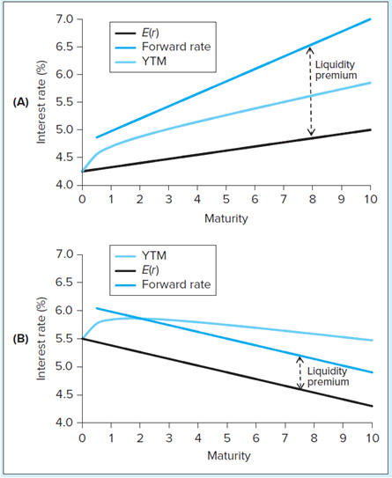
Illustrative Yield Curves
FIGURE 10.14
Illustrative yield curves
Panel A: Increasing expected short rates combined with increasing liquidity premium. The result is a sharply rising yield curve.
Panel B: Declining expected short rates combined with constant liquidity premium. The result is a hump-shaped yield curve.
Jump to long description

Slide 51
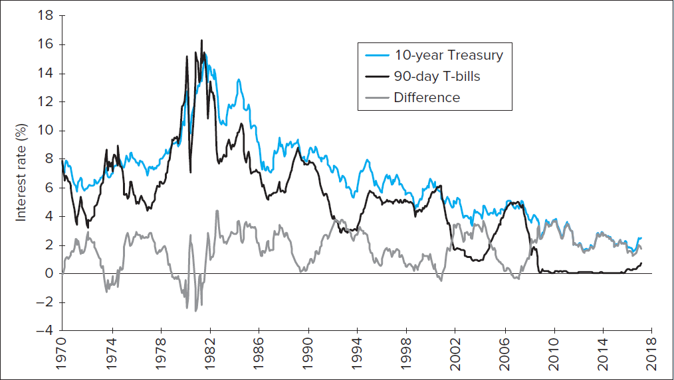
Figure 10.15 Term Spread: Yields on 10-Year versus 90-day Treasuries
Jump to long description

Slide 52
Appendix of Image Long Descriptions

Slide 53
Figure 10.3 Inverse Relationship between Bond Prices and Yields Long Description
Bond Price ($) is on the vertical axis and interest rate (percent) is on the horizontal axis. Curve slopes down from (0, 3,500) through (8, 1,000) and (10, 810.71).
Jump to image

Slide 54
Spreadsheet 10.1 Valuing Bonds Long Description
The inputs are the settlement date, the maturity date, the annual coupon rate, the yield to maturity, the redemption value (% of face value), and the coupon payments per year.
Jump to image

Slide 55
Figure 10.4 Bond Prices: Callable and Straight Debt Long Description
Prices (dollars) is on the vertical axis and interest rate (percent) is on the horizontal axis. Straight bond curve is decreasing and concave up from (3, 1,900) to (13, 600). Callable bond is horizontal at 1,100 until 7 percent, where it decreases in a concave up manner to (13, 600).
Jump to image

Slide 56
Figure 10.5 Growth of Invested Funds Long Description
Reinvestment rate of 10% shows a cash flow at time 1 of $100 and a cash flow at time 2 of $1,100. The future value is $1,210. At a reinvestment rate of 8% a cash flow of $100 at time 1 is shown and a cash flow at time 2 of $1,100 is shown. The future value is $1,208.
Jump to image

Slide 57
Figure 10.6 Price Paths of Coupon Bonds in Case of Constant Market Interest Rates Long Description
Price (percent of par value) is on the vertical axis and time (years) is on the horizontal axis. Coupon at 12 percent is decreasing and concave down from (0, 142) to (30, 100). Coupon at 4 percent is increasing and concave up from (0, 58) to (30, 100).
Jump to image

Slide 58
Figure 10.7 Price of 30-Year Zero-Coupon Bond over Time at Yield to Maturity of 10% Long Description
Price ($) is on the vertical axis, and time (years) is on the horizontal. The concave up curve increases from (0, 50) to maturity date (30, 1,000).
Jump to image

Slide 59
Figure 10.8 Bond Rating Classes Long Description
The table shows the Moody and S&P Bond ratings along with their descriptions. Both rate from A to D, where A A A is greater than A A and B B B is greater than B. Moody's ratings from high to low are A a a, A a, A, B a a, B a, B, C a a, C a, C, and D. S and P's ratings from high to low are A A A, A A, A, then B B B, then B, then C C C, then C C, then C, then D.
Jump to image

Slide 60
Figure 10.9 Callable Bond: Apple Long Description
This figure shows the terms of a large bond issue by Apple in 2015. ISSUE: Apple Inc. 3.45% Notes, DUE: February 9, 2045, RATING: Aa, TRUSTEE: Issued under an indenture between Apple and The Bank of New York Mellon Trust Company, REGISTERED: Issued in registered, book - entry form, SINKING FUND: None, CALLABLE: In whole or in part at any time, SECURITY: The notes are unsecured. However, “if Apple shall incur, assume or guarantee any Debt, … it will secure … the debt securities then outstanding equally and ratably with … such Debt.” SENIORITY OFFERED: $2,000,000,000 at 99.11%, JOINT BOOK - RUNNING MANAGERS: Goldman, Sachs; Deutsche Bank Securities.
Jump to image

Slide 61
Figure 10.10 Yield Spreads among Corporate Bonds Long Description
Yield spread (percent) is on the vertical axis and years 1970 to 2018 are on the horizontal axis. Aaa-rated bonds trend above zero and below 3; a small spike is shown in 2009, but not outside the overall trend. Baa-rated bonds trend above 1 and below 4 over most of the period; in 2009, it spikes above 4, but quickly resumes the previous, lower trend. High yield does not begin until 1997 and trend between 3 and 8 most of the period, with one spike to 16 in 2009.
Jump to image

Slide 62
Figure 10.11 Prices of CDS, Greece Long Description
Basis points is on the vertical axis and years Jan. 2009 to Feb. 2010 is on the horizontal axis. Greek 5-year sovereign CDS and government bond spreads move roughly in tandem over the period. Both begin around 250 in January 2009 and trend down to 100 in August 2009. They trend upward slightly, reaching 200 in early December, then 300 by late December. In January, they trend back down, almost reaching 200, before climbing rapidly, reaching 400 by February.
Jump to image

Slide 63
Figure 10.12 Treasury Yield Curve Long Description
All four graphs are labeled as Treasury yield curve yields as of 4:30 p.m. Eastern time and have percent on the vertical and months year maturities on the horizontal axes. Graph A, (January 2006) flat yield curve, has a line from 4.2 at one month to 4.5 at six months, down to 4.3 at 5 years, and then 4.5 at maturity (30 years). Graph B, (December 2012) Rising Yield Curve, rises from 0 at one month to 0.4 at six years, before climbing to 3.0 at maturity. Graph C, (September 11, 2000) Inverted Yield Curve, starts 6.1 at 3 months, climbs to 6.25 at 6 months, drops to 5.9 by 10 years, and ends at 5.8 at maturity. Graph D, (October 4, 1989) Hump-Shaped Yield Curve, starts at 8.05 at 3 months and rises unevenly to 8.4 at year 2, and drops unevenly to end at 8.2 at maturity. All values are approximations.
Jump to image

Slide 64
Figure 10.13 Returns to Two 2-Year Investment Strategies Long Description
The time line shows year 0, 1, and 2. The rate for year 1 is 8%. The rate for year 2 is 10%. The cumulative expected returns are 1.08 times 1.10 = 1.188. The 2-year investment yields 8.995%.
Jump to image

Slide 65
Figure 10.14 Illustrative Yield Curves Long Description
Graph A: Increasing expected short rates combined with increasing liquidity premium. The result is a sharply rising yield curve. Graph B: Declining expected short rates combined with constant liquidity premium. The result is a hump-shaped yield curve.
Jump to image

Slide 66
Figure 10.15 Term Spread: Yields on 10-Year versus 90-day Treasuries Long Description
Interest Rate (percent) is on the vertical axis and 1970 to 2018 is on the horizontal. 10-year Treasury trends from 8 in 1970 to 15 in 1982 then down to 3 in 2015. 90-day T-bills follow the same pattern until 2009 except the trend range is larger; in 2009, the line drops to zero and stays right above zero until 2016. The different line trends between 0 and 4 over most of the period, except in the early 1980s where it drops to negative 3. All values are approximations.
Jump to image

