Slide 1

Essentials of Investments
Eleventh Edition
Bodie, Kane, and Marcus
Chapter 11
Managing Bond Portfolios
© 2019 McGraw-Hill Education. All rights reserved. Authorized only for instructor use in the classroom. No reproduction or further distribution permitted without the prior written consent of McGraw-Hill Education.

Slide 2
11.1 Interest Rate Risk
Interest Rate Sensitivity
Bond prices and yields are inversely related
Increase in bond’s yield to maturity results in smaller price change than yield decrease of equal magnitude
Example: 10-year bond; $1,000 par value; 5 percent coupon; interest is paid annually
YTM Bond Price Δ from 6%
4% $1,081.11 16.7%
6 926.40 0.0
8 798.70 -13.8

Slide 3
11.1 Interest Rate Risk
Interest Rate Sensitivity
Long-term bond prices more sensitive to interest rate changes than short-term bonds
As maturity increases, sensitivity of bond prices to changes in yields increases at decreasing rate
Example: $1,000 par value; 5 percent coupon; interest is paid annually
Term to Price @ Price @
Maturity YTM = 8% YTM = 6% %Δ Price
20 years $705.46 885.30 25.5%
10 798.70 926.40 16.0
5 880.22 957.88 8.8

Slide 4
11.1 Interest Rate Risk
Interest Rate Sensitivity
Interest rate risk is inversely related to bond’s coupon rate; low-coupon bonds are more sensitive to interest rate changes.
Example: 10-year bond; $1,000 par value; interest is paid annually
Price @ Price @
Coupon YTM = 8% YTM = 6% %Δ Price
5% $798.70 926.40 16.0%
7 932.90 1,073.60 15.1

Slide 5
11.1 Interest Rate Risk
Interest Rate Sensitivity
Sensitivity of bond’s price-to-yield change is inversely related to current yield to maturity
Bonds with higher yields, are less sensitive to changes in market yields than bond with lower yields.
Example: 10-year bond; $1,000 par value; 5 percent coupon; interest is paid annually
YTM Bond Price %∆ from Previous
4% $1,081.11
6 926.40 -14.3%
8 798.70 -13.8
10 692.77 -13.3

Slide 6
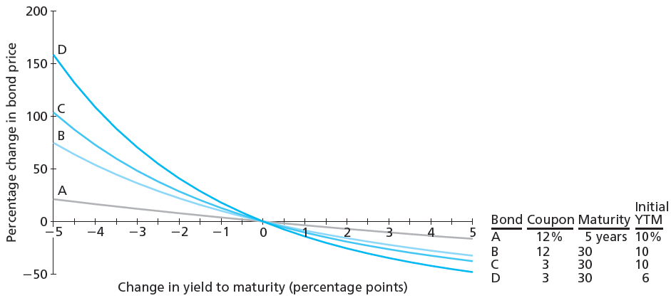
Figure 11.1 Change in Bond Prices as a Function of Change in Yield to Maturity

Slide 7
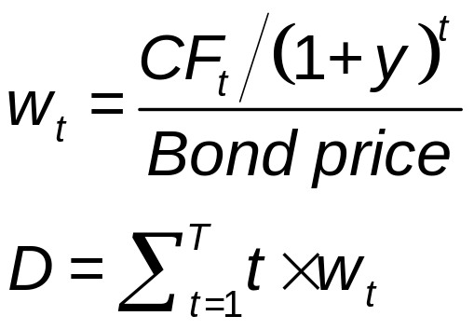
11.1 Interest Rate Risk
Macaulay’s Duration
Measures effective bond maturity
Weighted average of the times until each payment, with weights proportional to the present value of payment
PV of CF_{t}
=
Σ (PV of CFs)

Slide 8
Duration Example
Maturity = 5 years
Face value = $1,000
Coupon rate = 6%
YTM = 12%
N = 5; I/Y = 12; PMT = 60; FV = 1,000
PV = -783.71
Year Weight Duration
(1) Cash Flow Present Value (2) (1) x (2)
1 60 $ 53.57 0.068 0.068
2 60 47.83 0.061 0.122
3 60 42.71 0.054 0.163
4 60 38.13 0.049 0.195
5 1060 601.47 0.767 3.837
$783.71 1.000 4.386 yrs

Slide 9
Duration Example
Maturity = 5 years
Face value = $1,000
Coupon rate = 6%
YTM = 9%
N = 5; I/Y = 9; PMT = 60; FV = 1,000
PV = -883.31
Year Weight Duration
(1) Cash Flow Present Value (2) (1) x (2)
1 $ 60 $ 55.05 0.062 0.062
2 60 50.50 0.057 0.114
3 60 46.33 0.052 0.157
4 60 42.51 0.048 0.192
5 1060 688.93 0.780 3.900
$883.31 1.000 4.426 yrs

Slide 10
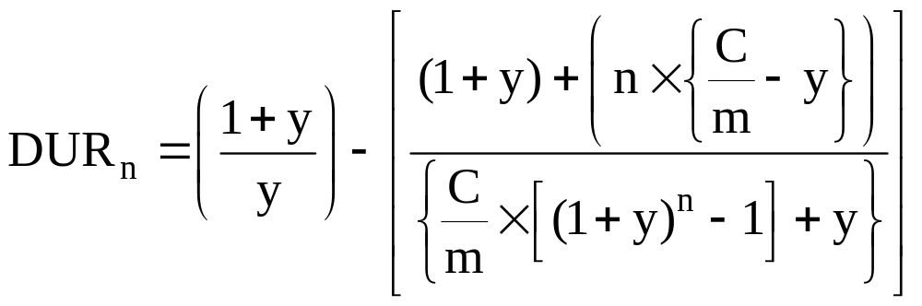
Duration
Variable Definitions
m = the number of interest payments per year
n = number of interest payments that remain to maturity
y = yield per compounding period = YTM/m
C = coupon rate of interest for a bond in decimal form

Slide 11
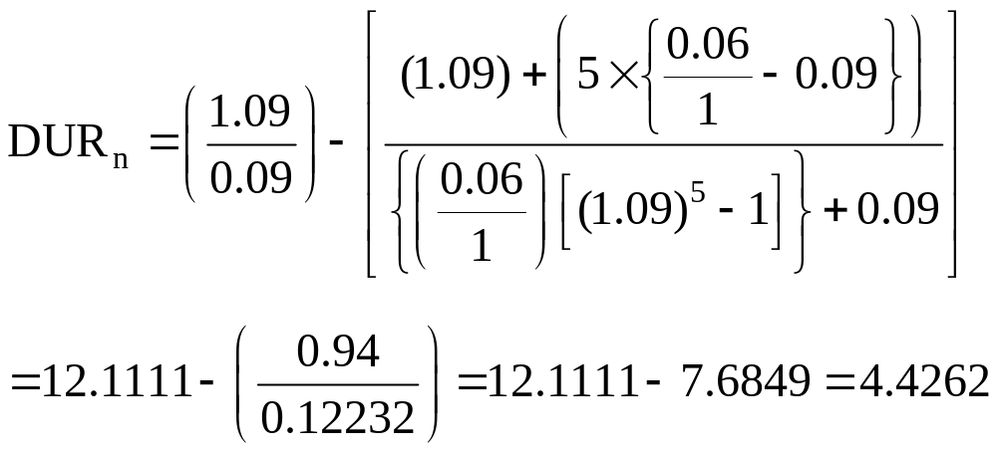
Duration
Face value = $1,000
Coupon rate = 6%
YTM = 9% = y (annual interest payments)
n = 5
# of periods

Slide 12
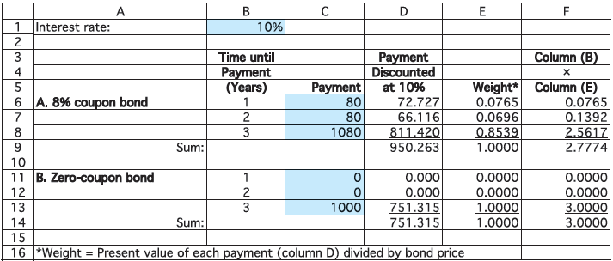
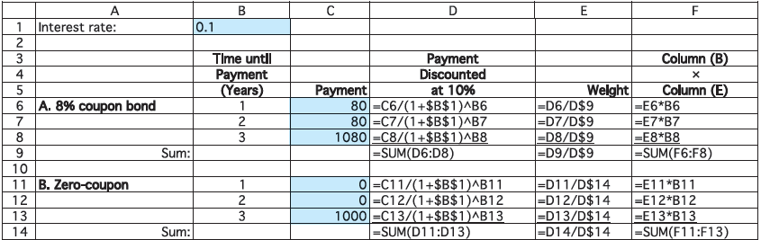
Spreadsheet 11.1 Calculation of Duration of Two Bonds

Slide 13
Spreadsheet 11.2 Computing Duration
 | A | B | C
1 | Inputs |  | Formula In column B
2 | Settlement date | 1/1/2000 | =DATE(2000,1,1)
3 | Maturity date | 1/1/2003 | =DATE(2003,1,1)
4 | Coupon rate | 0.08 | 0.08
5 | Yield to maturity | 0.10 | 0.10
6 | Coupons per year | 1 | 1
7
8 | Outputs
9 | Macaulay duration | 2.7774 | =DURATION(B2,B3,B4,B5,B6)
10 | Modified duration | 2.5249 | =MDURATION(B2,B3,B4,B5,B6)

Slide 14
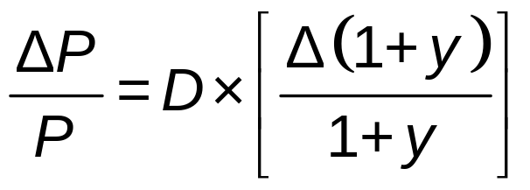
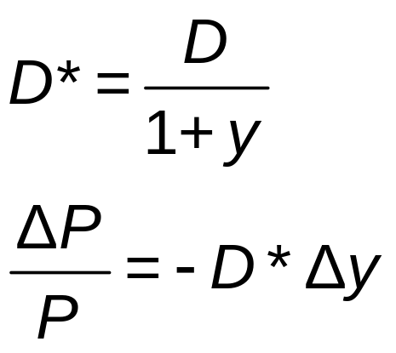
11.1 Interest Rate Risk
Change in Bond Price to Yield to Maturity, y
Modified Duration

Slide 15
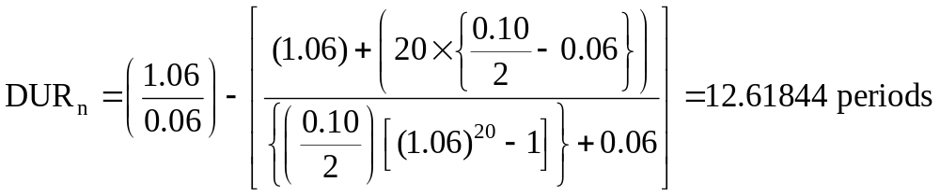
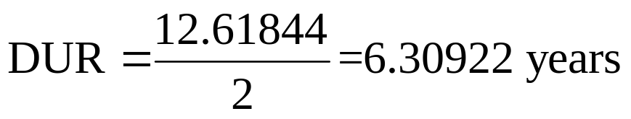
Interest Rate Risk & Duration—Example
Consider a bond with a 10 percent coupon rate and 10 years remaining until maturity. Interest is paid semiannually. If the YTM increases from 12 percent to 13 percent, by approximately how much will the price of this bond change?

Slide 16
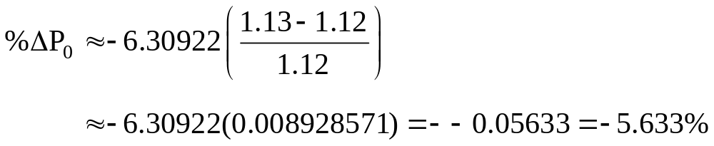
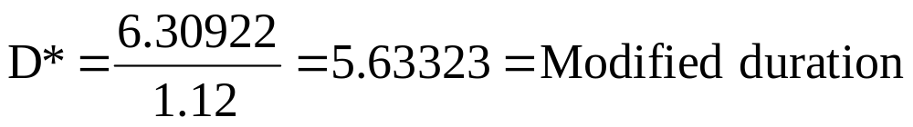

Interest Rate Risk & Duration—Example
DUR = 6.30922

Slide 17

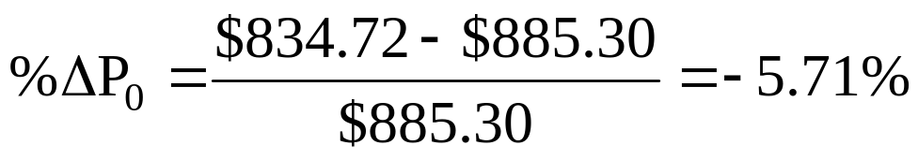
Interest Rate Risk & Duration—Example
Bond price at 12%:
N = 10 x 2 = 20
I/Y = 12/2 = 6
PMT = 100/2 = 50
FV = 1,000
PV = ? = -885.30
Bond price at 13%:
N = 10 x 2 = 20
I/Y = 13/2 = 6.5
PMT = 100/2 = 50
FV = 1,000
PV = ? = -834.72

Slide 18
11.1 Interest Rate Risk
What Determines Duration?
Zero-coupon bond’s duration is its time to maturity
Time/yield to maturity constant, bond’s duration and interest-rate sensitivity higher when coupon price lower
Coupon rate constant, bond’s duration and interest-rate sensitivity generally increase with time to maturity; duration always increases with maturity for bonds at or above par

Slide 19
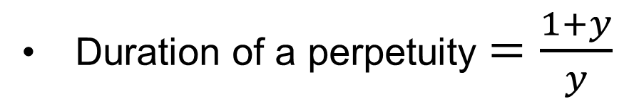
11.1 Interest Rate Risk
What Determines Duration?
Other factors constant, duration and interest rate sensitivity of coupon bond higher when bond’s yield to maturity lower
  Duration of a perpetuity $=\frac{1+y}{y}$

Slide 20
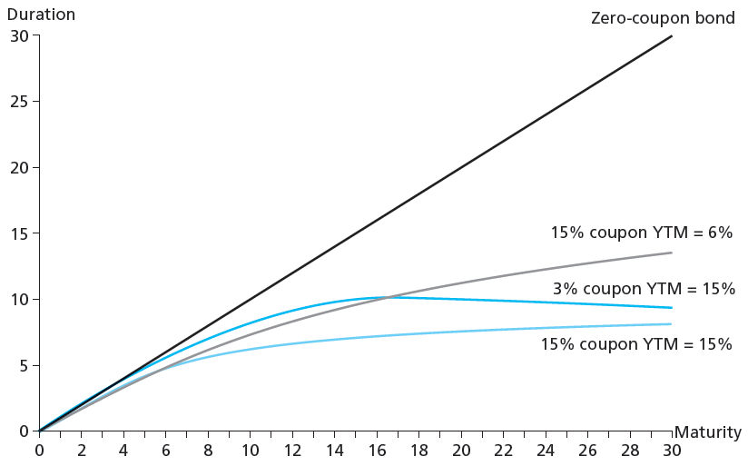
Figure 11.2 Duration as Function of Maturity

Slide 21
Annual Coupon Bond Duration
TABLE 11.3 Duration of annual coupon bonds (initial yield to maturity = 6%)
Maturity (Years) | Coupon Rate: 2% | Coupon Rate: 4% | Coupon Rate: 6% | Coupon Rate: 8%
1 | 1.000 | 1.000 | 1.000 | 1.000
5 | 4.786 | 4.611 | 4.465 | 4.342
10 | 8.961 | 8.281 | 7.802 | 7.445
20 | 15.170 | 13.216 | 12.158 | 11.495
Perpetuity | 17.667 | 17.667 | 17.667 | 17.667

Slide 22
11.2 Passive Bond Management
Immunization
Strategy to shield net worth from interest rate movements
Rebalancing
Realigning proportions of assets in portfolio as needed

Slide 23
Immunization—Example
Consider three $1,000 face value bonds whose characteristics and provisions are identical except with respect to their terms to maturity. Each bond has a coupon interest rate equal to 14 percent, and interest is paid semiannually. Assume the investment horizon for the investor is five (5) years, and the simple return per year currently is 8 percent.

Slide 24
Immunization—Example
Bond Characteristics:
Bond A Bond B Bond C
Maturity (N=years) 5.0 7.0 9.0
Price at year 0 $1,243.33 $1,316.89 $1,379.78
Duration ‑ years 3.899 4.997 5.934
Exp. effective yield 8.16% 8.16% 8.16%
PV_{A}: N = 5 x 2 = 10; I/Y = 8/2 = 4; PMT = 140/2 = -70; FV = 1,000
PV = -1,243.33
EAR = (1.04)² – 1 = 0.0816 = 8.16%

Slide 25
Immunization—Example
Situation 1—YTM remains at 8% for 5 years:
Bond A Bond B Bond C
Price in Year 5 $1,000.00 $1,108.90 $1,201.98
$ coupon interest
= $140 per year $700.00 $700.00 $700.00
Reinvest. income $140.43 $140.43 $140.43
Tot. wealth in Yr 5 $1,840.43 $1,949.32 $2,042.41
Effect. Ann. Return 8.16% 8.16% 8.16%
FVA: N = 5 x 2 = 10; I/Y = 8/2 = 4; PV = 0; PMT = 140/2 = -70
FV = 840.43

Slide 26
Immunization—Example
Situation 2—YTM increases to 10% immediately after purchase and remains at that level for 5 years:
Bond A Bond B Bond C
Price at year 0 $1,243.33 $1,316.89 $1,379.78
Price in Year 5 $1,000.00 $1,070.92 $1,129.26
$ coupon interest $700.00 $700.00 $700.00
Reinvest. income $180.45 $180.45 $180.45
Tot. wealth in Yr 5 $1,880.45 $1,951.37 $2,009.72
Effect. Ann. Return 8.63% 8.18% 7.81%
EAR_{A}: N = 5 x 2 = 10; PV_{A} = -1,243.33; PMT = 0; FV_{A} = 1,880.45
I/Y_{A} = 4.224 = 6-month rate
EAR_{A} = (1.04224)² - 1 = 8.63%

Slide 27
Immunization—Example
Comparison of Situation 1 and Situation 2:
Bond A Bond B Bond C
Price in Yr 5—S1 $1,000.00 $1,108.90 $1,201.98
Price in Year 5 – S2 1,000.00 1,070.92 1,129.26
Difference 0.00 (37.98) (72.72)
Reinvest. 2nc.—S1 $140.43 $140.43 $140.43
Reinvest. 2nc.—S2 180.45 180.45 180.45
Difference 40.02 40.02 40.02
Net Effect $40.02 $2.04 ($32.70)

Slide 28
Table 11.4 Terminal Value of Bond Portfolio after Five Years
Payment Number | Years Remaining until Obligation | Accumulated Value of Invested Payment
A. Rates remain at 8%
1 | 4 | 800 × (1.08)⁴ = 1,088.39
2 | 3 | 800 × (1.08)³ = 1,007.77
3 | 2 | 800 × (1.08)² = 933.12
4 | 1 | 800 × (1.08)¹ = 864.00
5 | 0 | 800 × (1.08)⁰ = 800.00
Sale of bond | 0 | 10,800/1.08 = 10,000.00
 |  | 14,693.28
B. Rates fall to 7%
1 | 4 | 800 × (1.07)⁴ = 1,048.64
2 | 3 | 800 × (1.07)³ = 980.03
3 | 2 | 800 × (1.07)² = 915.92
4 | 1 | 800 × (1.07)¹ = 856.00
5 | 0 | 800 × (1.07)⁰ = 800.00
Sale of bond | 0 | 10,800/1.07 = 10,093.46
 |  | 14,694.05
C. Rates Increase to 9%
1 | 4 | 800 × (1.09)⁴ = 1,129.27
2 | 3 | 800 × (1.09)³ = 1,036.02
3 | 2 | 800 × (1.09)² = 950.48
4 | 1 | 800 × (1.09)¹ = 872.00
5 | 0 | 800 × (1.09)⁰ = 800.00
Sale of bond | 0 | 10,800/1.09 = 9,908.26
 |  | 14,696.02

Slide 29
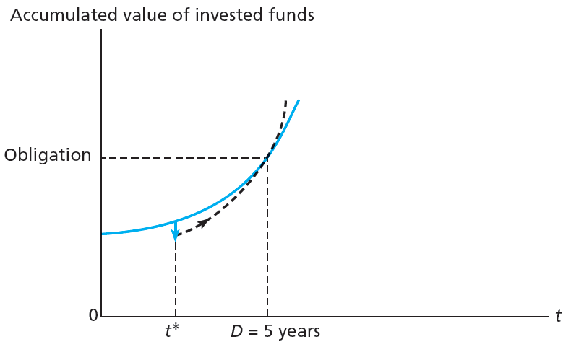
Figure 11.3 Growth of Invested Funds
Rates increase
Rates do not change

Slide 30
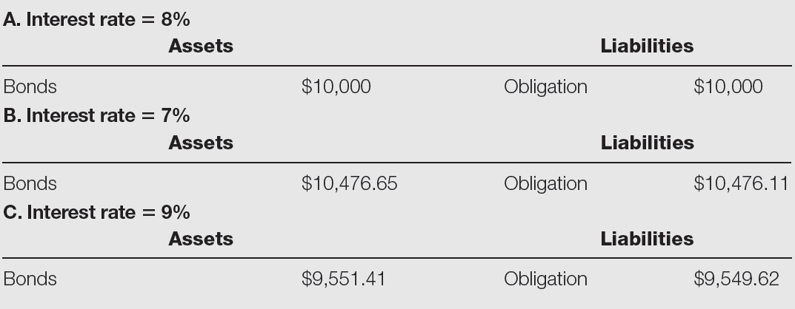
Table 11.5 Market Value Balance Sheets

Slide 31
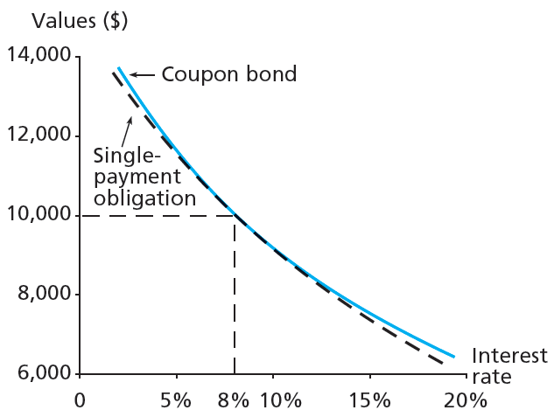
Figure 11.4 Immunization

Slide 32
11.2 Passive Bond Management
Cash Flow Matching and Deduction
Cash flow matching
  Matching cash flows from fixed-income portfolio with those of obligation, perhaps with a zer-coupon
Deduction strategy
  Multi-period cash flow matching

Slide 33
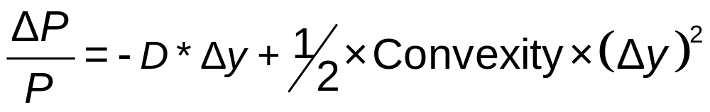
11.3 Convexity
Convexity
Curvature of price−yield relationship of bond
Why Do Investors Like Convexity?
More convexity = greater price increases, smaller price decreases when interest rates fluctuate by larger amounts

Slide 34
Convexity
Coupon = 6%
N = 30
N = 15
N = 5

Slide 35
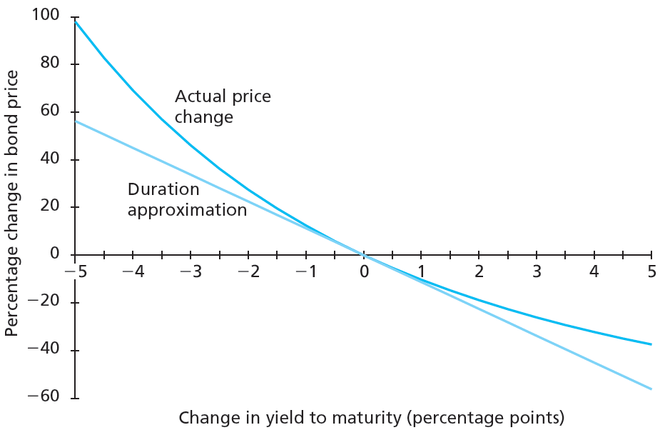
Figure 11.5 Bond Price Convexity

Slide 36
11.4 Active Bond Management: Strategies
Sources of Potential Profit | Strategy
Substitution swap | Exchange of one bond for bond with similar attributes and better price
Intermarket swap | Switching from one segment of bond market to another
Rate anticipation swap | Switch made in response to forecasts of interest rate changes
Pure yield pickup swap | Moving to higher yield bonds, usually with longer maturities
Tax swap | Swapping two similar bonds to receive tax benefit
Horizon analysis | Forecast of bond returns based largely on prediction of yield curve at end of investment horizon

Slide 37
11.4 Active Bond Management
Fixed-Income Investment Strategy
Key features
  Firms respect market prices
  To have value, information cannot already be reflected in prices
  Interest rate movements extremely hard to predict

