Slide 1

Essentials of Investments
Eleventh Edition
Bodie, Kane, and Marcus
Chapter 12
Macroeconomic and Industry Analysis
© 2019 McGraw-Hill Education. All rights reserved. Authorized only for instructor use in the classroom. No reproduction or further distribution permitted without the prior written consent of McGraw-Hill Education.

Slide 2
12.1 Global Economy
National Economic Environment
Crucial determinant of industry performance
Exchange Rate
Rate at which domestic currency can be converted into foreign currency

Slide 3
2016 Stock Market Return (%)
TABLE 12.1 Economic performance
 | Stock Market Return, 2016 (%): In Local Currency | Stock Market Return, 2016 (%): In U.S Dollars | Forecasted Growth in GDP, 2017(%)
Brazil | 42.1 | 74.4 | 0.9
Britain | 15.2 | −3.9 | 1.1
Canada | 19.3 | 24.6 | 1.9
China | −10.7 | −16.6 | 6.4
France | 5.7 | 1.9 | 1.2
Germany | 7.8 | 4.0 | 1.4
Greece | 4.1 | 0.4 | 1.2
Hong Kong | 1.0 | 0.9 | 1.8
India | −5.2 | 2.0 | −0.9
Italy | −8.4 | −11.6 | 0.8
Japan | 2.9 | 5.6 | 1.0
Mexico | 8.4 | −12.5 | 1.9
Russia | 28.9 | 55.4 | 1.2
Singapore | 1.3 | −0.2 | 2.0
South Korea | 4.3 | 1.4 | 2.5
Spain | −0.9 | −4.5 | 2.3
Thailand | 21.4 | 22.0 | 3.3
U.S. | 14.4 | 14.4 | 2.2
Source: The Economist, January 7, 2017.

Slide 4
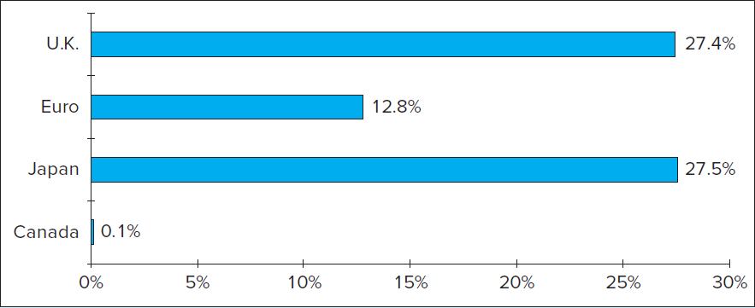
Figure 12.1 Change in Real Exchange Rate
U.S. Dollar vs. Major Currencies, 2003-2016

Slide 5
12.2 The Domestic Macroeconomy
Gross Domestic Product (GDP)
Market value of goods and services produced over period of time
Unemployment Rate
Ratio of number of unemployed to total labor force
Inflation
Rate at which general level of prices for goods and services is rising

Slide 6
12.2 The Domestic Macroeconomy
Interest Rates
High interest rates reduce present value of future cash flows
Budget Deficit
Government spending in excess of government revenues
Sentiment
Consumer optimism/pessimism

Slide 7
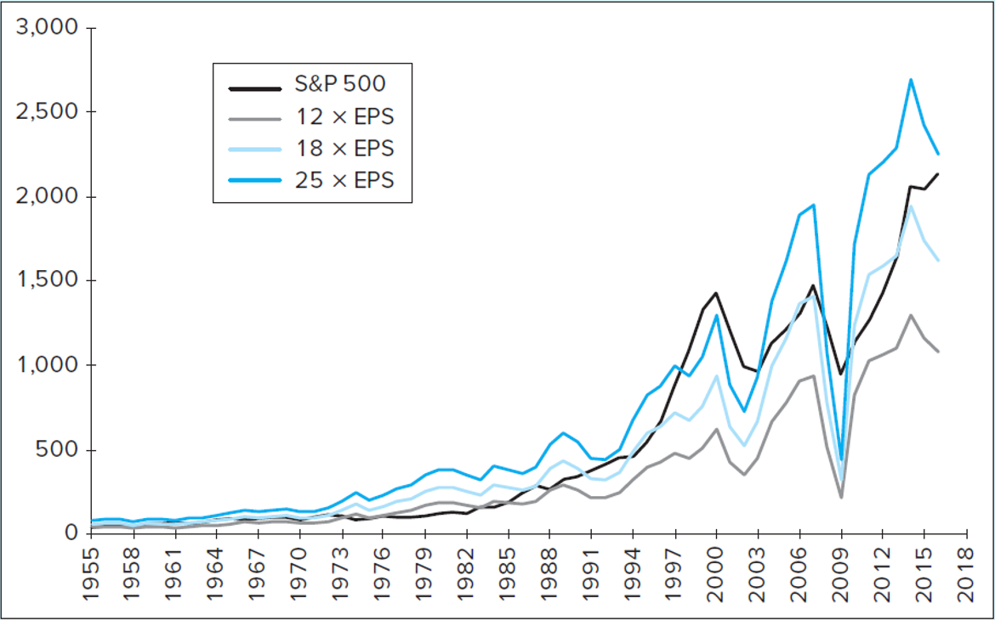
Figure 12.2 S&P 500 Index versus Earnings per Share
Source: S&P 500 Prices Saint Louis Fed Fred data base

Slide 8
12.3 Interest Rates
Fundamental Factors of Interest Rates
Supply of funds from savers
Demand for funds from borrowers
Government’s net supply/demand for funds, modified by Federal Reserve
Expected rate of inflation

Slide 9
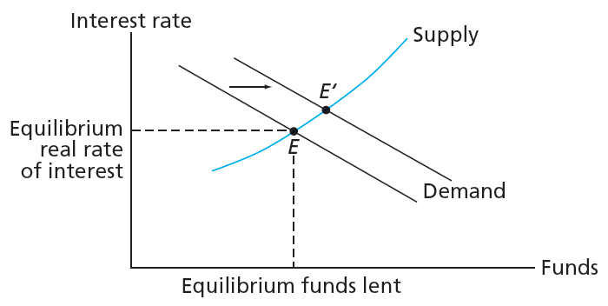
Figure 12.3 Determination of Equilibrium Real Rate of Interest

Slide 10
12.4 Demand and Supply Shocks
Demand Shock
Event that affects demand for goods and services in economy
Supply Shock
Event that influences production capacity and costs in economy

Slide 11
12.5 Federal Government Policy
Policy | Description
Fiscal Policy | Use of government spending and taxing for stabilizing economy
Monetary Policy | Actions taken by Board of Governors of Federal Reserve System to influence money supply/interest rates
Supply-Side Policies | Address productive capacity of economy, goal is to induce workers/owners to produce goods

Slide 12
12.6 Business Cycles
Business Cycles
Recurring cycles of recession and recovery
Peak
Transition from end of expansion to start of contraction
Trough
Transition point between recession and recovery

Slide 13
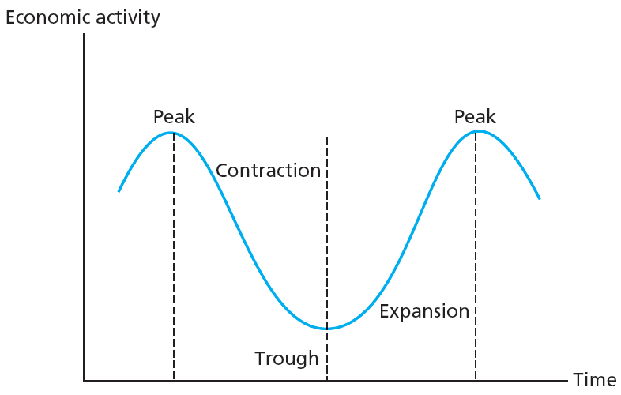
Figure 12.10 Stylized Depiction of Business Cycle

Slide 14
12.6 Business Cycles
Cyclical Industries
Industries with above-average sensitivity to state of economy
Defensive Industries
Industries with below-average sensitivity to state of economy

Slide 15
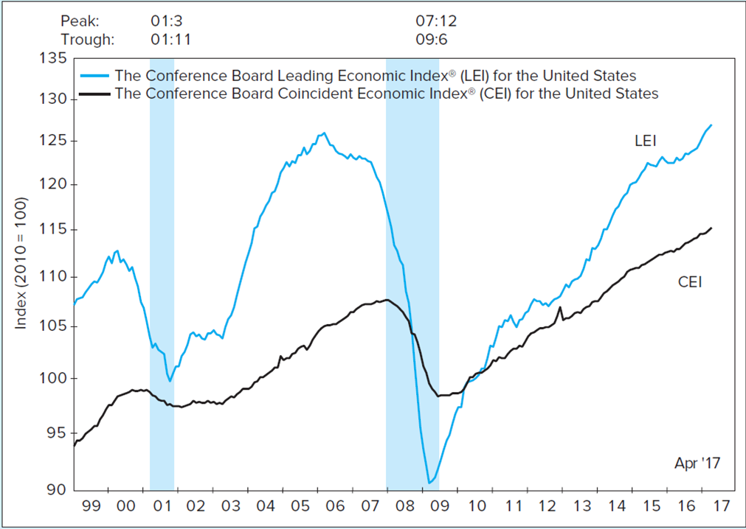
Leading and Coincident Indicators
FIGURE 12.4
Indexes of Leading and Coincident Indicators for the United States
Source: The Conference Board, News Release, May 18, 2017.

Slide 16
12.6 Business Cycles: Leading Indicators
Economic series that tend to rise or fall in advance of rest of the economy
Average weekly hours of production workers
Initial claims for unemployment insurance
Manufacturers’ new orders
Institute of Supply Management Index of New Orders
New orders for nondefense capital goods
New private housing units authorized by local building permits
Yield curve: spread between 10-year T-bond yield and federal funds rate
Stock prices, 500 common stocks
Money supply (M2) growth rate
Index of consumer expectations for business conditions

Slide 17
12.6 Business Cycles: Coincident Indicators
Economic series that tend to rise or fall in tandem with the rest of the economy
Employees on nonagricultural payrolls
Personal income less transfer payments
Industrial production
Manufacturing and trade sales

Slide 18
12.6 Business Cycles: Lagging Indicators
Economic series that tend to rise or fall behind the rest of the economy
Average duration of unemployment
Ratio of trade inventories to sales
Change in index of labor cost per unit of output
Average prime rate charged by banks
Commercial and industrial loans outstanding
Ratio of consumer installment credit outstanding to personal income
Change in consumer price index for services

Slide 19
12.7 Industry Analysis
Defining an Industry
NAICS (North American Industry Classification System) codes
  Classification of firms into industry groups using numerical codes to identify industries
Sensitivity to the Business Cycle
  Sensitivity of sales
  Operating leverage
  Financial leverage

Slide 20
Table 12.5 Examples of NAICS Industry Codes
NAICS Code | NAICS Title
23 | Construction
236 | Construction of Buildings
2361 | Residential Building Construction
23611 | Residential Building Construction
236115 | New Single-Family Housing Construction
236116 | New Multifamily Housing Construction
236117 | New Housing Operative Builders
236118 | Residential Remodelers
2362 | Nonresidential Building Construction
23621 | Industrial Building Construction
236210 | Industrial Building Construction
23622 | Commercial and Institutional Building Construction
236220 | Commercial and Institutional Building Construction

Slide 21
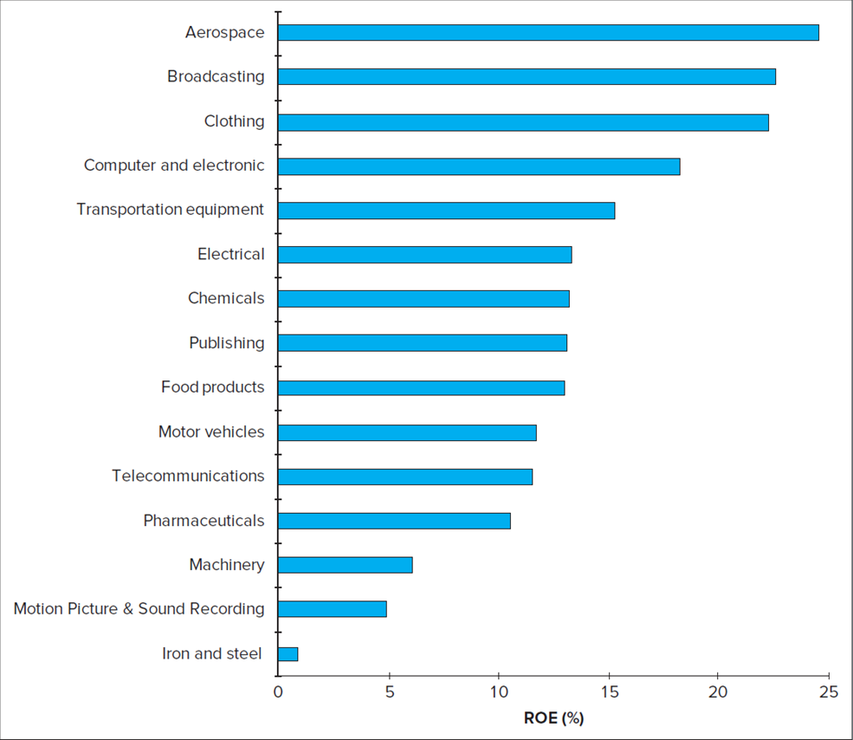
Figure 12.6 Return on Equity, 2016

Slide 22
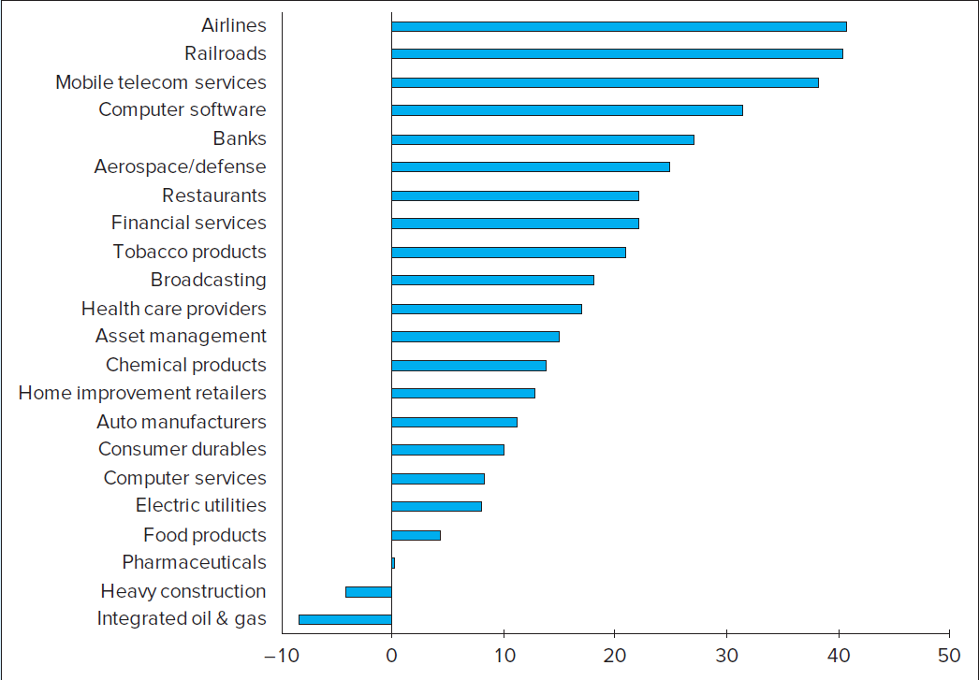
Figure 12.7 Industry Stock Price Performance, 2016

Slide 23
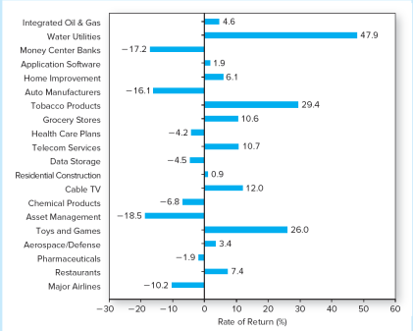
Industry Stock Price Performance, 2013 versus 2016

Slide 24
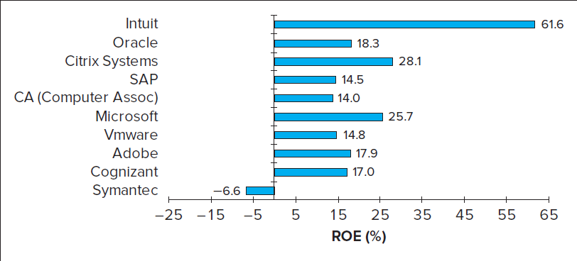
Figure 12.8 ROE of Application Software Firms

Slide 25
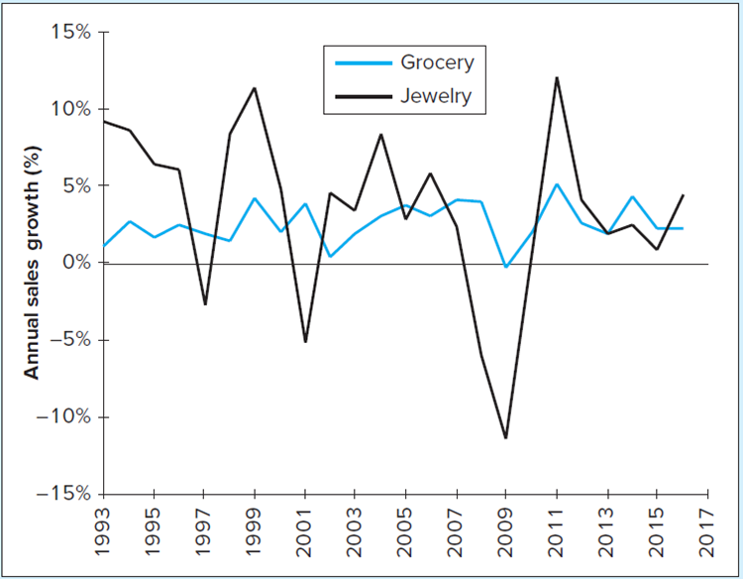
Industry Cyclicality
FIGURE 12.9 Industry cyclicality. Growth in sales, year over year, in two industries. Source: U.S. Census Bureau, www.census.gov/retail/index.html

Slide 26
12.7 Industry Analysis
Sector Rotation
Shifting portfolio into industry sectors expected to outperform
  Based on macroeconomic forecasts
  After peak, defensive industries often better performers
  In trough, capital goods industries often better performers
  In expansion, cyclical industries often better

Slide 27
Figure 12.10 Stylized Depiction of Business Cycle
Defensive
industries
Cyclical
industries
Capital
goods

Slide 28
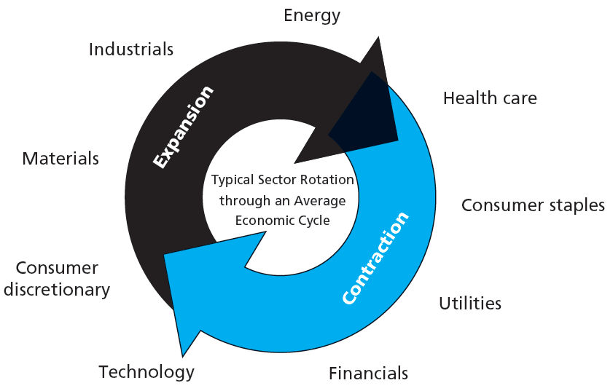
Figure 12.11 Sector Rotation

Slide 29
12.7 Industry Analysis
Industry Life Cycles:
Start-up stage: Often characterized by new technology/product
Consolidation stage: Industry leaders begin to emerge
Maturity stage: Product reaches potential for use by consumers
Relative decline: May grow less than rest of economy or shrink

Slide 30
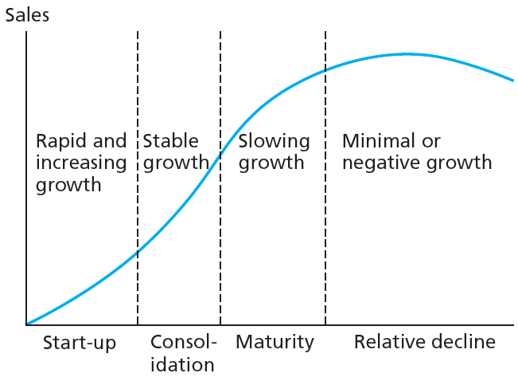
Figure 12.12 Industry Life Cycle

Slide 31
12.7 Industry Analysis
Industry Structure and Performance
Threat of entry: New entrants to industry pressure price/profits
Rivalry between existing competitors: Market share competition pressures price/profits
Pressure from substitute products: Firms in related industries can threaten market share

Slide 32
12.7 Industry Analysis
Industry Structure and Performance
Bargaining power of buyers
  Large-scale buyers have considerable bargaining power
Bargaining power of suppliers
  Large-scale suppliers have considerable bargaining power

