Slide 1

Essentials of Investments
Eleventh Edition
Bodie, Kane, and Marcus
Chapter 13
Equity Valuation
© 2019 McGraw-Hill Education. All rights reserved. Authorized only for instructor use in the classroom. No reproduction or further distribution permitted without the prior written consent of McGraw-Hill Education.

Slide 2
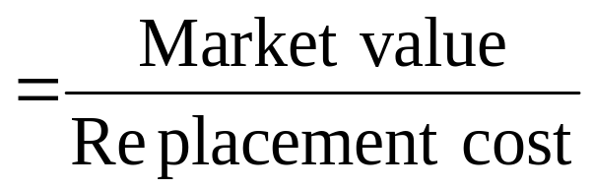
13.1 Equity Valuation
Book Value
Net worth of common equity according to a firm’s balance sheet
Limitations of Book Value
Liquidation value: Net amount realized by selling assets of firm and paying off debt
Replacement cost: Cost to replace firm’s assets
Tobin’s q
a high Tobin’s q will attract competition; should trend to 1.0

Slide 3
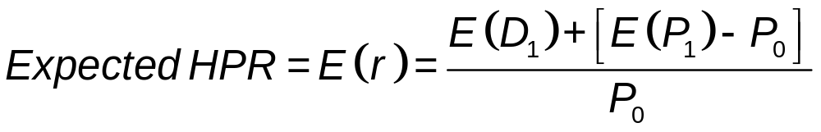
13.2 Intrinsic Value versus Market Price
E(D₁) = expected dividend per share
P₀ = current share price
E(P₁) = expected end-of-year price
Example: Suppose you purchased a share of DAR Inc. for $40 in January. You expect to sell it for $42 in December and expect to receive a dividend of $2.42 during that year. What is your expected HPR?

Slide 4
13.2 Intrinsic Value versus Market Price
Intrinsic Value
Present value of firm’s expected future net cash flows discounted by required RoR
Market Capitalization Rate
Market-consensus estimate of appropriate discount rate for firm’s cash flows
Investors’ required rate of return, k, determined by the CAPM
If E(r) > k, Market value < Intrinsic value

Slide 5
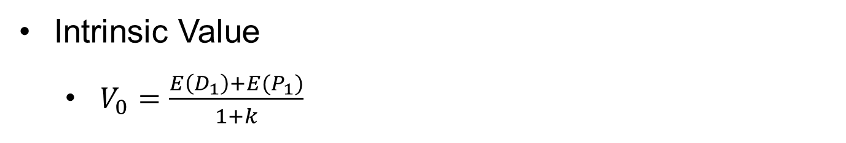
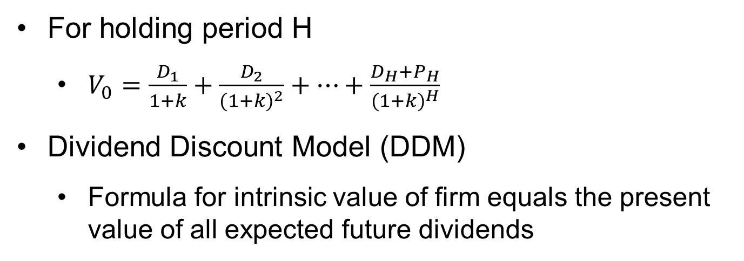
13.2 Intrinsic Value versus Market Price
Intrinsic Value
  $V_{0}=\frac{E\left(D_{1}\right)+E(P_{1})}{1+k}$
k = market capitalization rate
For holding period H
  $V_{0}=\frac{D_{1}}{1+k}+\frac{D_{2}}{{(1+k)}^{2}}+…+\frac{D_{H}+P_{H}}{{(1+k)}^{H}}$
Dividend Discount Model (DDM)
  Formula for intrinsic value of firm equals the present value of all expected future dividends

Slide 6
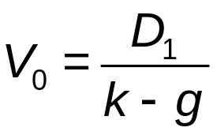
13.3 Dividend Discount Models
Constant-Growth DDM
Form of DDM that assumes dividends will grow at constant rate
Implies stock’s value greater if:
  Larger dividend per share
  Lower market capitalization rate, k
  Higher expected growth rate of dividends

Slide 7
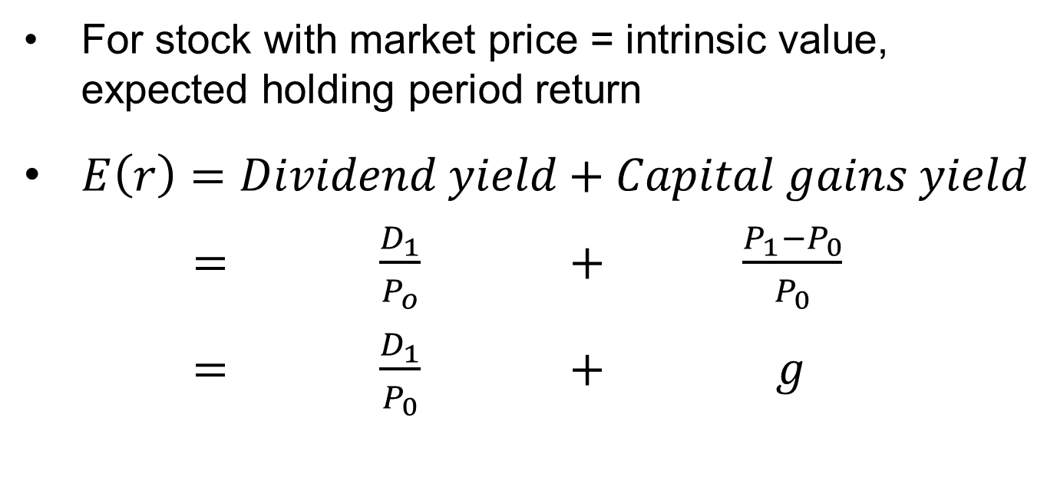
13.3 Dividend Discount Models
For stock with market price = intrinsic value, expected holding period return
  $E\left(r\right)=Dividend yield+Capital gains yield$
  $= \frac{D_{1}}{P_{o}} + \frac{P_{1}−P_{0}}{P_{0}}$
  $= \frac{D_{1}}{P_{0}} + g$

Slide 8
13.3 Dividend Discount Models
Stock Prices and Investment Opportunities
Dividend payout ratio
  Percentage of earnings paid as dividends
Plowback ratio/earnings retention ratio
  Proportion of firm’s earnings reinvested in business = b = 1 – (Dividend payout ratio)
  g = ROE x b

Slide 9
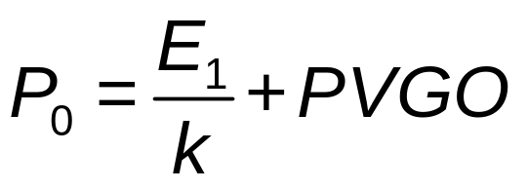
13.3 Dividend Discount Models
Stock Prices and Investment Opportunities
Present value of growth opportunities (PVGO)
  Price = No-growth value per share + PVGO

Slide 10
13.3 Dividend Discount Models
Life Cycles and Multistage Growth Models
Two-stage DDM
  DDM in which dividend growth assumed to level off at some future date
Multistage Growth Models
  Allow dividends per share to grow at several different rates as firm matures
  Growth levels off at some future date

Slide 11
13.3 Dividend Discount Models: Two Stage Example
Consider the following information:
The firm’s dividends are expected to grow at g = 20% until t = 3 yrs.
At the start of year four, growth slows to g_{s}= 5%.
The stock just paid a dividend Div₀ = $1.00
Assume a market capitalization rate of k = 12%
What is the price, P₀, of this stock?

Slide 12
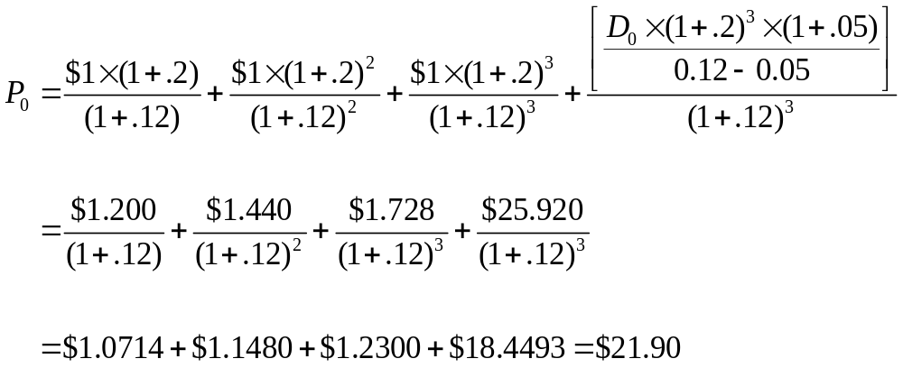
13.3 Dividend Discount Models: Two Stage Example
g₁ = g₂ = g₃ = 20%
g_{s}= … = g∞ = 5%.
D₀ = $1.00
k = 12%
P₃ = PV(D₄) +…+ PV(D∞)
P₃

Slide 13
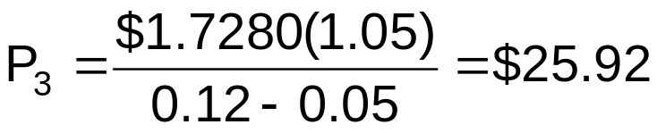
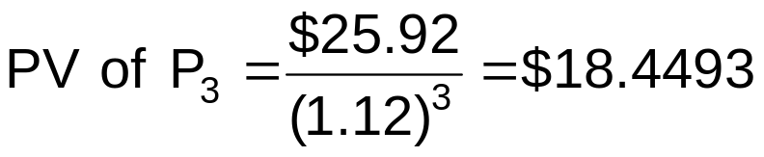
Dividend Discount Model: Two Stage Example
Years 1 -3 g = 20% D₀ = $1.00
Years 4 -  g = 5% k = 12%
Year Dividend PV of D @ 12%
1 $1.2000 = $1.00(1.20)¹ 1.0714
2 $1.4400 = $1.00(1.20)² 1.1480
3 $1.7280 = $1.00(1.20)³ 1.2300
$3.4494
P₀ = $3.4494 + $18.4493 = $21.8987 ≈ $21.90

Slide 14
Dividend Discount Model: Two Stage Example
Year Growth Dividend Computation PV of Dividend
1 20.0% $ 1.2000 $1.0000(1.20)¹ $ 1.0714
2 20.0 1.4400 1.0000(1.20)² 1.1480
3 20.0 1.7280 1.0000(1.20)³ 1.2300
4 5.0 1.8144 1.7280(1.05)¹ 1.1531
5 5.0 1.9051 1.7280(1.05)² 1.0810
6 5.0 2.0004 1.7280(1.05)³ 1.0135
7 5.0 2.1004 1.7280(1.05)⁴ 0.9501
8 5.0 2.2054 1.7280(1.05)⁵ 0.8907
9 5.0 2.3157 1.7280(1.05)⁶ 0.8351
10 5.0 2.4315 1.7280(1.05)⁷ 0.7829
25 5.0 5.0549 1.7280(1.05)²² 0.2973
50 5.0 17.1175 1.7280(1.05)⁴⁷ 0.0592
75 5.0 57.9660 1.7280(1.05)⁷² 0.0118
100 5.0 196.2934 1.7280(1.05)⁹⁷ 0.0024
125 5.0 664.7192 1.7280(1.05)¹²² 0.0005  = $21.8917

Slide 15
13.3 Dividend Discount Models: Stock Value
The Constant Growth Model states that a stock’s value will be greater
The larger its expected dividend per share.
The lower the market capitalization rate, k.
The higher the expected growth rate of dividends.

Slide 16
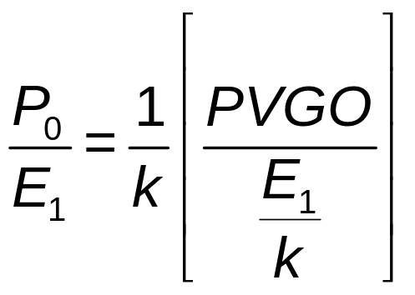
13.4 Price-Earnings Ratios
Price Earnings Ratio and Growth Opportunities
Price-earnings multiple
  Ratio of stock’s price to earnings per share
Determinant of P/E ratio

Slide 17
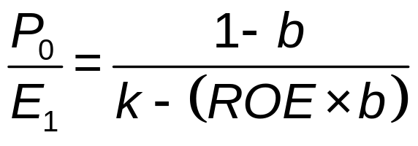
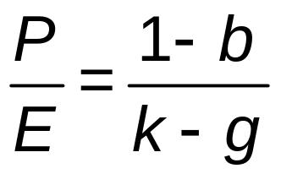
13.4 Price-Earnings Ratios
P/E Ratio for Firm Growing at Long-Run Sustainable Pace
PEG Ratio
Ratio of P/E multiple to earnings growth rate
PEG = (P/E ratio)/g

Slide 18
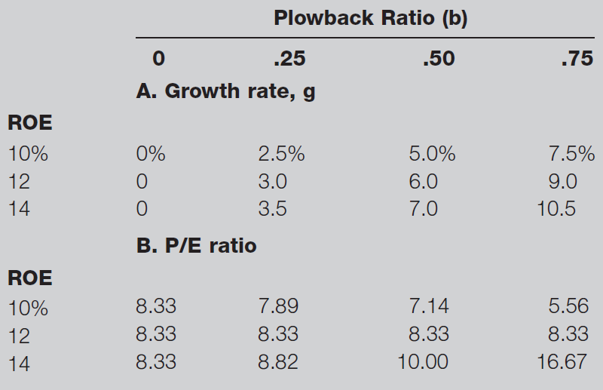
Table 13.3 Effect of ROE and Plowback on Growth and P/E Ratio

Slide 19
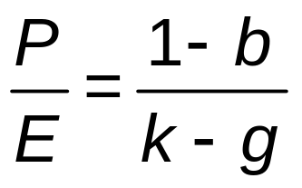
13.4 Price-Earnings Ratios
P/E Ratios and Stock
All else equal, riskier stocks have lower P/E multiples, higher required RoR, k

Slide 20
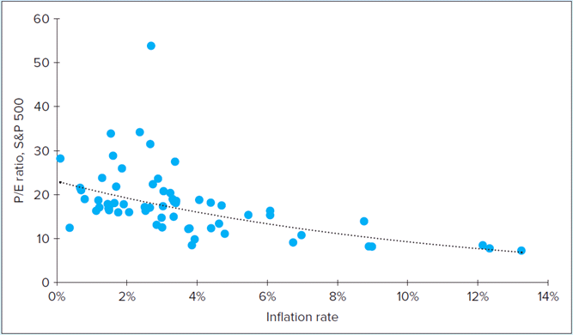
P/E Ratio and Inflation
FIGURE 13.3 P/E ratio of the S&P 500 versus inflation rate. Annual averages,1955-2016.

Slide 21
13.4 Price-Earnings Ratios
Pitfalls in P/E Analysis
Earnings Management
  Practice of using flexibility in accounting rules to improve apparent profitability of firm
  Large amount of discretion in managing earnings

Slide 22
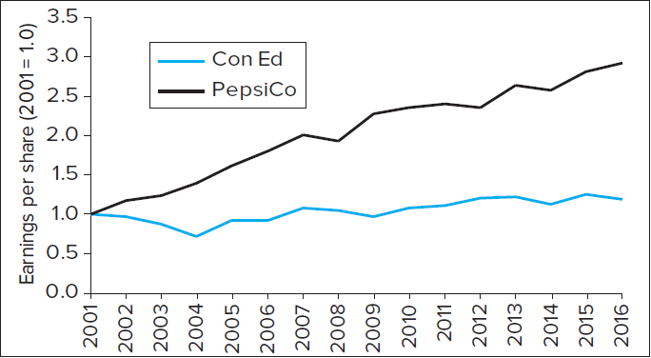
Figure 13.4 Earnings Growth for Two Companies

Slide 23
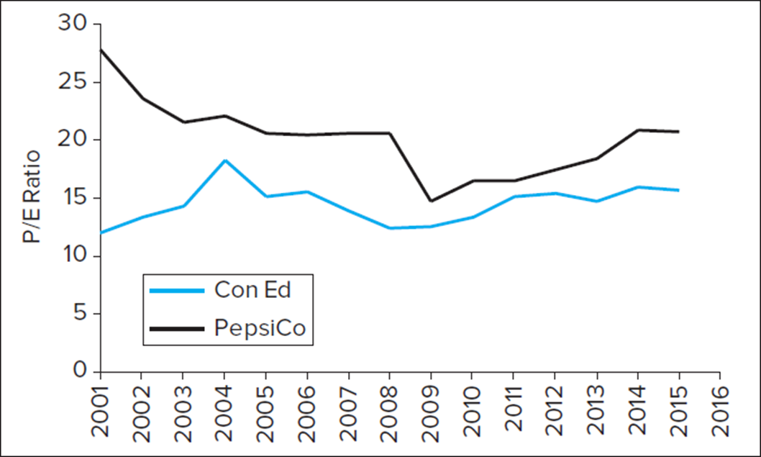
Figure 13.5 Price-Earnings Ratios

Slide 24
13.4 Price-Earnings Ratios
Combining P/E Analysis and the DDM
Estimates stock price at horizon (terminal) date
Other Comparative Valuation Ratios
Price-to-book: Indicates how aggressively market values firm
Price-to-cash-flow: Cash flow less affected by accounting decisions than earnings
Price-to-sales: For start-ups with no earnings

Slide 25
13.5 Free Cash Flow Valuation Approaches
Free Cash Flow for Firm (FCFF)
FCFF = EBIT(1 − t_{c}) + Depreciation − Capital expenditures − Increase in NWC
  EBIT = Earnings before interest and taxes
  t_{c} = Corporate tax rate
  NWC = Net working capital
Free Cash Flow to Equity Holders (FCFE)
FCFE = FCFF − Interest expense × (1 − t_{c}) + Increase in net debt

Slide 26
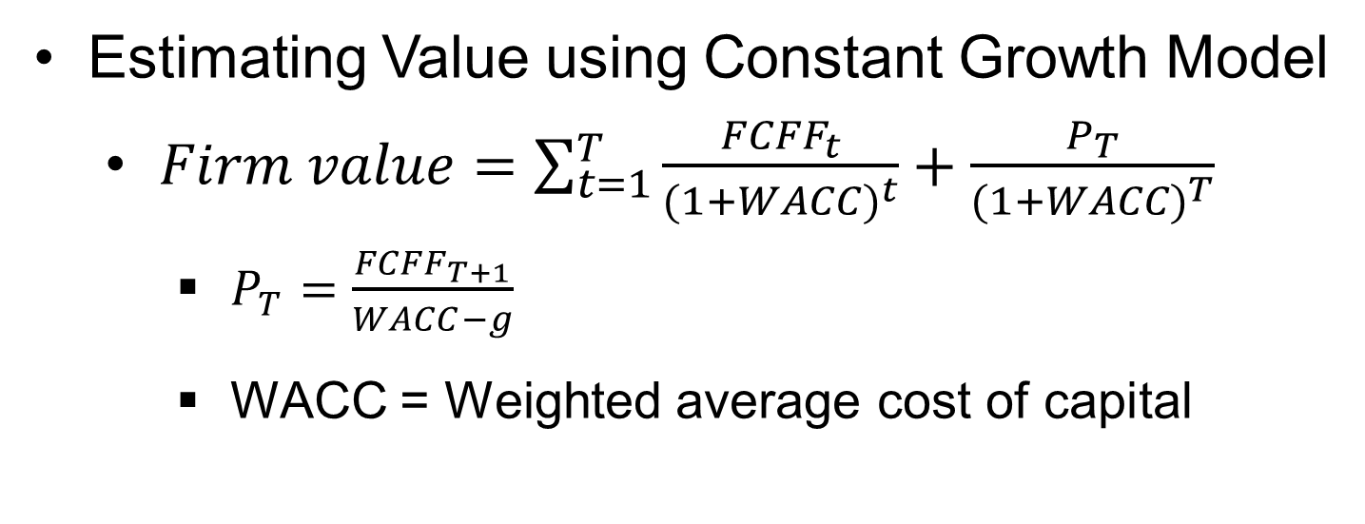
13.5 Free Cash Flow Valuation Approaches
Estimating Value using Constant Growth Model
  $Firm value=\sum_{t=1}^{T}{\frac{{FCFF}_{t}}{{(1+WACC)}^{t}}}+\frac{P_{T}}{{(1+WACC)}^{T}}$
    $P_{T}=\frac{{FCFF}_{T+1}}{WACC−g}$
    WACC = Weighted average cost of capital

Slide 27
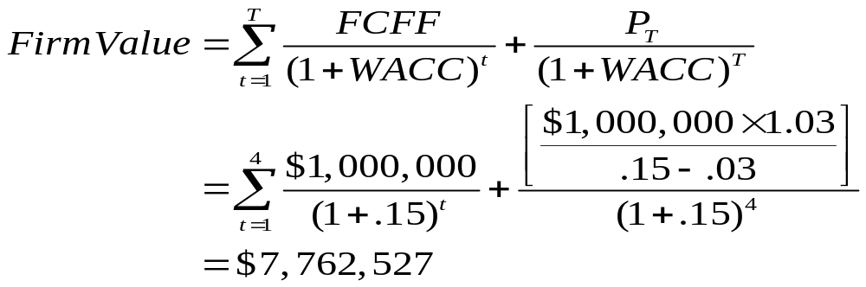
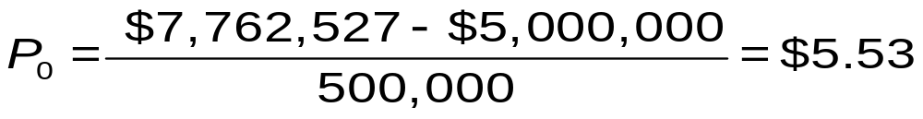
13.5 FCF Valuation Approaches: FCFF Example
Suppose FCFF = $1 mil for years 1-4 and then is expected to grow at a rate of 3%. Assume WACC = 15%
If 500,000 shares are outstanding, what is the predicted price of this stock if the firm has $5,000,000 of debt?

Slide 28
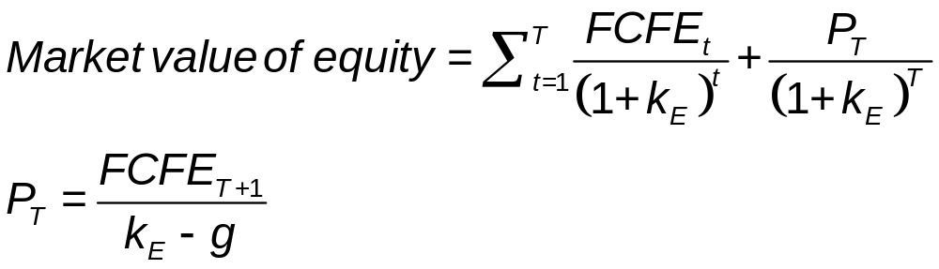
13.5 Free Cash Flow Valuation Approaches
Market Value of Equity

Slide 29
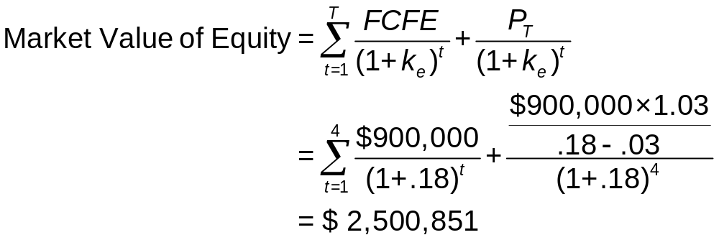
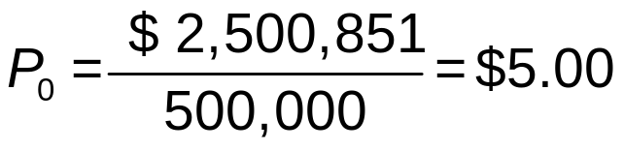
13.5 FCF Valuation Approaches: FCFE Example
Suppose FCFE = $900,000 for years 1-4 and then is expected to grow at a rate of 3%. Assume k_{e} = 18%
If there are 500,000 shares outstanding, what is the predicted price of this stock? Why can debt be ignored?

Slide 30
13.5 Free Cash Flow Valuation Approaches
Comparing Valuation Models
Model values differ in practice
Differences stem from simplifying assumptions
Problems with DCF Models
DCF estimates are always somewhat imprecise
Investors employ hierarchy of valuation
  Real estate, plant, equipment—values easier to estimate
  Economic profit on assets in place
  Growth opportunities—probably the least reliable estimate

Slide 31
13.6 The Aggregate Stock Market
Forecasting Aggregate Stock Market
Earnings multiplier applied at aggregate level
  Forecast corporate profits for period
  Derive estimate of aggregate P/E ratio based on long-term interest rates
Some analysts use aggregate DDM

