Slide 1

Essentials of Investments
Eleventh Edition
Bodie, Kane, and Marcus
Chapter 14
Financial Statement Analysis
© 2019 McGraw-Hill Education. All rights reserved. Authorized only for instructor use in the classroom. No reproduction or further distribution permitted without the prior written consent of McGraw-Hill Education.

Slide 2
14.1 Major Financial Statements
Income Statement: Statement showing firm’s revenues and expenses during specified period
Accounting Earnings | Economic Earnings
Earnings of a firm as reported on income statement | Real flow of cash firm could pay without impairing productive capacity

Slide 3
14.1 Major Financial Statements
Balance Sheet: Accounting statement of firm’s financial position at specified time
Shows firm’s investment in assets
Shows firm’s funding sources
  Assets
  Liabilities (debt)
  Equity (stock) = Net worth
  Investments
  Financing

Slide 4
14.1 Major Financial Statements
Statement of Cash Flows: Financial statement showing firm’s cash receipts and cash payments during specified period
  Asset
  Liability OR Equity
  Source:
  Decrease = sale
  Increase = raising funds
  Use:
  Increase = purchase
  Decrease = repayment

Slide 5
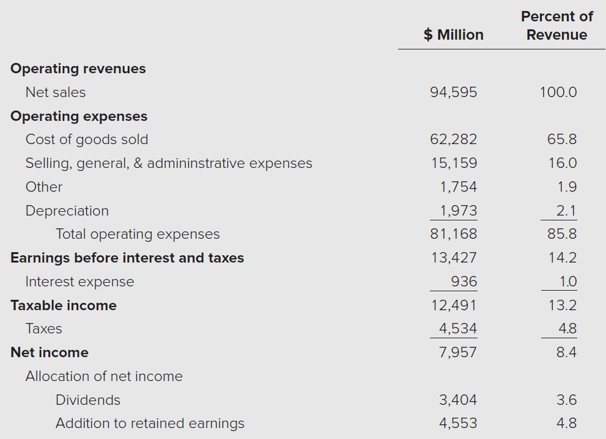
Table 14.1 Home Depot’s Income Statement
Fiscal Year Ending January 29, 2017

Slide 6
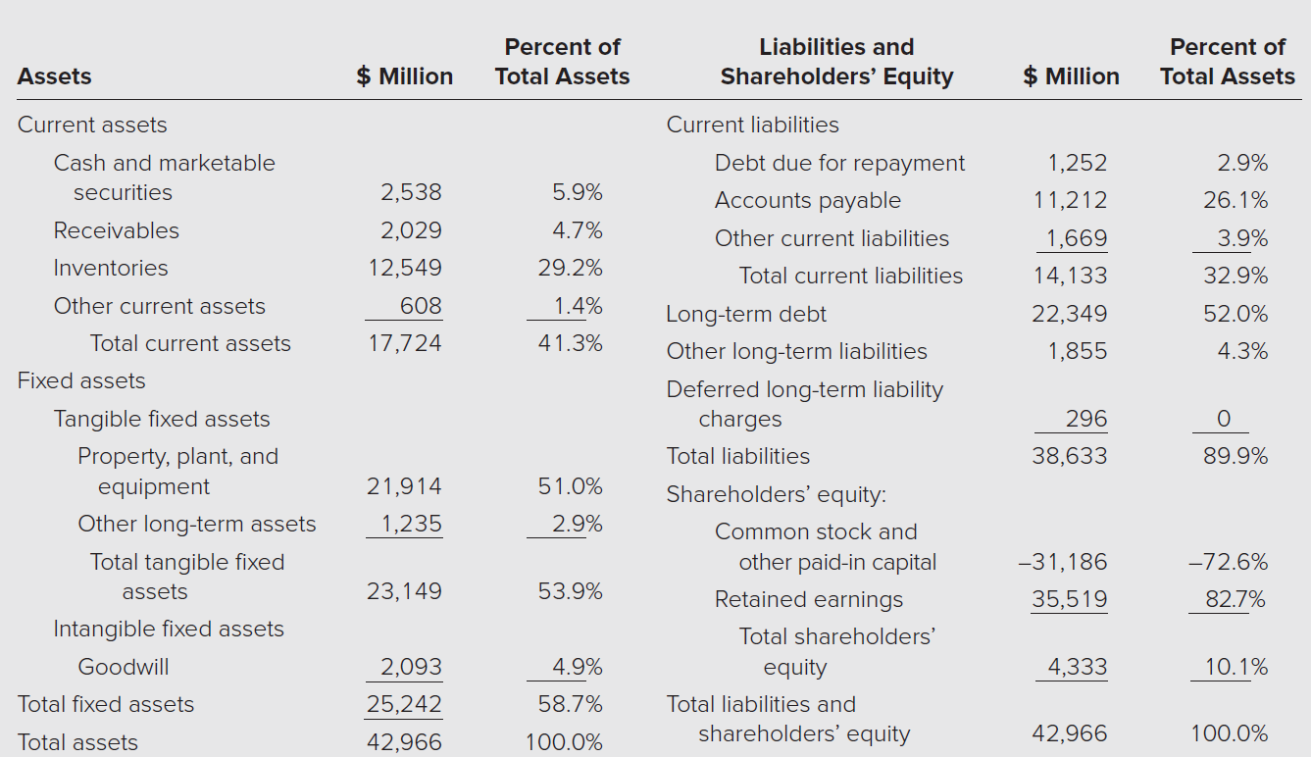
Table 14.2 Home Depot’s Balance Sheet
January 29, 2017

Slide 7
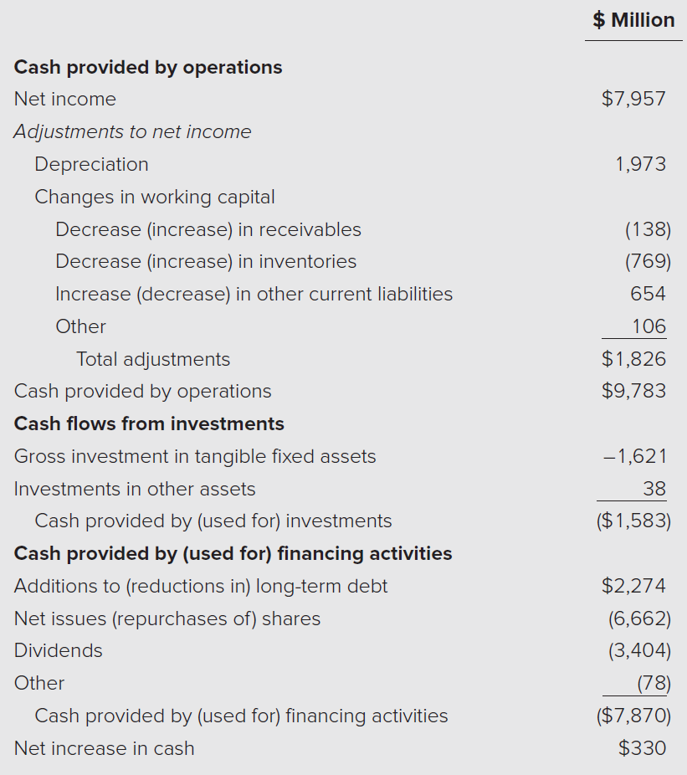
Table 14.3 Home Depot’s Statement of Cash Flows
Fiscal Year Ending January 29, 2017

Slide 8
14.2 Measuring Firm Performance
Shareholder Value
Investment Decisions
  Efficiency of Assets
  Profitability of Sales
Financing Decisions
  Leverage
  Liquidity
Shareholder value depends on good investment and financing decisions.
Financial Ratios help measure the success and soundness of these decisions; help forecast FUTURE financial position

Slide 9
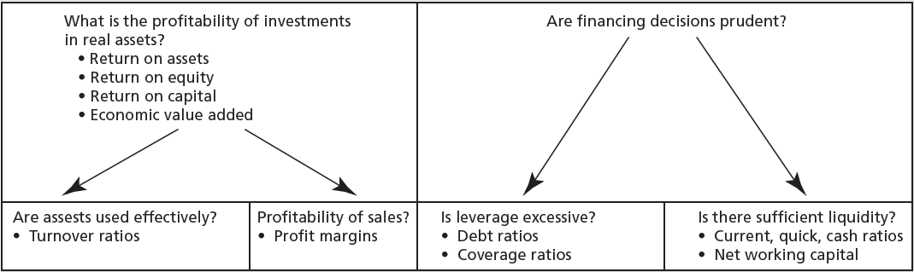
Figure 14.1 Ratios

Slide 10
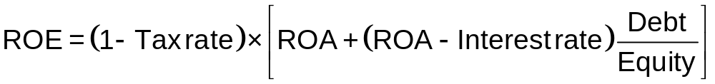
14.3 Profitability Measures
Return on Assets (ROA)
EBIT divided by total assets
Net income divided by total assets
Return on Capital (ROC)
EBIT divided by long-term capital
Equity + LT Debt
Return on Equity (ROE)
Net income divided by shareholders’ equity
Financial Leverage and ROE

Slide 11
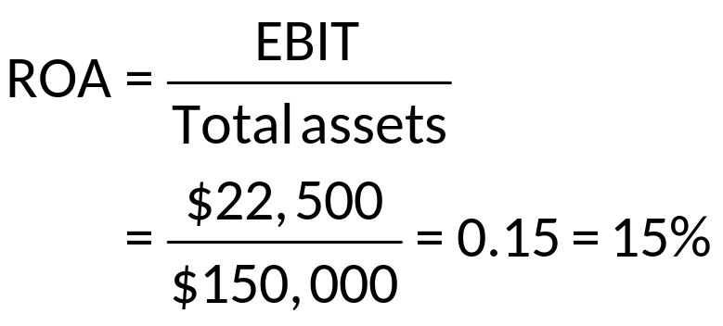
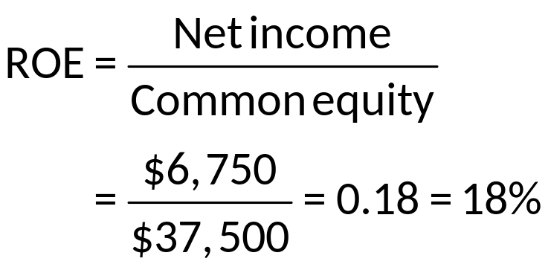
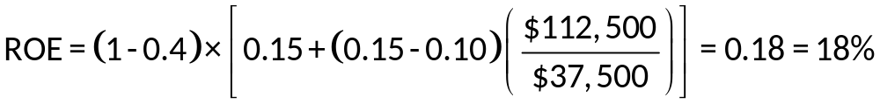
14.3 Profitability Measures
Balance Sheet
Total Assets | $150,000
Total Liabilities | $112,500 | 75%
Stockholer's equity | $37,500 | 25%
Income Statement
EBIT | $22,500
interest | ($11,250) | Int = 10%
Net income | $6,750 | T = 40%

Slide 12
Table 14.4 Nodett’s Profitability over Business Cycle
Scenario | Sales ($ million) | EBIT ($ million) | ROA (% per year) | Net Profit ($ million) | ROE (% per year)
Bad year | $ 80 | $ 5 | 5% | $3 | 3%
Normal year | $100 | 10 | 10 | 6 | 6
Good year | 120 | 15 | 15 | 9 | 9

Slide 13
Table 14.5 Impact of Financial Leverage on ROE
Scenario | EBIT ($ million) | Nodett: Net Profit ($ million) | Nodett: ROE (%) | Somdett: Net Profit* ($ million) | Somdett: ROE† (%)
Bad year | $ 5 | $3 | 3% | $1.08 | 1.8%
Normal year | 10 | 6 | 6 | 4.08 | 6.8
Good year | 15 | 9 | 9 | 7.08 | 11.8
*Somdett’s after-tax profits equal 0.6(EBIT − $3.2 million).
†Somdett’s equity is only $60 million.

Slide 14
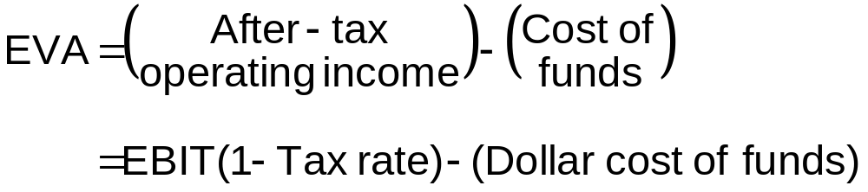
14.3 Profitability Measures
Economic Value Added (residual income)
Earnings must be sufficient to pay those who provide funds to the firm; otherwise the value of the firm should decrease.
Measure of dollar value of firm’s return in excess of opportunity cost
Also known as residual income
Spread between ROA and cost of capital multiplied by capital invested in firm

Slide 15
Table 14.6 Economic Value Added, 2016
 | Ticker | EVA ($ billion) | Capital ($ billion) | ROA (%) | Cost of Capital (%)
Apple | AAPL | 5.28 | 220.07 | 11.85 | 9.45
Home Depot | HD | 3.27 | 27.93 | 19.76 | 8.05
Walmart | WMT | 3.16 | 123.97 | 7.14 | 4.59
Microsoft | MSFT | 2.26 | 164.37 | 9.41 | 8.04
Intel | INTC | 0.60 | 91.28 | 8.78 | 8.12
Walt Disney | DIS | 0.44 | 63.15 | 9.75 | 9.05
AT&T | T | −2.35 | 250.28 | 4.07 | 5.01
Honda | HMC | −4.10 | 124.56 | 2.13 | 5.42

Slide 16
14.4 Ratio Analysis
Decomposition of ROE
DuPont system
Profit margins
  (Net profit)/(Pretax profit) = E/EBT = tax burden ratio
  (Pretax profit)/EBIT = interest-burden ratio < 1.0
  EBIT/Sales = operating profit margin
  Net profit margin = (Net income)/Sales

Slide 17
14.4 Ratio Analysis
Decomposition of ROE
DuPont system
Decomposition of ROE
Total asset turnover (ATO) = Sales/(Total assets)
Equity multiplier = (Total assets)/Equity
ROE = (Net profit)/(Total assets) x Equity multiplier

Slide 18
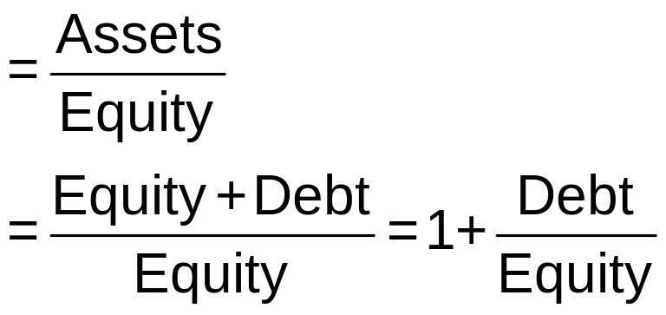
14.4 Ratio Analysis
Leverage ratios
Interest coverage ratio
  Financial leverage measure
  TIE ratio = EBIT/(Interest expense)
Debt ratio
  Measure of debt to total capitalization of firm
  Debt ratio = (Total liabilities)/(Total assets)
Equity multiplier = leverage ratio

Slide 19
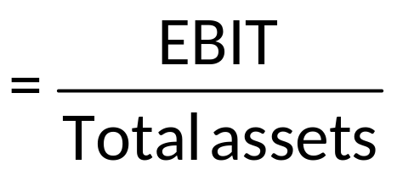
14.4 Ratio Analysis
Decomposition of ROE
ROE = Tax burden
× Interest burden
    × Operating profit margin
    × Assets turnover
    × Leverage
ROA = Operating profit margin × Assets turnover

Slide 20
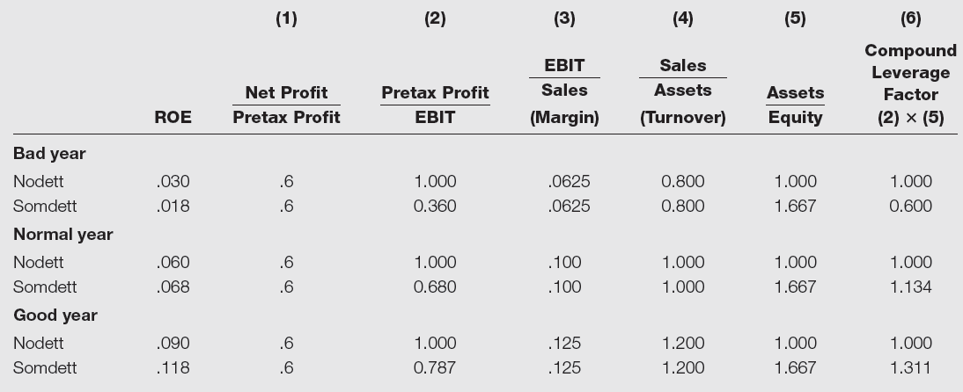
Table 14.7 Ratio Decomposition Analysis for Nodett and Somdett

Slide 21
Table 14.8 Differences between Profit Margin and Asset Turnover across Industries
 | Margin | × | ATO | = | ROA
Supermarket chain | 2% |  | 5.0 |  | 10%
Utility | 20% |  | 0.5 |  | 10%

Slide 22
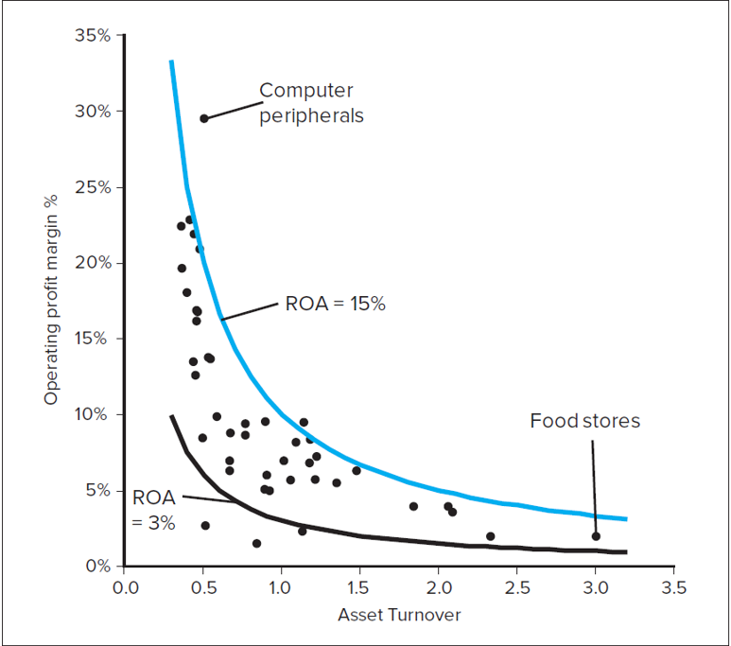
Figure 14.2 Median ROA, Profit Margin, and Asset Turnover for 45 Industries

Slide 23
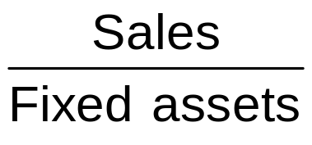
14.4 Ratio Analysis
Turnover and Asset Utilization
Fixed-asset turnover
Inventory turnover ratio
  Cost of goods sold divided by average inventory
Average collection period
  Accounts receivable per dollar of daily sales
  Days sales outstanding = average age of receivables

Slide 24
14.4 Ratio Analysis
Liquidity Ratios
Liquidity: Ability to convert assets into cash at short notice without loss of principal
Current ratio: Current assets/Current liabilities
Quick ratio: Measure of liquidity similar to current ratio; excludes inventories
Cash ratio: Cash and marketable securities to current liabilities

Slide 25
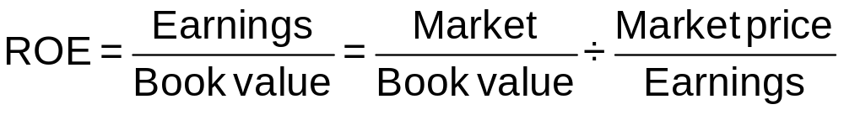
14.4 Ratio Analysis
Market Price (Value) Ratios
Market-to-book-value ratio
  Market price of share divided by book value per share
Price-earnings ratio
  Ratio of stock’s price to earnings per share
  Also known as P/E multiple
    ROE = P/B ratio ÷ P/E ratio

Slide 26
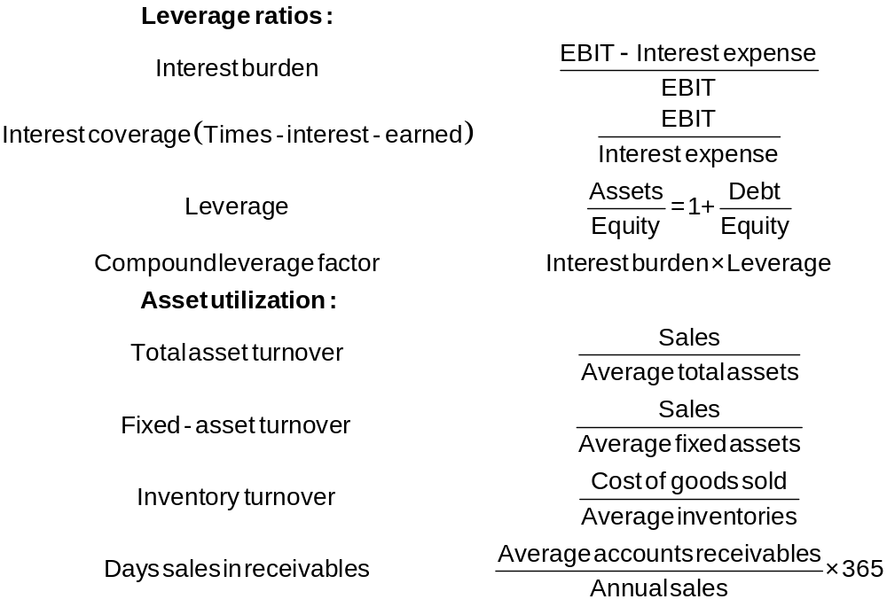
Table 14.10A Summary of Financial Ratios

Slide 27
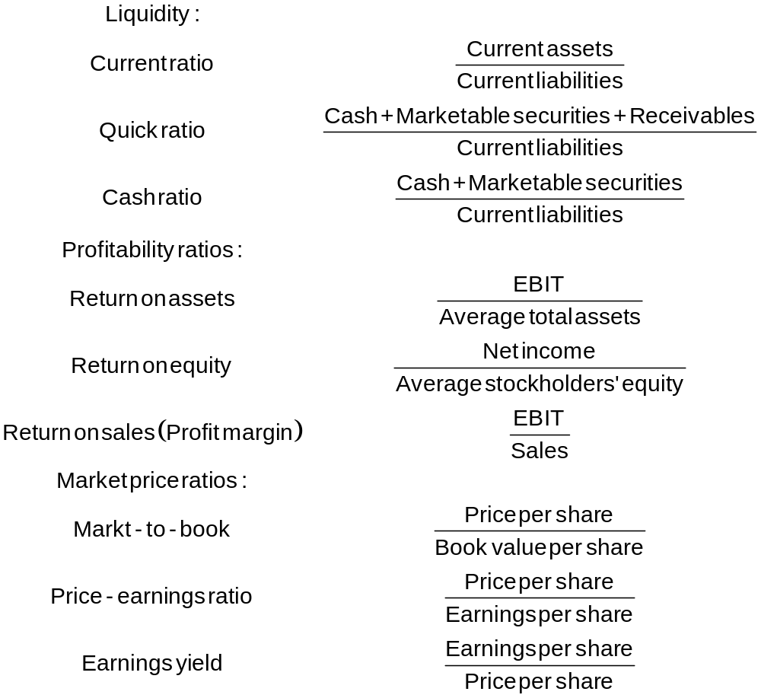
Table 14.10B Summary of Financial Ratios

Slide 28
Table 14.11 Financial Ratios: Major Industry Groups
 | LT Debt Assets | Interest Coverage | Current Ratio | Quick Ratio | Asset Turnover | Profit Margin (%) | Return on Assets (%) | Return on Equity (%) | Payout Ratio
All manufacturing | 0.26 | 3.11 | 1.26 | 0.85 | 0.63 | 6.76 | 4.28 | 13.04 | 0.54
Food products | 0.25 | 6.87 | 1.52 | 0.97 | 0.91 | 8.92 | 8.09 | 13.05 | 0.44
Clothing | 0.25 | 7.36 | 1.17 | 0.36 | 2.07 | 5.49 | 11.39 | 22.28 | 0.23
Aerospace | 0.23 | 5.70 | 1.15 | 0.47 | 0.71 | 9.29 | 6.62 | 24.59 | 1.01
Chemicals | 0.32 | 2.29 | 1.12 | 0.83 | 0.39 | 10.11 | 3.97 | 13.20 | 0.66
Drugs | 0.33 | 2.18 | 1.05 | 0.81 | 0.32 | 11.85 | 3.76 | 10.52 | 0.86
Machinery | 0.23 | 2.43 | 1.32 | 0.86 | 0.65 | 5.03 | 3.28 | 6.11 | 1.22
Electrical | 0.21 | 4.51 | 1.12 | 0.74 | 0.54 | 7.74 | 4.19 | 13.29 | 0.74
Motor vehicles | 0.14 | 4.50 | 1.04 | 0.74 | 1.25 | 3.24 | 4.06 | 11.70 | 0.54
Computer and electronic | 0.27 | 3.10 | 1.21 | 0.98 | 0.42 | 9.83 | 4.12 | 18.27 | 0.27
Source: U.S. Department of Commerce, Quarterly Financial Report for Manufacturing, Mining and Trade Corporations, March 2017.

Slide 29
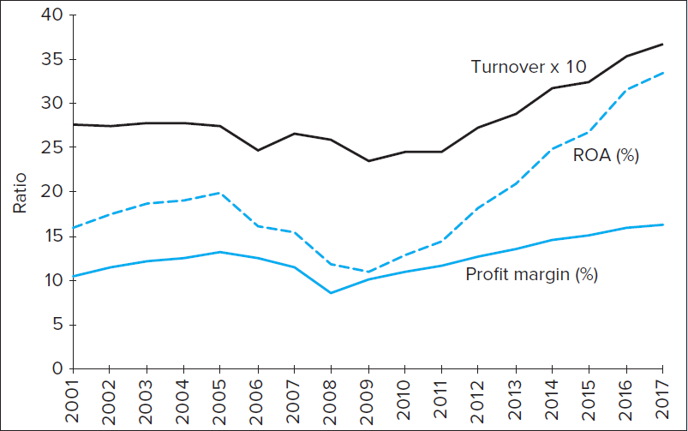
Figure 14.3 DuPont Composition for Home Depot

Slide 30
14.5 Illustration of Financial Statement Analysis
Example: Growth Industries
Sales, assets, operating income increased 20%
ROE declining
ROA not declining
Rapid increase in year-to-year short-term debt and interest expense

Slide 31
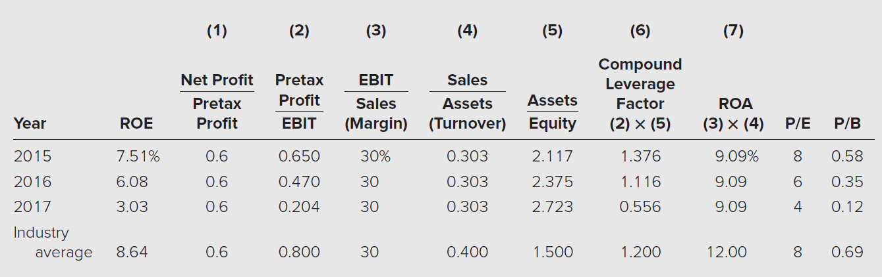
Table 14.12 Key Financial Ratios: Growth Industries

Slide 32
Table 14.13 Growth Industries Cash Flows
 | 2015 | 2016 | 2017
Cash flow from operating activities
Net income | $ 11,700 | $ 10,143 | $ 5,285
Depreciation | 15,000 | 18,000 | 21,600
Decrease (increase) in accounts receivable | (5,000) | (6,000) | (7,200)
Decrease (increase) in inventories | (15,000) | (18,000) | (21,600)
Increase in accounts payable | 6,000 | 7,200 | 8,640
Cash provided by operations | $ 12,700 | $ 11,343 | $ 6,725
Cash flow from investing activities
Investment in plant and equipment* | $(45,000) | $(54,000) | $(64,800)
Cash flow from financing activities
Dividends paid† | $ 0 | $ 0 | $ 0
Short-term debt issued | 42,300 | 54,657 | 72,475
Change in cash and marketable securities‡ | $ 10,000 | $ 12,000 | $ 14,400

Slide 33
14.6 Comparability Problems
Inventory Valuation
LIFO
  Last-in first-out inventory valuation
  FIFO
    First-in first-out inventory valuation

Slide 34
14.6 Comparability Problems
Depreciation
Economic
  Amount of operating cash flow that must be reinvested in firm to sustain real cash flow
Accounting
  Amount of acquisition cost of asset that is allocated to each accounting period over arbitrarily specified life of asset

Slide 35
14.6 Comparability Problems
Fair Value Accounting = mark-to-market accounting
Use of current market values rather than historic costs in firm’s financial statements
Relies heavily on estimates

Slide 36
14.6 Comparability Problems
Quality of Earnings
Realism and sustainability of reported earnings
Factors that affect quality of earnings
  Allowance for bad debt
  Nonrecurring items
  Earnings smoothing
  Revenue recognition
  Off-balance-sheet assets and liabilities

Slide 37
14.6 Comparability Problems
International Accounting Conventions
Reserving practices
  Subject to more managerial discretion in U.S.
Depreciation
  Other countries do not allow dual sets of accounts
  Most firms in foreign countries use accelerated depreciation
Intangibles
  Treatment varies wildly from country to country

Slide 38
14.6 Comparability Problems
International Accounting Conventions
International Financial Reporting Standards (IFRS)
  Principles-based set of accounting rules adopted by around 100 countries, including European Union

Slide 39
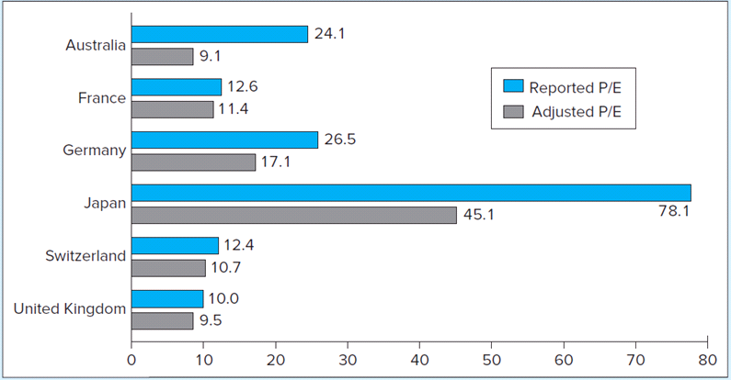
Figure 14.4 Adjusted versus Reported Price-Earnings Ratios
Source: Figure J: Adjusted versus Reported Price/Earnings Ratios: from Lawrence S. Speidell and Vinod Bavishi, “GAAP Arbitrage: Valuation Opportunities in International Accounting Standards.” “Financial Analysts Journal, November-December 1992, pp. 58-66. Copyright 1992, CFA Institute. Reproduced and republished from Financial Analysts Journal with permission from the CFA Institute. All Rights Reserved.

Slide 40
BALANCE SHEET
as of January 31
($ millions)
1974 1973 1972 1971 1970
Cash/MS 45.95 30.94 49.85 34.01 32.98
Accts rec 540.80 542.75 477.34 419.73 368.27
Invent 450.64 399.53 298.70 260.49 222.13
Other CA 7.30 6.65 5.38 4.25 5.04
Total CA 1,044.69 979.87 831.27 718.48 628.42
Net FA 150.30 30.83 113.43 89.15 78.37
TA 1,194.99 1,110.70 944.70 807.63 706.79

Slide 41
BALANCE SHEET
as of January 31
($ millions)
1974 1970
Cash/MS 45.95 32.98 39.33%
Accts rec 540.80 368.27 46.85%
Invent 450.64 222.13 102.87%
Other CA 7.30 5.04 44.84%
Total CA 1,044.69 628.42 66.24%
Net FA 150.3 78.37 91.78%
TA 1,194.99 706.79 69.07%
BALANCE SHEET
as of January 31
($ millions)
1974 1970
Cash/MS 45.95 32.98 39.33%
Accts rec 540.80 368.27 46.85%
Invent 450.64 222.13 102.87%
Other CA 7.30 5.04 44.84%
Total CA 1,044.69 628.42 66.24%
Net FA 150.3 78.37 91.78%
TA 1,194.99 706.79 69.07%

Slide 42
1974 1973 1972 1971 1970
Acct pay 58.19 78.79 94.68 80.68 70.85
Notes pay 453.10 390.03 237.74 246.42 182.13
Accruals 46.69 25.62 20.83 23.83 23.72
Other CL 103.08 138.61 122.32 108.05 90.00
Total CL 661.06 633.05 475.57 458.98 366.70
LT debt 176.25 142.23 144.03 46.35 49.40
TL 837.31 775.28 619.60 505.33 416.10
Pref stock 7.46 8.60 9.05 9.60 11.45
CS 67.81 64.59 70.95 62.01 67.56
Ret earn 282.41 262.23 245.10 230.69 211.68
Own eq 357.68 335.42 325.10 302.30 290.69
Total L&E 1,194.99 1,110.70 944.70 807.63 706.79

Slide 43
1974 1970
Acct pay 58.19 70.85 -17.87%
Notes pay 453.10 182.13 148.78%
Accruals 46.69 23.72 96.84%
Other CL 103.08 90.00 14.53%
Total CL 661.06 366.70 80.27%
LT debt 176.25 49.40 256.78%
TL 837.31 416.10 101.23%
Pref stock 7.46 11.45 -34.85%
CS 67.81 67.56 0.37%
Ret earn 282.41 211.68 33.41%
Own eq 357.68 290.69 23.05%
Total L&E 1,194.99 706.79 69.07%
1974 1970
Acct pay 58.19 70.85 -17.87%
Notes pay 453.10 182.13 148.78%
Accruals 46.69 23.72 96.84%
Other CL 103.08 90.00 14.53%
Total CL 661.06 366.70 80.27%
LT debt 176.25 49.40 256.78%
TL 837.31 416.10 101.23%
Pref stock 7.46 11.45 -34.85%
CS 67.81 67.56 0.37%
Ret earn 282.41 211.68 33.41%
Own eq 357.68 290.69 23.05%
Total L&E 1,194.99 706.79 69.07%

Slide 44
INCOME STATEMENT
For the Period Ending January 31
($ millions)
1974 1973 1972 1971 1970
Sales 1,853.77 1,648.50 1,378.25 1,259.12 1,214.67
GP 570.83 523.24 447.01 416.00 397.00
EBIT 60.17 85.15 78.66 91.87 95.30
Interest ( 18.08) ( 21.13) ( 16.61) ( 19.23) ( 14.92)
NI 41.30 38.27 35.55 39.84 42.38
Pref div ( 0 .29) ( 0.33) ( 0.35) ( 0.40) ( 0.46)
EAC 41.01 37.94 35.20 39.44 41.92
Com div $20.83 $20.81 $20.79 $20.43 $19.28
DPS $ 1.50 $ 1.50 $ 1.40 $ 1.40 $ 1.40

Slide 45
INCOME STATEMENT
For the Period Ending January 31
($ millions)
1974 1970
Sales 1,853.77 1,214.67 52.62%
GP 570.83 397.00 43.79%
EBIT 60.17 95.30 -36.86%
Interest (18.08) (14.92) 21.18%
NI 41.30 42.38 -2.55%
Pref div (0.29) (0.46) -36.96%
EAC 41.01 41.92 -2.17%
Com div 20.83 19.28 8.04%
DPS 1.50 1.40 7.14%

Slide 46
1974 1973 1972 1971 1970
Current ratio 1.58 1.55 1.75 1.57 1.71
Quick ratio 0.90 0.92 1.12 1.00 1.11
DSO 105.02 118.53 124.68 120.01 109.15
FA turnover 12.33 53.47 12.15 14.12 15.50
TA turnover 1.55 1.48 1.46 1.56 1.72
Debt ratio 70.07% 69.80% 65.59% 62.57% 58.87%
TIE 3.33 4.03 4.74 4.78 6.39
Prof margin 2.21% 2.30% 2.55% 3.13% 3.45%
ROA 3.43% 3.42% 3.73% 4.88% 5.93%
ROE 11.47% 11.31% 10.83% 13.05% 14.42%
DOL 9.49 6.14 5.68 4.53 4.17
DFL 1.44 1.34 1.28 1.28 1.20
DTL 13.70 8.23 7.26 5.77 4.98
1974 1973 1972 1971 1970
Current ratio 1.58 1.55 1.75 1.57 1.71
Quick ratio 0.90 0.92 1.12 1.00 1.11
DSO 105.02 118.53 124.68 120.01 109.15
FA turnover 12.33 53.47 12.15 14.12 15.50
TA turnover 1.55 1.48 1.46 1.56 1.72
Debt ratio 70.07% 69.80% 65.59% 62.57% 58.87%
TIE 3.33 4.03 4.74 4.78 6.39
Prof margin 2.21% 2.30% 2.55% 3.13% 3.45%
ROA 3.43% 3.42% 3.73% 4.88% 5.93%
ROE 11.47% 11.31% 10.83% 13.05% 14.42%
DOL 9.49 6.14 5.68 4.53 4.17
DFL 1.44 1.34 1.28 1.28 1.20
DTL 13.70 8.23 7.26 5.77 4.98

Slide 47
STATEMENT OF CASH FLOWS
For the Period Ending January 31
($ millions)
1974 1973 1972 1971
From Operations:
Net Income 41.30 38.27 35.55 39.84
Adjustments to NI:
Depreciation 13.58 12.00 10.58 9.62
Δ receivables 1.95 ( 65.41) (57.61) (51.46)
Δ inventories (51.11) (100.83) (38.21) (38.36)
Δ other CA ( 0.65) ( 1.27) ( 1.13) 0.79
Δ payables (20.60) ( 15.89) 14.00 9.83
Δ accruals 21.07 4.79 ( 3.00) 0.11
Δ other CL (35.53) 16.29 14.27 18.05
Net CF—operations (29.99) (112.05) (25.55) (11.58)

Slide 48
1974 1973 1972 1971
Net CF—operations (29.99) (112.05) (25.55) (11.58)
From Long‑Term Investing:
LT assets (33.05) ( 29.40) (34.86) (20.40)
From Financing Activities:
Δ notes 63.07 152.29 ( 8.68) 64.29
Δ LT debt 34.02 ( 1.80) 97.68 ( 3.05)
Dividends (21.12) ( 21.14) (21.14) (20.83)
Δ pref stock ( 1.14) ( 0.45) ( 0.55) ( 1.85)
Δ com stock 3.22 (6.36) 8.94 (5.55)
Net CF—financing 78.05 122.54 76.25 33.01
Net Δ cash 15.01 (18.91) 15.84 1.03
Beg cash 30.94 49.85 34.01 32.98
End cash 45.95 30.94 49.85 34.01

